Slide 1

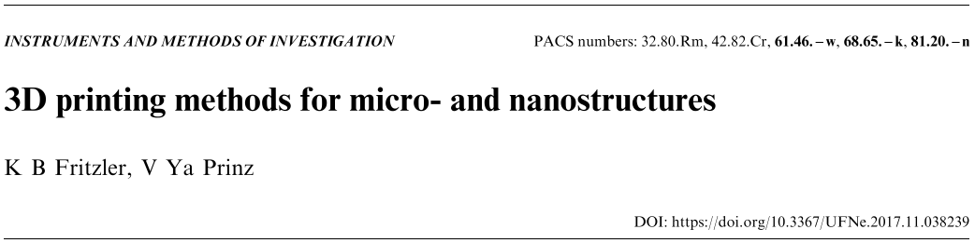
Osamu Katagiri-Tanaka A01212611@itesm.mx
20 May 2020
K.B. Fritzler, V.Y. Prinz, 3D printing methods for micro- and nanostructures, Uspekhi Fiz. Nauk. 189 (2019) 55–71. https://doi.org/10.3367/UFNr.2017.11.038239.

Slide 2
Agenda
<a point for discussion> : <5min
<another point for discussion> : ~20min

Slide 3
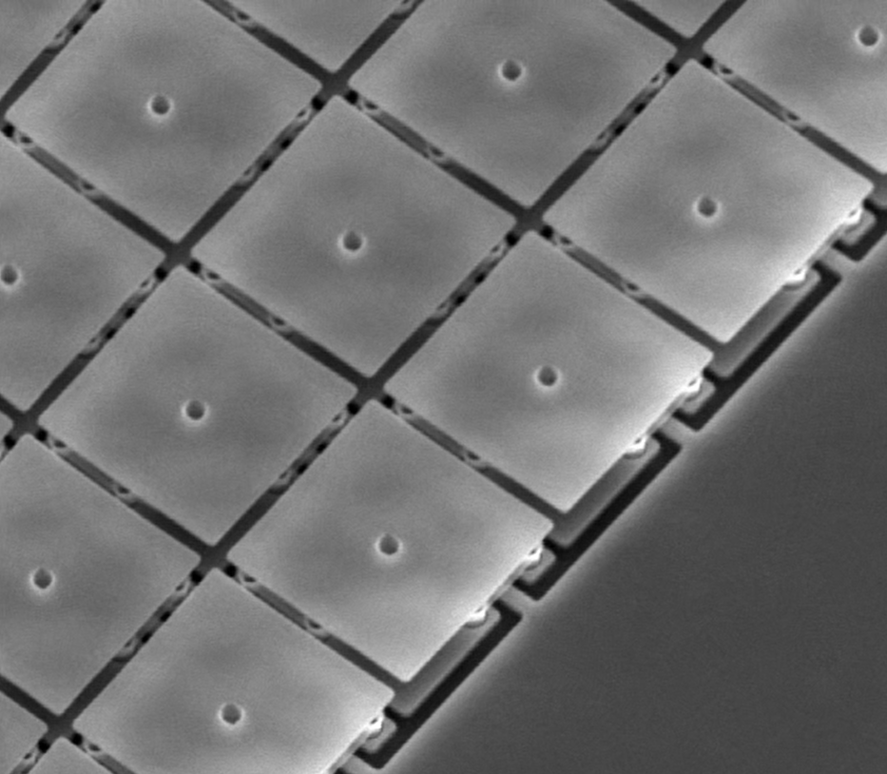
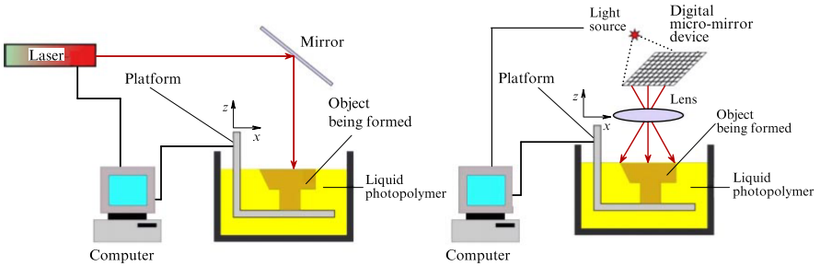
Nanostereolithography (Charles Hull, 1986)
Is one of the earliest and most popular additive manufacturing methods by layer-by-layer formation of 3D objects by photoirradiation.
10 by 10 μm mirrors
scanning stereolithography
(point-by-point solidification)
projection stereolithography
(layer-by-layer solidification)
How Digital Light Processing (DLP) works - YouTube, (n.d.). https://www.youtube.com/watch?v=9nb8mM3uEIc (accessed 20 May 2020).
Hull C W, U.S. Patent No. 4575330A (1986)

Slide 4
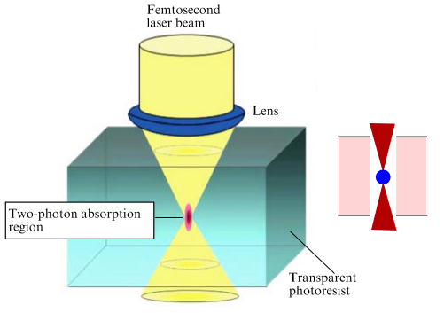
Two-photon polymerization (Maruo, 1997)
Enhancing the resolution of stereolithographic methods to about 1/100 the optical wave-length
Voxel size is multivariable dependent, hence hard to control
(radiation power and wavelength, oxygen diffusion, the radiation dose, and the properties of photoinitiators and monomers)
voxel
In short, a highly sensitive and efficient photoinitiator and a low laser radiation wavelength result in smaller objects
Maruo S, Nakamura O, Kawata S Opt. Lett. 22 132 (1997)

Slide 5
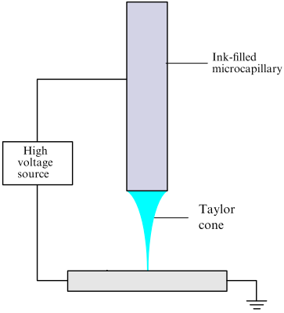
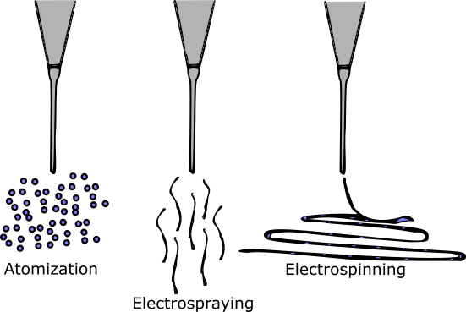
Electrohydrodynamic inkjet printing
Sequential selective deposition of ink droplets onto a substrate, just like when printing a document.
The jet diameter depends mainly on the electrodynamic force, rather than only on the ink viscosity as in conventional inkjet printing
K.B. Fritzler, V.Y. Prinz, 3D printing methods for micro- and nanostructures, Uspekhi Fiz. Nauk. 189 (2019) 55–71. https://doi.org/10.3367/UFNr.2017.11.038239.

Slide 6
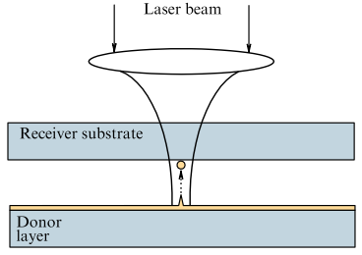
Laser-induced forward/backward transfer
The method is based on the transfer of a material from one
substrate to another laser pulses.
Laser-induced backward transfer
heating, melting, and subsequent crystallization
K.B. Fritzler, V.Y. Prinz, 3D printing methods for micro- and nanostructures, Uspekhi Fiz. Nauk. 189 (2019) 55–71. https://doi.org/10.3367/UFNr.2017.11.038239.
Notes:
Donor vs acceptor & viceversa
transparent substrate
melting and evaporation of the donor material

Slide 7
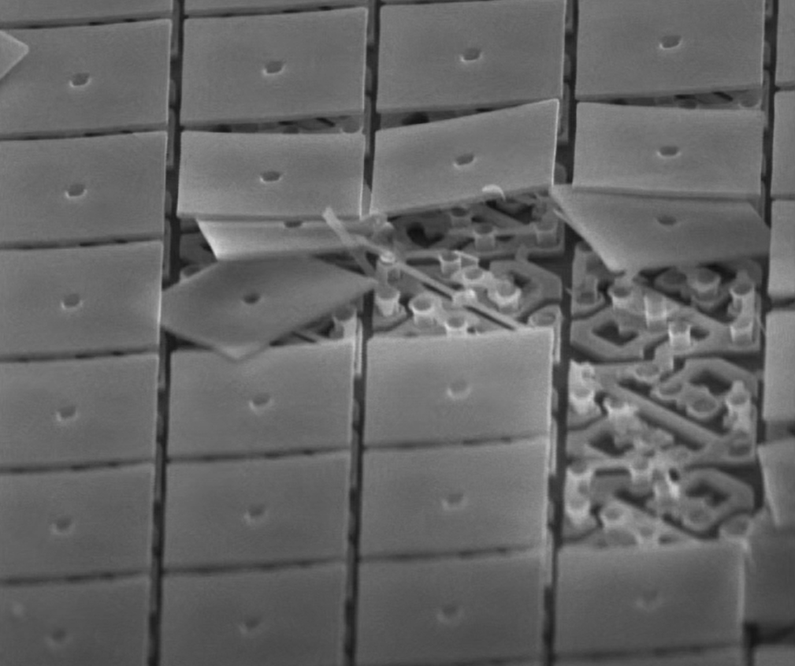
Conclusions:
Scanning stereolithography | Projection stereolithography | Two-photon polymerization
Slow, but easy to maintain | Faster, but more sensitive | More versatile, but voxel is hard to control
Resolution is limited by the radiation wave-length |  | Higher resolution
Very slow processes –> rate of mm per sec
EHD Inkjet printing | Laser-induced transfer
Fast process (cm per sec), can yield droplets and fibers | free from nozzle clogging, but the donor material may change
scalable, low cost, variety of materials
The ink/donor properties alter the process
How Digital Light Processing (DLP) works - YouTube, (n.d.). https://www.youtube.com/watch?v=9nb8mM3uEIc (accessed 20 May 2020).
V. Galstyan, M. Bhandari, V. Sberveglieri, G. Sberveglieri, E. Comini, Metal Oxide Nanostructures in Food Applications: Quality Control and Packaging, Chemosensors. 6 (2018) 16
Notes:
Multiple focal points – increase scanning velocity

Slide 8


Slide 9
References
<reference A>
<reference B>

Slide 10
Electrohydrodynamic inkjet printing

