Slide 1


reviewed by: Osamu Katagiri A01212611@itesm.mx
03 Oct 2019

Slide 2
Problem statement
<content> <key concept>
Notes:
Despite the impor- tance in analyzing the inherent volumetric shrinkage experienced during pyrolysis of TPP structures, no studies to date have experimentally and theoretically assessed how the different geometrical building blocks, such as nanorods or micro/nanowires30, and bars4,24, transform upon carbonization.
Thus, estimation of the voxel line- width percent reduction would enable the rational design of the carbonized version of photoresist templates, with- out necessarily undergoing extensive optimization
In this work, we study the pyrolysis-induced shrinkage
of structures consisting of suspended microwires of photocured resin (SU-8 2050).

Slide 3
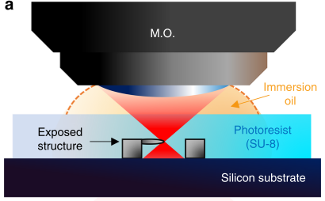
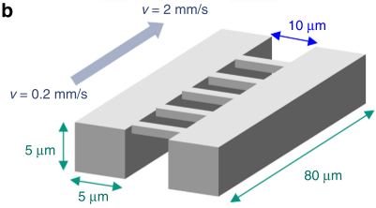
Experiment
The TPP threshold for polymerization and successful patterning of the wires was 1.13 ± 0.12 mW, at a scanning velocity of 0.2 mm/s.
Notes:
By varying the TPP exposure dose on the photoresist, the linewidth of the photoresist microwires was controlled in the range of 1250–1800 nm and subsequently reduced to 300–550 nm carbon structures through pyrolysis.
This variation was achieved by tuning the scanning velocity and power of the laser, to produce a change in the exposure dose.
We first undertook the fabrication of SU-8 microwires
by varying scanning velocity (v) and laser average power (Pt) to study the effect of dosage on voxel linewidth.
Following the fabrication of the suspended SU-8 microstructures, the samples were pyrolyzed in a fur- nace at 900 °C to obtain the carbon nanowire structures.
threshold for polymerization and successful patterning of the wires was 1.13 ± 0.12 mW, at a scanning velocity of 0.2 mm/s

Slide 4
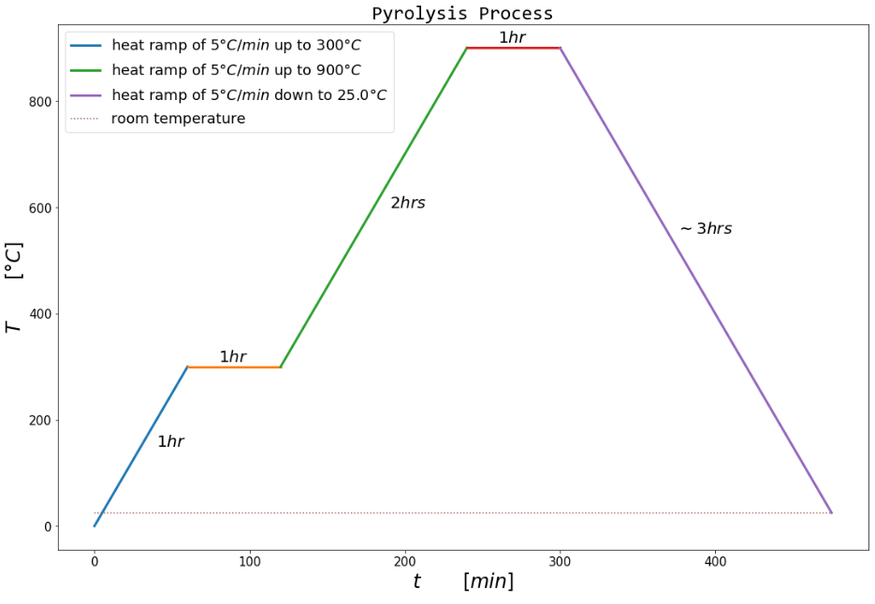
Experiment
Chosen temperatures and ramp rates were as depicted by Microchem in the SU-8 2050 datasheet

Slide 5
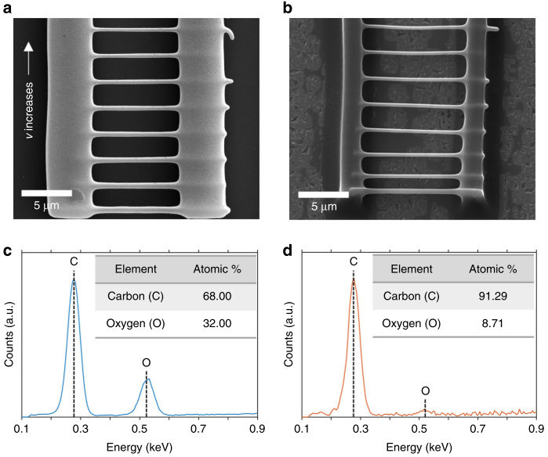
Characterization
High degree of heteroatom volatilization in the samples.
scanning electron microscopy (SEM)
Pyrolysis
energy dispersive X-ray spectroscopy (EDS)
Notes:
We examined the degree of shrinkage through direct mea- surement using scanning electron microscopy (SEM), and studied the quality of the obtained carbon material through energy dispersive X-ray spectroscopy (EDS) and Raman spectroscopy.
To confirm the degree of carbonization of the samples,
we analyzed their carbon-to-oxygen (C/O) weight per- centage, before and after pyrolysis using EDS.

Slide 6

Modeling
The TPP linewidth (aka. voxel diameter) before pyrolysis can be described different parameters involved in the fabrication process, such as scanning velocity, average laser power, repetition rate, and pulse duration.
Notes:
In addition, we developed a semi- empirical model that estimates the near-isometrical transformation experienced by TPP structures after pyr- olysis.
Using this empirical model, we estimate the residual mass of the TPP structures, assuming that the volatilized material: (1) is solely lost to degassing; and (2) is dependent on the initially available surface area of the microstructures.
An expression for the resolution of the TPP linewidth
before pyrolysis can be obtained by taking into account the different parameters involved in the fabrication process, such as scanning velocity, average laser power, repetition rate, and pulse duration

Slide 7
<Sub-title>
<content> <key concept>

Slide 8
Conclusions:
<Conclusion A>
<Conclusion B>
Notes:
the approximate functional form of the dependence between TPP exposure dose and feature linewidth after pyrolysis
a model that relates the feature percentage reduction to the mechanical elonga- tion and degassing of the structures
an empirical model that uses fitting parameters with a precise physical meaning.
A good agreement was obtained between our model and the experimental line- width measurements of the fabricated structures.
we have found that nanowire structures with high aspect ratio (length over linewidth of 30 or more) can be susceptible to buckling, resulting in deflections in the range of 100–250 nm caused by the thermal stress in the pyrolysis process (Euler’s buckling theory)

Slide 9

Q&A

Slide 10
References
<reference A>
<reference B>

