Slide 1
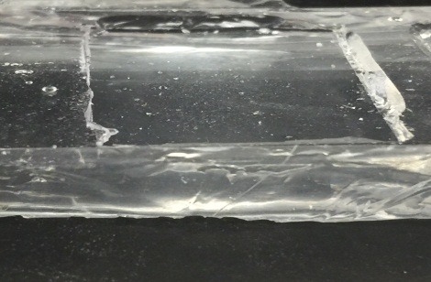
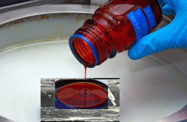
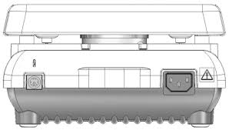
SU-8
PDMS
Evaporation of solvent
SU-8
PDMS
SU-8
SU-8 Sheet
PDMS
Making it flexible
SU-8 Sheet
Compressed Sample
Glass
SU-8
Glass
UV
Pyrolyzed Sheet
Photocured Sheet
SU-8 Sheet
Notes:
1- First challenging step : preparing a thick SU-8 sheet the depth of mold (Preparation appropriate Mold)
2- Casting
3- Evaporation of solvent (Second challenging step : thermal cycle)
4- (remove pull off)
5- Applying compression stress (its Tg is higher than the room temperature) + heating up clamping with screw +photoiradiation
6- Removing the photocured sheet
7-Pyrolysing

