Slide 1

Research Overview & Related Article
A. Osamu Katagiri Tanaka A01212611itesm.mx
April 04, 2019

Slide 2
Agenda
My Thesis Overview : ~5min
Related Article : ~15min
Q&A : ~10min

Slide 3
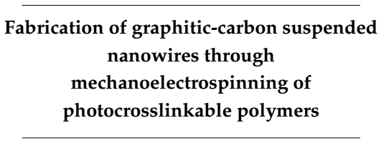
Thesis Overview
Study the practice and feasibility of a new fabrication process to achieve mass scale manufacturing of carbon nano-wires in an inexpensive, continuous, simple and reproducible manner

Slide 4
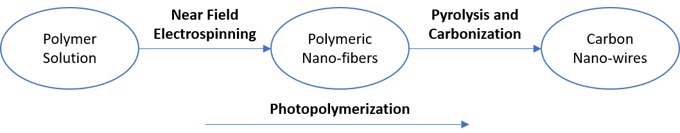
Thesis Overview
Design polymer solutions that can be electrospun by NFES, photopolymerized, and then pyrolyzed into carbon nano-wires.

Slide 5
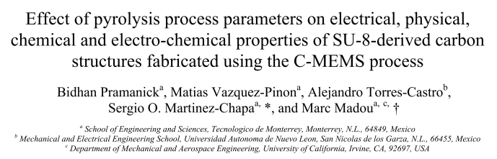
Related Article
Pramanick, B., Vazquez-Pinon, M., Torres-Castro, A., & Martinez-Chapaa, S. O. (2018). Effect of pyrolysis process parameters on electrical, physical, chemical and electro-chemical properties of SU-8-derived carbon structures fabricated using the C-MEMS process. Materials Today: Proceedings, 5(3), 9669–9682. https://doi.org/10.1016/J.MATPR.2017.10.153

Slide 6

Pyrolysis
Is the chemical decomposition of any organic polymer by heating in an oxygen-free environment
This degradation technique can lead to the formation condensable gases and carbonized materials
Basu, P. (2018). Biomass Gasification, Pyrolysis and Torrefaction - Practical Design and Theory (3rd Edition). Elsevier. Retrieved from https://app.knovel.com/hotlink/pdf/id:kt011PGVNJ/biomass-gasification/biomass-ga-historical

Slide 7

Pyrolysis Parameters to be investigated
Maximum Pyrolysis Temperature
Temperature Ramp Rate
Gas ($N_{2}$) flow rate
Pramanick, B., Vazquez-Pinon, M., Torres-Castro, A., & Martinez-Chapaa, S. O. (2018). Effect of pyrolysis process parameters on electrical, physical, chemical and electro-chemical properties of SU-8-derived carbon structures fabricated using the C-MEMS process. Materials Today: Proceedings, 5(3), 9669–9682. https://doi.org/10.1016/J.MATPR.2017.10.153

Slide 8
Title
Pyrolysis is …
SU-8 photoresist was used
Three pyrolysis parameters
Maximum temperature
600°C, 700°C, 800°C and 900°C
Temperature ramp rate constant @ 5°C/min
Nitrogen flow rate constant @ 6l/m
Temperature ramp rate
2.5°C/min, 5°C/min, 10°C/min and 20°C/min
Maximum temperature constant @ 900°C
Nitrogen flow rate constant @ 6l/min
Nitrogen flow rate
3l/min, 4.5l/min, 6l/min and 7.5l/min
Maximum temperature constant @ 900°C
Temperature ramp rate constant @ 5°C/min
sewr

Slide 9
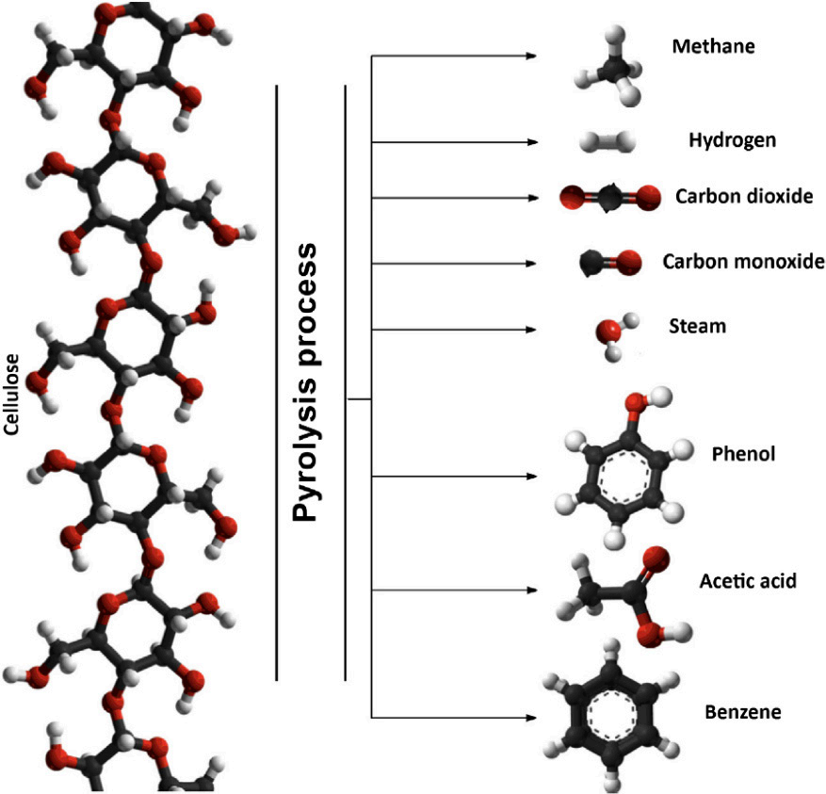
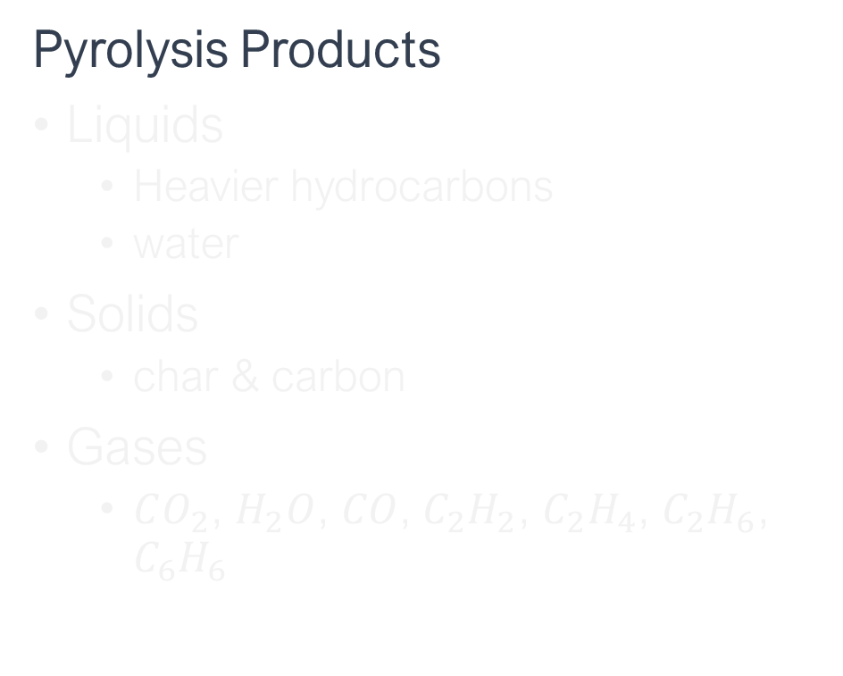
Decomposition of large hydrocarbon molecules into smaller ones during pyrolysis
Pyrolysis Products
Liquids
Heavier hydrocarbons
water
Solids
char & carbon
Gases
$CO_{2}$, $H_{2}O$, $CO$, $C_{2}H_{2}$, $C_{2}H_{4}$, $C_{2}H_{6}$, $C_{6}H_{6}$
Basu, P. (2018). Biomass Gasification, Pyrolysis and Torrefaction - Practical Design and Theory (3rd Edition). Elsevier. Retrieved from https://app.knovel.com/hotlink/pdf/id:kt011PGVNJ/biomass-gasification/biomass-ga-historical

Slide 10
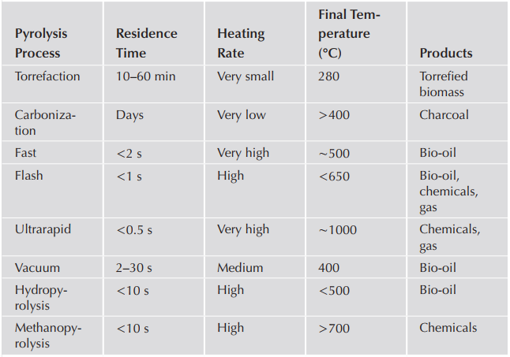
Characteristics of some thermal decomposition processes
Mohan, D., Pittman Jr., C.U., Steele, P.H., 2003. Pyrolysis of Wood/Biomass for Bio- oil: A Critical Review. Energy Fuels 20, 848–889.

Slide 11
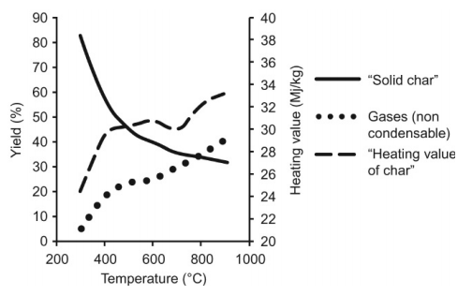
Pyrolysis
Rapid heating -> higher volatiles (more liquids)
Low temperatures -> greater amount of char, gas yield decreases
Small particles -> higher liquid yield
Basu, P. (2018). Biomass Gasification, Pyrolysis and Torrefaction - Practical Design and Theory (3rd Edition). Elsevier. Retrieved from https://app.knovel.com/hotlink/pdf/id:kt011PGVNJ/biomass-gasification/biomass-ga-historical

Slide 12
References
Pramanick, B., Vazquez-Pinon, M., Torres-Castro, A., & Martinez-Chapaa, S. O. (2018). Effect of pyrolysis process parameters on electrical, physical, chemical and electro-chemical properties of SU-8-derived carbon structures fabricated using the C-MEMS process. Materials Today: Proceedings, 5(3), 9669–9682. https://doi.org/10.1016/J.MATPR.2017.10.153
Ulyanov, V., Koshelev, M., Kharchuk, S., Gulevskii, V., & Timochkin, A. (2018). Study of the pyrolysis of solid organic polymers by their heating with metal melt. Petroleum Chemistry, 58(1), 68–75. https://doi.org/10.1134/S0965544118010140

