Slide 1
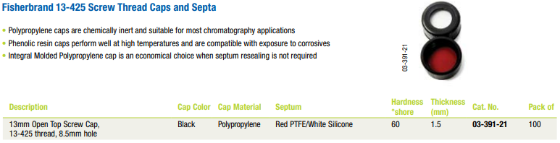
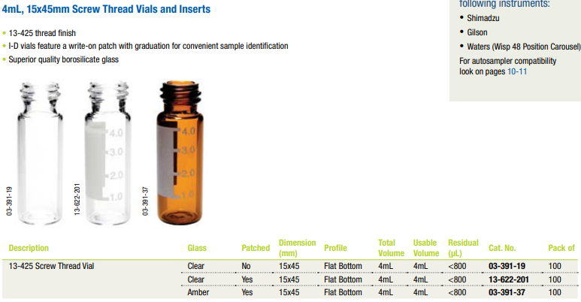
Option 1 for alcohols, acetone, ether, DMF, DMSO
https://www.fishersci.com/shop/products/fisherbrand-4ml-autosampler-vials-4/0339121
https://www.fishersci.com/shop/products/fisherbrand-4ml-autosampler-vials-4/0339137

Slide 2
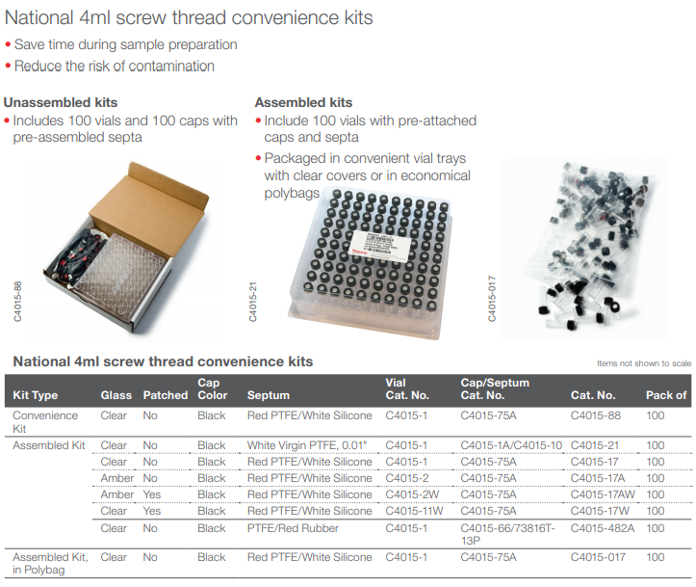
Option 2 for alcohols, acetone, ether, DMF, DMSO
https://www.fishersci.com/shop/products/national-unassembled-4ml-screw-thread-vial-convenience-kits/0337528h

