Slide 1

Research Overview & Related Article
A. Osamu Katagiri Tanaka A01212611itesm.mx
April 04, 2019

Slide 2
Agenda
My Thesis Overview : ~10min
Related Article : ~15min
Q&A : ~10min

Slide 3
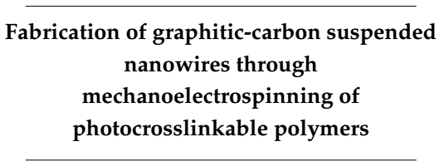
Thesis Overview
Study the practice and feasibility of a new fabrication process to achieve mass scale manufacturing of carbon nano-wires in an inexpensive, continuous, simple and reproducible manner

Slide 4
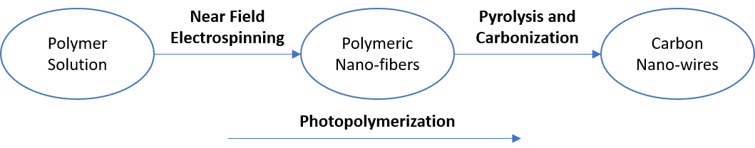
Thesis Overview
Design polymer solutions that can be electrospun by NFES, photopolymerized, and then pyrolyzed into carbon nano-wires.

Slide 5
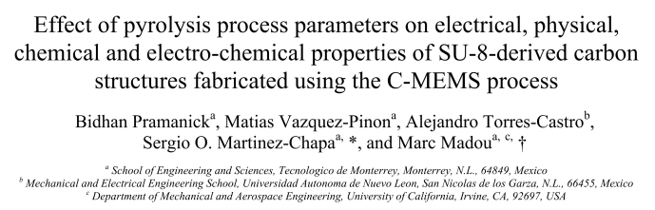
Related Article
Pramanick, B., Vazquez-Pinon, M., Torres-Castro, A., & Martinez-Chapaa, S. O. (2018). Effect of pyrolysis process parameters on electrical, physical, chemical and electro-chemical properties of SU-8-derived carbon structures fabricated using the C-MEMS process. Materials Today: Proceedings, 5(3), 9669–9682. https://doi.org/10.1016/J.MATPR.2017.10.153

Slide 6
Title
Pyrolysis is …
SU-8 photoresist was used
Three pyrolysis parameters
Maximum temperature
600°C, 700°C, 800°C and 900°C
Temperature ramp rate constant @ 5°C/min
Nitrogen flow rate constant @ 6l/m
Temperature ramp rate
2.5°C/min, 5°C/min, 10°C/min and 20°C/min
Maximum temperature constant @ 900°C
Nitrogen flow rate constant @ 6l/min
Nitrogen flow rate
3l/min, 4.5l/min, 6l/min and 7.5l/min
Maximum temperature constant @ 900°C
Temperature ramp rate constant @ 5°C/min
sewr

