Slide 1

Fabrication of carbon nanowires through electrospinning of polymers
A Osamu Katagiri Tanaka A01212611@itesm.mx
05 Sep 2019

Slide 2
Agenda
<a point for discussion> : <5min
<another point for discussion> : ~20min

Slide 3
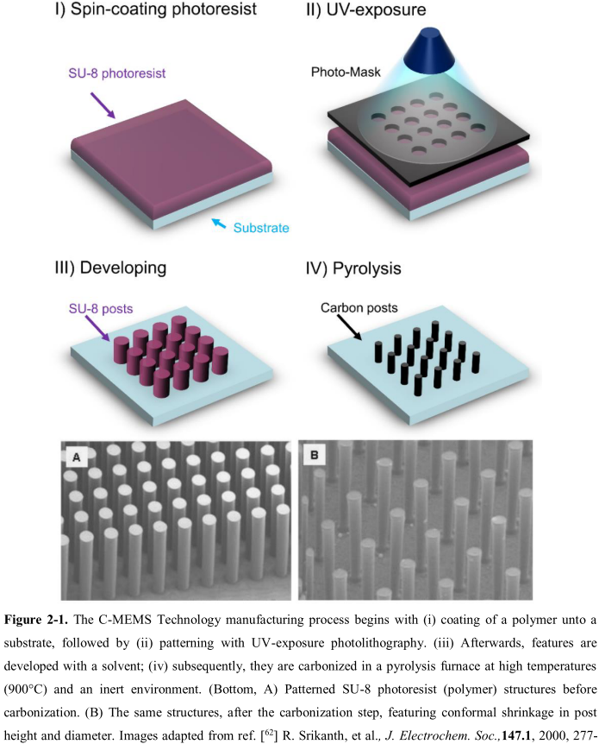
Previous work
The production of C-MEMS:
Polymer patterning through photolithography
Carbonization through pyrolysis
SU-8 waste

Slide 4
<subTitle>
<content> <key concept>

Slide 5
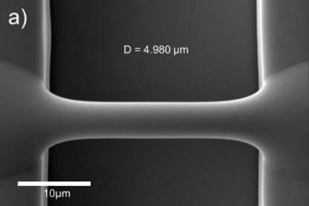
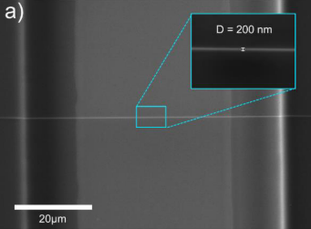
Braulio’s Thesis Results
Fiber yield rate of 81 %
Fiber diameter before pyrolisis of 4.966 um
Fiber diameter after pyrolisis of 204 nm
Fiber length of 60.5 ± 4.3 μm
Fiber conductivity of 1488.1 ± 448.9 S/m

Slide 6
<subTitle>
<content> <key concept>

Slide 7
Conclusions:
<Conclusion A>
<Conclusion B>

Slide 8

Q&A

Slide 9
References
Cárdenas, B. (2017). Advanced Manufacturing Techniques for the Fabrication and Surface Modification of Carbon Nanowires, 160.
<reference B>

Slide 10
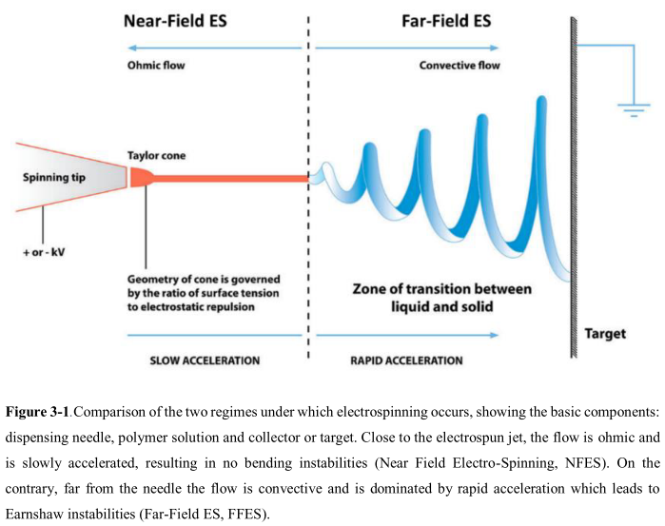

Slide 11
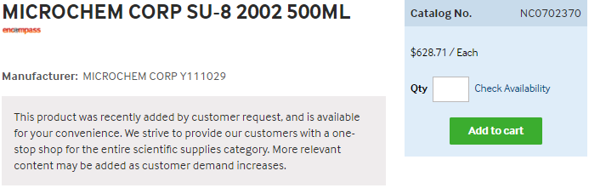
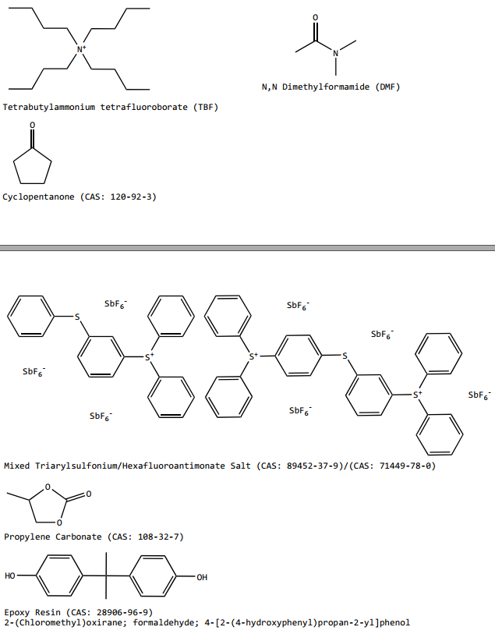
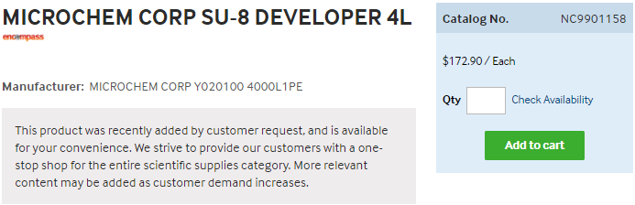
https://www.fishersci.com/shop/products/NC0702370/nc0702370#?keyword=MICROCHEM+CORP+PHOTORESIST+SU-8
https://www.fishersci.com/shop/products/NC9901158/nc9901158#?keyword=SU-8++developer

