Slide 1

Electrospunable Concentrations
Osamu Katagiri-Tanaka A01212611@itesm.mx
14 Jul 2020

Slide 2
Agenda
<a point for discussion> : <5min
<another point for discussion> : ~20min

Slide 3
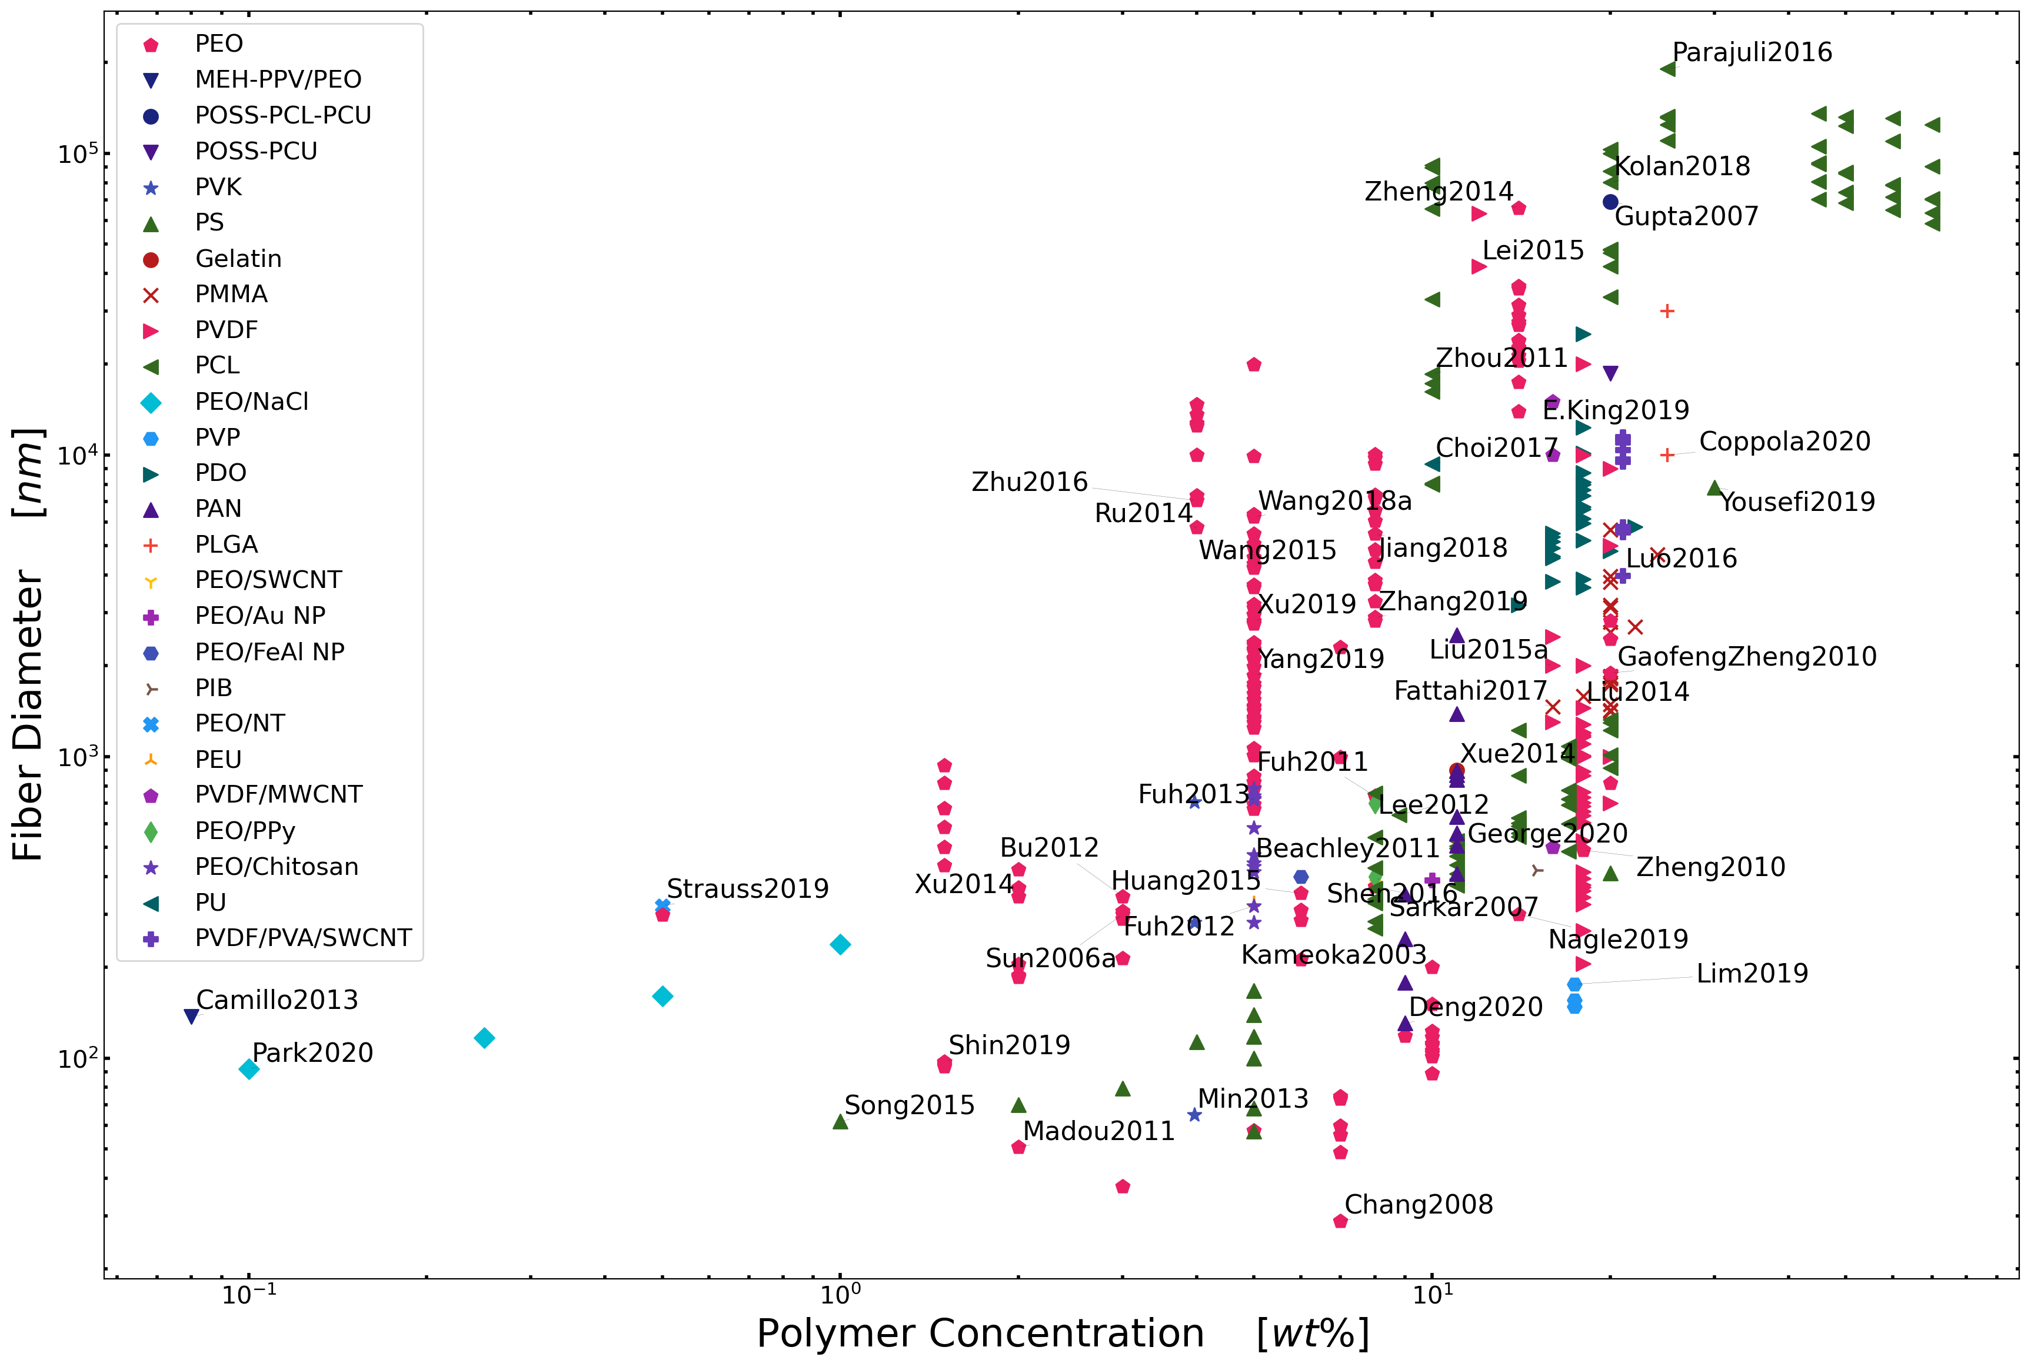
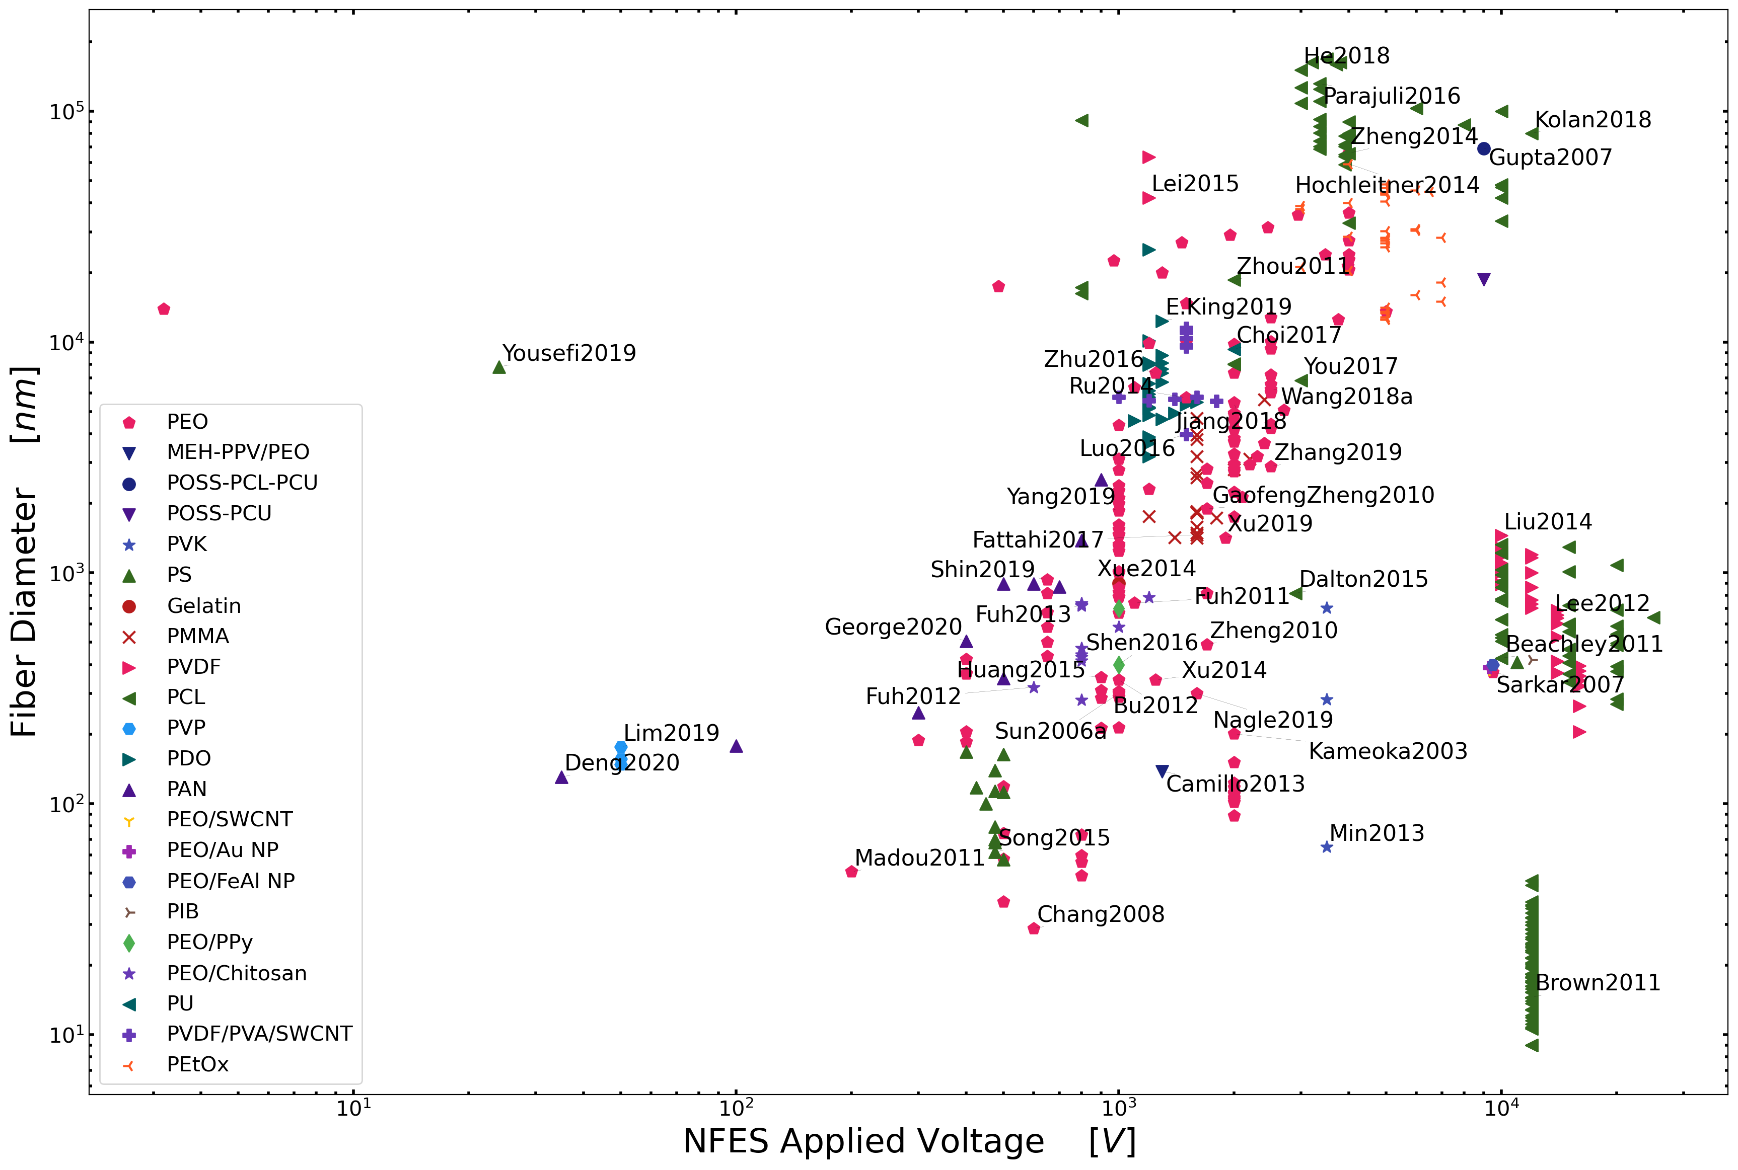
Let’s focus on polymer concentration
Polymer concentration is the most reliable process parameter to control the morphology of electrospun fibers. (regardless the type of NFES process)

Slide 4
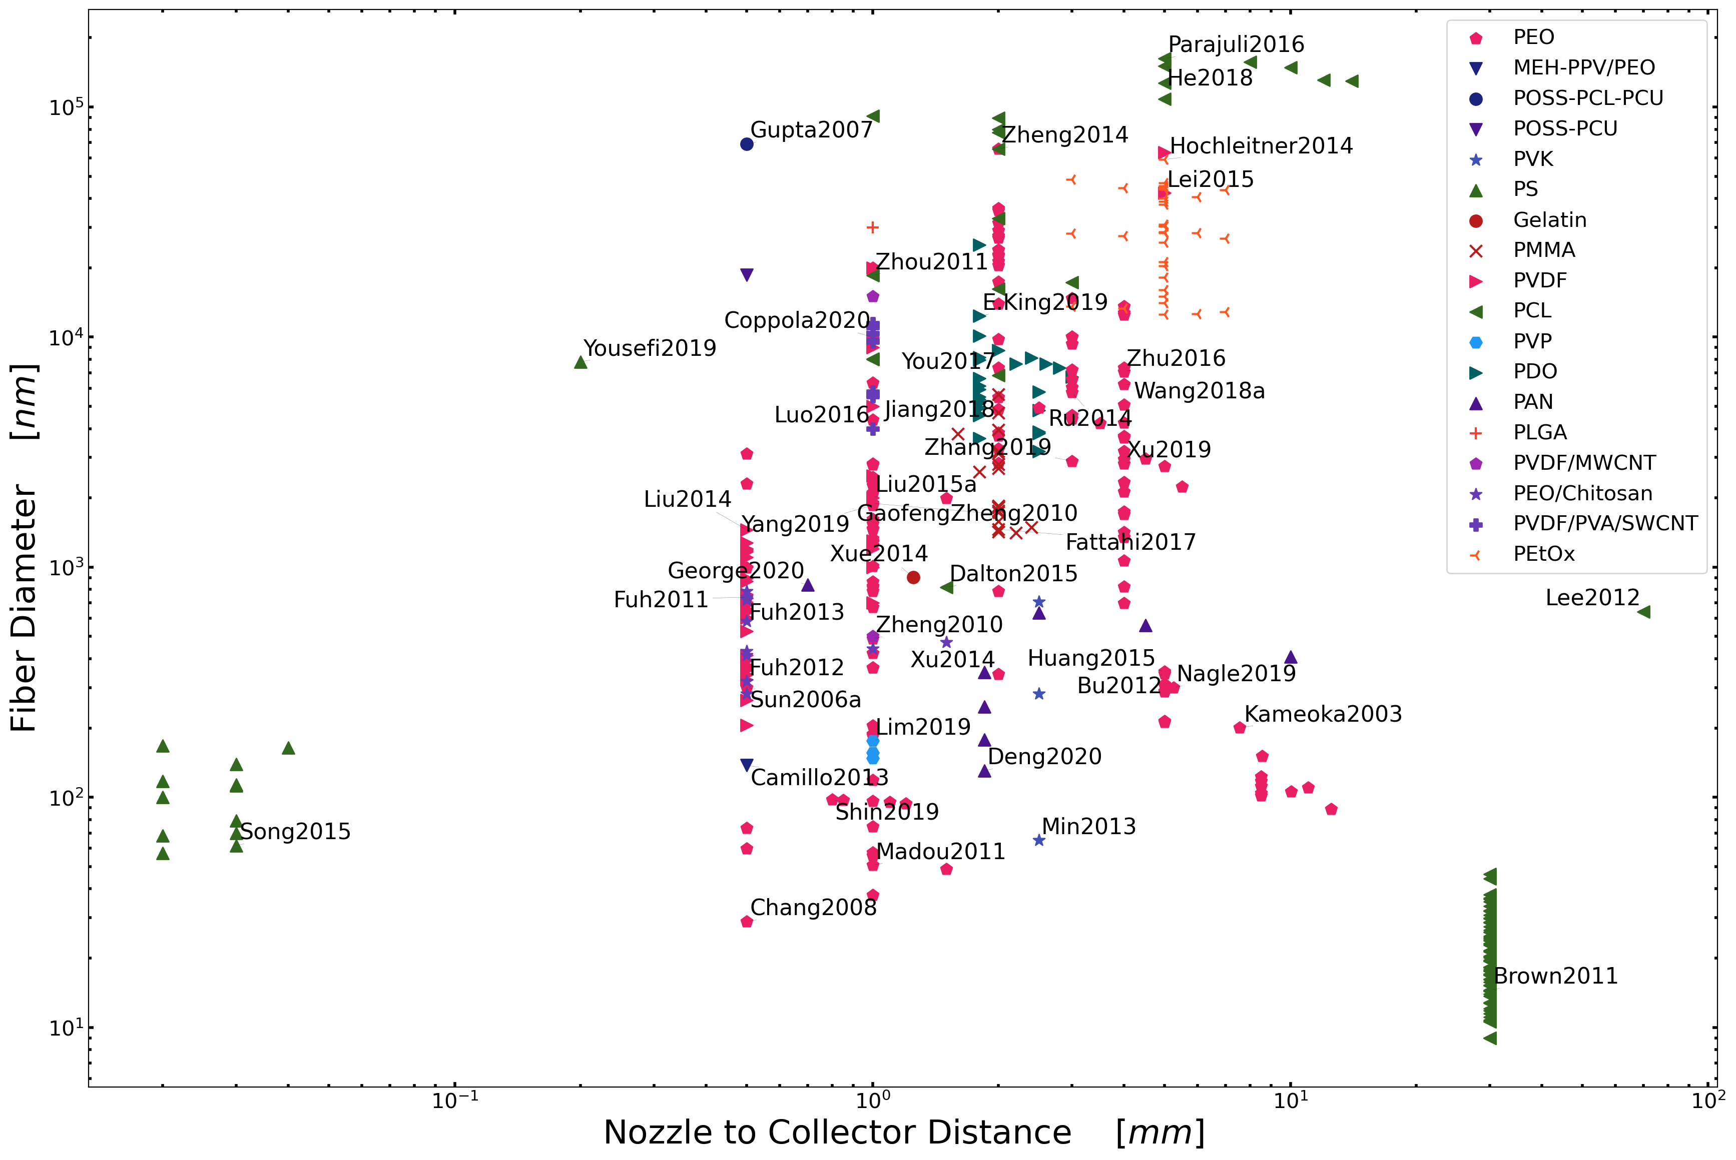
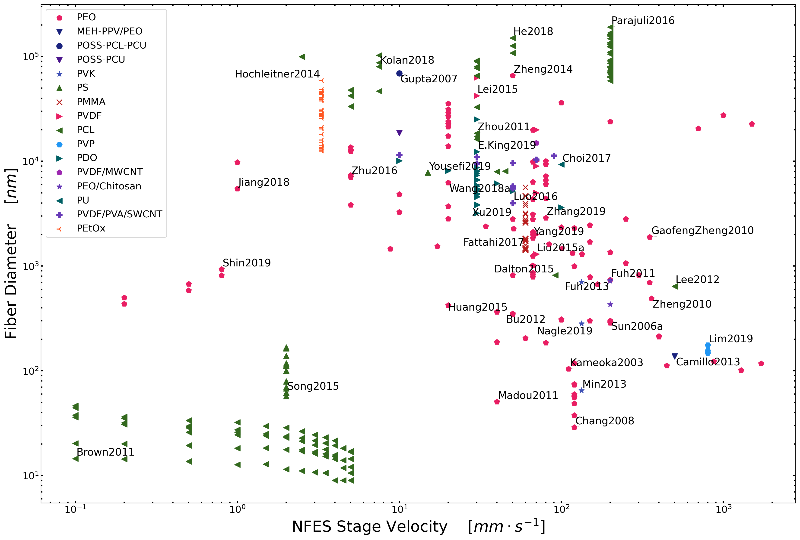
Let’s focus on polymer concentration
Polymer concentration is the most reliable process parameter to control the morphology of electrospun fibers. (regardless the type of NFES process)

Slide 5
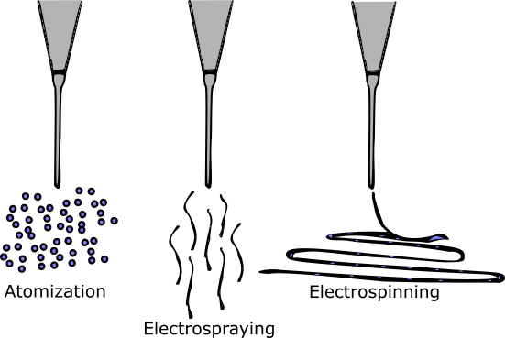
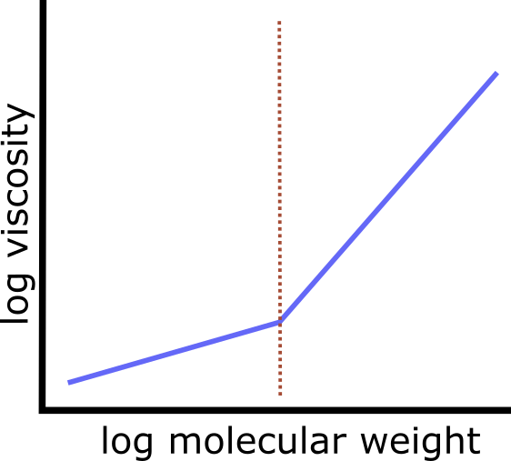
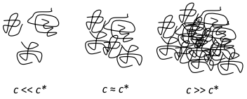
Literature claims
Under some critical concentration NFES yields beads or small fibres
Viscosity increases with molecular weight
Over some critical concentration NFES continuous fibres
The general belief is that the molecular weight needs to be sufficient enough to create or induce entanglements
D.R. Flores, Role of rheological properties in near field electrospun fibers morphology, (2017) 130.
G.L. Wilkes, An overview of the basic rheological behavior of polymer fluids with an emphasis on polymer melts, J. Chem. Educ. 58 (1981) 880. https://doi.org/10.1021/ed058p880.

Slide 6
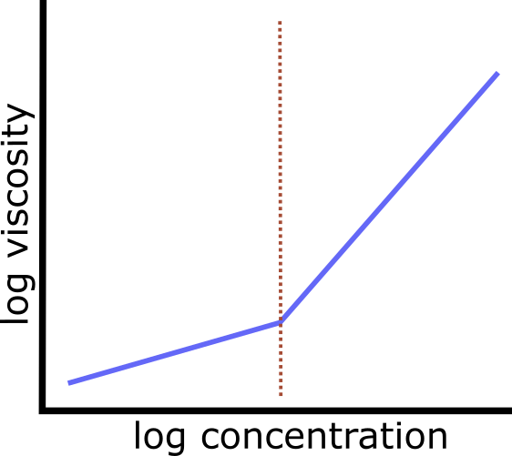
Regarding the previous slide …
Hyp.
If chain entanglement is controlled by molecular weight,
increasing molecular weight increases viscosity, and
viscosity is controlled by polymer concentration, then
The critical concentration can be found in a viscosity vs. concentration plot
?
critical
concentration
N. Bhardwaj, S.C. Kundu, Electrospinning: A fascinating fiber fabrication technique, Biotechnol. Adv. 28 (2010) 325–347. https://doi.org/10.1016/j.biotechadv.2010.01.004.G.L. Wilkes, An overview of the basic rheological behavior of polymer fluids with an emphasis on polymer melts, J. Chem. Educ. 58 (1981) 880. https://doi.org/10.1021/ed058p880.

Slide 7
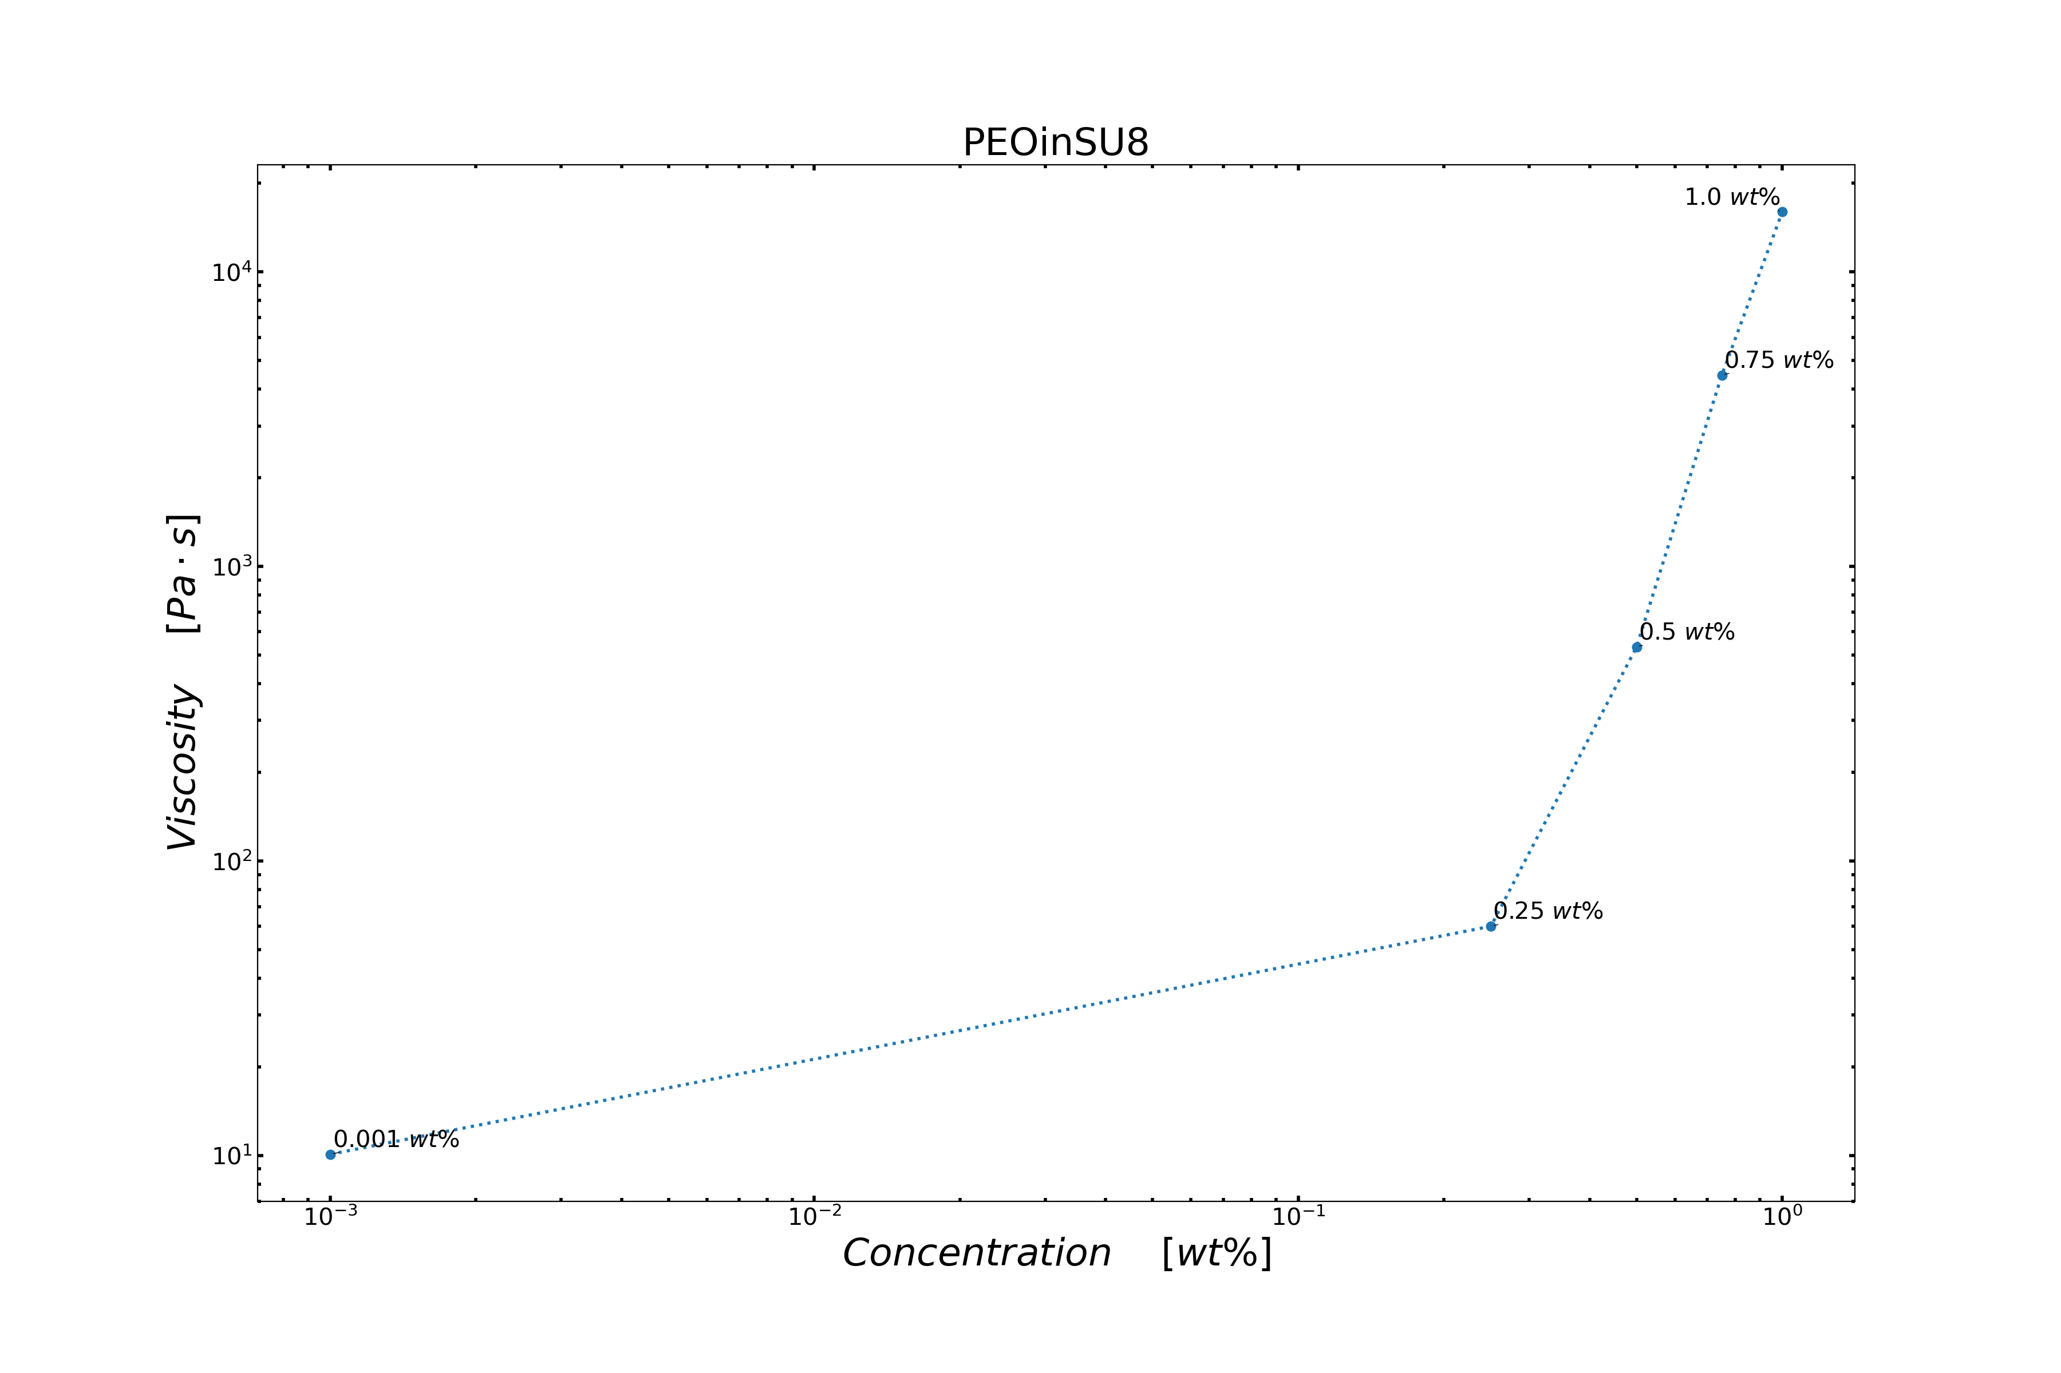
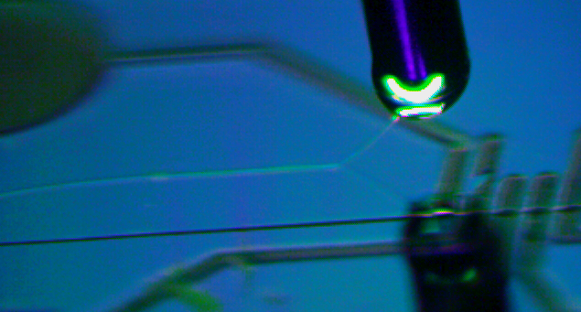
POLY(ETHYLENE OXIDE)
SU-8
successful NFES fibres

Slide 8
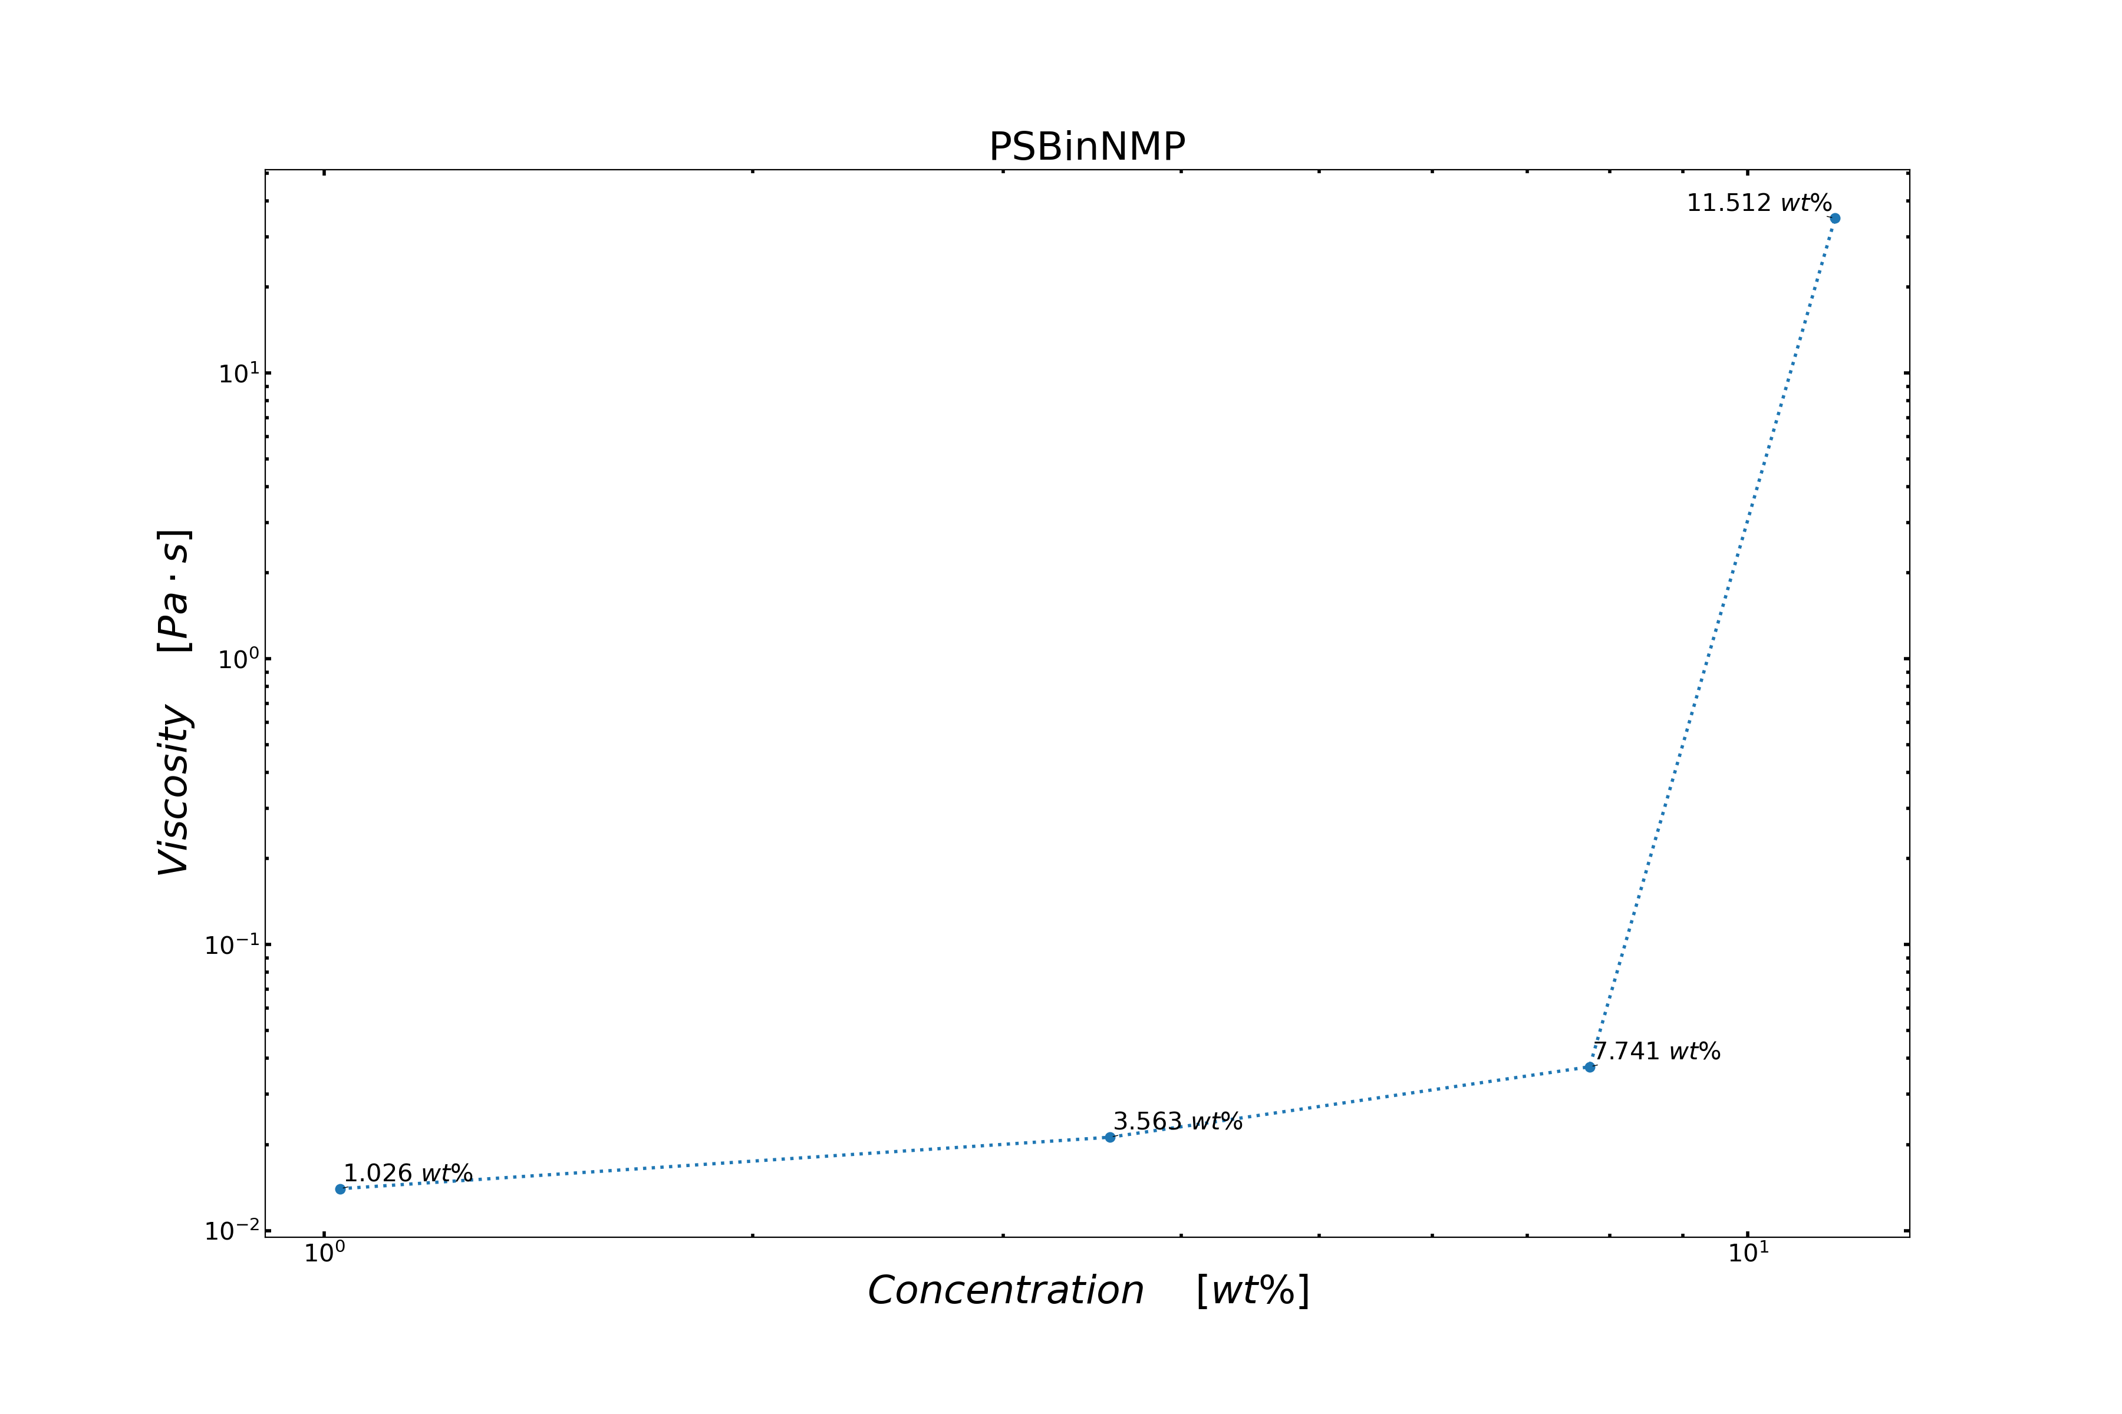
POLY(STYRENE-CO-BUTADIENE)
1-METHYL-2-PYRROLIDINONE
successful NFES fibres

Slide 9
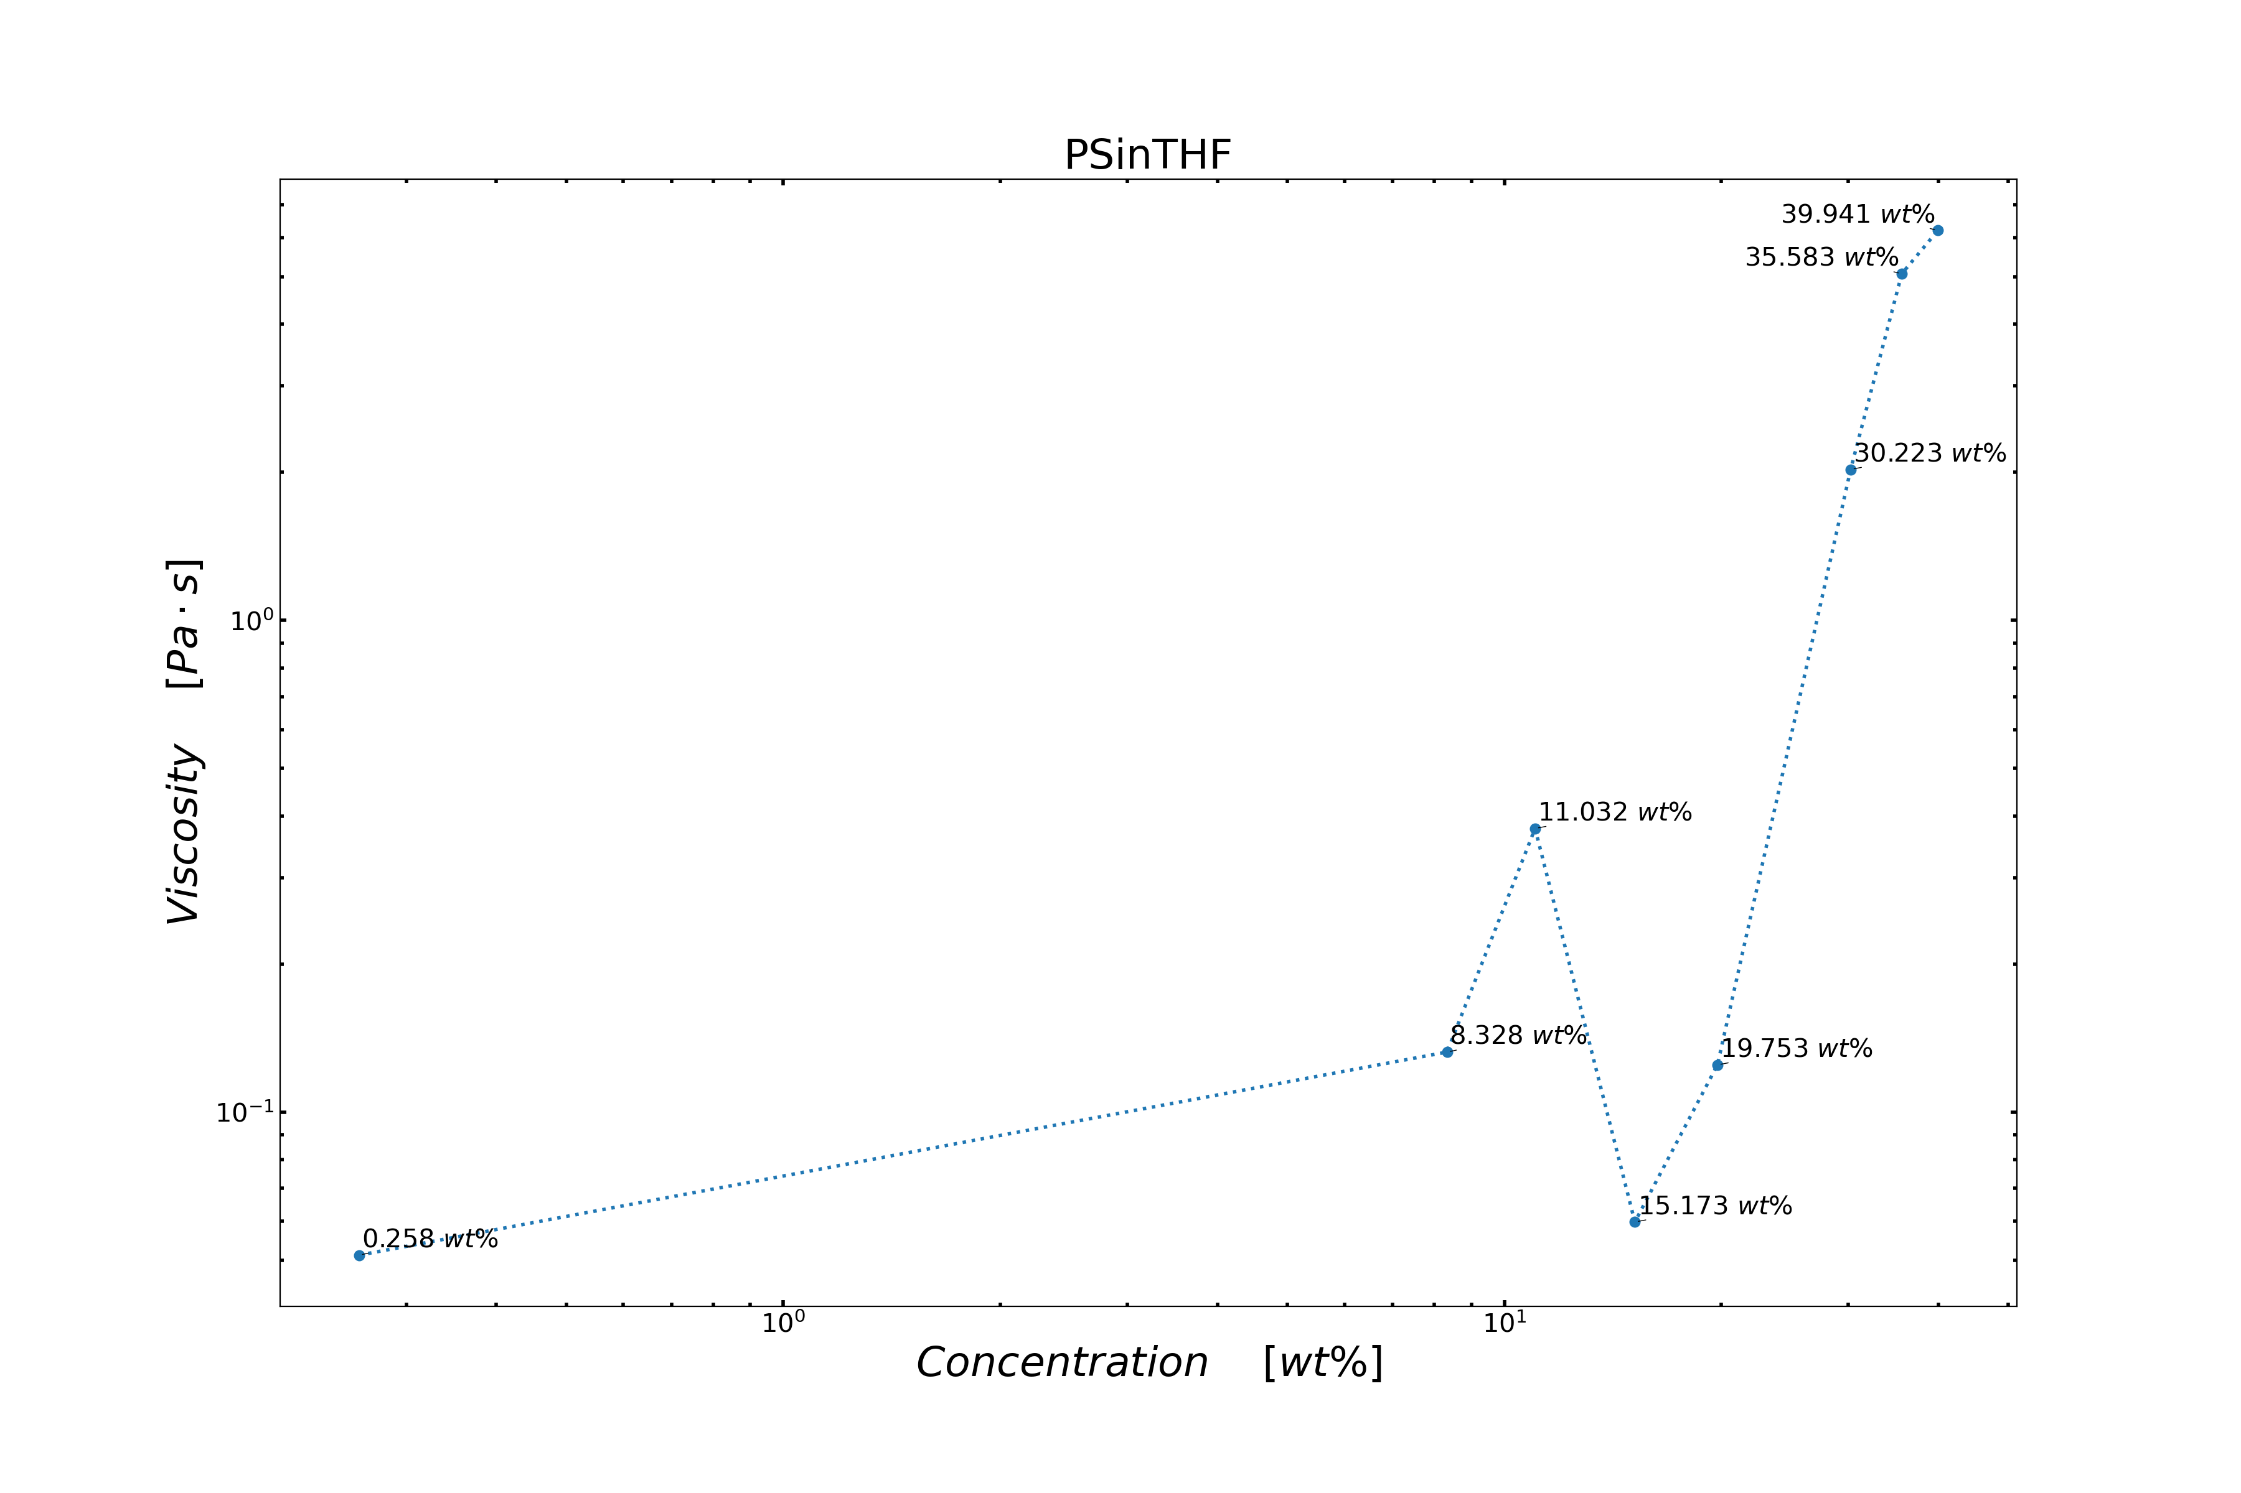
POLYSTYRENE
TETRAHYDROFURAN
successful NFES fibres

Slide 10
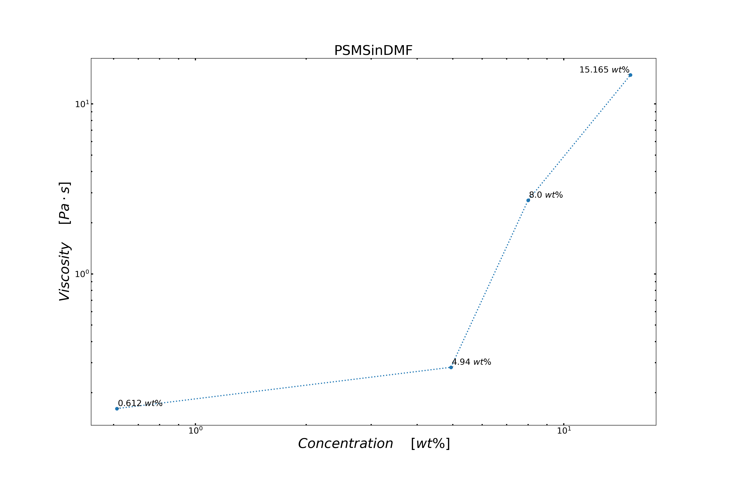
POLY(STYRENE-CO-ALPHA-METHYLSTYRENE)
N,N-DIMETHYLFORMAMIDE
non-spunable concentrations
spunable concentrations

Slide 11


Slide 12
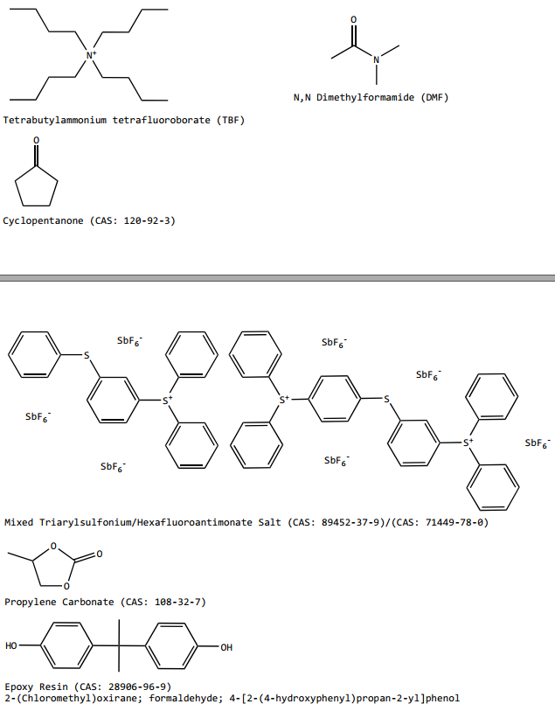
SU-8

Slide 13
References
<reference A>
<reference B>

Slide 14
Title
<content> <key concept>

