Slide 1


Polymers Engineering
Group #5
INFOGRAPHY
Constanza Alvares-Lopez - A00829469@itesm.mx
Osamu Katagiri-Tanaka - A01212611@itesm.mx
Juan Jesús Rocha-Cuervo - A01752555@itesm.mx
Angel Manuel Villalba-Rodriguez - A00828035@itesm.mx

Slide 2
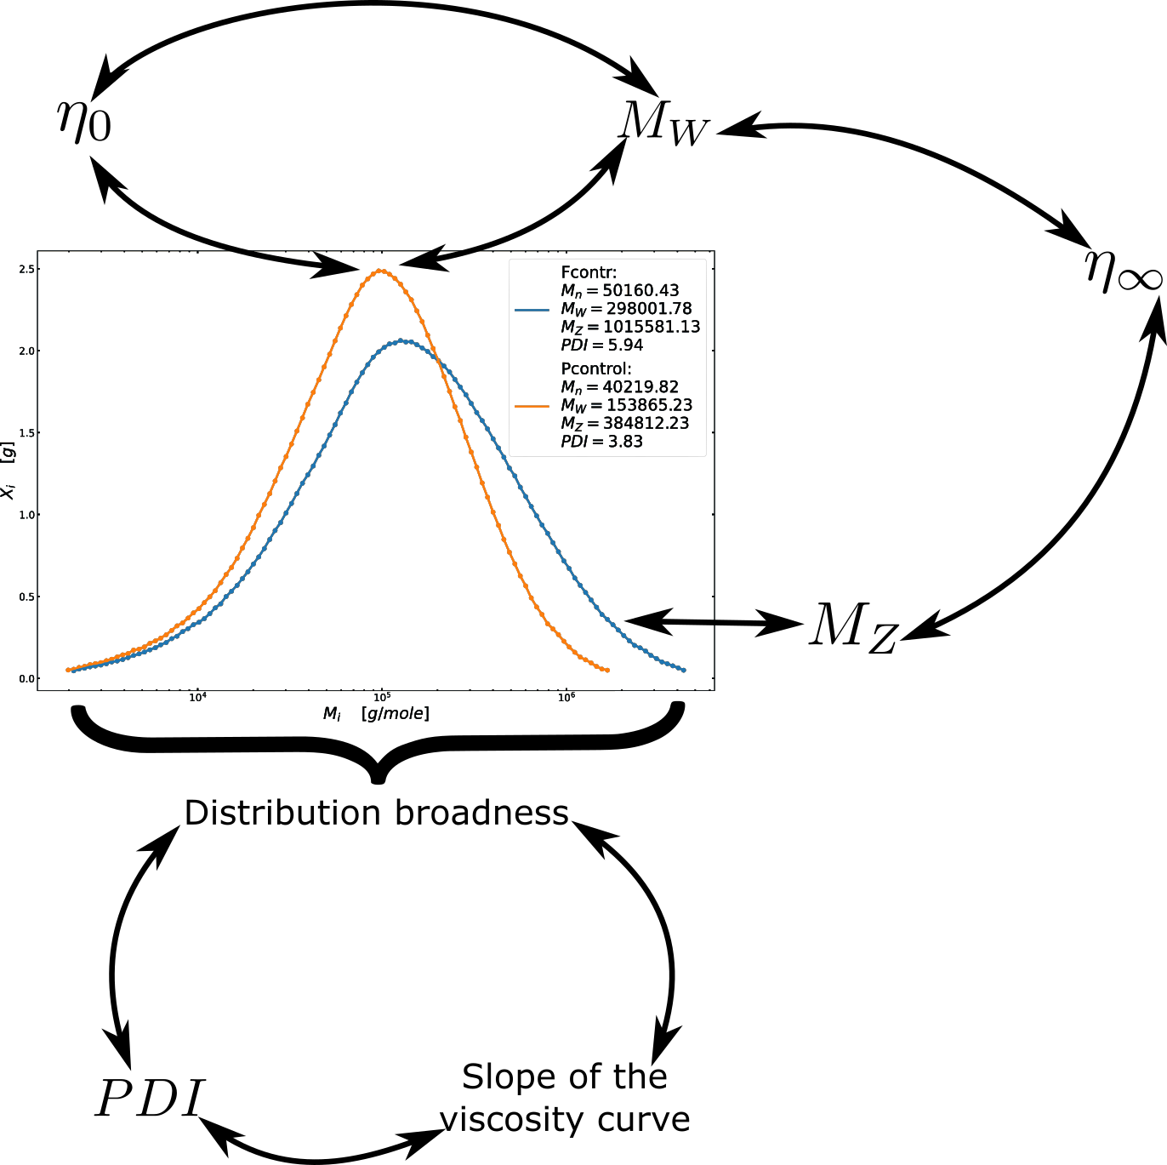
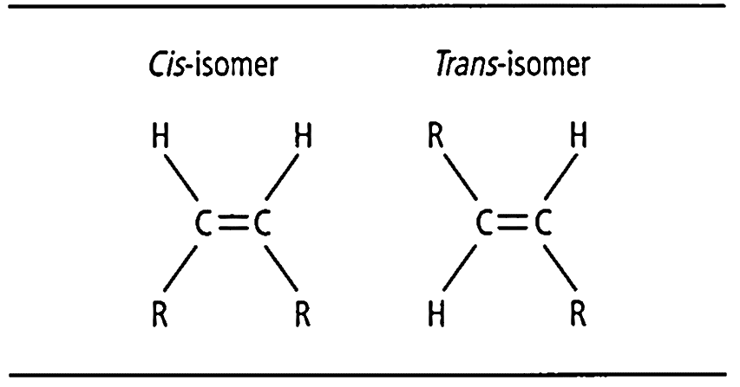

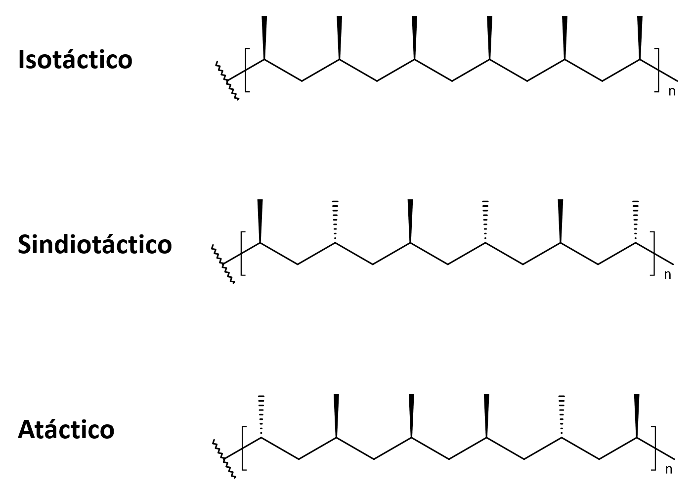

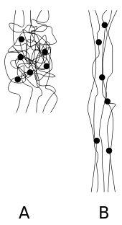
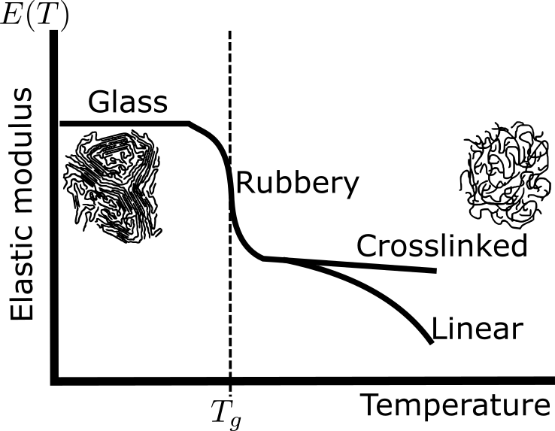







Sample 2
Chemical & Physical Aspects
Mw
>
Zero-shear viscosity
Distribution broadness
>
creep
Polymeric structure
Space
orientation
>
recovery
Tacticity
Chemical
structure
branch size
>
Tg
crosslinks
>
Tg
Distribution broadness
>
PDI
Molecular
forces
>
MFI
Crystallinity
& Steeper slope

Slide 3
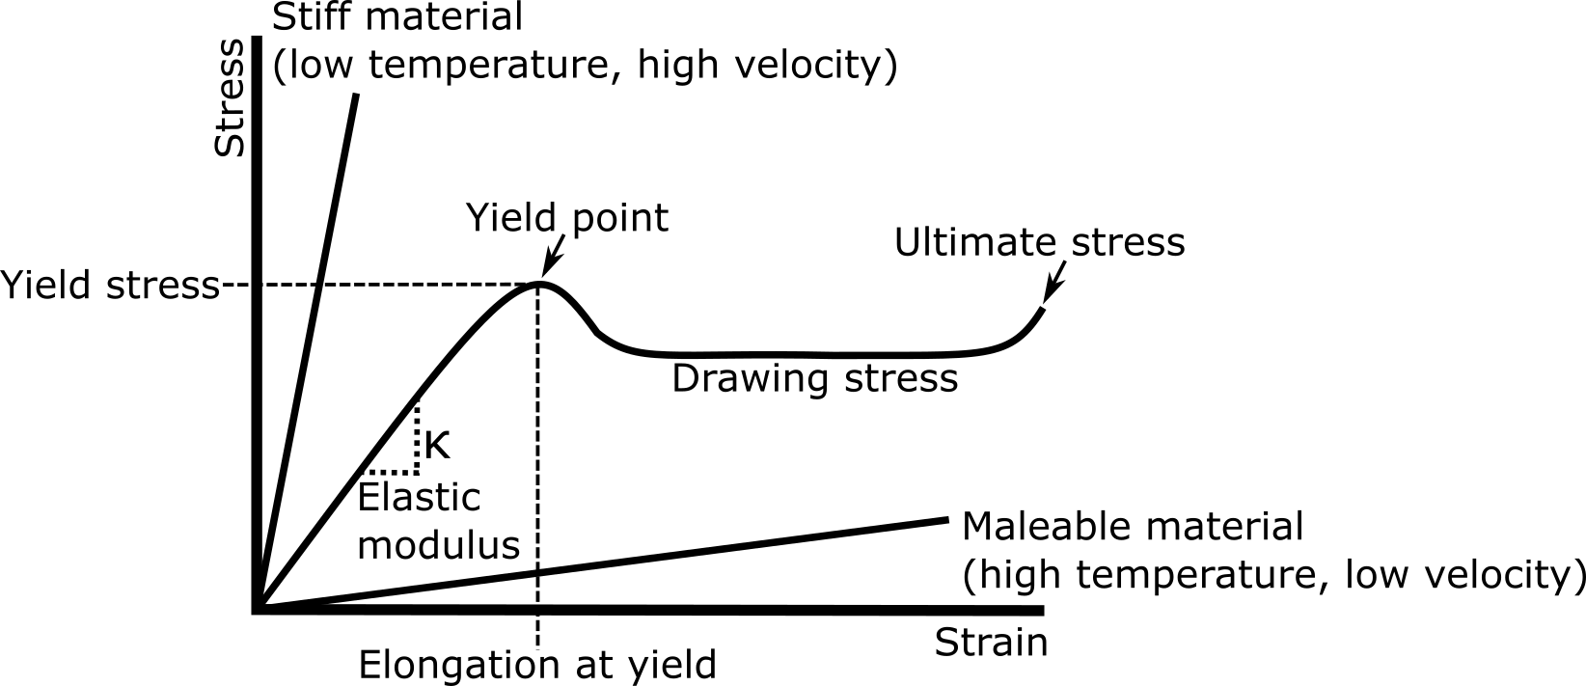
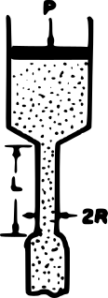
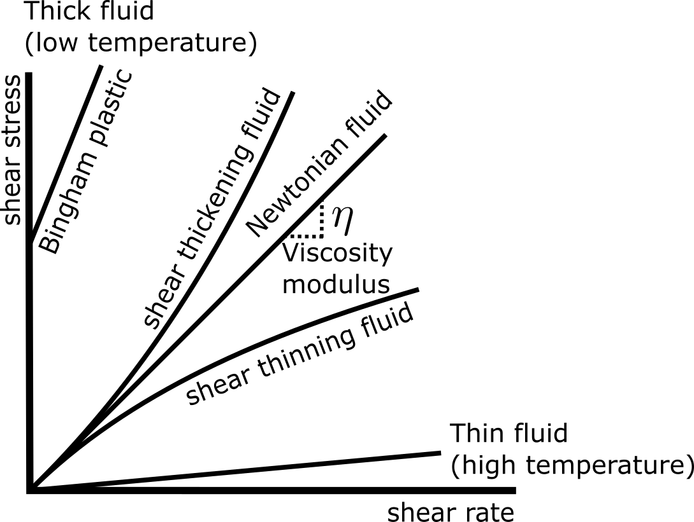
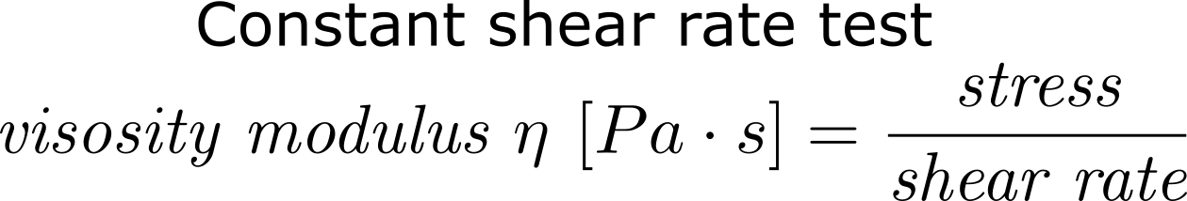



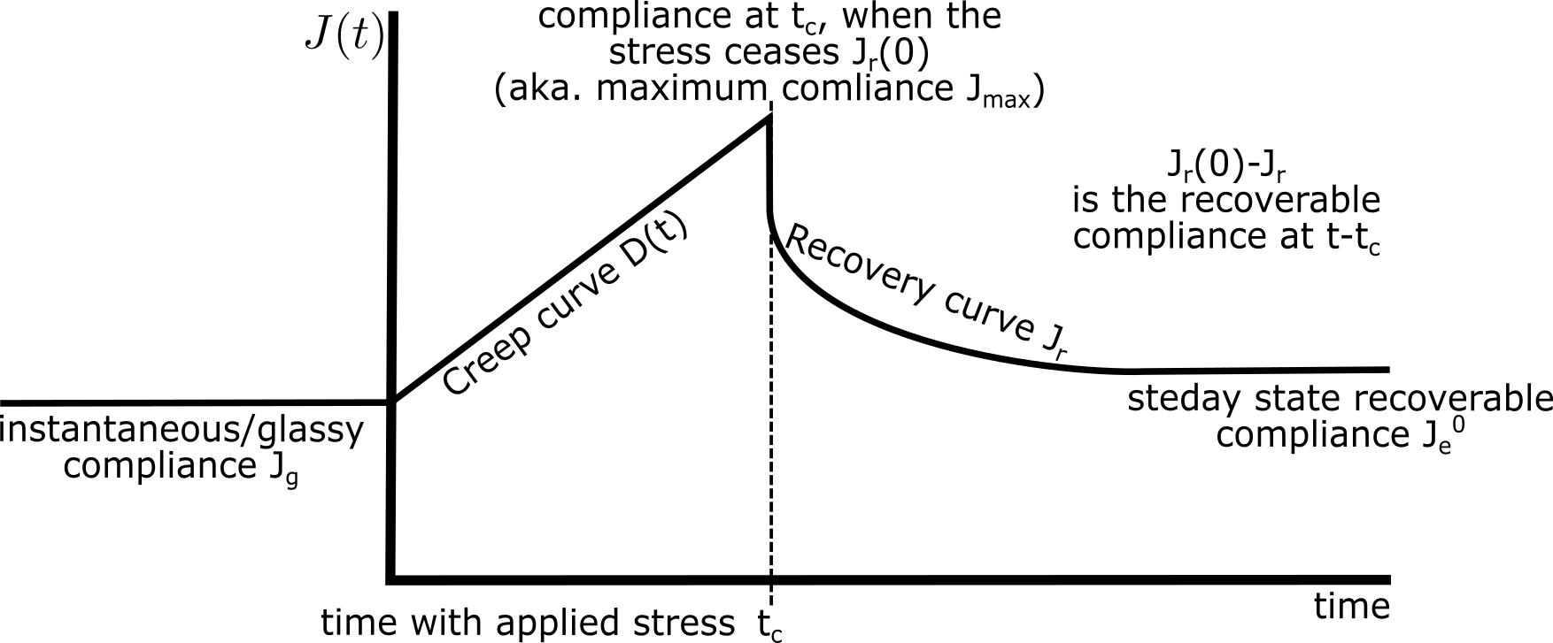
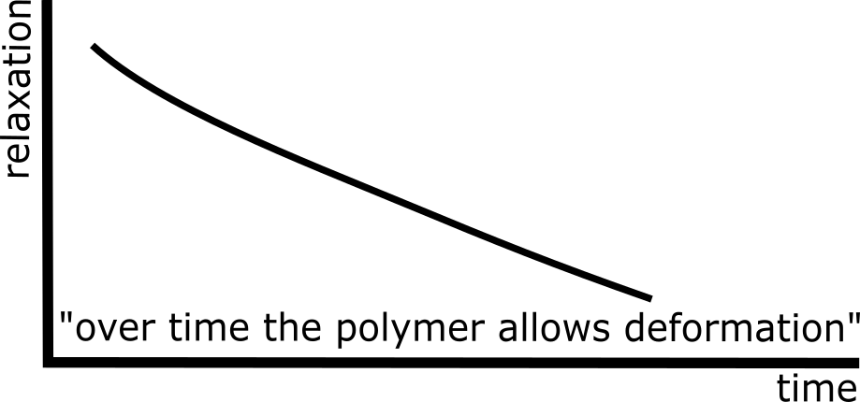

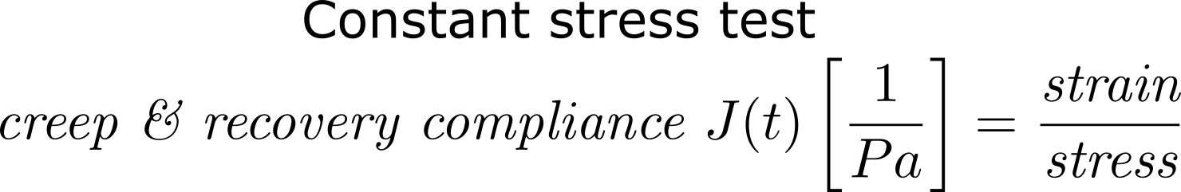

Tips and Tricks (PC and Mac)
Rheology

Slide 4
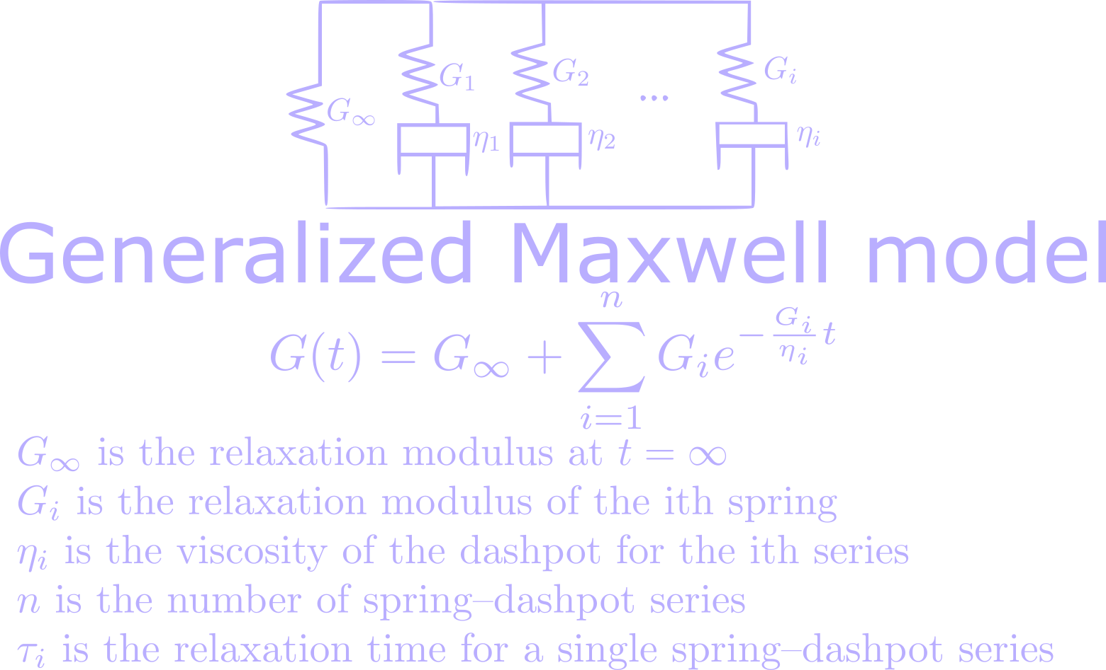
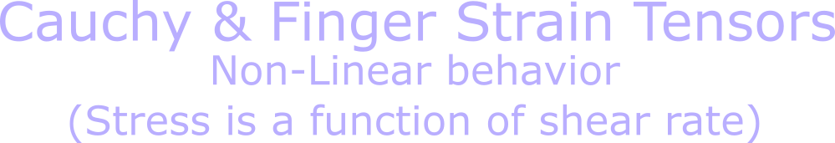




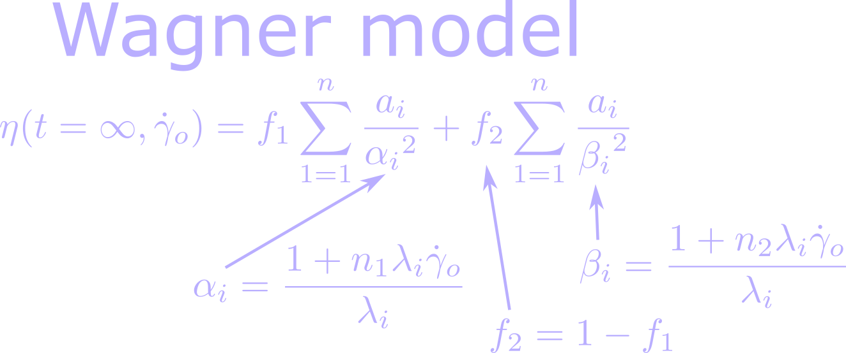


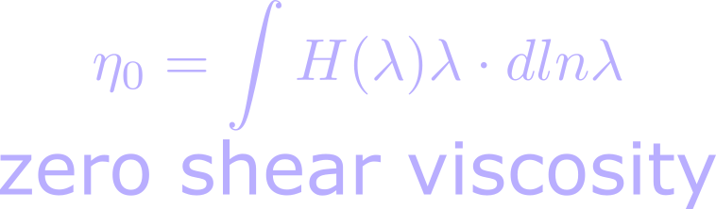

Sample 1
Viscoelastic models

Slide 5
Sample 4
Polymer Processing

