Slide 1

Effect of peroxides in controlled-rheology polypropylene (CRPP)
Osamu Katagiri-Tanaka A01212611@itesm.mx
17 Jul 2020

Slide 2
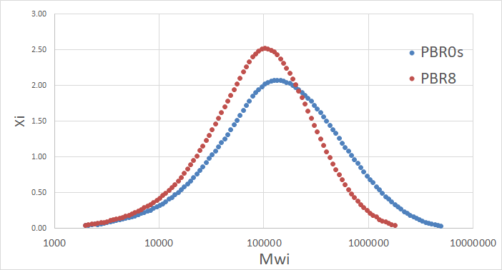
Effect of peroxides in controlled-rheology polypropylene (CRPP)
1) the PP resin / peroxide mixture creates radicals
2) the radicals attack the polymeric chains
3) the increase of the number of broken chains:
a) decreases the average molecular weight (Mw), and
b) narrows the MWD.
CRPP
PP
Notes:
In short, high peroxide concentrations accelerate creepness and harm recovery.

Slide 3
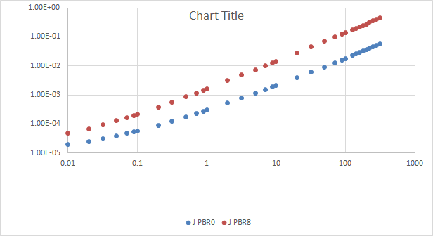
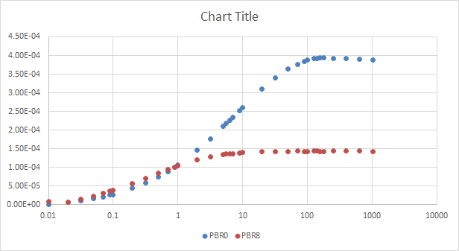
4) which, increases the MFI.
5) Furthermore, the new material will creep faster, and
6) will NOT recover as fast as the starting material.
CRPP
PP
PP
CRPP
* In short, high peroxide concentrations accelerate creep-ness and harm recovery.
Notes:
In short, high peroxide concentrations accelerate creepness and harm recovery.

