Slide 1

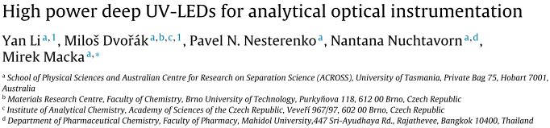
Spectrophotometry <paper review>
Antonio Osamu Katagiri Tanaka A01212611@itesm.mx
27 Feb 2020

Slide 2
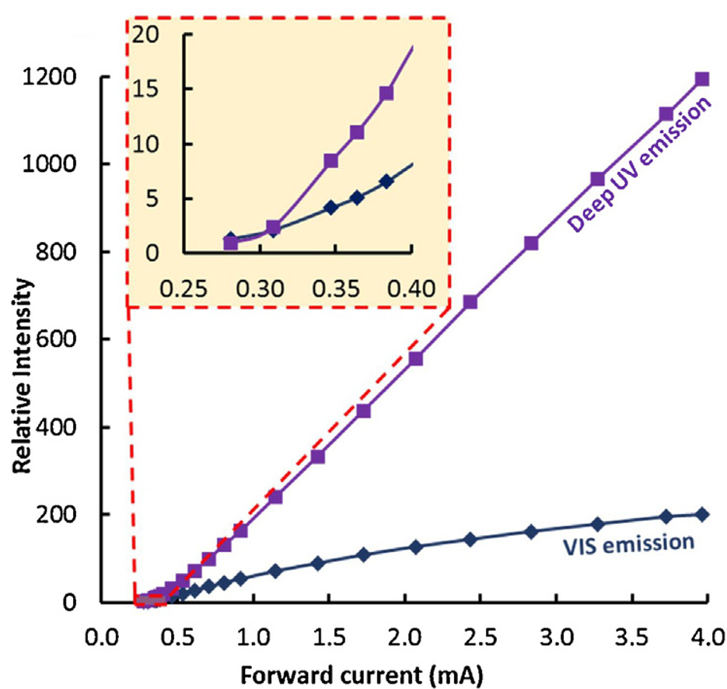
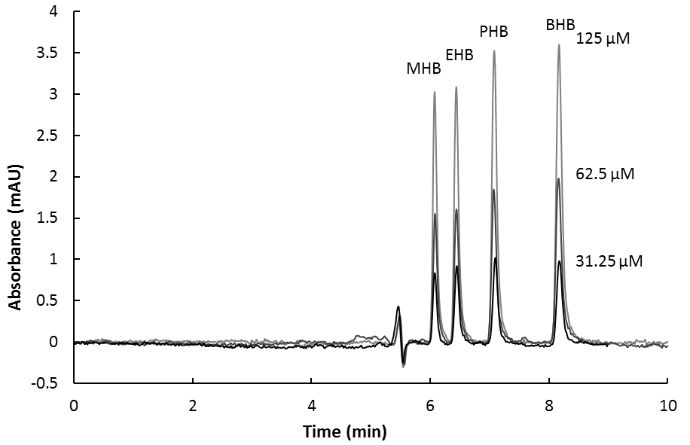
LEDs offer a better alternative to traditional UV sources (low-cost, small
size, robustness, portability, and low noise).
Li et al. intention was to report the performance newly deep UV-LEDs and investigate their feasibility for analytical applications.
With increasing input current the ratio of VIS parasitic emission to the deep UV emission decreases
The performance was demonstrated by detecting four parabens.
The new deep UV-LED noise was low, which is approximately 10 times lower than the noise using the old generation deep UV-LEDs

