Slide 1
Phonons
Packets of sound found present in the lattice as it vibrates … but the lattice vibration cannot be heard.
Unlike static lattice model , which deals with average positions of atoms in a crystal, lattice dynamics extends the concept of crystal lattice to an array of atoms with finite masses that are capable of motion. This motion is not random but is a superposition of vibrations of atoms around their equilibrium sites due to the interaction with neighbor atoms. A collective vibration of atoms in the crystal forms a wave of allowed wavelength and amplitude.
Just as light is a wave motion that is considered as composed of particles called photons, we can think of the normal modes of vibration in a solid as being particle-like.
Quantum of lattice vibration is called the phonon.
This is a presentation from some one else, need to have the reference

Slide 2
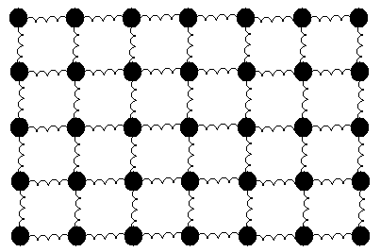
Uniform Solid Material
Considering the regular lattice of atoms in a uniform solid material, you would expect there to be energy associated with the vibrations of these atoms. But they are tied together with bonds, so they can't vibrate independently. The vibrations take the form of collective modes which propagate through the material.
(X-1)
(X)
(X+1)

Slide 3
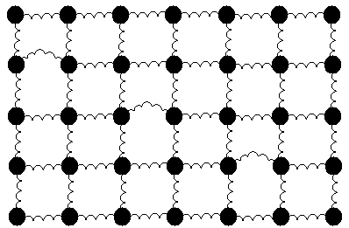
Phonon: A Lump of Vibrational Energy
Propagating lattice vibrations can be considered to be sound waves, and their propagation speed is the speed of sound in the material.
Phonon:
Sound
Wavepackets

Slide 4
If N atoms make up the lattice, and the spring constant between the atoms is C, then we can write an equation for the force when the atoms are displaced:
Using a position/time dependence
of exp(iωt) and solving, we get the
relationship between wave number k and frequency w:

Slide 5
It is usually convenient to consider phonon wave vectors k which have the smallest magnitude (|k|) in their "family". The set of all such wave vectors defines the first Brillouin zone. Additional Brillouin zones may be defined as copies of the first zone, shifted by some reciprocal lattice vector.

Slide 6
There are Acoustic and Optical Phonons
Acoustic phonons occur when wave numbers are small (i.e. long wavelengths) and correspond to sound transmission in crystals. Acoustic phonons vary depending on whether they are longitudinal or transverse
"Optical phonons," which arise in crystals that have more than one atom in the unit cell. They are called "optical" because in ionic crystals are excited very easily by light (by infrared radiation in NaCl). The positive and negative ions vibrate to create a time-varying dipole moment. Optical phonons that interact in this way with light are called infrared active.

Slide 7
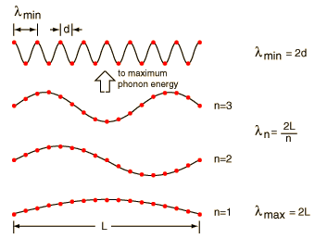
Solid is a periodic array of mass points, there are constraints on both the minimum and maximum wavelength associated with a vibrational mode.

Slide 8
Quantization of Elastic Waves
The energy of an elastic mode of angular frequency ω is
It is quantized, in the form of phonons, similar to the quantization of light, as both are derived from a discrete harmonic oscillator model.
Elastic waves in crystals are made up of phonons. Thermal vibrations are thermally excited phonons.
Notes:
the quantum number n indicates the mode is occupied by n phonons. n can take on any integer value and vary with time
The energy in the mode, as with any harmonic oscillator, is half kinetic and half potential energy, when averaged over time.
Note the zero point energy

Slide 9
Phonon Momentum
A phonon with a wavevector q will interact with particles, like neutrons, photons, electrons, as if it had a momentum (the crystal momentum)
Be careful! Phonons do not carry momentum like photons do. They can interact with particles as if they have a momentum. For example, a neutron can hit a crystal and start a wave by transferring momentum to the lattice.
However, this momentum is transferred to the lattice as a whole. The atoms themselves are not being translated permanently from their equilibrium positions.
The only exception occurs when q = 0, where the whole lattice translates. This, of course, does carry momentum.

Slide 10
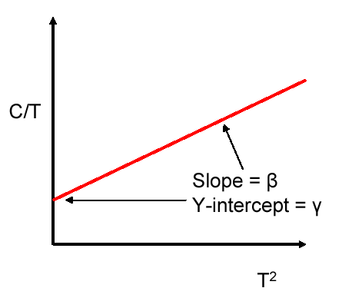
Heat Capacity
You may remember from your study of thermal physics that
the specific heat is the amount of energy per unit mass required to raise the temperature by one degree Celsius. Q = mcΔT
Thermodynamic models give us this definition:
C_{v} = yT+βT³
electrons
phonons
Notes:
We now move to a model that treats phonons like particles in a gas.
As mentioned before, now we are going to look at how what we know about phonons will lead us to a description of the heat capacity as a function of temperature at constant volume.
What we have to do is establish the rules we need to count how many phonons are active at a certain temperature, and then figure out how much energy goes into each.

Slide 11
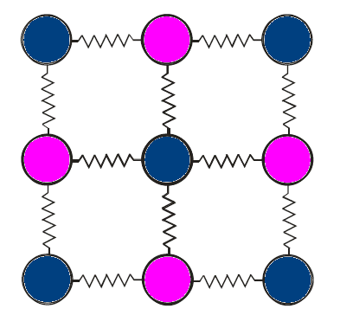
Heat Capacity
Equipartition Theorem:
The internal energy of a system of N particles is
Monatomic particles have only 3 translational degrees of freedom. They possess no rotational or vibrational degrees of freedom. Thus the average energy per degree of freedom is
It turns out that this is a general result.
The mean energy is spread equally over all degrees of freedom, hence the terminology – equipartition.

Slide 12
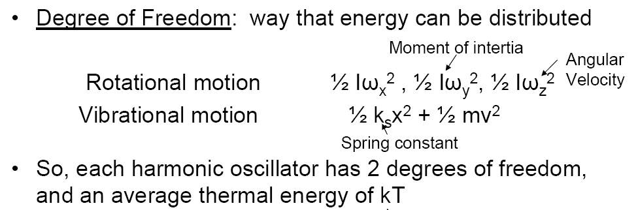
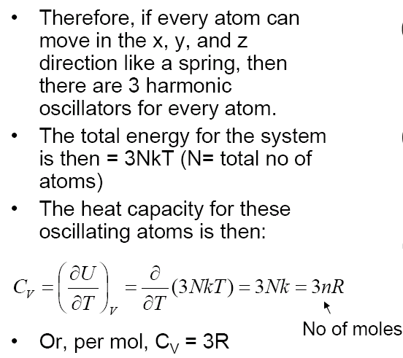
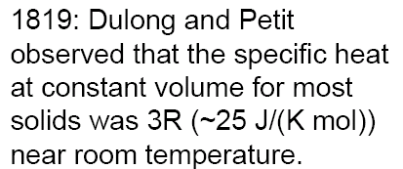

Slide 13
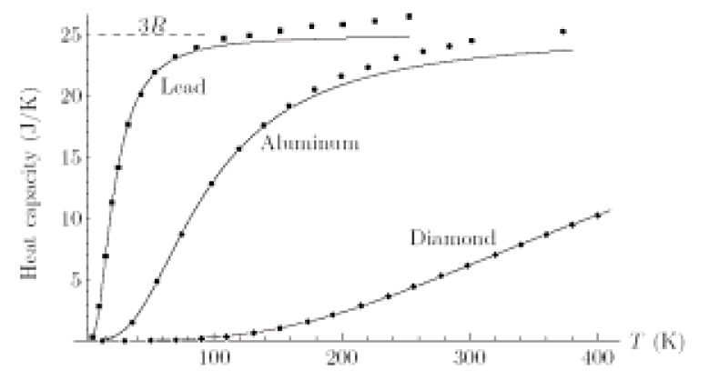
Heat Capacity
Notes:
Upon cooling to low temperature, this law was no longer valid.
It also wasn’t true for some materials, like diamond (why?)
Also, it should be pointed out that the shape of the curves look different for different materials
Can we use what we know about phonons to calculate the heat capacity?
Some of our heat capacity goes to the electrons, and other sources, but in most materials the lattice vibrations absorb most of the energy.

Slide 14
Heat Capacity
Answer: You need to use quantum statistics to describe this properly.
Bosons and Fermions
Bosons: particles that can be in the same energy state (e.g. photons, phonons)
Fermions: particles that cannot be in the same energy level (e.g. electrons)
Notes:
Before we need to talk about how many phonons there are at a certain temperature, we need to discuss some terms in quantum statistics.
Electrons can only be paired up if their spins are pointing in the opposite direction (and thus they have slightly different energies).

Slide 15
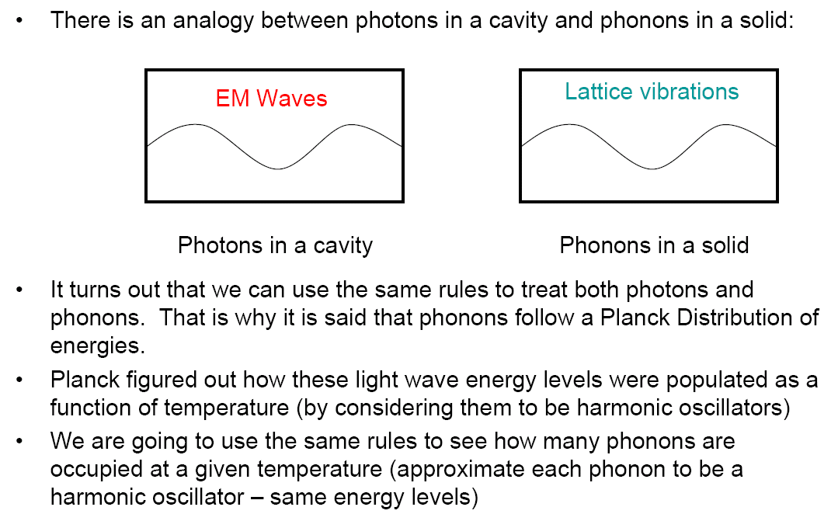
Planck Distribution

Slide 16
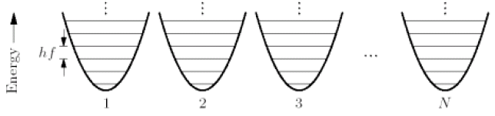
Einstein Model
1907-Einstein developed first reasonably satisfactory theory of specific heat capacity for a solid
assumed a crystal lattice structure comprising N atoms that are treated as an assembly of 3N one-dimensional oscillators
approximated all atoms vibrating at the same frequency (unrealistic, but makes things easier)
Notes:
So, Einstein applied the Planck distribution to the problem and we know what the average energy distribution looks like. To get the average energy per oscillator, just multiply it by

Slide 17
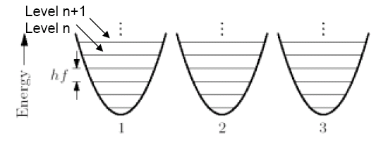
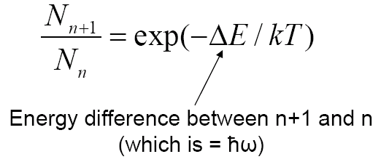

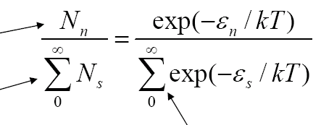
Planck Distribution
number of phonons in energy level n
total number of phonons
all possible energy levels ε₀, ε₁, ε₂, etc.
Notes:
Any system with a quadratic potential energy function has evenly spaced energy levels separated by energy hf, where f is the oscillation frequency.
For a set of identical harmonic oscillators in equilibrium, the ratio of the number of oscillators in the (n+1)th state to the nth state is shown.

Slide 18
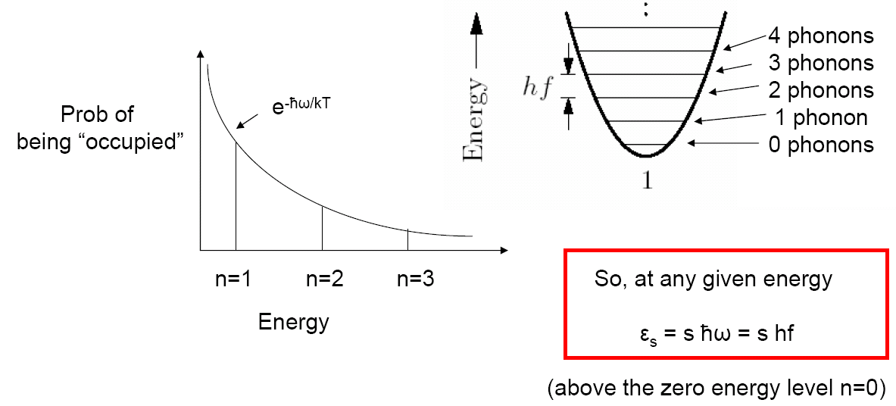
Planck Distribution
Notes:
In order to calculate the heat capacity, we need to know how many phonons there are at each energy level on the average. So, what is the average energy level at a temp. T?

Slide 19
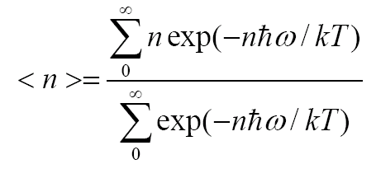
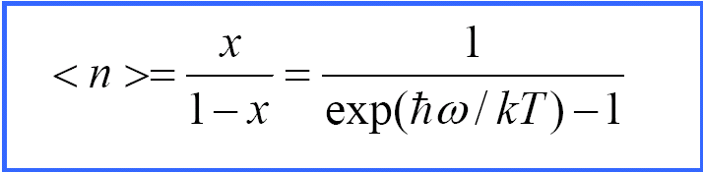
Planck Distribution
average
occupied
energy
level
DENOMINATOR
NUMERATOR
Notes:
This is the average energy level, or the average number of phonons (since this is equal to n) that are occupied at a temperature T with frequency ω
High T limit: as T →∞, <n> = 1/(exp(ħω/kT)-1) ~ 1/(1+ (ħω/kT) -1) ~ kT/ ħω(this is a large number)
Low T limit: as T →0, <n> ~ exp(-ħω/kT) ~ 0 (ground state) no vibrations
High energy limit, vibrations are suppressed or not active
This is a handy number, because it tells us how many phonons are at each frequency
we will need this to calculate the total phonon energy

Slide 20


Einstein Model
average
energy
per oscillator
We have 3N such oscillators, so the total energy is

Slide 21
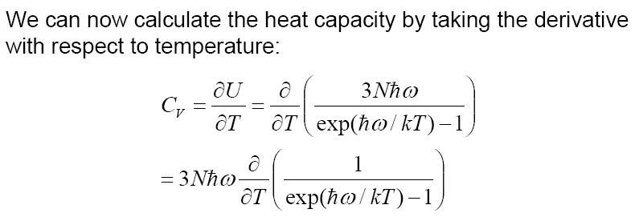
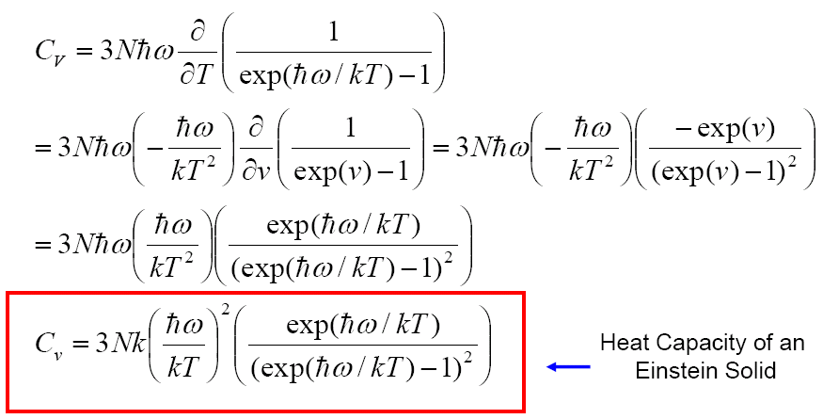
Einstein Model

Slide 22
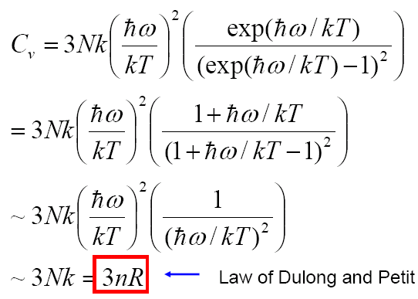
Einstein Model
How did Einstein do?

Slide 23
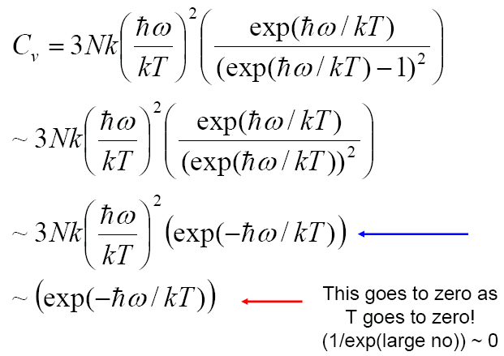
Einstein Model
How did Einstein do?
Notes:
Third line down: the exponential part dominates over the 1/T^2 term
In the last line, we have 1 over a very large number, which goes to zero.

Slide 24
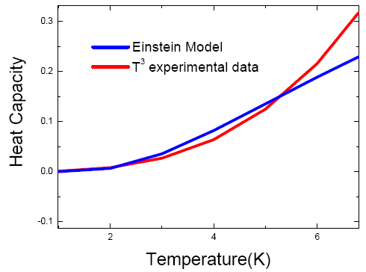
Einstein Model
The Einstein model failed to identically match the behavior of real solids, but it showed the way.
In real solids, the lattice can vibrate at more than one frequency at a time.
Answer: the Debye Model
Notes:
The model works well sometimes. Often, the optical modes are nearly constant with frequency, so the model works for those modes.
I was reminded of a story that a friend of mine told about three guys who I think were with National Geographic. They were off in some dark part of Africa or someplace on an expedition and they were captured by what they thought or had been told would possibly be head-hunters or cannibals. And these three guys were scared to death and they were staked up to three stakes in the center of this village. Around them were 50-100 people with bones in their nose, spears and all kinds of things working themselves up into a frenzy and these guys were scared to death. All of a sudden it grew quiet and the Chief stepped forward and he went up to the first guy and he said, "you wish death-you wish Magumba?" And the guy said, "I don't want to die - I don't know what Magumba is, but I don't want to die - I choose Magumba." And the Chief said "Magumba!" at which point some guys step forward, cut him off of the stake, they picked him up over their heads, they dragged him off. This guy started screaming, the other two couldn't see him and he was goin' in the crowd. There was dust bein' raised - I mean it sounded like they were doing unspeakable, terrible things to this poor fellow. And as the screams got quieter and quieter, everything else got louder and louder and they couldn't imagine what was going on until pretty soon it got all quiet again. The Chief stepped up to the second guy - "you wish death - you wish Magumba?" "The poor guy's - God, I don't know what happened, but I don't want to die. I don't know what to do - Magumba." And the Chief said "Magumba!" Same thing - terrible unspeakable things were obviously happening to this poor fellow. Got quiet again - Chief stepped up to the third guy - "you wish death - you wish Magumba?" Guy said, "I ain't afraid of dyin' - I ain't afraid of Magumba - But I choose death." The Chief said, "Ah, very good choice, but first Magumba!

