Slide 1

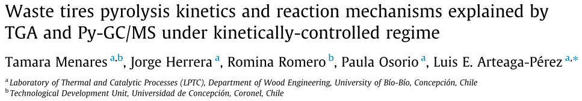
Thermal Methods <paper review>
Antonio Osamu Katagiri Tanaka A01212611@itesm.mx
23 Apr 2020

Slide 2
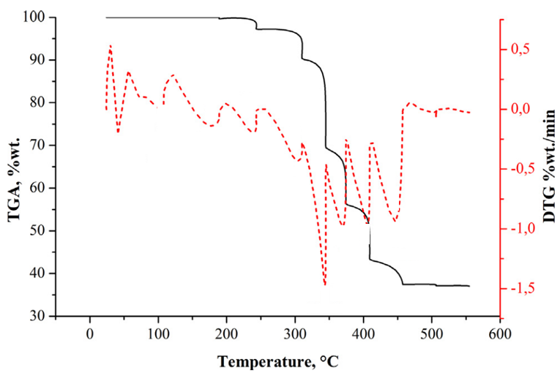
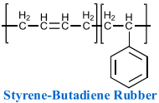
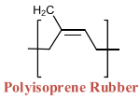


Pyrolysis of waste tires (WTs) is a thermochemical degradation occurring at high temperatures (typically 400–800 °C) in an oxygen-free atmosphere. The WTs pyrolysis products includes a liquid (oil), from which valuable compounds such as limonene, benzene, toluene and xylene (BTX) can be extracted.
DTGs peaks correspond to tire decomposition.
Plasticizers;
<2% weight loss
NR
SBR
Process parameters:
20 mg of sample
alumina crucible
N2 flow (50 mL/min)
20–25 min of heating at 20 °C/min
formation of radicals from NR and BR;
11% weight loss
BR
scission of C-C to form C=C in SBR;
8% weight loss
depolymerization, devolatilization and condensation of NR & BR;
21% weight loss
The completion of the pyrolysis process was around 510 °C, with a final residue of 37% in the TGA
T. Menares, J. Herrera, R. Romero, P. Osorio, L.E. Arteaga-Pérez, Waste tires pyrolysis kinetics and reaction mechanisms explained by TGA and Py-GC/MS under kinetically-controlled regime, Waste Manag. 102 (2020) 21–29. https://doi.org/10.1016/j.wasman.2019.10.027.

