Slide 1

Intro to LaTeX
Osamu Katagiri-Tanaka A01212611@itesm.mx
12 Aug 2020

Slide 2

A Bit of History
https://www.latex-project.org/get/
TEX is a computer program created by Donald E. Knuth.
It is aimed at typesetting text and mathematical formulae.
Created in 1977 and released in 1982
In the 1990’s, Leslie Lamport created LaTeX (TEX with more features)
Today, LaTeX is maintained by the LaTeX Project
Donald E. Knuth. The TEXbook, Volume A of Computers and Typesetting, Addison-Wesley, Reading, Massachusetts, second edition, 1984, ISBN 0-201-13448-9.
Leslie Lamport. LATEX: A Document Preparation System. AddisonWesley, Reading, Massachusetts, second edition, 1994, ISBN 0-201- 52983-1.

Slide 3
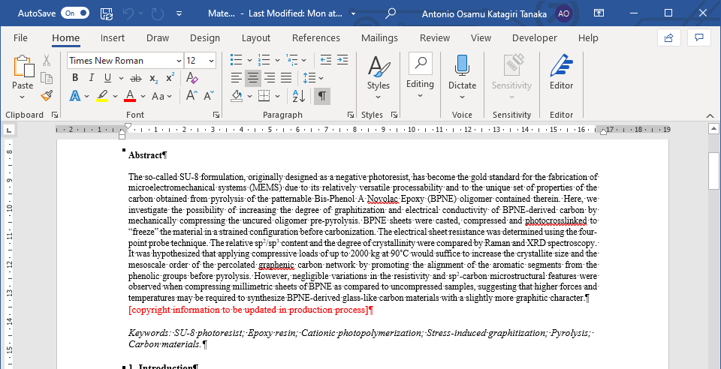
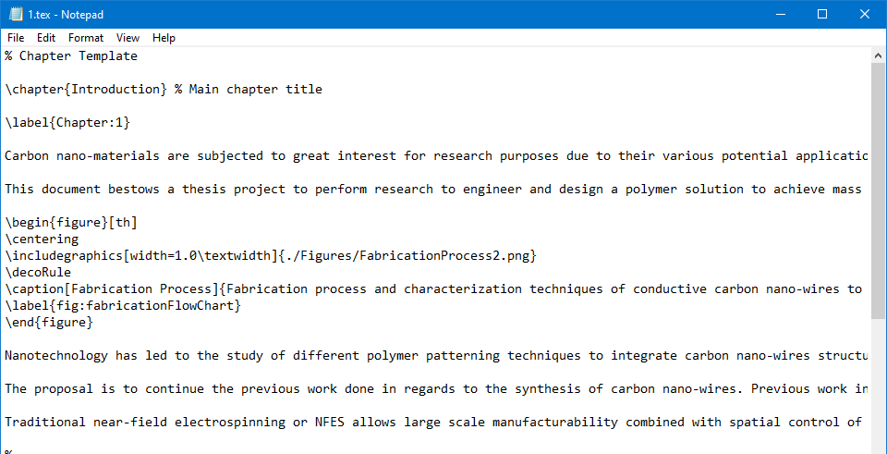
LaTeX is not “What you see is what you get”
In MS Word or LibreOffice or Pages, authors can see on the screen how the final work will look when it is printed.
In LATEX it is not possible to see the final output while typing, but it can be previewed after processing the file
Donald E. Knuth. The TEXbook, Volume A of Computers and Typesetting, Addison-Wesley, Reading, Massachusetts, second edition, 1984, ISBN 0-201-13448-9.
Leslie Lamport. LATEX: A Document Preparation System. AddisonWesley, Reading, Massachusetts, second edition, 1994, ISBN 0-201- 52983-1.

Slide 4
Basics (commands)
LaTeX takes care of all the formatting. But LaTeX is “only” a program and therefore needs some guidance.
Commands start with a backslash \ and then have a name consisting of letters only.
Some commands require a parameter, given between curly braces { }
Other commands take optional parameters, inserted in square brackets [ ]
\command[optional parameter]{required parameter}
Donald E. Knuth. The TEXbook, Volume A of Computers and Typesetting, Addison-Wesley, Reading, Massachusetts, second edition, 1984, ISBN 0-201-13448-9.
Leslie Lamport. LATEX: A Document Preparation System. AddisonWesley, Reading, Massachusetts, second edition, 1994, ISBN 0-201- 52983-1.
Notes:
This additional information is written into the text as “LaTeX commands.”

Slide 5
Basics (comments)
When LATEX encounters a % character while processing an input file, it ignores the rest of the present line
Useful to write notes/reminders into the input file, which will not show up in the printed version.
% explain A, B and C
% [TODO: add figure …]
Donald E. Knuth. The TEXbook, Volume A of Computers and Typesetting, Addison-Wesley, Reading, Massachusetts, second edition, 1984, ISBN 0-201-13448-9.
Leslie Lamport. LATEX: A Document Preparation System. AddisonWesley, Reading, Massachusetts, second edition, 1994, ISBN 0-201- 52983-1.

Slide 6
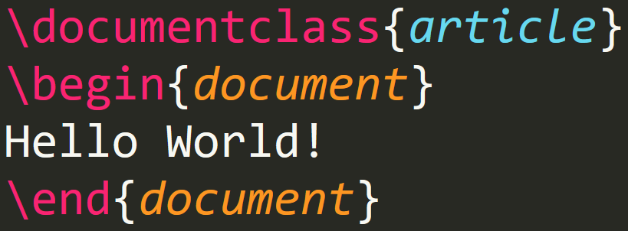
Input File Structure
\documentclass{...} specifies what sort of document you intend to write
\usepackage{...} adds new features to the LaTeX system.
When all the setup work is done, you start the body of the text with \begin{document}
At the end of the document you add the \end{document}
Donald E. Knuth. The TEXbook, Volume A of Computers and Typesetting, Addison-Wesley, Reading, Massachusetts, second edition, 1984, ISBN 0-201-13448-9.
Leslie Lamport. LATEX: A Document Preparation System. AddisonWesley, Reading, Massachusetts, second edition, 1994, ISBN 0-201- 52983-1.

Slide 7
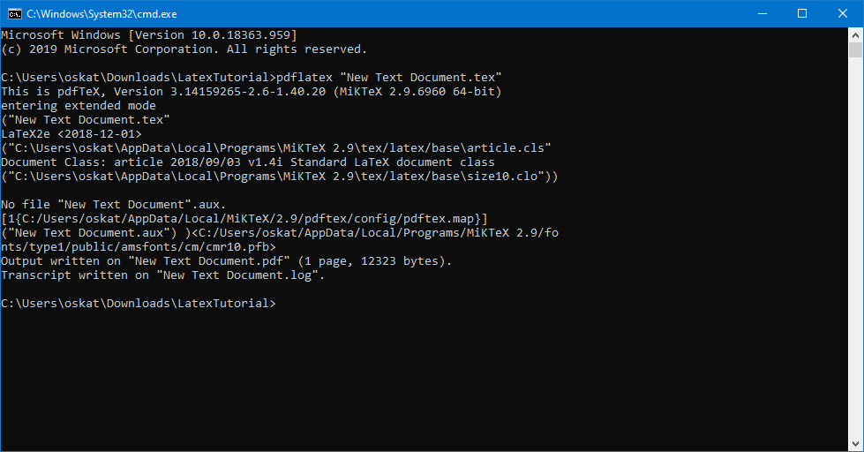
The scary thing
LaTeX itself comes without a GUI nor fancy buttons to press.
It is just a “command-line” program that processes your input file into a PDF.
Pdflatex *.tex
Donald E. Knuth. The TEXbook, Volume A of Computers and Typesetting, Addison-Wesley, Reading, Massachusetts, second edition, 1984, ISBN 0-201-13448-9.
Leslie Lamport. LATEX: A Document Preparation System. AddisonWesley, Reading, Massachusetts, second edition, 1994, ISBN 0-201- 52983-1.

Slide 8
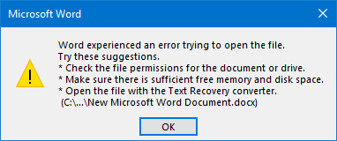
Why would you use LaTeX?
Formatting is a one-time job → you can concentrate in the content
Handle big documents with ease
Able to recover corrupted files
Faster than MS Word-like programs → more typing, less clicking
Even MS Word implements LaTeX to input equations
LaTeX is highly portable
Donald E. Knuth. The TEXbook, Volume A of Computers and Typesetting, Addison-Wesley, Reading, Massachusetts, second edition, 1984, ISBN 0-201-13448-9.
Leslie Lamport. LATEX: A Document Preparation System. AddisonWesley, Reading, Massachusetts, second edition, 1994, ISBN 0-201- 52983-1.

Slide 9


