Slide 1

Raman Spectroscopy and its applications
Osamu Katagiri-Tanaka A01212611@itesm.mx
4 May, 2020

Slide 2
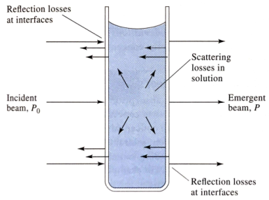
Light Scattering (deviation of the trajectory of photons)
Rayleigh Scattering (scattered photons have the same energy as incident photons)
Ramman Scattering (scattered photons have a different energy than incident photons)
Stokes Scattering (frequency of scattered light is lower than that of incident light)
anti-Stokes Scattering (scattered light has higher frequency)
Y. I. Vega, Raman Spectroscopy, in: M5052 Charact. Mater. Nanomater. - Grad. Progr. Nanotechnol., N.L. Monterrey, 2015.

Slide 3
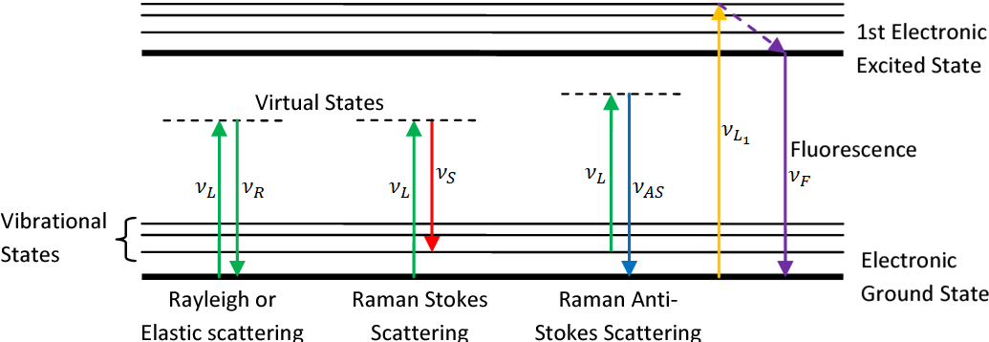
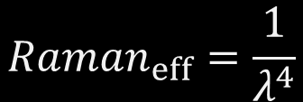

Stokes vs Rayleigh vs anti-Stokes vs Fluorescence
$$ν_{S}=ν_{L}−ν_{0→1}$$
$${Raman}_{eff}=\frac{1}{λ^{4}}$$
J. Griffiths, Raman Spectroscopy For Medical Diagnosis, Anal. Chem. 79 (2007) 3975–3978. https://doi.org/10.1021/ac071917k.

Slide 4
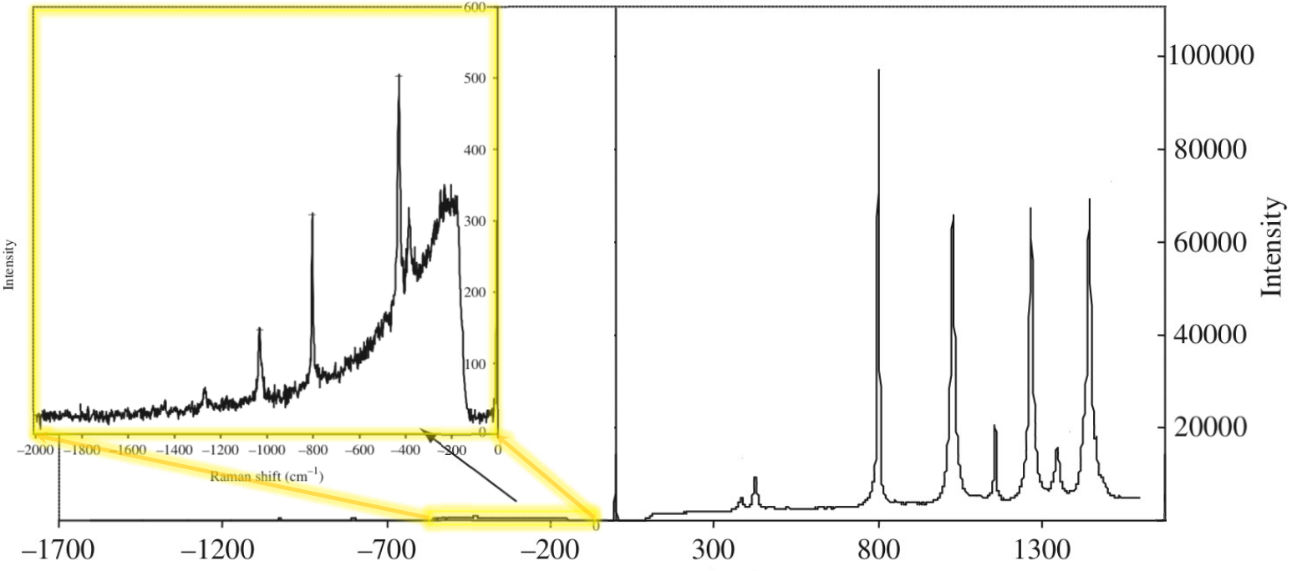



Stokes vs anti-Stokes and the Boltzmann dist.
$$ν_{AS}$$
$$ν_{L}$$
$$ν_{S}$$
Raman spectrum of cyclohexane
Y. I. Vega, Raman Spectroscopy, in: M5052 Charact. Mater. Nanomater. - Grad. Progr. Nanotechnol., N.L. Monterrey, 2015.

Slide 5
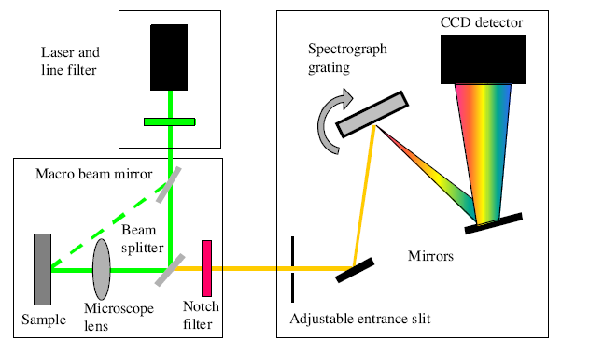
Raman Instrumentation
J. Bardina, R. Thirumalainambi, Micro-Flying Robotics in Space Missions, in: SAE Tech. Pap., 2005. https://doi.org/10.4271/2005-01-3405.

Slide 6
Some applications
Polymers
Monitor the polymerization progress
Observation of vibrational modes
Study of crystal lattice vibrations
Identification of specific compounds
Characterization of graphitic carbon structures
Y. I. Vega, Raman Spectroscopy, in: M5052 Charact. Mater. Nanomater. - Grad. Progr. Nanotechnol., N.L. Monterrey, 2015.
https://www.nobelprize.org/prizes/physics/1930/summary/
G. Xue, Fourier transform Raman spectroscopy and its application for the analysis of polymeric materials, Prog. Polym. Sci. 22 (1997) 313–406. https://doi.org/10.1016/S0079-6700(96)00006-8.

Slide 7

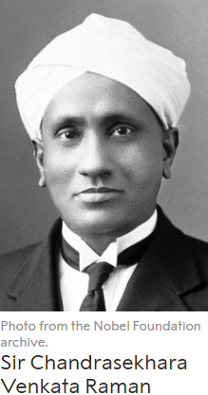
C. V. RAMAN, K.S. KRISHNAN, A New Type of Secondary Radiation, Nature. 121 (March 31, 1928) 501–502. https://doi.org/10.1038/121501c0.

