Slide 1

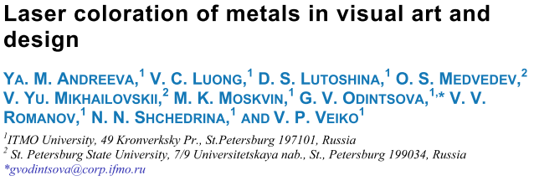
“ […] laser as a brush; metal as a canvas, and
surface structuring as paint.”
13 June 2020
Notes:
As stated by Andreeva et al. several metal coloration techniques have been explored in recent literature, however technologies involving lasers are of more interest due to the wide color palette and the ability to tune the result with high accuracy. The authors present three coloration techniques: a) Metal coloration by laser oxidation of the surface, b) Metal coloration by laser production of silver nanoparticles, and c) Metal coloration by la ser structuring of the stainless-steel surface. The three techniques amend the material surface at the nanoscale to control how light is reflected/emitted from the surface. The surface modifications are in accordance with different methods to control the metal coloration.

Slide 2
Agenda
<a point for discussion> : <5min
<another point for discussion> : ~20min

Slide 3
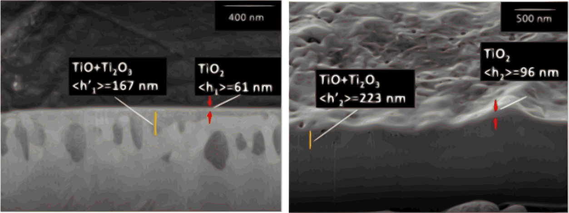
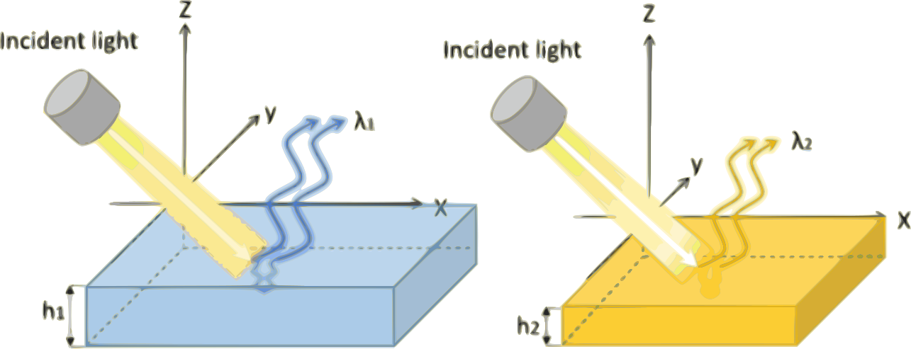
Metal coloration by laser oxidation
Colour is determined by:
metal oxide chemical composition, and
oxide layer thickness
Y.M. Andreeva, V.C. Luong, D.S. Lutoshina, O.S. Medvedev, V.Y. Mikhailovskii, M.K. Moskvin, G. V. Odintsova, V. V. Romanov, N.N. Shchedrina, V.P. Veiko, Laser coloration of metals in visual art and design, Opt. Mater. Express. 9 (2019) 1310. https://doi.org/10.1364/OME.9.001310.
Notes:
Metal coloration by laser oxidation of the surface exploits the fact that color is determined by the metal oxide chemical composition (i.e. TiO₂, Ti₂O₃, TiO) and the oxide layer thickness. The oxide film thickness is controlled with temperature exposure, which increases with the increasing temperature.

Slide 4
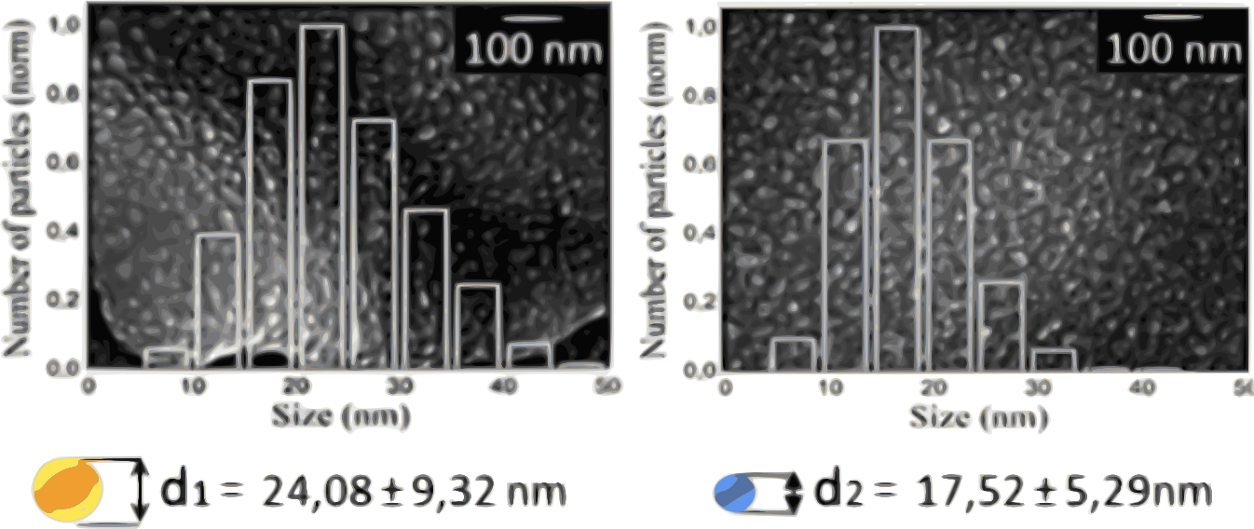
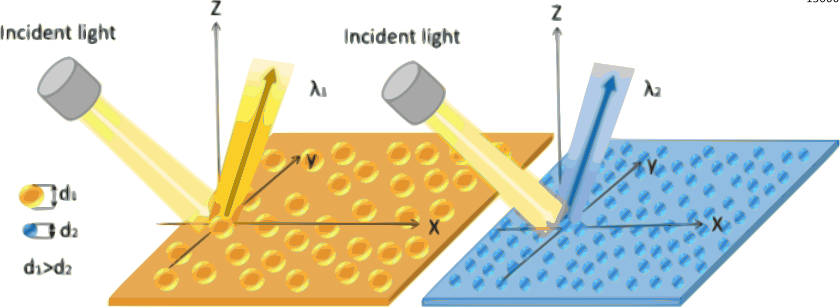
Metal coloration by laser production of nanoparticles
The surface plasmon resonance of the nanoparticles absorb specific wavelengths to resemble the desired colour.
The obtained colour depends on the size, shape, and distribution of the deposited nanoparticles.
Y.M. Andreeva, V.C. Luong, D.S. Lutoshina, O.S. Medvedev, V.Y. Mikhailovskii, M.K. Moskvin, G. V. Odintsova, V. V. Romanov, N.N. Shchedrina, V.P. Veiko, Laser coloration of metals in visual art and design, Opt. Mater. Express. 9 (2019) 1310. https://doi.org/10.1364/OME.9.001310.
Notes:
Metal coloration by laser production of nanoparticles by controlling the surface plasmon resonance of deposited nanostructures (metal nanoparticles) on a surface by high-intensive laser irradiation. The desired wavelengths are reflected building-up the wanted color as the surface plasmon resonance of the nanoparticles achieve a selective absorption of the non-desired wavelengths. The obtained color depends on the size, shape, and distribution of the deposited nanoparticles.

Slide 5
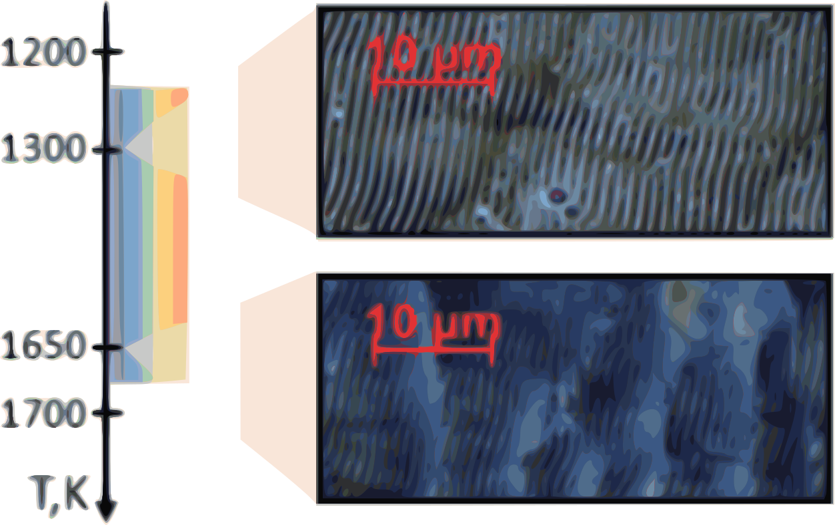
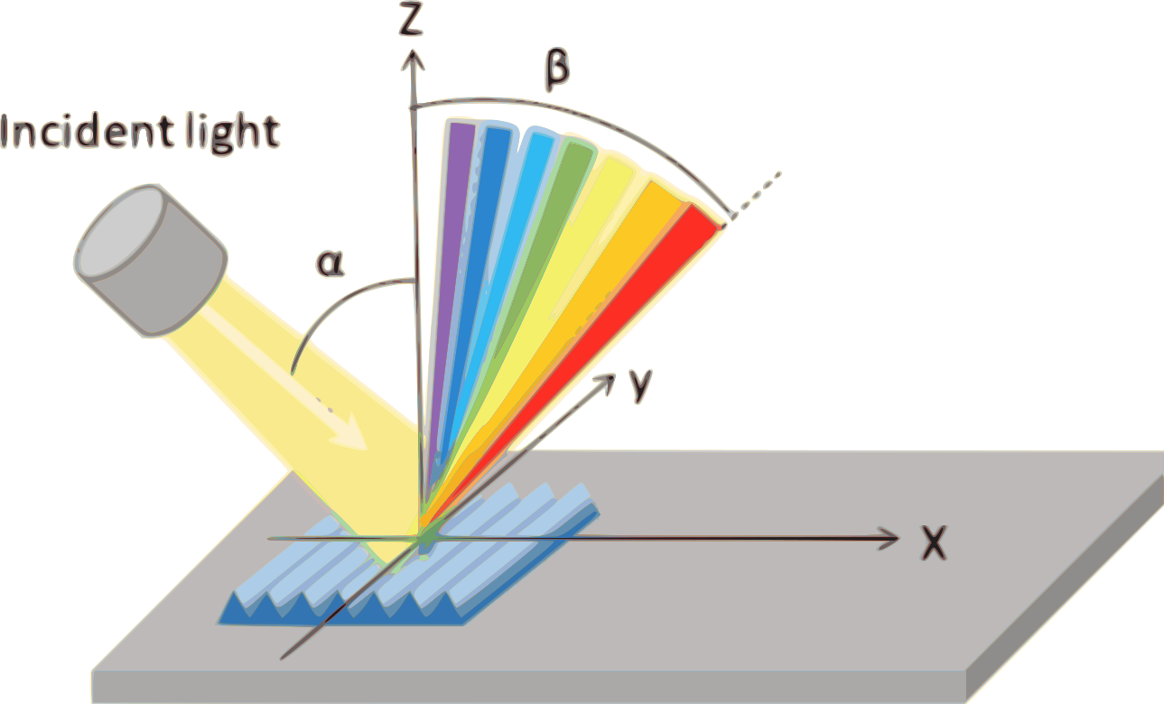
Metal coloration by laser structuring
Rainbow-like colorations are created with periodic surface structures on metal by single-beam laser action.
Coloration controlled by surface electromagnetic wave excitation and by polarized laser irradiation.
Y.M. Andreeva, V.C. Luong, D.S. Lutoshina, O.S. Medvedev, V.Y. Mikhailovskii, M.K. Moskvin, G. V. Odintsova, V. V. Romanov, N.N. Shchedrina, V.P. Veiko, Laser coloration of metals in visual art and design, Opt. Mater. Express. 9 (2019) 1310. https://doi.org/10.1364/OME.9.001310.
Notes:
Metal coloration by la ser structuring of the stainless-steel surface creates rainbow-like coloration with periodic surface structures on metal by single-beam laser action. This technique pretends to achieve the desired coloration by controlling the surface electromagnetic wave excitation and by polarized laser irradiation. Due to the polarized irradiation, the surface coloration depends on the viewing angle
Regardless of the surface modification technique, the smaller the average thickness, particle size or particle distribution; the lower is the wavelength absorbed by the amended surface.

Slide 6

“ […] laser as a brush; metal as a canvas, and
surface structuring as paint.”

Slide 7
References
<reference A>
<reference B>

