Slide 1

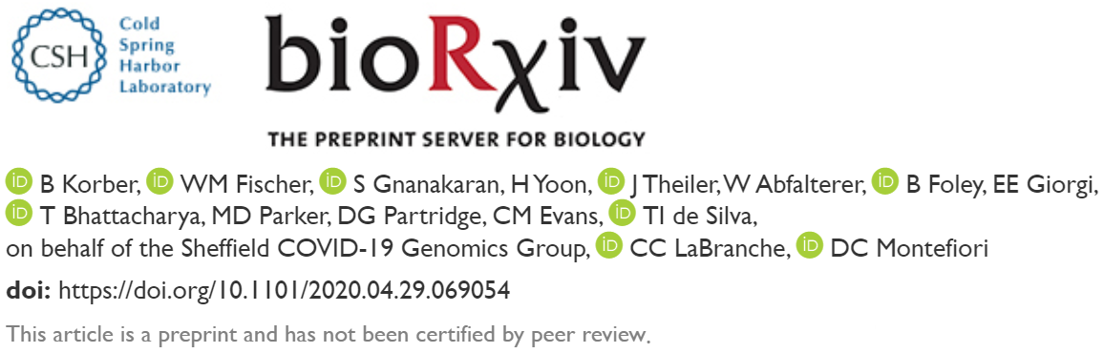
Spike mutation pipeline reveals the emergence of a more transmissible form of SARS-CoV-2
Osamu Katagiri-Tanaka A01212611@itesm.mx
22 May 2020
B. Korber, W. Fischer, S.G. Gnanakaran, H. Yoon, J. Theiler, W. Abfalterer, B. Foley, E.E. Giorgi, T. Bhattacharya, M.D. Parker, D.G. Partridge, C.M. Evans, T. de Silva, C.C. LaBranche, D.C. Montefiori, S.C.-19 G. Group, Spike mutation pipeline reveals the emergence of a more transmissible form of SARS-CoV-2, BioRxiv. (2020) 2020.04.29.069054. https://doi.org/10.1101/2020.04.29.069054.

Slide 2
Agenda
<a point for discussion> : <5min
<another point for discussion> : ~20min

Slide 3
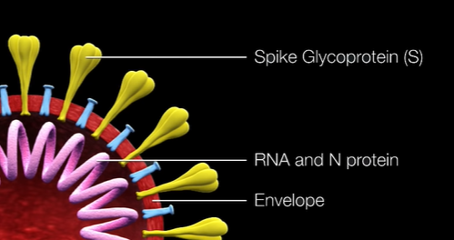
Introduction & Motivation
About 62 candidate SARS-CoV-2 vaccines are currently being explored.[1]
Spike steps in binding and entry into host cells and is a major target of neutralizing antibodies.[2, 3]
Most efforts target the trimeric Spike protein (S) of the virus.[1]
“ […] we felt an urgent need for an “early warning” pipeline to evaluate Spike pandemic evolution.” [4]
[1] WHO, Landscape of COVID-19 candidate vaccines, 2020. https://www.who.int/blueprint/priority-diseases/key-action/Novel_Coronavirus_Landscape_nCoV_11April2020.PDF.
[2] Chen, W.H., Hotez, P.J., and Bottazzi, M.E. (2020). Potential for developing a SARS-CoV receptor-binding domain (RBD) recombinant protein as a heterologous human vaccine against coronavirus infectious disease (COVID)-19. Hum Vaccin Immunother, 1-4.
[3] Yuan, M., Wu, N.C., Zhu, X., Lee, C.-C.D., So, R.T.Y., Lv, H., Mok, C.K.P., and Wilson, I.A. (2020). A highly conserved cryptic epitope in the receptor-binding domains of SARS-CoV-2 and SARS-CoV. Science, eabb7269.
[4] B. Korber, W. Fischer, S.G. Gnanakaran, H. Yoon, J. Theiler, W. Abfalterer, B. Foley, E.E. Giorgi, T. Bhattacharya, M.D. Parker, D.G. Partridge, C.M. Evans, T. de Silva, C.C. LaBranche, D.C. Montefiori, S.C.-19 G. Group, Spike mutation pipeline reveals the emergence of a more transmissible form of SARS-CoV-2, BioRxiv. (2020) 2020.04.29.069054. https://doi.org/10.1101/2020.04.29.069054.

Slide 4
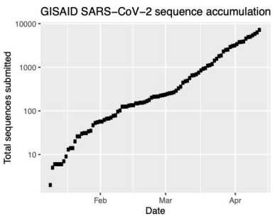
Paper overview
The authors turned their efforts to track the evolution of the SARS-CoV-2 Spike (S) protein in the COVID-19 pandemic, using the Global Initiative for Sharing All Influenza Data GISAID SARS-CoV-2 sequence database.[1]
Fetch daily GISAID data (~10000 sequences) Discard partial and problematic sequences
Trim jagged ends
Codon Block-based nucleotide
multiple sequence alignment
Monitor Spike mutational frequencies over time
https://github.com/jts/nanopolish
[1] B. Korber, W. Fischer, S.G. Gnanakaran, H. Yoon, J. Theiler, W. Abfalterer, B. Foley, E.E. Giorgi, T. Bhattacharya, M.D. Parker, D.G. Partridge, C.M. Evans, T. de Silva, C.C. LaBranche, D.C. Montefiori, S.C.-19 G. Group, Spike mutation pipeline reveals the emergence of a more transmissible form of SARS-CoV-2, BioRxiv. (2020) 2020.04.29.069054. https://doi.org/10.1101/2020.04.29.069054.

Slide 5
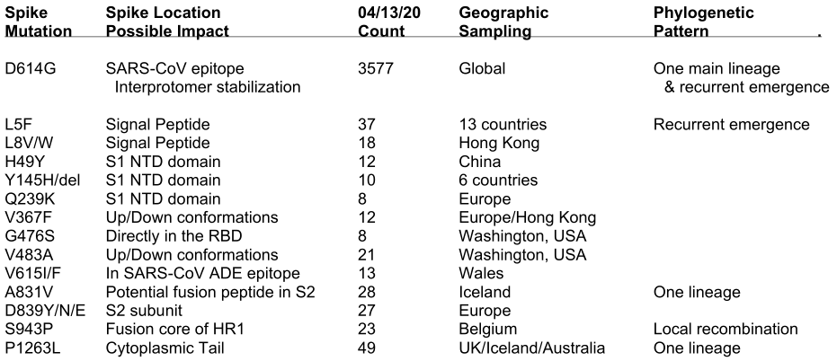
Table 1. Table summarizing the mutations we are following in Spike.[1]
[1] B. Korber, W. Fischer, S.G. Gnanakaran, H. Yoon, J. Theiler, W. Abfalterer, B. Foley, E.E. Giorgi, T. Bhattacharya, M.D. Parker, D.G. Partridge, C.M. Evans, T. de Silva, C.C. LaBranche, D.C. Montefiori, S.C.-19 G. Group, Spike mutation pipeline reveals the emergence of a more transmissible form of SARS-CoV-2, BioRxiv. (2020) 2020.04.29.069054. https://doi.org/10.1101/2020.04.29.069054.

Slide 6
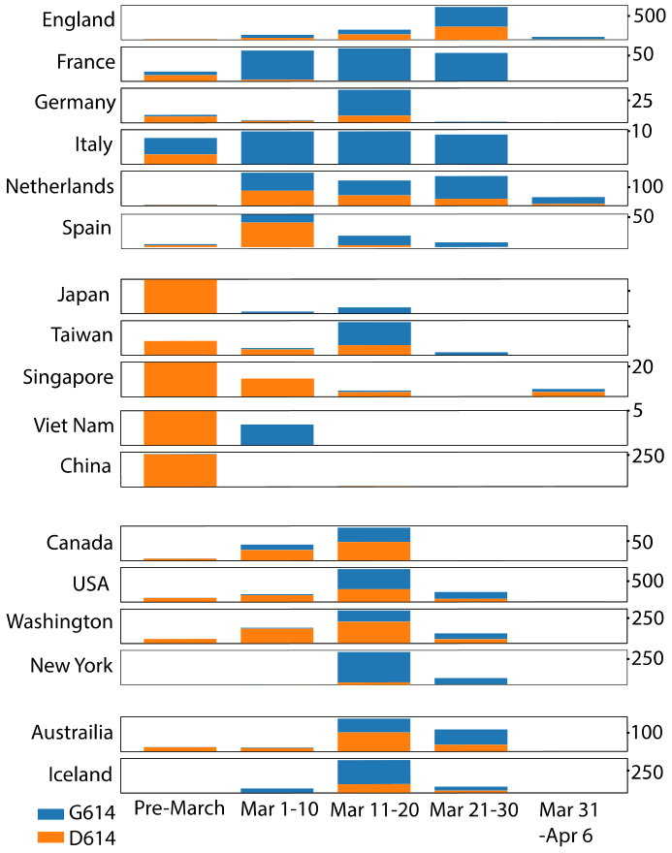
Fig. S2. The increasing frequency of the D614G mutation over time
D614G is a G-to-A base change @position 23,403
The seven first D614G strains (Pre-March) were sampled in Europe, and one each in Mexico, Brazil, and in Wuhan
GISAID showed that G614’s frequency was increasing with geographic spread

Slide 7
Transmissibility study[1]
Since clinical outcome data was not available in GISAID, authors generated sequences from 453 individuals with COVID-19 at Sheffield Teaching Hospital in England
data included:
age, gender, date of sampling, and
clinical status:
outpatient (OP),
inpatient (IP), or
admittance into the intensive care unit (ICU)
Takeaway:
D614G is more infectious, but does not predict hospitalization
[1] B. Korber, W. Fischer, S.G. Gnanakaran, H. Yoon, J. Theiler, W. Abfalterer, B. Foley, E.E. Giorgi, T. Bhattacharya, M.D. Parker, D.G. Partridge, C.M. Evans, T. de Silva, C.C. LaBranche, D.C. Montefiori, S.C.-19 G. Group, Spike mutation pipeline reveals the emergence of a more transmissible form of SARS-CoV-2, BioRxiv. (2020) 2020.04.29.069054. https://doi.org/10.1101/2020.04.29.069054.

Slide 8

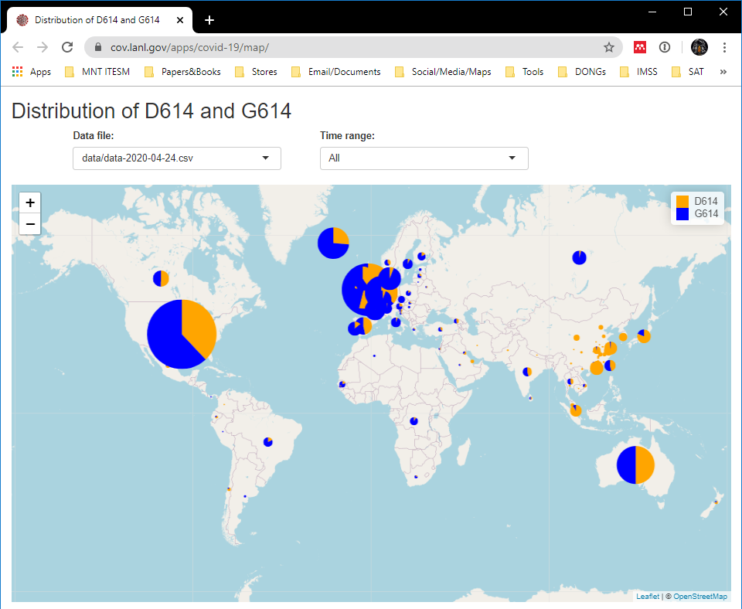

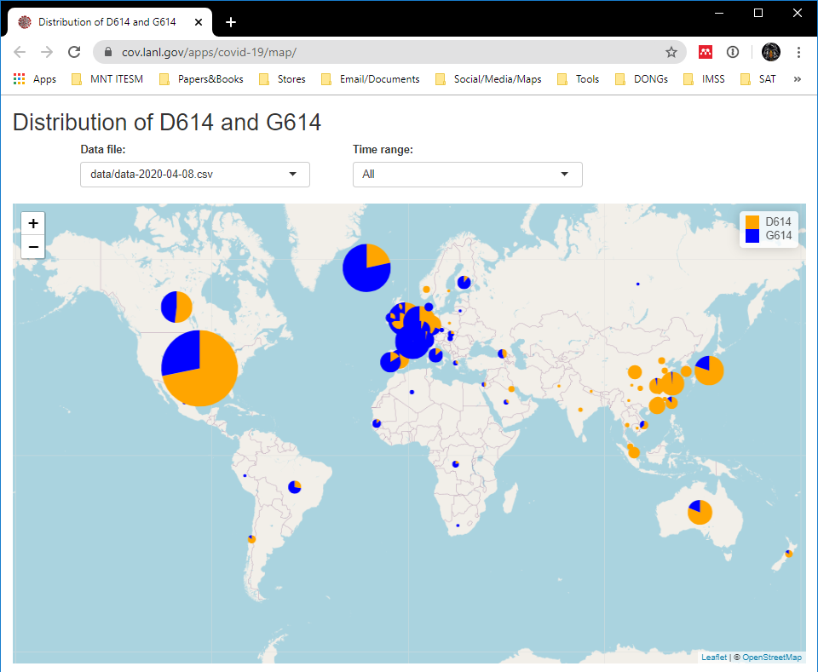

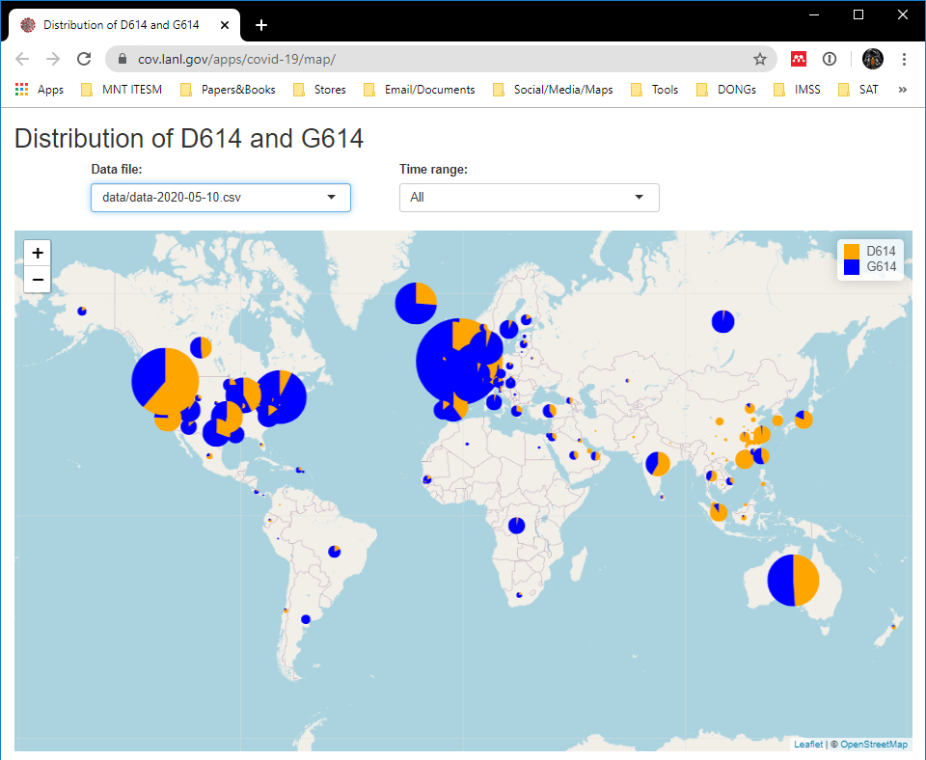
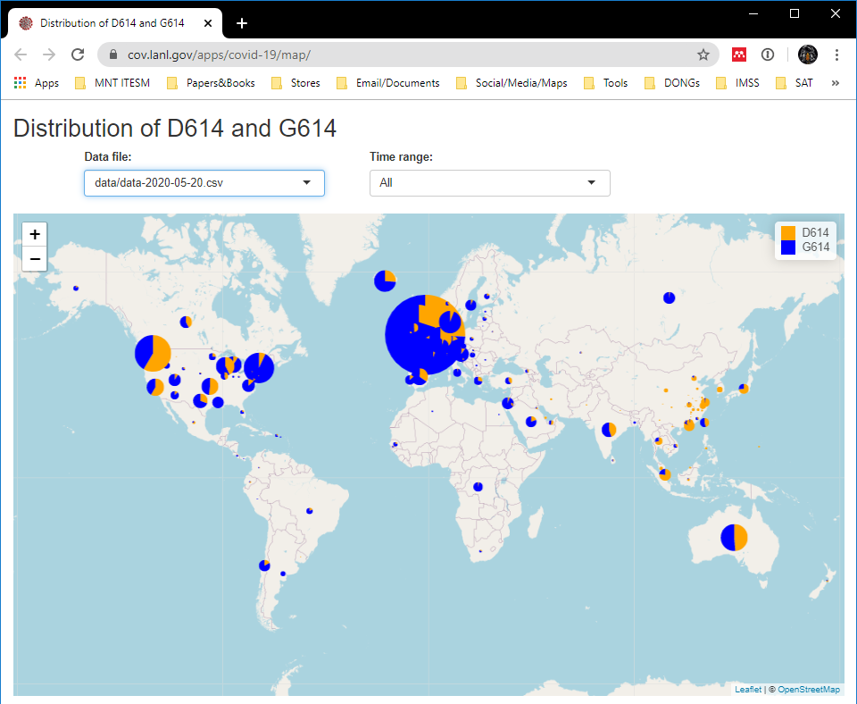
https://cov.lanl.gov/apps/covid-19/map/

Slide 9
Conclusions:
The mutation Spike D614G is replacing the original Wuhan form of the virus across the globe
The D614G mutation improves
receptor binding
fusion activation, and
Neutralization of antibody sensitivity.
Individuals susceptible to a second infection

Slide 10



Slide 11
References
<reference A>
<reference B>

