Slide 1

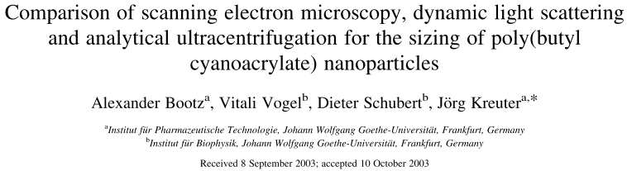
Dynamic Light Scattering <paper review>
Osamu Katagiri-Tanaka A01212611@itesm.mx
7 May, 2020

Slide 2
Agenda
<a point for discussion> : <5min
<another point for discussion> : ~20min

Slide 3
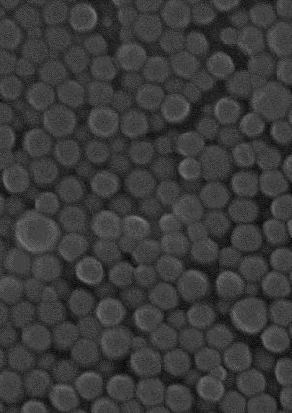
Three different methods were used to determine the size and size distribution of PBCA nanoparticles (nanoparticles formed by anionic emulsion polymerization of butylcyanoacrylate in the presence of poloxamer 188 as a stabilizer).
 | scanning electron microscopy SEM | dynamic light scattering DLS | analytical ultracentrifugation AUC
Particle diameter | 167 nm | 199 nm | 184 nm
advantages | detailed shape and morphological information | short time and low cost | measurements can be obtained at low particle concentrations
 |  | the movement of particles in a centrifuge (ANUC) shows a stronger size dependence than the diffusion coefficient (DLS)
disadvantages | risk of changes in particle properties during drying and contrasting | measurement will be identical or ~larger than the ‘real’ particle | sedimentation of nanoparticles shall be slow enough to obtain sufficient data points
A. Bootz, V. Vogel, D. Schubert, J. Kreuter, Comparison of scanning electron microscopy, dynamic light scattering and analytical ultracentrifugation for the sizing of poly(butyl cyanoacrylate) nanoparticles, Eur. J. Pharm. Biopharm. 57 (2004) 369–375. https://doi.org/10.1016/S0939-6411(03)00193-0.

Slide 4
Conclusions:
<Conclusion A>
<Conclusion B>

Slide 5


Slide 6
References
<reference A>
<reference B>

