Slide 1

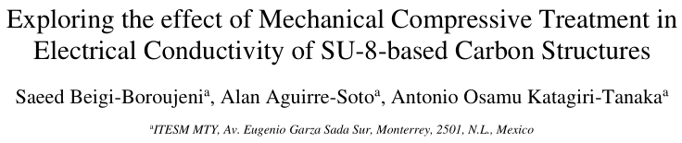
19 May 2020

Slide 2
Agenda
<a point for discussion> : <5min
<another point for discussion> : ~20min

Slide 3
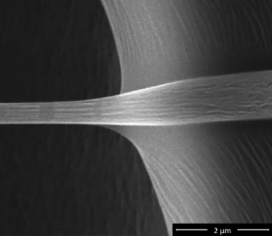
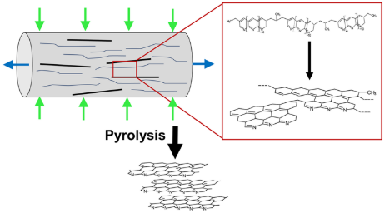
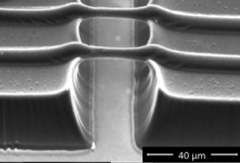
Enhancement of the electrochemical properties of SU-8 based structures
Increasing the graphitization and molecular alignment in a polymer precursor with electrohydrodynamic forces (aka. electrospinning) [1]
The shrinkage and elongation of suspended SU-8 fibers during pyrolysis enhances the resulting electrical properties [2]
[1] M. Ghazinejad, S. Holmberg, O. Pilloni, L. Oropeza-Ramos, M. Madou, Graphitizing Non-graphitizable Carbons by Stress-induced Routes, Sci. Rep. 7 (2017) 16551. https://doi.org/10.1038/s41598-017-16424-z.
[2] G. Canton, T. Do, L. Kulinsky, M. Madou, Improved conductivity of suspended carbon fibers through integration of C-MEMS and Electro-Mechanical Spinning technologies, Carbon N. Y. 71 (2014) 338–342. https://doi.org/10.1016/j.carbon.2014.01.009.

Slide 4
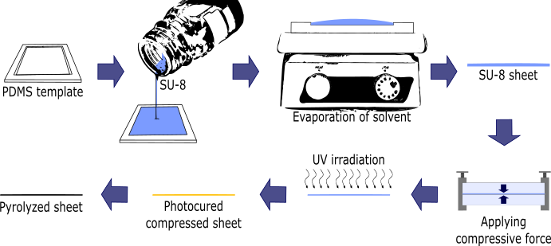
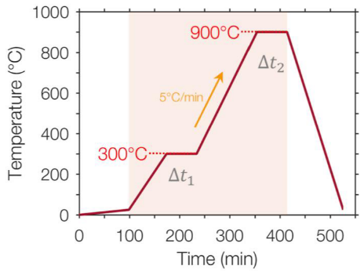
Methods
75°C for 4h
under N2 atmosphere
for 50sec (300W)
20KN for 30min

Slide 5
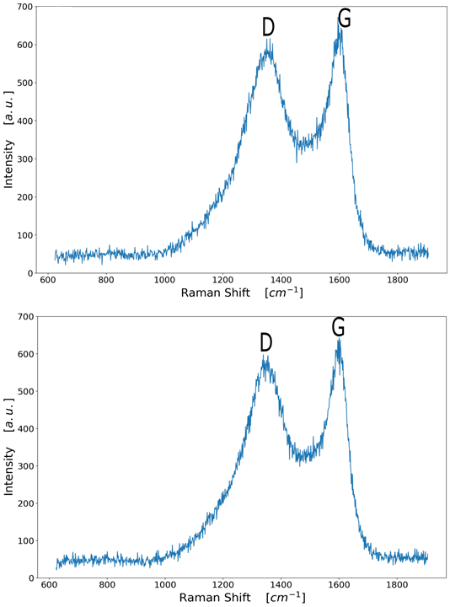
Characterization: Raman Spec
Control Sample
Compressed Sample
.
The higher the D to G ratio is related to the lower alignment of graphitic planes
Y.M. Hassan, C. Caviglia, S. Hemanth, D.M.A. Mackenzie, T.S. Alstrøm, D.H. Petersen, S.S. Keller, High temperature SU-8 pyrolysis for fabrication of carbon electrodes, J. Anal. Appl. Pyrolysis. 125 (2017) 91–99. https://doi.org/10.1016/j.jaap.2017.04.015.
Notes:
D:1367cm⁻¹: corresponds to the disorder structure
G:1606cm⁻¹: stretching motion of the sp²-hybridized carbon-carbon bond

Slide 6
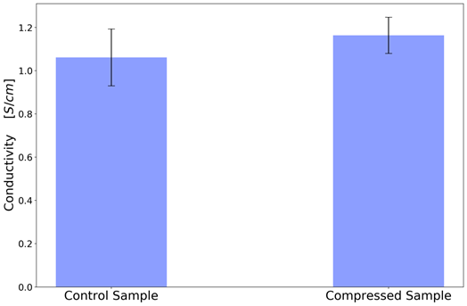
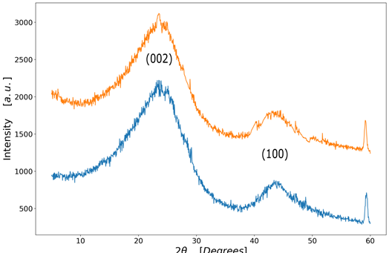
Characterization
4-wire Kelvin
X-ray diffraction
Compressed Sample
Control Sample
The broad band at 22° and 55 are related to (002) plane and (100) plane respectively
S. Mamidi, M. Kakunuri, C.S. Sharma, Fabrication of SU-8 Derived Three-Dimensional Carbon Microelectrodes as High Capacity Anodes for Lithium-Ion Batteries, ECS Trans. 85 (2018) 21–27. https://doi.org/10.1149/08501.0021ecst.

Slide 7
Conclusions:
<Conclusion A>
<Conclusion B>

Slide 8


Slide 9
References
<reference A>
<reference B>

Slide 10
