Slide 1

Garden Gem Final Project
Bruno Gonzalez Soria - (CEM) A01169284@itesm.mx
Antonio Osamu Katagiri Tanaka - (CEM) A01212611@itesm.mx
Carlos Cardoso Isidoro - (CEM) A01750267@itesm.mx
05 May 2019

Slide 2
Agenda
Problem & Work Context : <2min
Objectives : ~1min
Results : ~3min
Conclusions & Further Work : ~2min

Slide 3
Problem & Work Context
Urban agriculture is performed under specific conditions that require technologies different to those used in the rural context. Such specific conditions include among others:
Limited availability of space and the high price of urban land, proximity to large numbers of people (and thus a need for safe production methods),
use of urban resources (organic waste and wastewater), and
possibilities for direct producer-consumer contacts.
Food policies require training citizens about new lifestyles

Slide 4
Objectives
Help urban gardeners in order to assist them in the correct development and maintenance of their urban gardens.
Economical goal: For the average citizen, growing vegetables locally saves money and selling the produce (fresh or processed) brings in resources.
Social goal: Urban agriculture play an important role for poverty alleviation and social integration.​
Environmental goal: Urban agriculture enhances the diversity and distribution of food products through processes that reuse resources​

Slide 5
Results
Development of the mobile application
The app is able record data about growing plants in order to monitor the growing conditions and make the plants grow better, and identify potential issues during the growing process.
Concentrating in the three pillars of sustainability

Slide 6
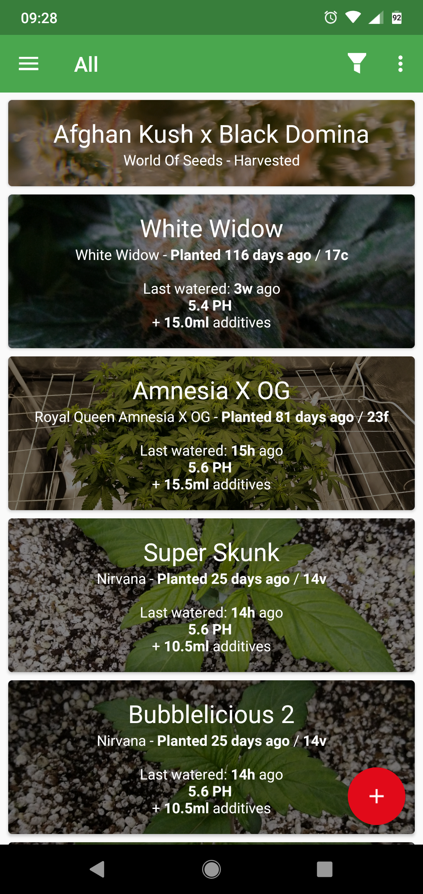
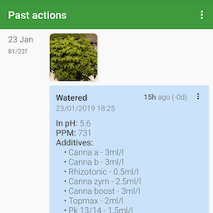
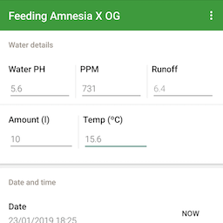
Results (continued)

Slide 7
Conclusions & Further Work
A growing number of cities are designing policies and programmes on urban agriculture
Urban agriculture has the potential to become a dynamic economic sector that quickly adapts to changing urban conditions and demands
The sustainability of urban agriculture is closely related to its contributions to the development of a sustainable and resilient city that is socially inclusive, food-secure, productive and environmentally-healthy.
Another related project that represents an important ally is OpenAg Initiative of the MIT with a Personal Food Computer (PFC)
Legal advice and permits will be required for public gardens

Slide 8

Q&A

Slide 9
References
Barthel, S., Parker, J., & Ernstson, H. (2015). Food and Green Space in Cities: A Resilience Lens on Gardens and Urban Environmental Movements. Urban Studies, 52(7), 1321–1338. https://doi.org/10.1177/0042098012472744​
Broadway, M. (2009). American Cities : The Example of Milwaukee by. New York.​
Calvet-Mir, L., & March, H. (2019). Crisis and post-crisis urban gardening initiatives from a Southern European perspective: The case of Barcelona. European Urban and Regional Studies, 26(1), 97–112. https://doi.org/10.1177/0969776417736098​
Certomà, C. (2015). Expanding the ‘dark side of planning’: Governmentality and biopolitics in urban garden planning. Planning Theory, 14(1), 23–43. https://doi.org/10.1177/1473095213506202​
Sandrini, S., & Cabini, E. (2014). Multi-subject training for a sustainable farming and food system. Education Sciences & Society, 5(1), 83–92. Retrieved from https://bit.ly/2SXzLcQ​
Trefle, the plants API. (2019). Retrieved from https://trefle.io/reference

