Slide 1

Effect of peroxides in controlled-rheology polypropylene (CRPP)
Osamu Katagiri-Tanaka - A01212611@itesm.mx
Juan Jesús Rocha-Cuervo - A01752555@itesm.mx
Angel Villalba-Rodríguez - A00828035@itesm.mx
Constanza Álvarez-López – A00829469@itesm.mmx
17 Jul 2020

Slide 2

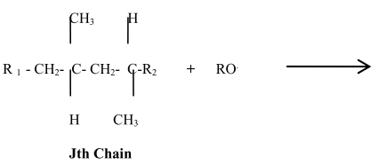
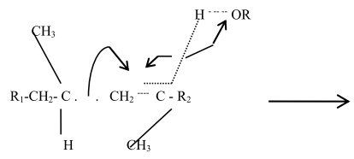
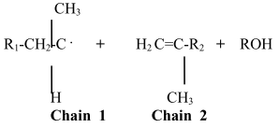
Effect of peroxides in controlled-rheology polypropylene (CRPP)
1) the PP resin / peroxide mixture creates radicals
2) the radicals attack the polymeric chains
J. Bonilla-rios, R. Darby, J. M. Sosa, A STOCHASTIC MODEL FOR THE PREDICTION OF THE MOLECULAR WEIGHT DISTRIBUTION OF (CONTROLLED RHEOLOGY) PEROXIDE DEGRADED POLYPROPYLENE, in: ANTEC 95, Annual Technical Conference of the Society of Plastics Engineers, 1995: pp. 1630–1634.
Notes:
In short, high peroxide concentrations accelerate creepness and harm recovery.

Slide 3
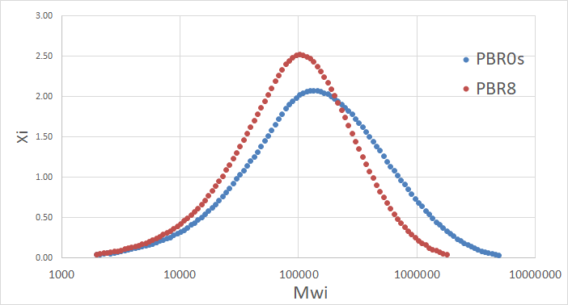
3) the increase of the number of broken chains:
a) decreases the average molecular weight (Mw), and
b) narrows the MWD.
CRPP
PP
Notes:
In short, high peroxide concentrations accelerate creepness and harm recovery.

Slide 4
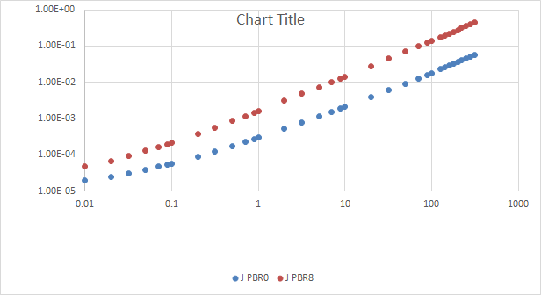
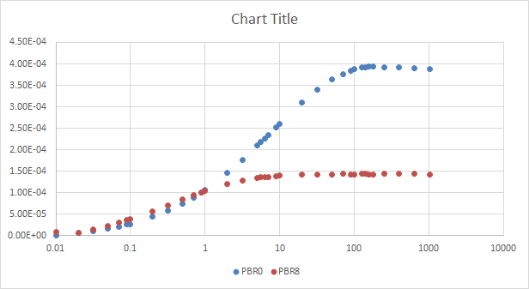
4) which, increases the MFI.
5) Furthermore, the new material will creep faster, and
6) will NOT recover as well as the starting material.
CRPP
PP
PP
CRPP
* In short, high peroxide concentrations accelerate creep-ness and harm recovery.
Notes:
In short, high peroxide concentrations accelerate creepness and harm recovery.

Slide 5
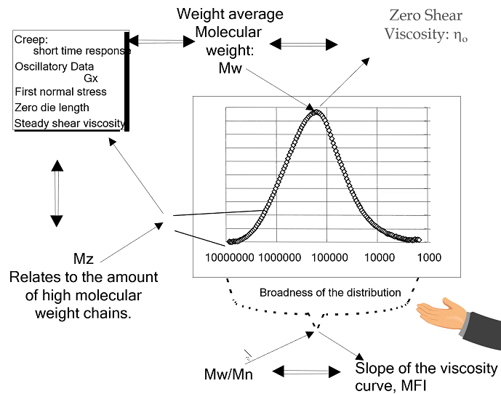
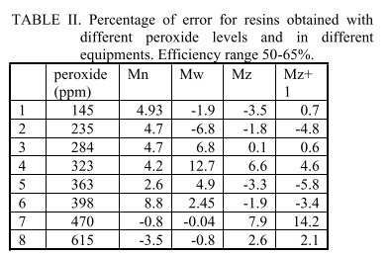
The model to calculate the amount of peroxide shall include the initial and final values of Mn, Mw and Mz, as well as the peroxide efficiency.
J. Bonilla-rios, R. Darby, J. M. Sosa, A STOCHASTIC MODEL FOR THE PREDICTION OF THE MOLECULAR WEIGHT DISTRIBUTION OF (CONTROLLED RHEOLOGY) PEROXIDE DEGRADED POLYPROPYLENE, in: ANTEC 95, Annual Technical Conference of the Society of Plastics Engineers, 1995: pp. 1630–1634.
Notes:
Mn – number of chains of a given weight
Mw – amount of mass per chain
Mz -

