Slide 1

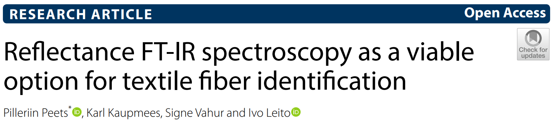
FTIR <paper review>
Antonio Osamu Katagiri Tanaka A01212611@itesm.mx
05 Mar 2020

Slide 2
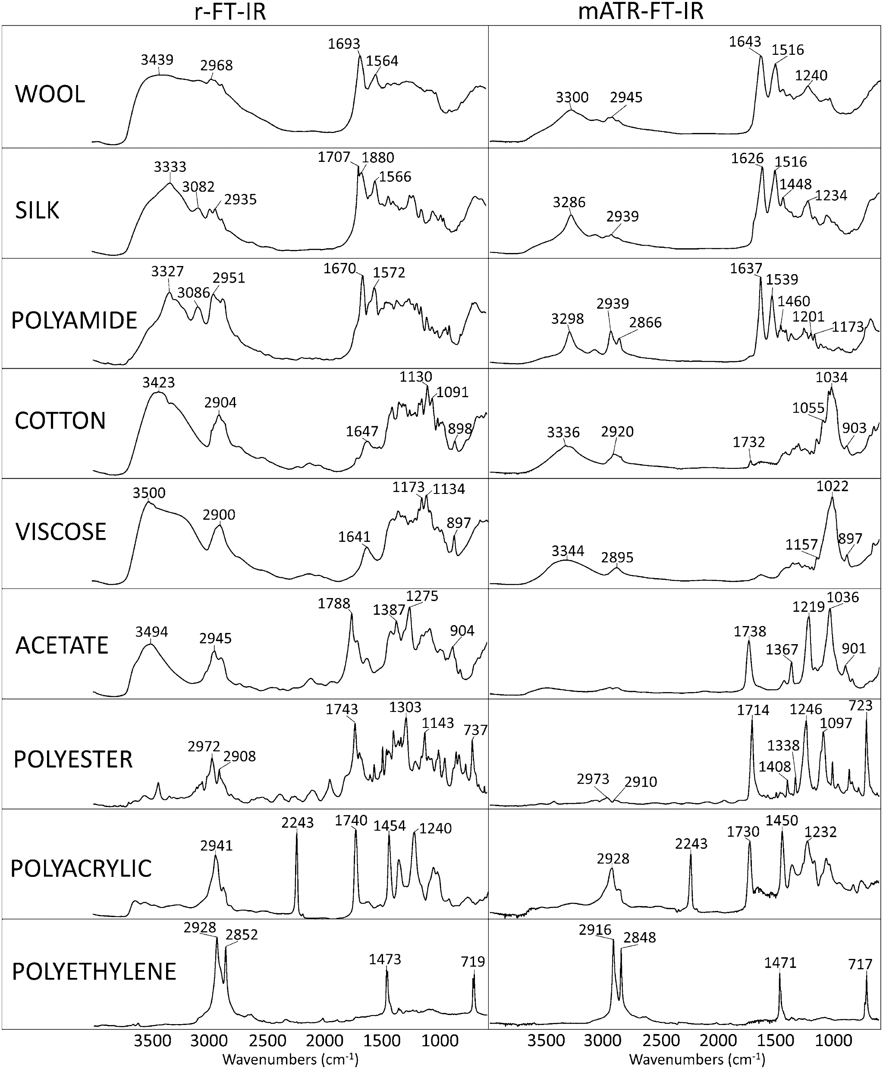
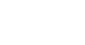
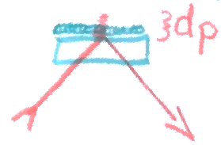
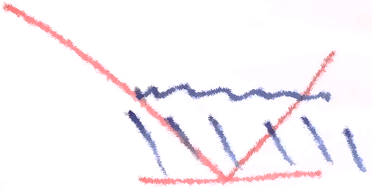
The r-FTIR vs. ATR-FTIR spectrum comparison revealed general similarity with small variations.
In general, the absorbance bands in r-FTIR are wider, with wave numbers shifted
to higher values from the ATR-FTIR equivalents.
ATR-FTIR
r-FTIR
r-FTIR works better than ATR-FTIR in the identification of polyamide-based
fibers, but it’s less successful in differentiating cellulose-based fibers.

