Slide 1

3 SARS-CoV-2/COVID-19 papers
Osamu Katagiri-Tanaka A01212611@itesm.mx
15 May 2020

Slide 2
Agenda
<a point for discussion> : <5min
<another point for discussion> : ~20min

Slide 3
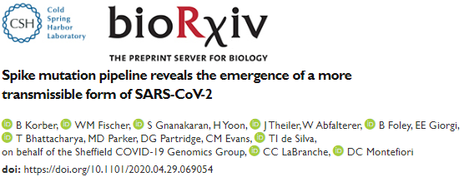
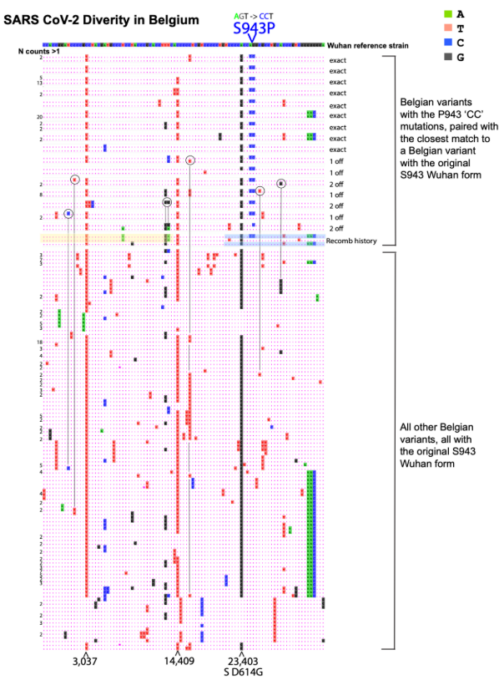
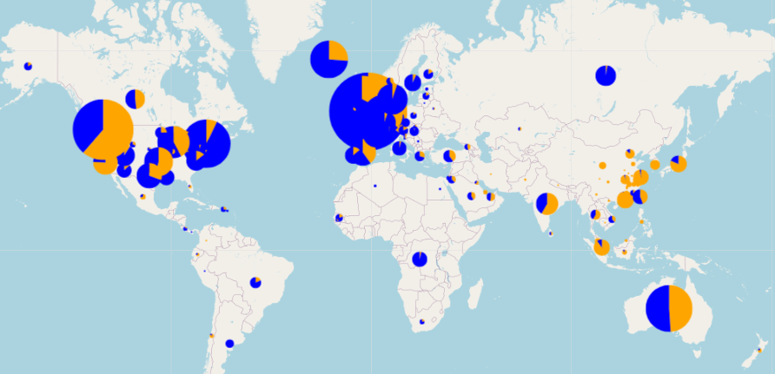

Korber, Bette : Total citations 31512 by 16445 documents : h-index: 99
April 30
Distribution of D614 and G614 mutations - 10May2020

Slide 4
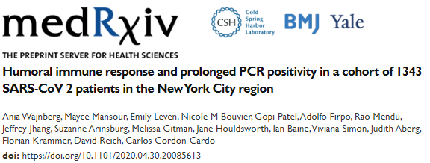

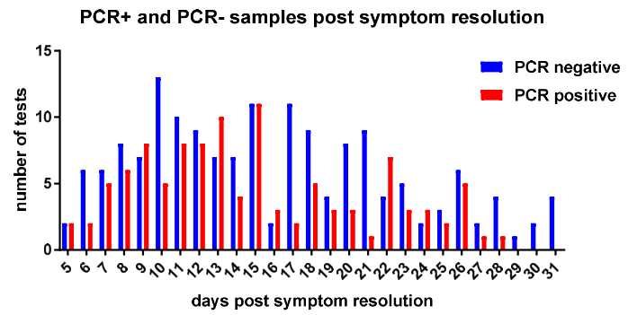
Wajnberg, Ania : Total citations 158 by 152 documents : h-index: 6
May 05

Slide 5
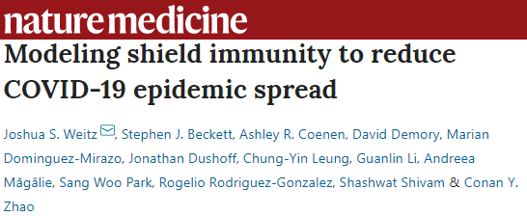
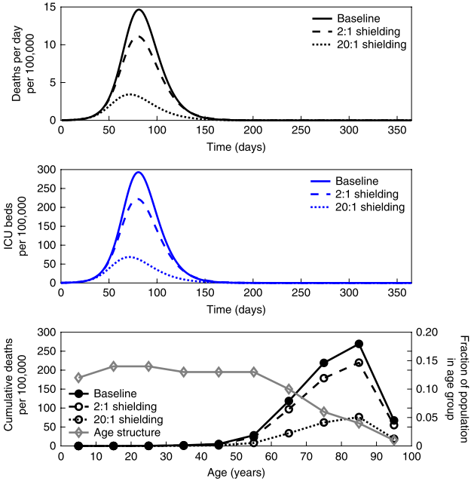
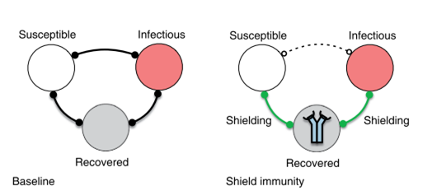
Weitz, Joshua S. : Total citations 4406 by 3460 documents : h-index: 40
May 07

Slide 6
Conclusions:
<Conclusion A>
<Conclusion B>

Slide 7
1
2
3

Slide 8
References
<reference A>
<reference B>

Slide 9
<content> <key concept>

