Slide 1

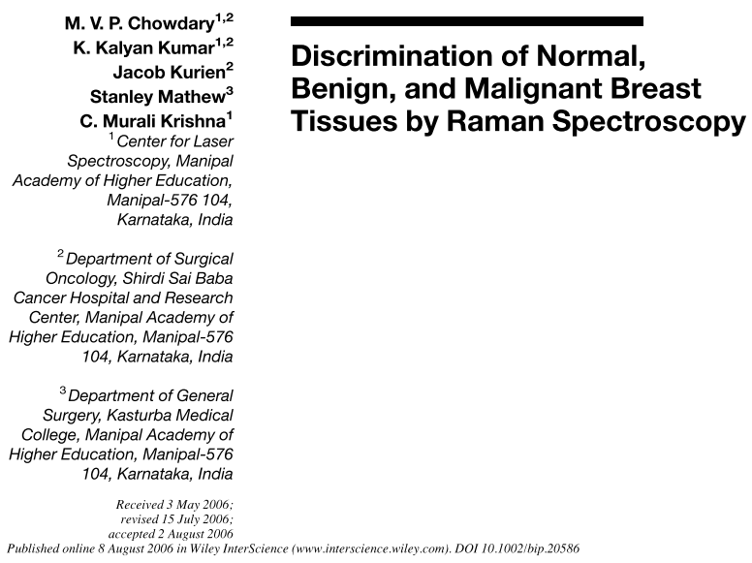
Raman Spectroscopy <paper review>
Antonio Osamu Katagiri Tanaka A01212611@itesm.mx
13 Mar 2020

Slide 2
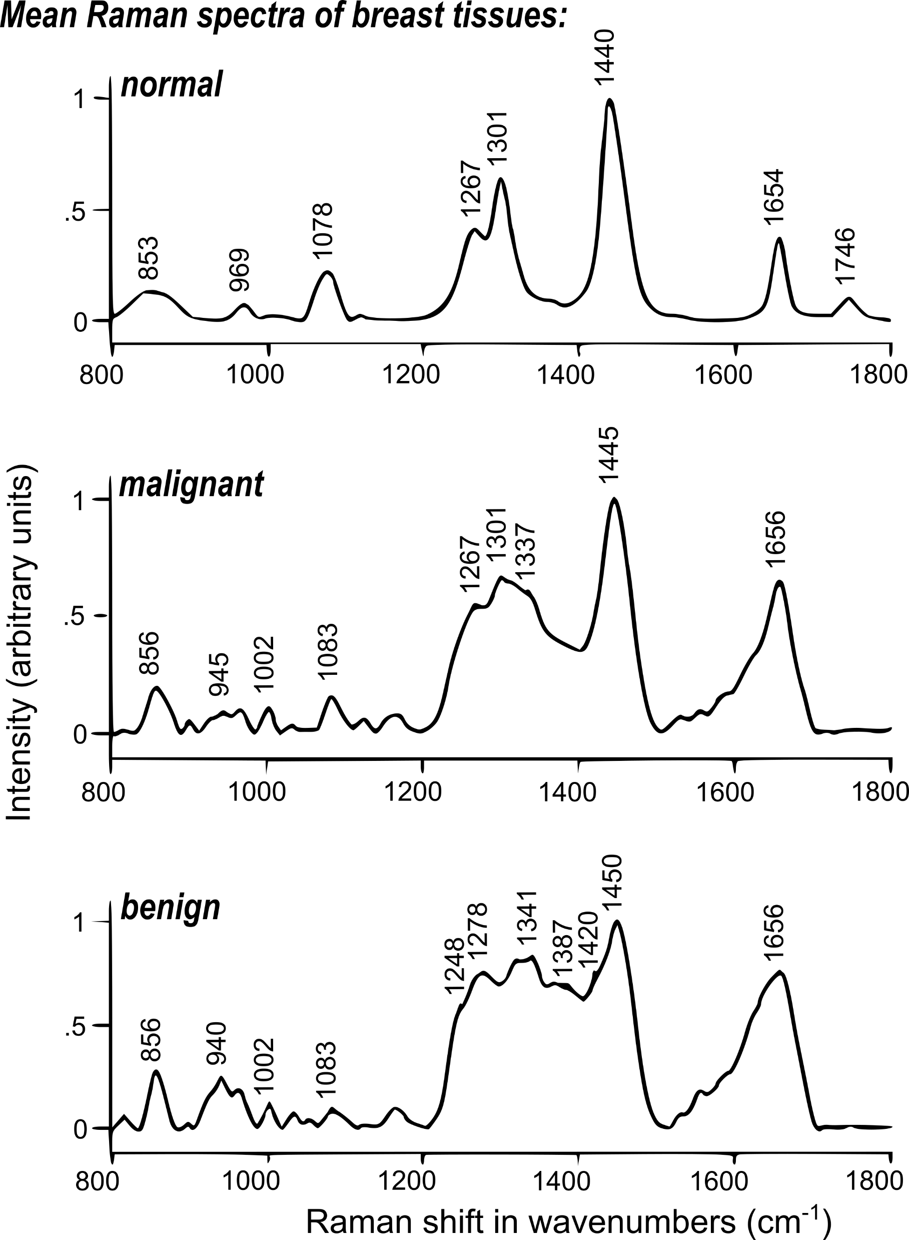
The spectral profile of normal tissues is indicative of higher levels of lipids (1078, 1267, 1301, 1440, 1654, 1746 cm–1). In comparison, the spectral profile of pathological tissues, both benign and malignant, indicates the presence of more proteins (amide I, red shifted DCH2, and amide III, 1002, 1083, 1656 cm–1) and fewer lipids.
Further, among the pathological tissues, malignant tissue contains relatively more lipids (1301 cm–1) in comparison to benign tissue.
A total of 258 spectra (105 normal, 101 malignant, 52 benign) from 29 normal, 24 malignant, and 7 benign subjects were studied in the study

