Slide 1

Leharne, S. (2017). The physical chemistry of high-sensitivity differential scanning calorimetry of biopolymers. ChemTexts, 3(1), 1–12.
Angel Manuel Villalba Rodríguez A00828035@itesm.mx
Antonio Osamu Katagiri Tanaka A01212611@itesm.mx
Jose Ivan Aviles Castrillo A01749804@itesm.mx
29 Oct 2019

Slide 2



Figure 7a:
Full process & source code
Fitting
parameters

Slide 3
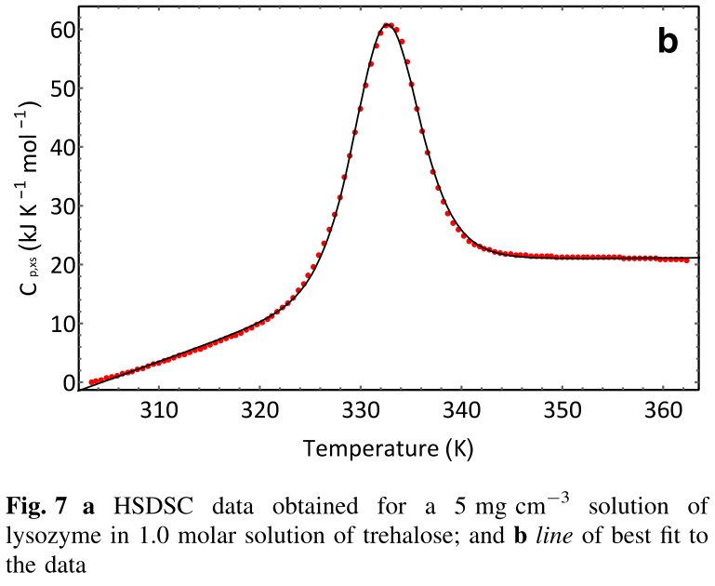
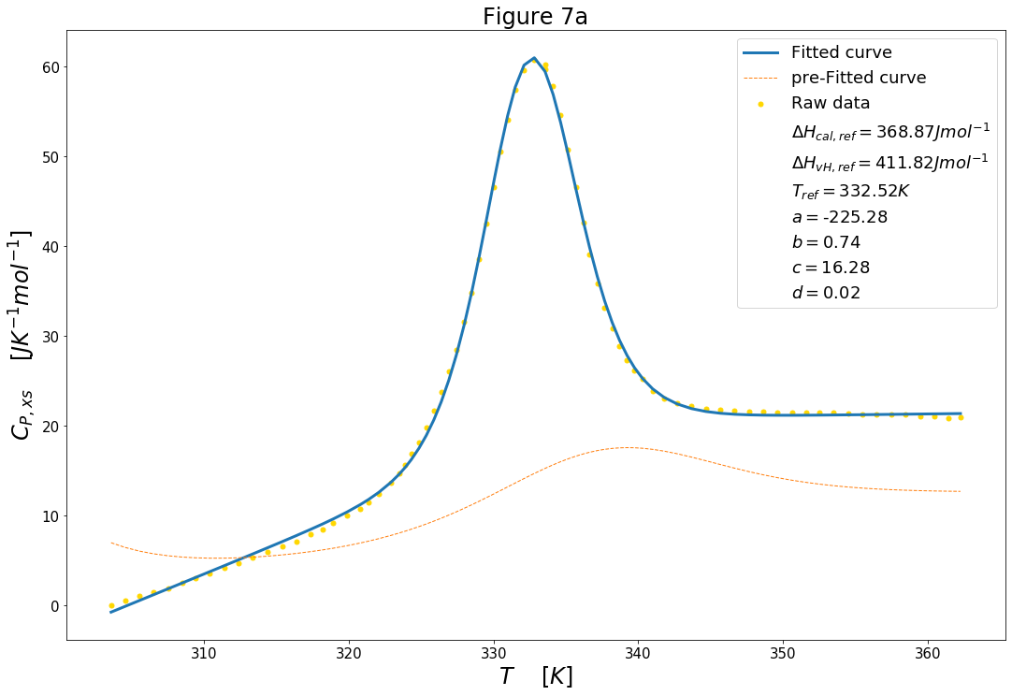
Figure 7a:

Slide 4
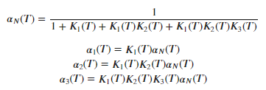


Figure 11:
Full process & source code
Fitting
parameters

Slide 5
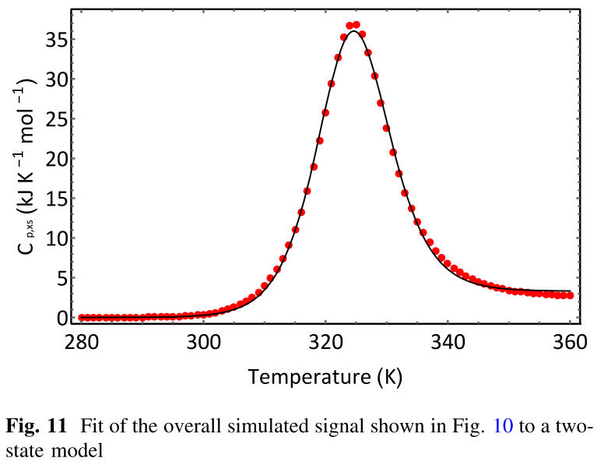
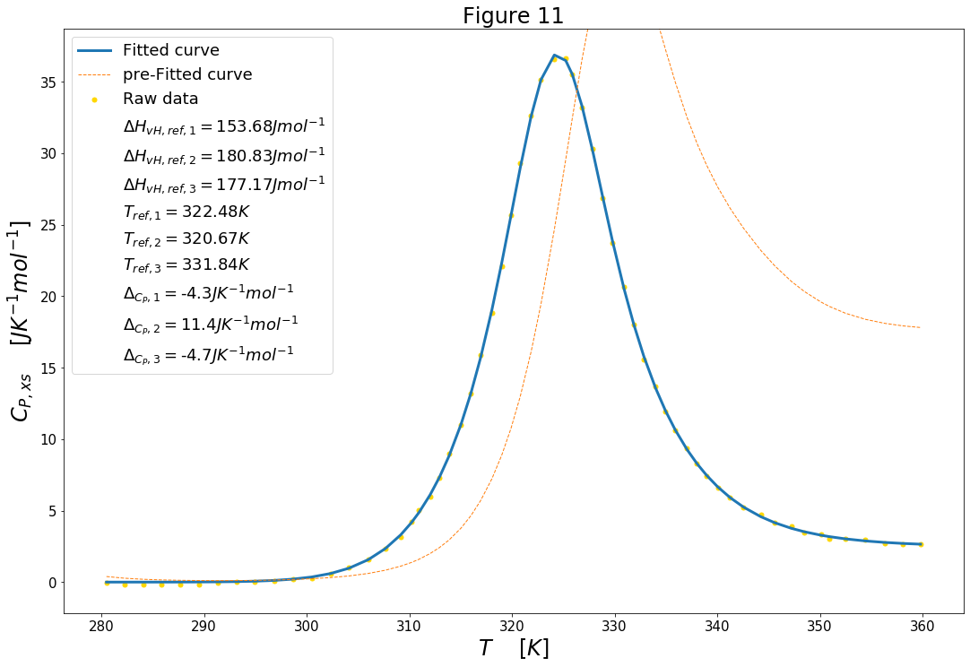
Figure 11:

Slide 6

Q&A

Slide 7





Figure 1:
Full process & source code
Fitting
parameters

Slide 8
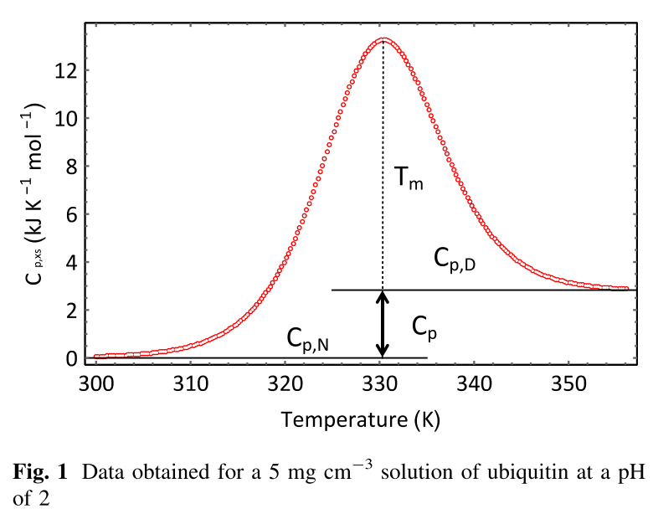
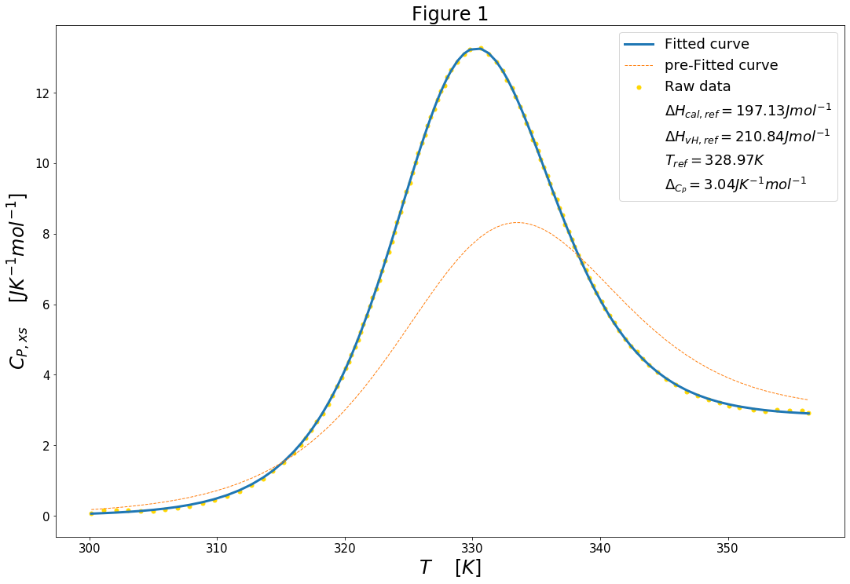
Figure 1:

Slide 9
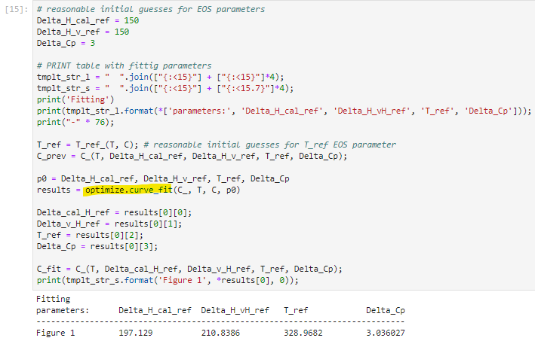
Optimize.curve_fit (from Scipy lib):

Slide 10
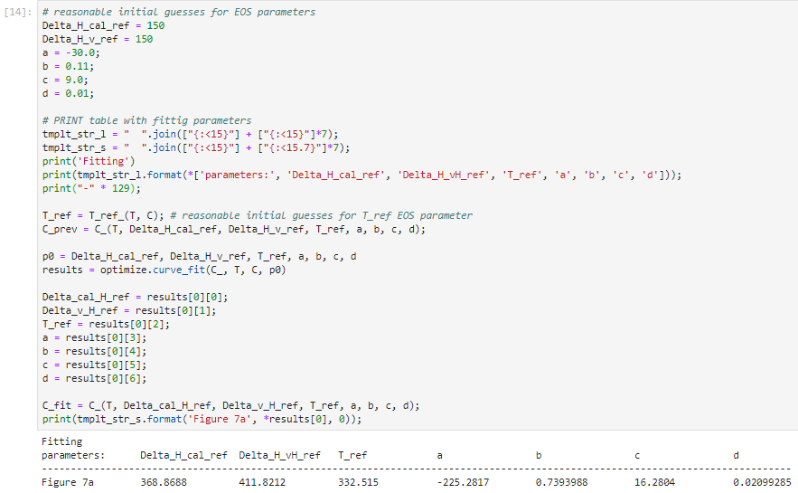
Optimize.curve_fit (from Scipy lib):

Slide 11
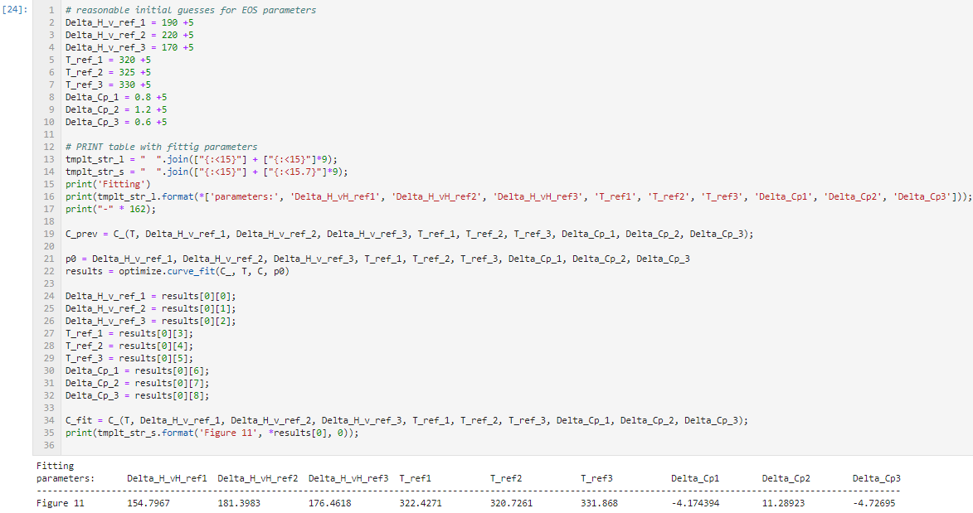
Optimize.curve_fit (from Scipy lib):

Slide 12
References
Leharne, S. (2017). The physical chemistry of high-sensitivity differential scanning calorimetry of biopolymers. ChemTexts, 3(1), 1–12. https://doi.org/10.1007/s40828-016-0038-0

