Slide 1

Garden Gem Final Project
Bruno Gonzalez Soria - (CEM) A01169284@itesm.mx
Antonio Osamu Katagiri Tanaka - (CEM) A01212611@itesm.mx
Carlos Cardoso Isidoro - (CEM) A01750267@itesm.mx
05 May 2019

Slide 2
Agenda
Problem & Work Context : <2min
Objectives : ~1min
Results : ~3min
Conclusions & Further Work : ~2min

Slide 3
Problem & Work Context
At least 55% of word's population lives in urban areas
Urban areas consume ±80% of all food produced
60% of irrigated and 35% of rainfed croplands are within 20Km from these areas
1/3 of all food is lost into waste
Food expenditure represents up to 2/3 of total household in low-income countries
Urban agriculture is performed under specific conditions:
Limited availability of space and the high price of urban land, proximity to large numbers of people (and thus a need for safe production methods),
use of urban resources (organic waste and wastewater), and
possibilities for direct producer-consumer contacts.
Food policies require training citizens about new lifestyles

Slide 4
Objectives
GardenGem’s purpose is to be a tool for urban gardeners, researchers and citizens for appropiate food education and practical urban agriculture.
GardenGem is a mobile application that will help urban gardeners by assisting them in the correct development and maintenance of their urban gardens.
Economical goal: To enable the average citizen, and local community to grow vegetables locally in order to save money and create a possible source of income.
Social goal: To promote social integration and combat poverty by the creation of urban garden communities based on participation.
Environmental goal: To enhance the diversity and distribution of food products through processes that reuse resources in a sustainable and local way.

Slide 5
Results
Development of the mobile application
The app is able record data about growing plants in order to monitor the growing conditions and make the plants grow better, and identify potential issues during the growing process.
The concept behind this application is concentrated in the three pillars of sustainability as established in its goals, although more development is still needed for the complete fulfillment of these goals.
Surveys made to validate the app, its concept and the future steps have shown outstanding possitive results that demonstrate the need and interest of the community in this product. More than 60% were already considering urban gardens.
Received above 95% approval!

Slide 6
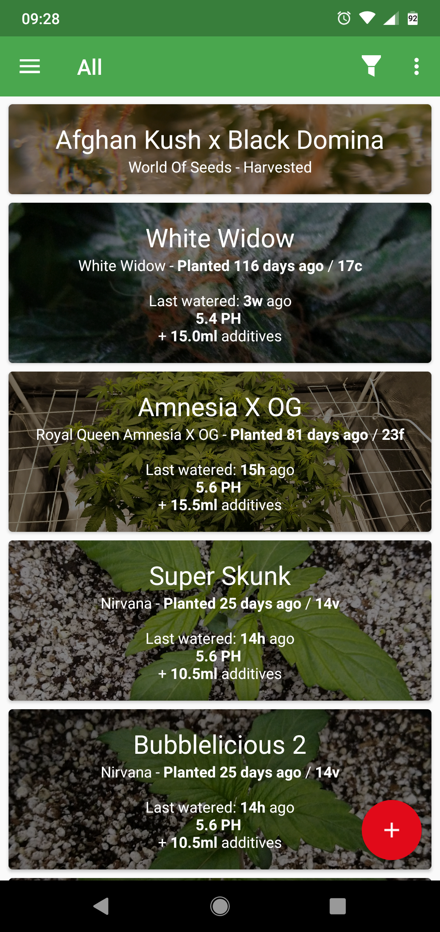
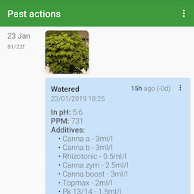
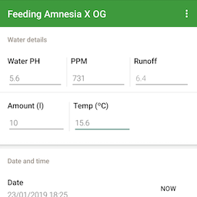
Results (continued)

Slide 7
Conclusions & Further Work
A growing number of cities are designing policies and programmes on urban agriculture
Urban agriculture has the potential to become a dynamic economic sector that quickly adapts to changing urban conditions and demands
The sustainability of urban agriculture is closely related to its contributions to the development of a sustainable and resilient city that is socially inclusive, food-secure, productive and environmentally-healthy.
Another related project that represents an important ally is OpenAg Initiative of the MIT with a Personal Food Computer (PFC)
Legal advice and permits will be required for public gardens

Slide 8

Q&A

Slide 9
Relevant References
Barthel, S., Parker, J., & Ernstson, H. (2015). Food and Green Space in Cities: A Resilience Lens on Gardens and Urban Environmental Movements. Urban Studies, 52(7), 1321–1338. https://doi.org/10.1177/0042098012472744
Broadway, M. (2009). American Cities : The Example of Milwaukee by. New York.
Calvet-Mir, L., & March, H. (2019). Crisis and post-crisis urban gardening initiatives from a Southern European perspective: The case of Barcelona. European Urban and Regional Studies, 26(1), 97–112. https://doi.org/10.1177/0969776417736098
Certomà, C. (2015). Expanding the ‘dark side of planning’: Governmentality and biopolitics in urban garden planning. Planning Theory, 14(1), 23–43. https://doi.org/10.1177/1473095213506202
FAO. (2019). FAO framework for the Urban Food Agenda [Ebook]. Rome: Food and Agriculture Organization of the United Nations (FAO).
FAO - News Article: Urgent action in urban areas, key to achieving Zero Hunger and healthy diets for all. (2019). Retrieved from http://www.fao.org/news/story/en/item/1184269/icode/
pfc_edu_3.0 [OpenAg]. (2019). Retrieved from https://wiki.openag.media.mit.edu/pfc_edu_3.0
Sandrini, S., & Cabini, E. (2014). Multi-subject training for a sustainable farming and food system. Education Sciences & Society, 5(1), 83–92. Retrieved from https://bit.ly/2SXzLcQ
Trefle, the plants API. (2019). Retrieved from https://trefle.io/reference

