Slide 1

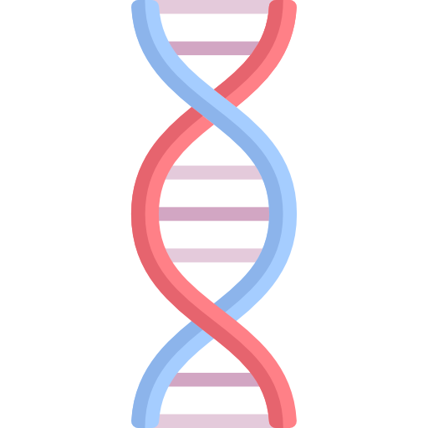
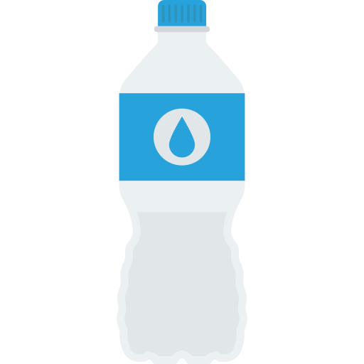
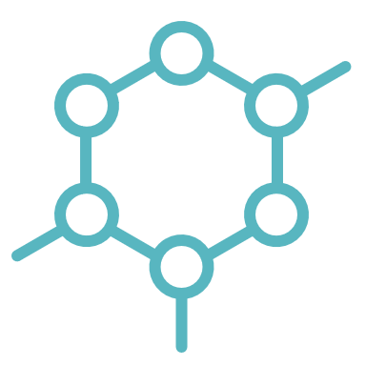

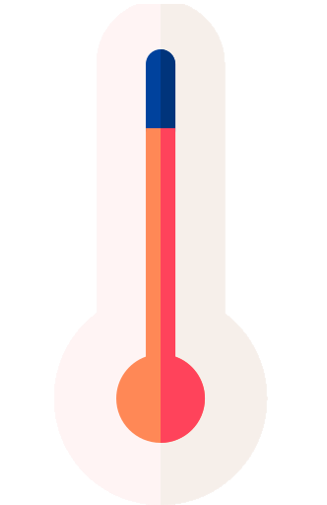


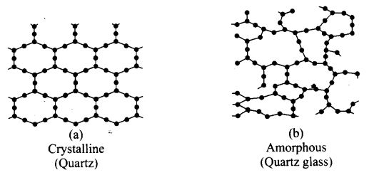

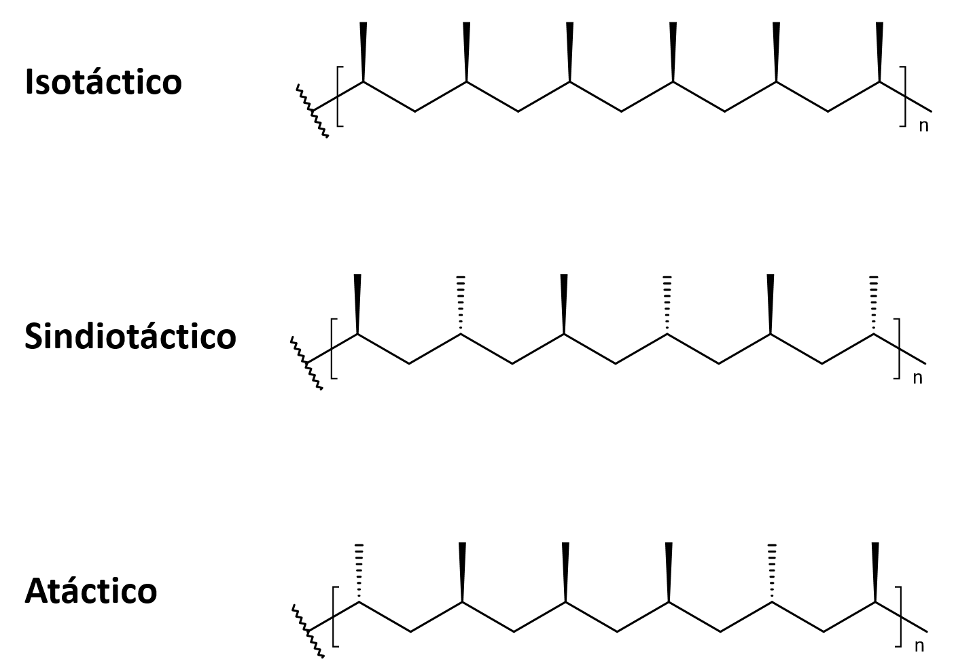
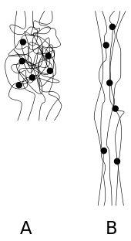

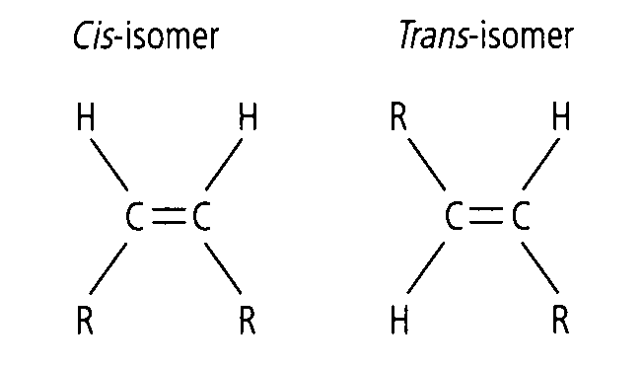
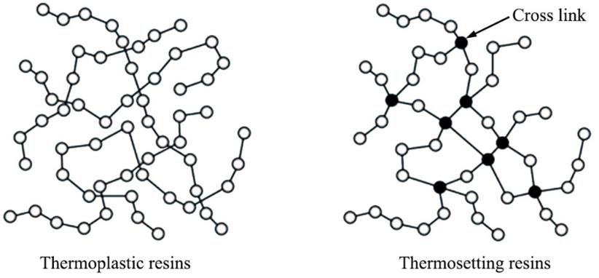
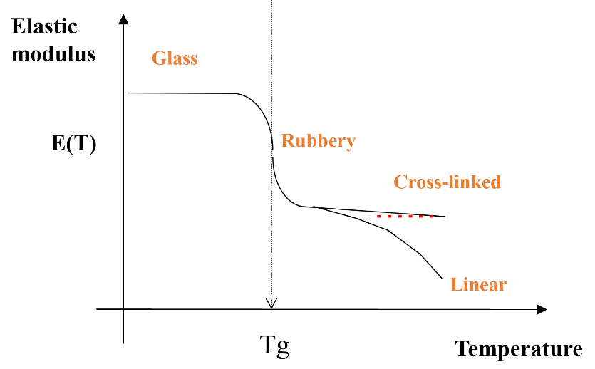

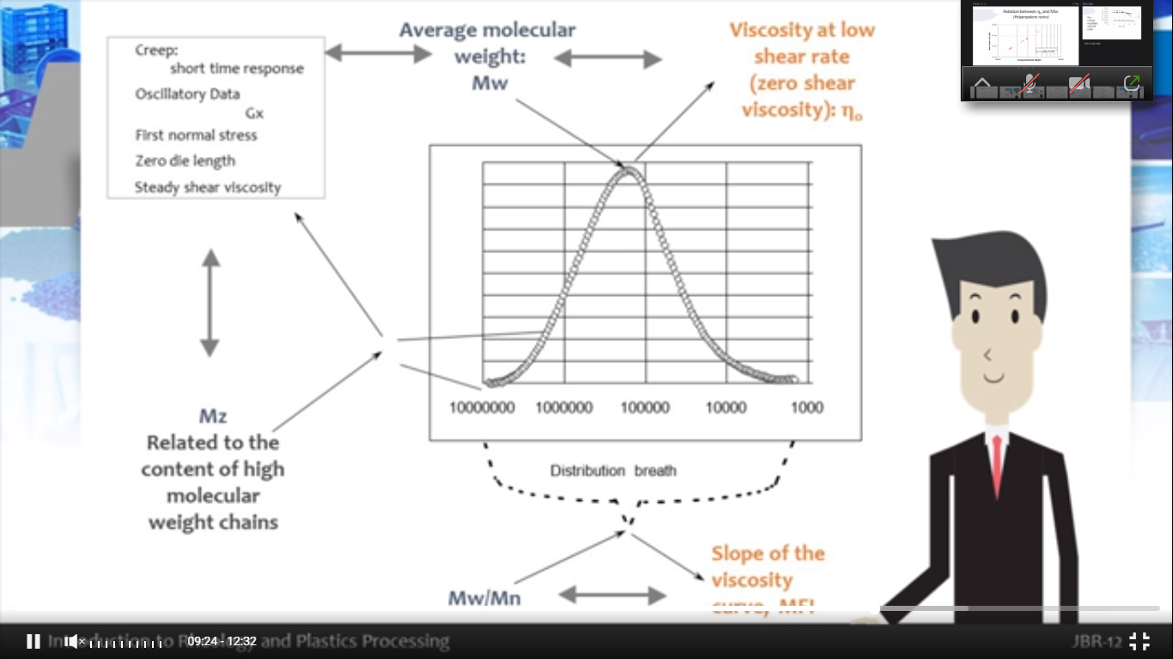
Plastics and Composites Engineering
Constanza Alvarez Lopez – A00829469
1
Polymers
A polymer is a material composed of macromolecules consisting in a chain of repeating subunits.
Polymers are found in everyday life as: synthetic plastics -> polystyrene, natural biopolymers -> DNA, and proteins.
2
Classification of polymers
A
Chemical structure
Alternating
Graft
Random
Homopolymer
Copolymer
Chemical stability
Can be aided though:
Additives, stabilizers
Averting high temperatures
Avoiding frequent heating cycles
Depends on:
O₂
$$ε$$
$$UV$$
B
Polymeric structure
C
Arrangement of monomers
Linear
Branched
Crosslinked
Block copolymers
Graft copolymers
D
Crystallinity
E
Tacticity
Crystalline
Amorphous
Isotactic
Syndotactic
Atactic
F
Molecular forces
Space orientation
Elastomers
Fibers
Polymeric chains are usually conformed in a zig-zag.
Trans bonds make straight chains, cis bonds cause the chain to bend.
G
Thermal behavior
Glass transition temperature
Thermoplastics
can be melted and reformed
Thermosets
cannot be reformed
Tg -> the temperature at which a material becomes softer
branch size
Tg
crosslinks
Tg
H
Methods of synthesis
Random polymerization
Mn
Addition
Free radical
Ionic
Condensation
Catalysts
No. avg. molecular weight (Mn): number of molecules
Weight avg. molecular weight (Mw): weight of molecules
Polydispersity index (PDI): Mw/Mn
Monomers
Catalyst, radical, anion, etc.
Polymer
PDI Random Wide of curve
PDI
3
Rheology
The study of the properties of matter which determine how it will deform/flow when subjected to an external force(s). It looks for a quantitative relation, modulus, between the force applied and the resulting deformation/flow.
Colored icons from: www.flaticon.es

Slide 2

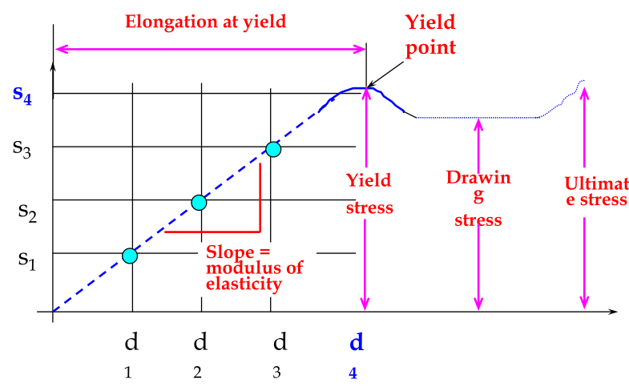

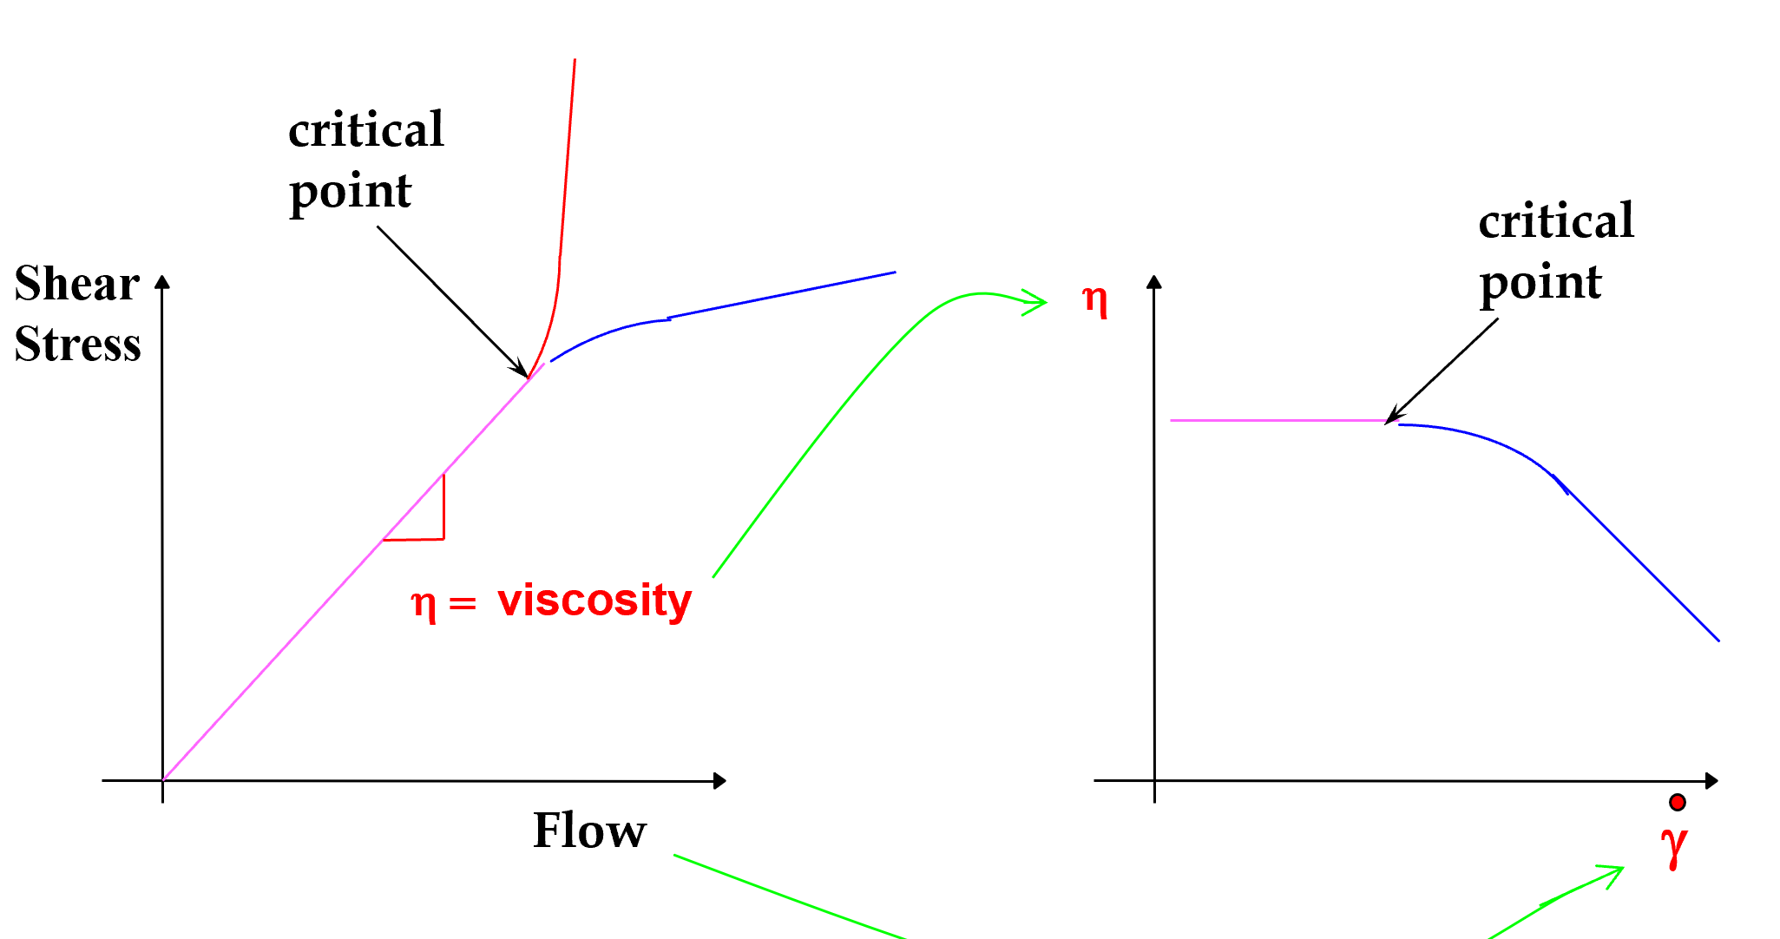
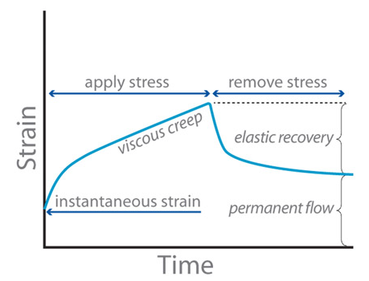
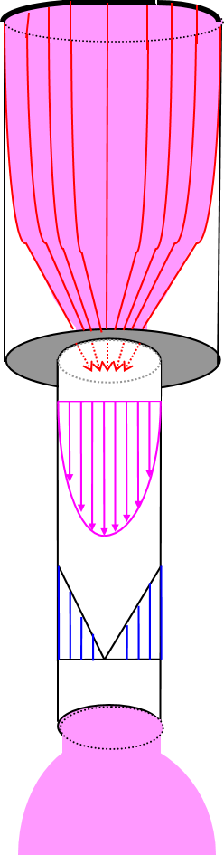
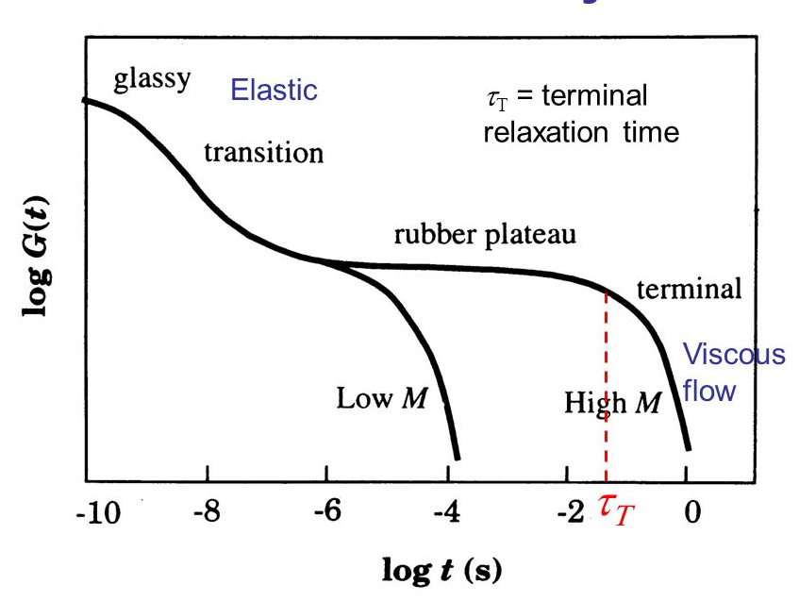
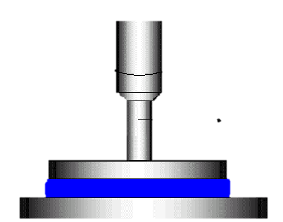
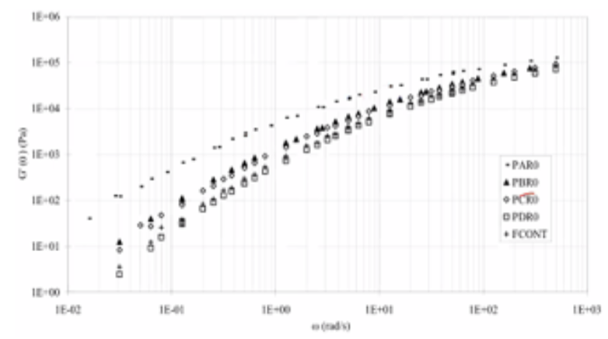

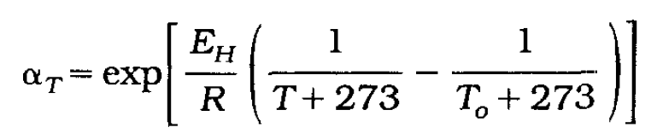
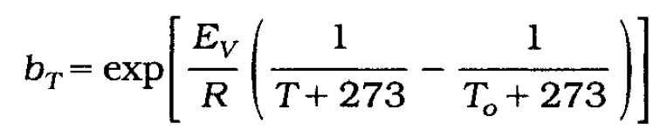
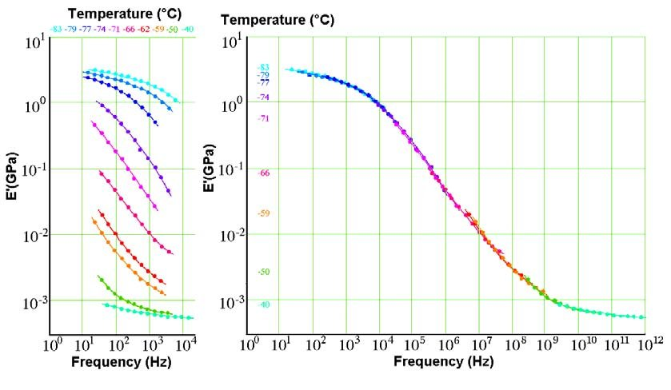
3
Rheology
Internal vaiables that affect viscosity
Molecular architecture
Molecular shape
Molecular concentration
Viscosity
Molecular weight
Molecular weight distribution (PDI)
Branches
MW
Viscosity
Entanglement
Viscosity
PDI
Velocity of viscosity decrease
Concentration
Viscosity
External vaiables that affect viscosity
Pressure
Temperature
Time
Rheopectic
Newtonian: linear
Thixotropic
Pressure
Viscosity
Time
Viscosity
Time
Viscosity
Temperature
Viscosity
Solids
Stress (s) = F/A, a force to cause deformation
Strain (d) = (L1-L0)/L0, amount of deformation or elongation
Elastic modulus (E) = slope
Velocity
Temperature
Elastic modulus
Liquids
Q is translated to shear rate (γ ̇), how fast the velocity changes due to F
η = τ_{yx} /γ ̇
Shear stress (τ_{yx}) = F/A
Flow (Q) = A/v
Viscosity (η) = slope
Zero shear viscosity: Newtonian viscosity (constant)
Critical point: intersection of Newtonian and non-Newtonian behavior
Rheometry
Capillary rheometry
Creep and recovery compliance (J)
Constant stress -> strain/stress
Measures the deformation and recovery of the polymer
Rabinowitch correction
Bagley correction
Relaxation modulus (G)
Constant strain -> stress/strain
Measures the response in time of the polymer against the plate
Parallel-plate rheometry
Complex modulus (G*)
Constant strain -> stress/strain
Measures the response in angular velocity (Oscillatory rheometry)
Oscillatory rheometry
Time-Temperature superposition
Obtain information at different temperatures G’, G’’, and get tan δ
Shift data to superpose curves and get shift factors aT and, in the given case, bT
Obtain the curve aT vs log(1/t-1/t0and from slope obtain activation energy over the gas cst
With the Arrhenius equation obtain the aT and bT for the objective time
Plot the master curve at the objective time

Slide 3
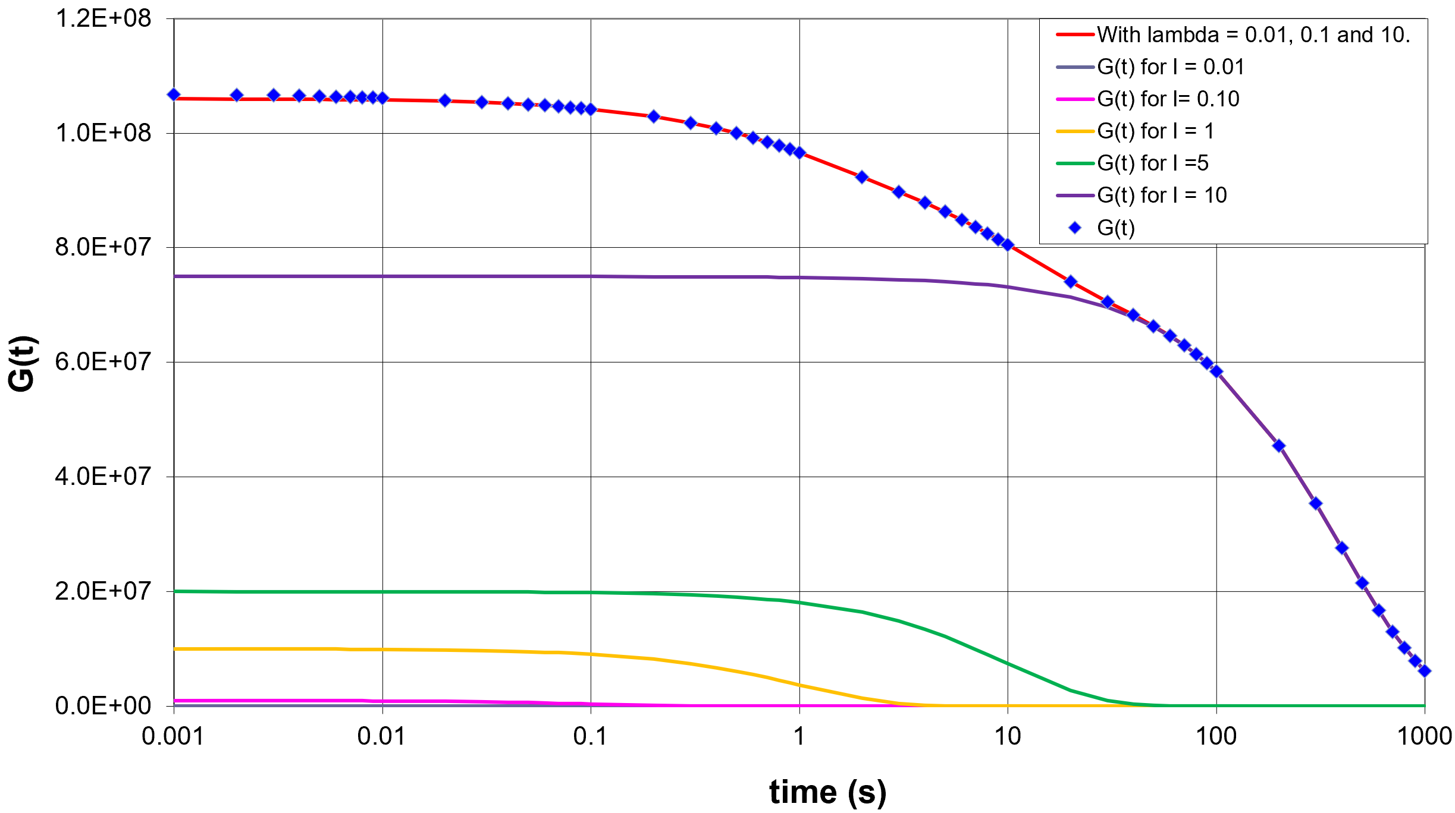
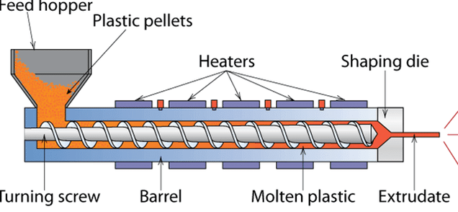
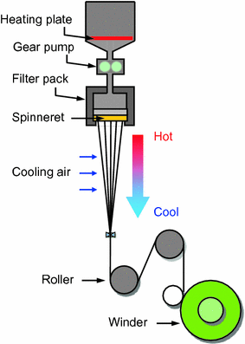
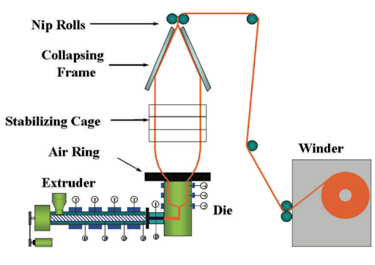
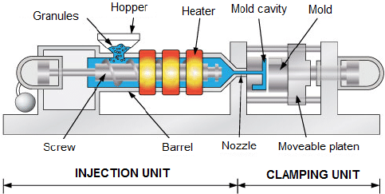
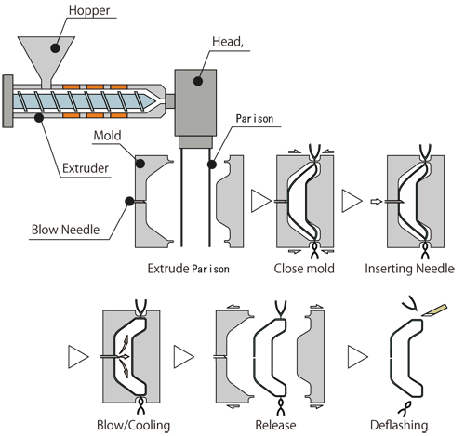



4
Viscoelastic Models
dashpot -> viscosity
spring -> elasticity
η_{n}
Linear
η₁
η₂
Maxwell elements
Obtain λ and G
Calculate H(λ)
E₁
E₂
E_{n}
Non-Linear
Mass equation
Momentum equation
Constitutive equations
Navier-Stokes
$$−(\bar{∇}•ρ\bar{v})=\frac{∂ρ}{∂t}$$
Wagner model -> recovery compliance
PTT model
Rubber-like liquid model
Describes the flow of incompressible fluids
$$ρ\left(\frac{∂\vec{V}}{∂t}+\left(\vec{V}∙∇\right)\vec{V}\right)=−∇p−∇∙τ+ρ\vec{g}$$
Tensors (to use Maxwell)
Cauchy
Finger Strain
$$where \bar{∇}≡\frac{∂\hat{i}}{∂x}+\frac{∂\hat{j}}{∂y}+\frac{∂\hat{k}}{∂z}$$
5
Polymer processing
A
Extrusion
Important parameters:
Screw rotating frequency
Screw design
Barrel temperature
Cooling conditions
Die dimensions
Polymer characteristics
Defects
Excessive shrinkage
Surging
Sharkskin / orange peel
Pimples
Lumpy surface
Bubbles
Some types of extrusion:
Fiber-spinning (right)
Blown film (below)
B
Injection Molding
Important parameters:
Clamping force
Shot size
Injection pressure
Screw design
Mold design
Polymer characteristics
Blown Molding
Defects
Flash
Sink marks
Jetting
Warpage
Charcoal like edges
Weld lines
Short shot
6
Final product performance!!!

