Slide 1


Polymers Engineering
Group #5
INFOGRAPHY
Constanza Alvares-Lopez - A00829469@itesm.mx
Osamu Katagiri-Tanaka - A01212611@itesm.mx
Juan Jesús Rocha-Cuervo - A01752555@itesm.mx
Angel Manuel Villalba-Rodriguez - A00828035@itesm.mx

Slide 2
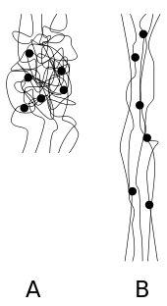
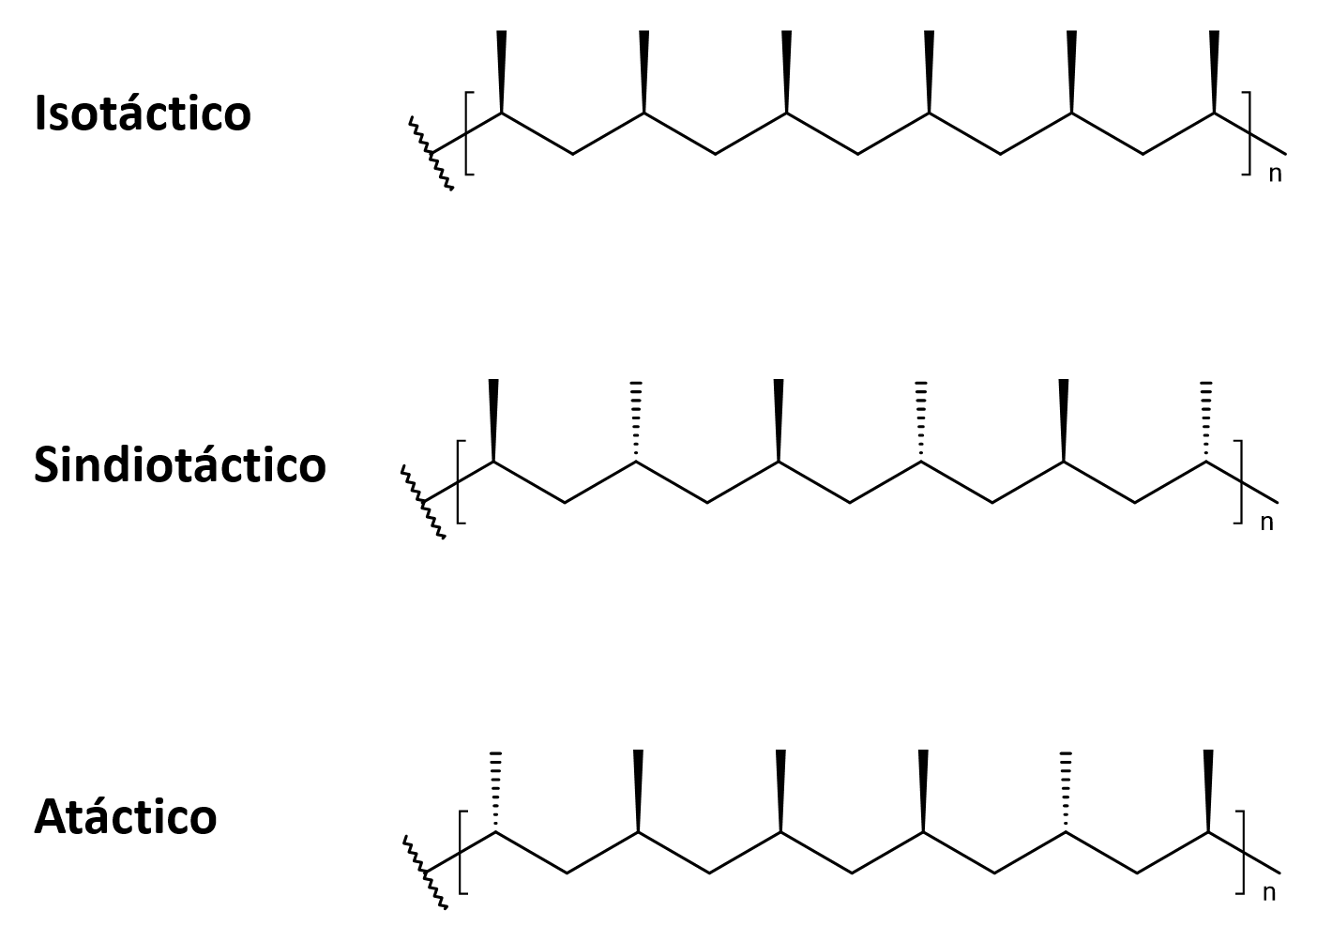








Sample 2
Polymeric structure
Molecular
forces
Tacticity
Chemical
structure
Crystallinity

Slide 3
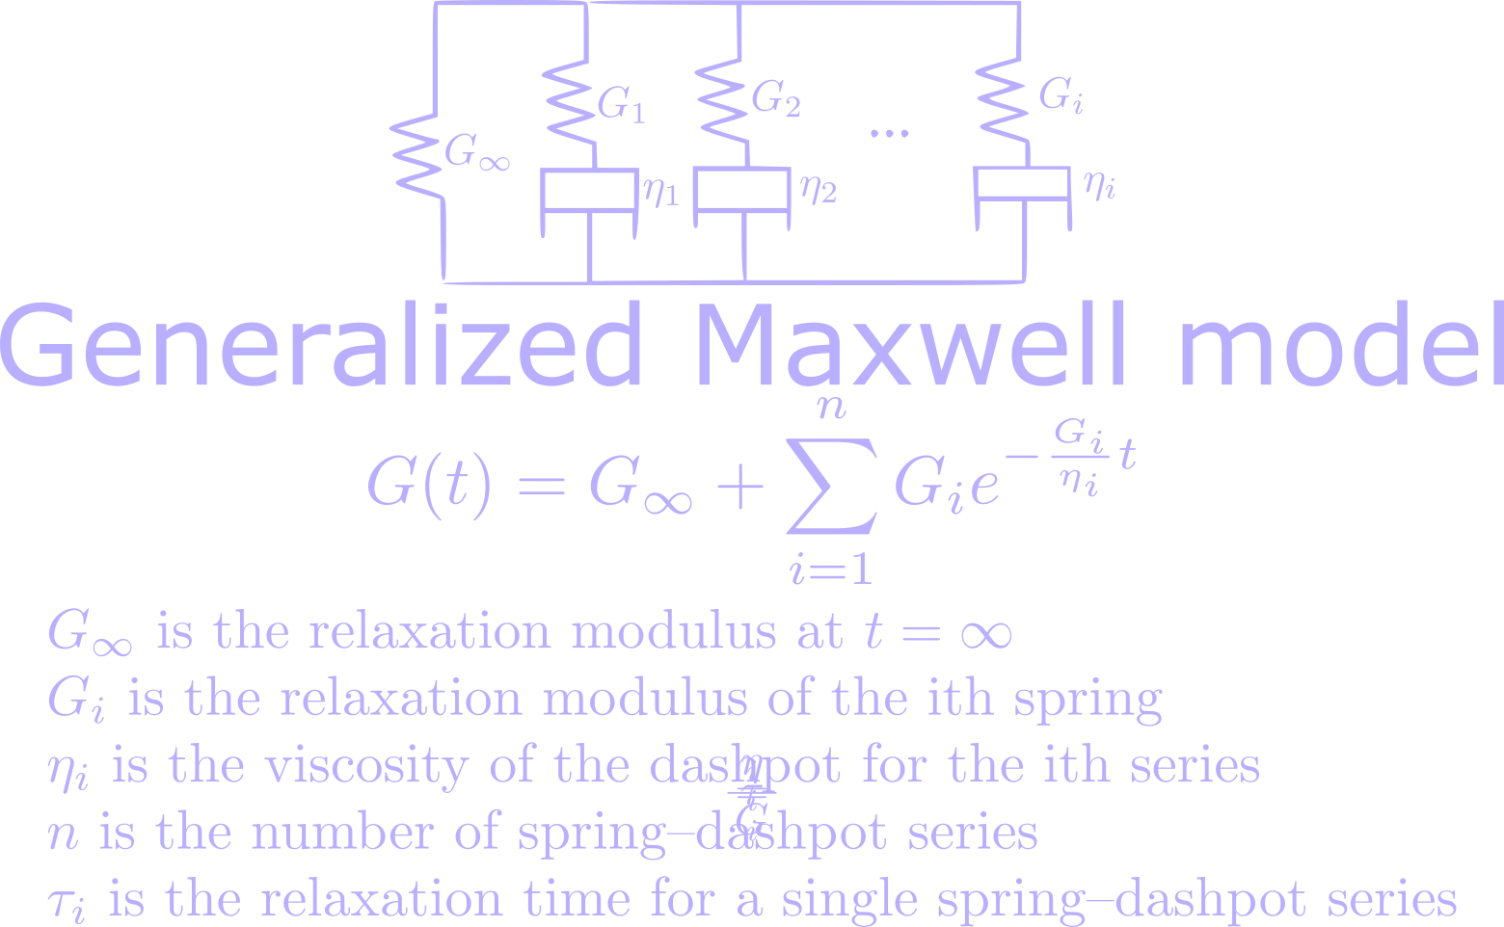





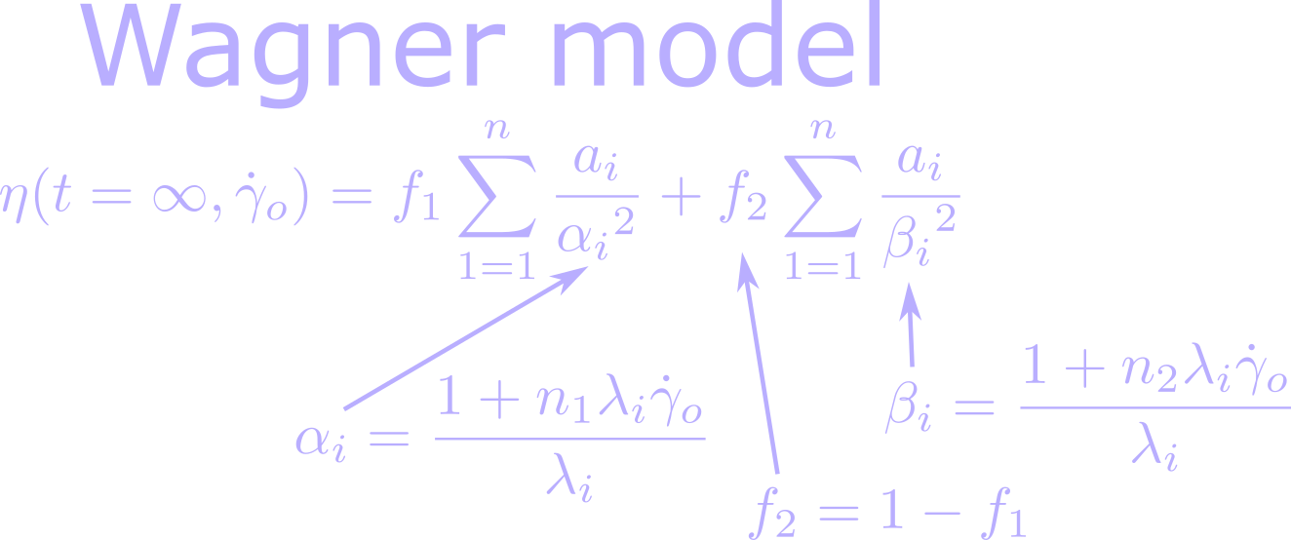


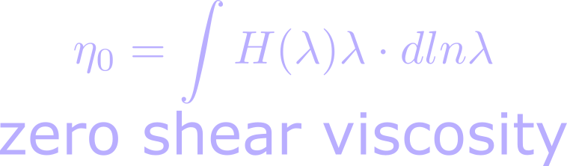

Sample 1
Viscoelastic models

Slide 4
Sample 3

Slide 5
Sample 4
YOUR TITLE HERE
Males
Females
22% Element One
Place additional content here. Your content can be placed in this area.
43% Element One
Place additional content here. Your content can be placed in this area.
3 in 5
Place additional content here. Your content can be placed in this area.
Variable One
14%
14%
Variable One
2 in 5
Place additional content here. Your content can be placed in this area.
Variable Two
22%
22%
Variable Two
Variable Three
31%
31%
Variable Three
Variable Four
34%
34%
Variable Four
Variable Five
39%
39%
Variable Five
275 Element
Place additional content here. Your content can be placed in this area.
450 Element
Place additional content here. Your content can be placed in this area.
29%
Place additional content here.
80%
Place additional content here.

Slide 6
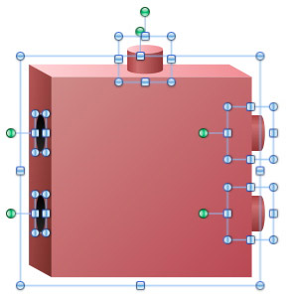
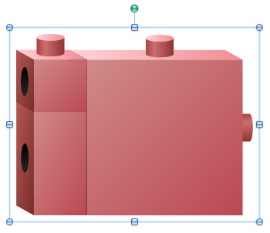
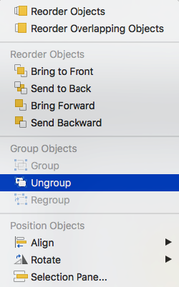
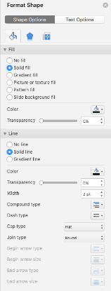
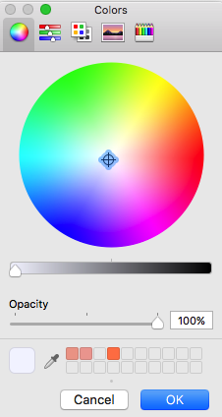
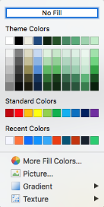
Tips and Tricks (PC and Mac)
Tips & Tricks (PC and Mac)
Group
Elements are grouped logically (hierarchically).
Scale
Group elements when scaling.
Use “Increase Font Size” and “Decrease Font Size” to scale text.
Scale proportionally (“Lock Aspect Ratio”).
Color
Edit colors via the “Shape Fill” tool.
Use the “Format” paintbrush to sample and apply other styles (e.g., gradients, lines).
For advanced editing select “Format Shape.”
General
Some quantitative graphics (e.g., bar charts) are data-driven. Use “Edit Data” to modify data. Use “Chart Tools” to edit aesthetics.
To embed fonts, follow these steps: Click the Microsoft Office Button, then click Save As. In the Save As dialog box, click Tools, then click Save Options. Click to select the Embed fonts in the file check box under Preserve fidelity when sharing this presentation, and then click OK.

Slide 7
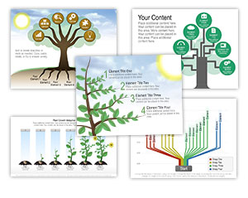

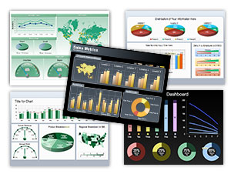
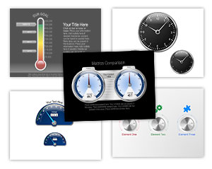
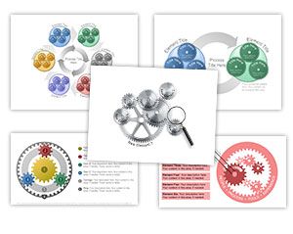
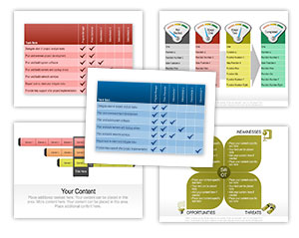
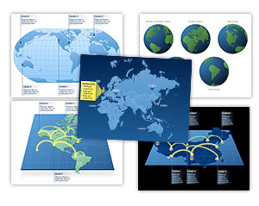
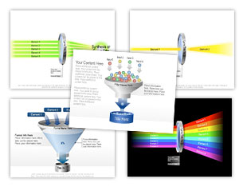

Check Out our PowerPoint Graphics Library
9,000+ fully editable PowerPoint Graphics
CLICK HERE
to Check Out our PowerPoint Graphics Library

Slide 8
INFOGRAPHIC ELEMENTS:
Shapes

Slide 9
Slide 2

Slide 10
Slide 3

