Slide 1

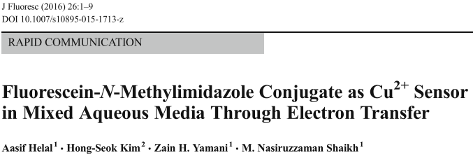
Fluorescence Spectroscopy <paper review>
Antonio Osamu Katagiri Tanaka A01212611@itesm.mx
16 Apr 2020

Slide 2
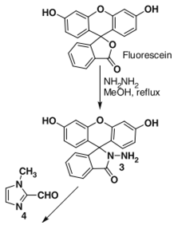
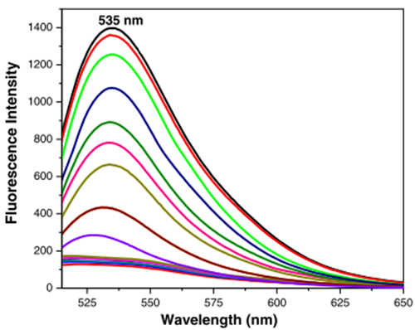
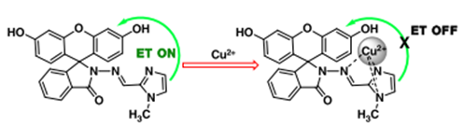

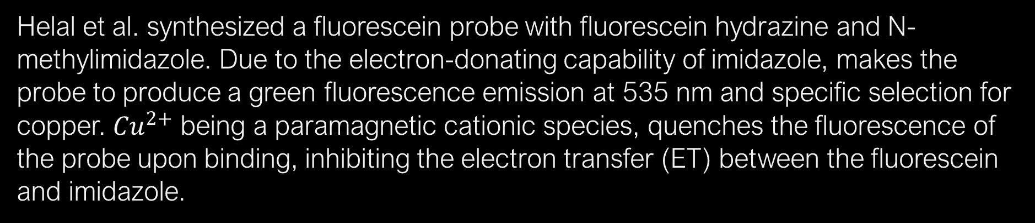
Helal et al. synthesized a fluorescein probe with fluorescein hydrazine and N-methylimidazole. Due to the electron-donating capability of imidazole, makes the probe to produce a green fluorescence emission at 535 nm and specific selection for copper. ${Cu}^{2+}$ being a paramagnetic cationic species, quenches the fluorescence of the probe upon binding, inhibiting the electron transfer (ET) between the fluorescein and imidazole.
The addition of ${Cu}^{2+}$ results in complete quenching of the fluorescent emission
fluorescein
hydrazine
n-methylimidazole
fluorescein probe
[1] A. Helal, H.-S. Kim, Z.H. Yamani, M. Nasiruzzaman Shaikh, Fluorescein-N-Methylimidazole Conjugate as Cu2+ Sensor in Mixed Aqueous Media Through Electron Transfer, J. Fluoresc. 26 (2016) 1–9. https://doi.org/10.1007/s10895-015-1713-z.

