Slide 1

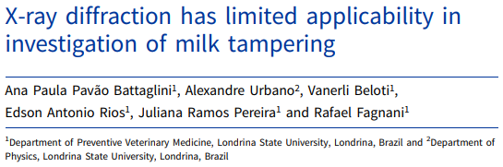
X-Ray Diffraction <paper review>
Antonio Osamu Katagiri Tanaka A01212611@itesm.mx
30 Apr 2020

Slide 2
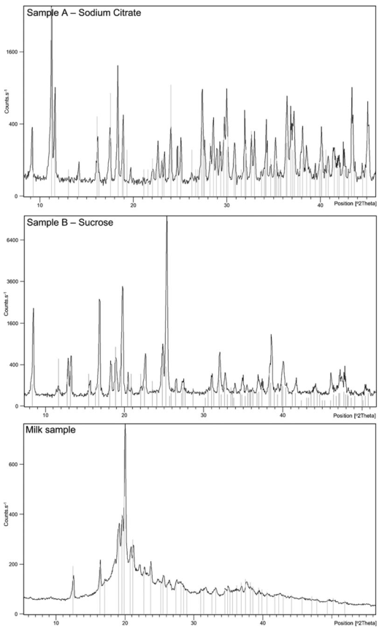
Two unknown substances were analysed. Sample ‘A’ was an odourless and homogeneous white powder. The sample ‘B’ was a translucent gel.
Each sample produced an unique diffractogram with the peaks identifying:
sodium citrate for sample A, and
sucrose for sample B
X-ray diffraction can not detect extraneous substances already mixed in milk. Fresh raw milk produced a similar diffractogram, with the peaks identifying monohydrate lactose crystals, however without detecting any extraneous substances.
The polymorphism of milk is likely to influence the crystallinity of urea, starch, citrate and sodium hydroxide, which consequently negatively affects the sensitivity of X-ray diffraction towards the accurate detection of extraneous substances in milk
[1] A.P.P. Battaglini, A. Urbano, V. Beloti, E.A. Rios, J. Ramos Pereira, R. Fagnani, X-ray diffraction has limited applicability in investigation of milk tampering, J. Dairy Res. 86 (2019) 337–340. https://doi.org/10.1017/S0022029919000566.

