Slide 1
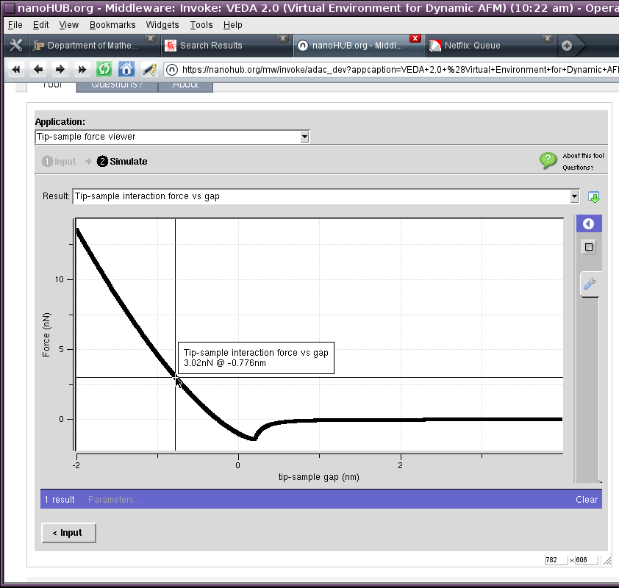
Mechanics of the GUI: Output Window
Choose different results from this dropdown box
Click to save graph as image or spreadsheet file
Mouse over for Cursors

Slide 2
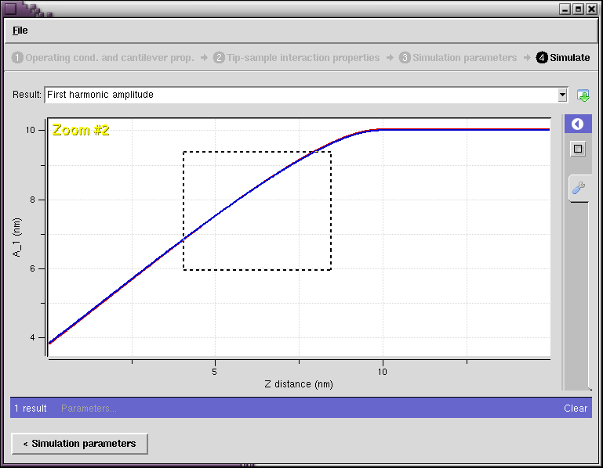
Output Window
Click to un-zoom
Click to return
to input
Click and drag to zoom

Slide 3
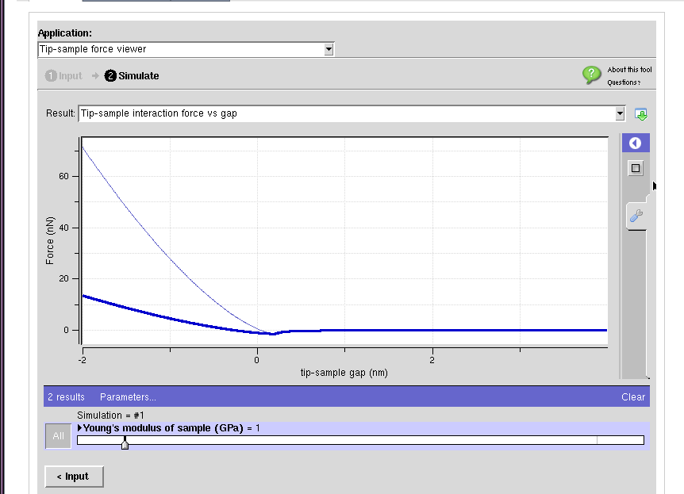
Output window
“clear” button erases all results
If you have run multiple simulations, you can choose between them with the slider bar, or overlay all with the “All” button

Slide 4
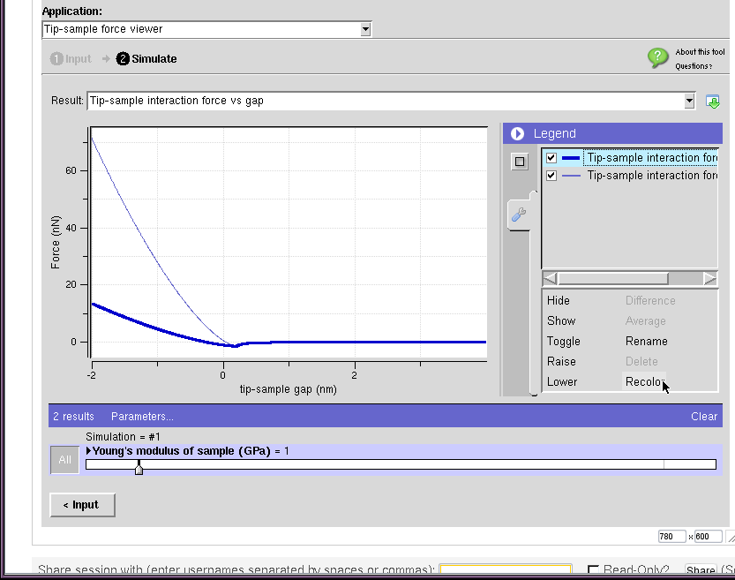
Output window
Click the triangle to open close the legend sidebar
on the legend sidebar, you can change colors, hide/show different lines.

Slide 5
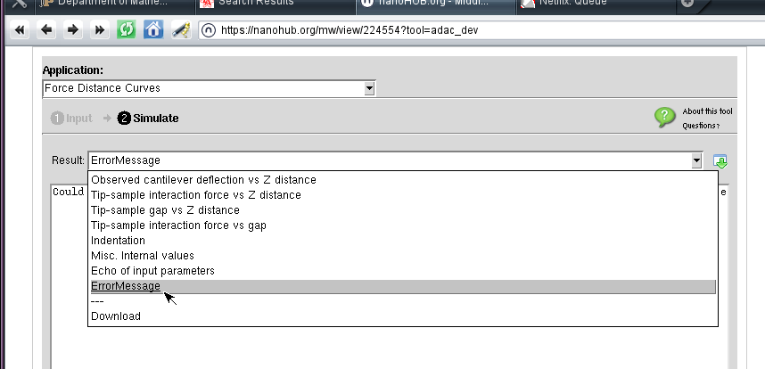
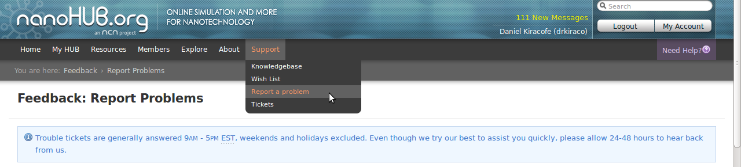
What to do if you have problems
Read the Error message if there is one. It is sometimes helpful
If you still can't figure it out, log a trouble ticket with nanohub
Be sure to specify VEDA as the tool, and include the error message and the “Echo of input parameters”

