Slide 1
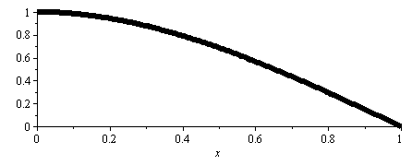
x
Flat mirror displaces down an amount h.
Laser spot moves h/sinΘ
Θ
h
x
H
2dΘ
Flat mirror rotates an amount dΘ.
Laser spot moves Hsin(2dΘ)
dΘ
h
Bending cantilever both translates and rotates. What is the relative contribution from each?
Notes:
Static bending shape g(x)=1-0.5 (x/L) ^2 * (3 – (x/L)), where L is cantilever length.
d/dx g(L) = -1.5/L. In other words, for a bending displacement of h, the cantilever has a slope at the end of 1.5h/L. or dΘ=arcsin(1.5h/L). Because angles are small, sin(dΘ) ~= dΘ. So, when bending an amount h, the laser spot moves H*2*1.5h/L
assume H = 1 cm, Θ=45 deg, h=1e-9, L=100e-6 Then the displacement contribution to spot movement is 1.4e-9 = 1.4 nm
the rotation contribution is H*2*1.5h/L = 2e-7 = 200 nm.

