Slide 1
Research Master's in Computer Science, Intelligent Pervasive Systems
Evaluating Coding Agent Quality
Application to Software Design Principles
Akram Ben Fekih
Supervised by Mrs. Maha Khemaja
ISSAT Sousse, University of Sousse · 2025/2026
Notes:
1/56 Title

Slide 2
Outline
Problem, state of the art and research questions
The five principles as measurable proxies
The before/after delta
Corpus: two languages, three agents
Pipeline and algorithms
Validation
Results per agent and per language
Findings, conclusions, limitations
Notes:
2/56 Outline

Slide 3
Part 1
Problem, state of the art and research questions
Notes:
3/56 Part 1: Problem, state of the art and research questions

Slide 4
Coding agents now submit real changes
Claude Code, GitHub Copilot and OpenAI Codex take a task and open a pull request.
The AIDev dataset records 7.69 million agent pull requests in 957k repositories.
They are evaluated mainly on whether tests pass (HumanEval, SWE-bench).
Passing tests says nothing about design: whether the next developer can change the code.
about half
of SWE-bench Verified patches that pass the tests would not be merged by maintainers (METR, 2026)
77%
of long-horizon agent trajectories show growing structural erosion (SlopCodeBench, 2026)
Notes:
4/56 Coding agents now submit real changes

Slide 5
State of the art: what agents do to code
Passing the tests is not the same as being accepted: about half of passing SWE-bench Verified patches would not be merged, 24 points below the automated score. Whitfill et al., METR, 2026
Functional correctness hides structural debt: Cursor projects of 16,965 lines reach 91% correctness, yet carry 1,305 CodeScene and 3,193 SonarQube design issues. Kashif et al., 2026
Structure decays over long horizons: erosion grows in 77% of trajectories, and agent code is 2.3× more verbose than human open-source Python. SlopCodeBench, Orlanski et al., 2026
AI defects have a shape, broken abstractions, duplication, over-engineering, and a Volume-Quality Inverse Law: more code generated, more structure decayed. Zhu, Yuecai et al., 2026
Agents are poor at repairing structure: 4.3% success on dependency control, 15.2% on responsibility decomposition, over 21 C++ probes. Zhu, Haichao et al., NITR, 2026
Notes:
5/56 State of the art: what agents do to code

Slide 6
State of the art: measurement and attribution
A language model can detect SOLID violations. SRP is easiest, DIP hardest, and accuracy falls as complexity rises. This is the technique our judge uses. Pehlivan et al., 2025
Differences between agents largely vanish once normalised for churn, and a merge does not guarantee structural quality. Cynthia et al., 2026
After a merge, humans do almost all the maintenance on agent-written files, so maintainability is a human cost. Sawada et al., 2026
The harness around the model, its tools and context management, affects quality independently of the LLM. Ben Sghaier et al., 2026
“Vibe architecting”: agents make implicit architectural choices from prompt nuance, giving 141 to 827 lines for one and the same task. Konrad et al., 2026
Notes:
6/56 State of the art: measurement and attribution

Slide 7
The gap, and what this thesis does
What existing work does
What this thesis does
Benchmarks on functions or small task sets
LLMs detecting SOLID violations in examples
Smell counts on merged code only
Metrics assumed to capture a principle
Real pull requests from three agents
All five SOLID principles, one detector each
Merged, rejected and open requests
Every detector's precision and recall measured
The whole study repeated in a second language
Unit of analysis: one pull request. Object of measurement: what that pull request did to the design of the code it touched.
Notes:
7/56 The gap, and what this thesis does

Slide 8
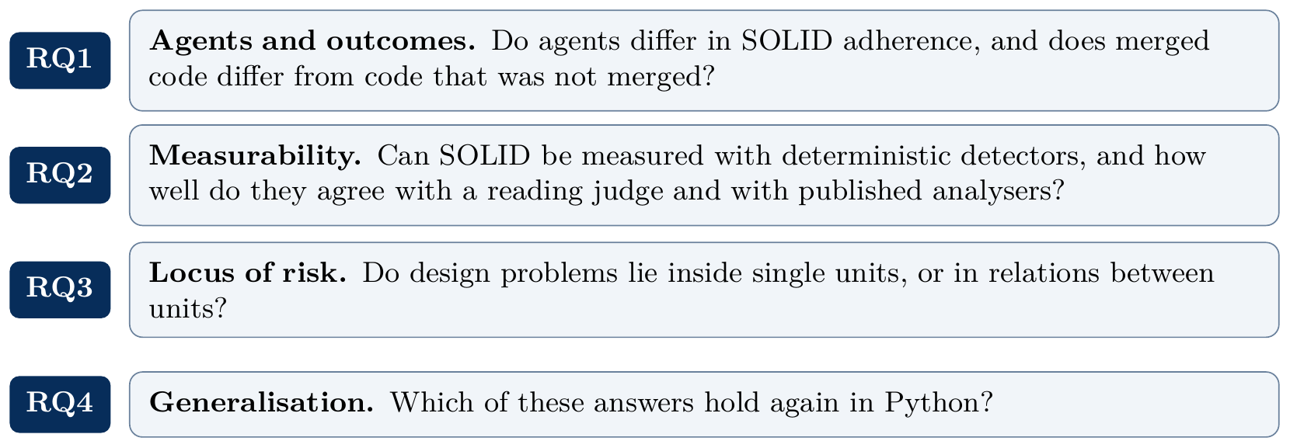
Research questions
Notes:
8/56 Research questions

Slide 9
Part 2
The five principles as measurable proxies
Notes:
9/56 Part 2: The five principles as measurable proxies

Slide 10
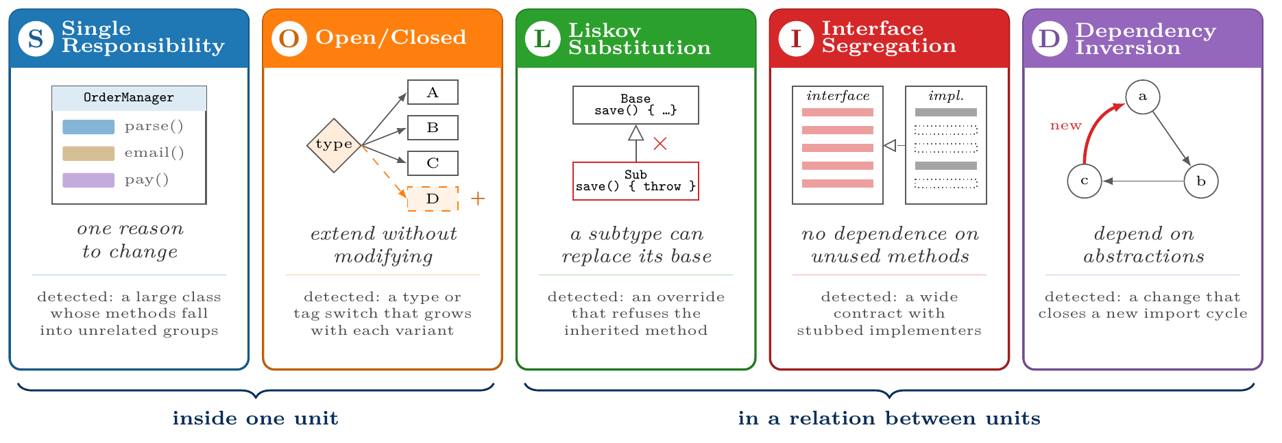
From principle to detector
Each principle is a statement about intent. A detector can only see the structure that a violation usually leaves behind, so every result is first a statement about the detector.
Notes:
10/56 From principle to detector

Slide 11

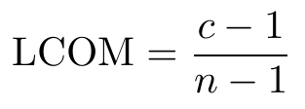

SRP: God Class rubric with a cohesion suppressor
Six size and complexity metrics; one hit per threshold reached:
Threshold | Java | Python
class lines | 362 | 250
weighted methods | 45 | 36
methods | 20 | 10
method complexity | 11 | 12
parameters | 5 | 7
LCOM | 0.86 | 0.8
Cohesion, LCOM4 over the method graph (edge = shared field or a call), constructors excluded:
Conceptual cohesion over TF-IDF vectors of method token bags:
Each value is the 90th percentile of that corpus, fixed before any label existed.
0.350 / 0.110
precision, Java / Python
Notes:
11/56 SRP: God Class rubric with a cohesion suppressor

Slide 12
OCP: dispatch width with a closed-set suppressor
A dispatch chain is an if/else if ladder or a switch branching on one subject. With b branches:
τ | Java | Python
type chains | 3 | 3
tag / value chains | 8 | 5
closed holds when the subject's resolved type is an enumeration: a client cannot add a value. A pull request is flagged when it creates or widens such a chain.
0.330 / 0.390
precision, Java / Python
Width does not predict truth: precision stays between 0.270 and 0.400 across every band. The sets that are closed in practice are fixed by specifications, not by the language.
Notes:
12/56 OCP: dispatch width with a closed-set suppressor

Slide 13
LSP: override compared with its nearest ancestor
For each pair (subclass method, nearest ancestor method with the same signature and a real body):
Java signal | precision
refused bequest | 31/31
weakened postcondition | 6/36
strengthened precondition | 3/33
Java S = refused bequest, strengthened precondition, weakened postcondition. Python S adds what no compiler checks: parameter removed, required parameter added, parameter type narrowed, return type widened.
The shipped Java flag keeps refused bequest only: 64 of 64 across two samples.
0.420 / 0.510
precision of the full signal set, Java / Python
Notes:
13/56 LSP: override compared with its nearest ancestor

Slide 14
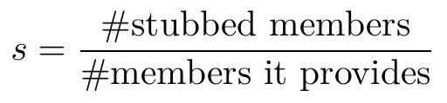
ISP: contract width and implementer stubs
A contract is an interface or abstract class with at least one abstract member and at least one implementer inside the repository. Width w = abstract members; for each implementer,
Members | judged | precision
0–17 | 43 | 0.116
18–29 | 28 | 0.071
30–49 | 14 | 0.786
50–99 | 10 | 0.900
≥100 | 5 | 1.000
Java: contract fat if w≥ 13; forced stub if stubs ≥ 2 and s≥ 0.5. Flag if the request creates a fat contract, widens one, or leaves a forced stub. Python: flag if at least two of: w>7; mean implementer coverage <0.75 over ≥2 implementers; an implementer with forced stubs.
Width does separate violations here, which is why 13 was too low a bar.
0.335 / 0.425
precision, Java / Python
Notes:
14/56 ISP: contract width and implementer stubs

Slide 15

DIP: new cycles in the import graph
Build the internal import graph before and after the change and take strongly connected components with Tarjan's algorithm. With P(G) the set of module pairs inside one component:
0.892 / 1.000
precision, Java / Python
Java precision is exact: all 195 flagged pull requests were judged. In Python, 100 of 173 were judged and all were correct. The distance D was tested as a change signal and confirmed none of 17 flags, so it describes packages and never raises a flag.
Also computed, as description only: I=C_e/C_a+C_e, A=N_a/N_c, D=|A+I-1|.
Notes:
15/56 DIP: new cycles in the import graph

Slide 16
Calibration: same rules, two languages
Principle | Java | Python
SRP | six metrics, ≥2 hits; 362 / 45 / 20 / 11 / 5 / 0.86 | same rubric; 250 / 36 / 10 / 12 / 7 / 0.8
OCP | type ≥3, tag ≥8 branches | type ≥3, value ≥5 branches
LSP | three behavioural signals | five signals, adding what a compiler would reject
ISP | contract ≥13 members, or a forced stub | at least two of three signals, width alone never flags
DIP | new cyclic pairs through a touched file | new cyclic pairs through a touched module
Every threshold is the 90th percentile of its own corpus, set before any label existed; the result files were then deleted and the pass re-run, so no flag predates its threshold.
Notes:
16/56 Calibration: same rules, two languages

Slide 17
Part 3
The before/after delta
Notes:
17/56 Part 3: The before/after delta

Slide 18
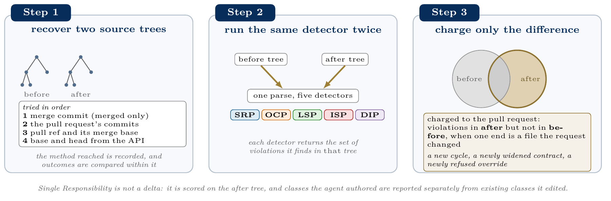
What is charged to the pull request
Notes:
18/56 What is charged to the pull request

Slide 19
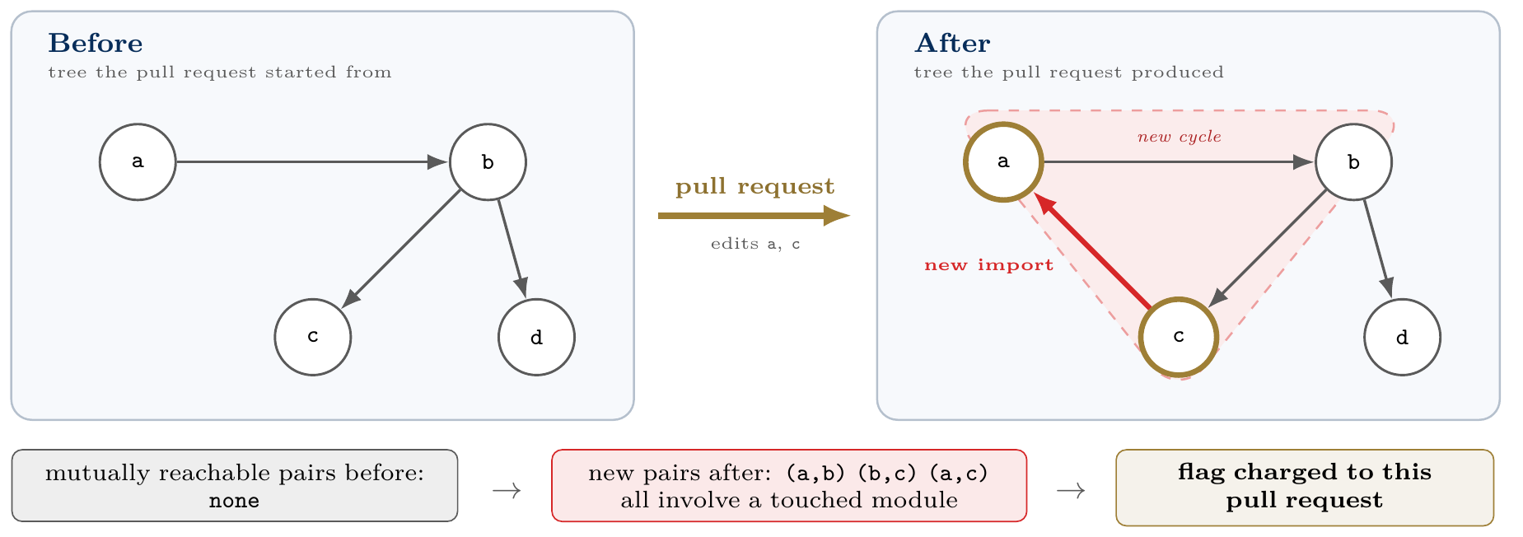
The delta in the data
Attribution rule for relations: a violation is charged when either end is in a changed file, so an agent that widens a base class is charged for the subclasses it breaks in files it never opened.
Notes:
19/56 The delta in the data

Slide 20
Part 4
Corpus, pipeline and algorithms
Notes:
20/56 Part 4: Corpus, pipeline and algorithms

Slide 21
Corpus: two languages, three agents, three outcomes
Java | merged | rejected | open
Claude Code | 970 | 485 | 283
GitHub Copilot | 2,544 | 1,272 | 364
OpenAI Codex | 630 | 315 | 93
Python
Claude Code | 940 | 540 | 182
GitHub Copilot | 885 | 407 | 178
OpenAI Codex | 1,069 | 549 | 196
4,245 / 4,946
analysable pull requests, Java / Python
≥25 stars, permissive licence
balanced on agent and outcome
Python also stratified by repository: no repository gives more than 0.4% of a cell
Java rows are the curated corpus (6,956), Python rows the analysable one (4,946).
Notes:
21/56 Corpus: two languages, three agents, three outcomes

Slide 22
Attrition and how the two trees were recovered
Status | Java | Python
analysable | 4,245 | 4,946
no production file touched | 2,540 | 1,816
no module resolved | n/a | 232
tree too large | 150 | 14
history gone | 18 | 2
no distinct before tree | 3 | 40
curated | 6,956 | 7,050
Recovery method by outcome (Java):
 | 1 | 2 | 3 | 4
merged | 1,052 | 425 | 665 | 431
open | 5 | 209 | 250 | 31
rejected | 0 | 646 | 482 | 49
Method 1 is the merge commit, available to merged requests only. That is why every merged-versus-unmerged comparison is made within the same method. 7.0% of Python requests lost their source entirely: the branch was deleted.
Notes:
22/56 Attrition and how the two trees were recovered

Slide 23
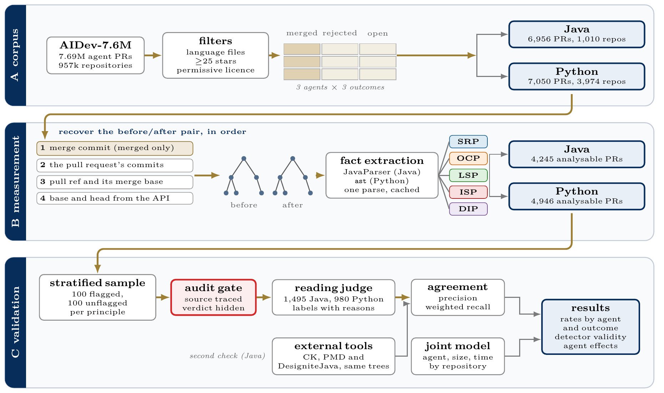
Full workflow
Notes:
23/56 Full workflow

Slide 24
Algorithms: from the dataset to the facts
Phase | Algorithm | Why it is needed
Curation | seeded stratified draw, balanced on agent and outcome, repository-stratified in Python | one agent would dominate any raw aggregate
Tree recovery | four fallbacks, git archive, cache keyed by content hash | branches are deleted, especially for closed requests
Java facts | JavaParser with symbol solving, source roots inferred from package lines | without resolution two classes named Node merge into one
Python facts | standard library ast, imports resolved by module path | no compiler and no type information is available
Notes:
24/56 Algorithms: from the dataset to the facts

Slide 25
Algorithms: detectors and statistics
Phase | Algorithm | Why it is needed
SRP | union-find for LCOM4, TF-IDF cosine for C3 | size alone cannot separate large from incoherent
OCP | dispatch chains grouped by subject, enum resolution | a switch over a fixed set is not a violation
LSP | nearest ancestor with a real body, over the resolved hierarchy | an abstract base has no behaviour to refuse
ISP | contract to implementer index over the hierarchy | inherited members are part of the contract
DIP | Tarjan strongly connected components | a cycle is a property of the whole graph
Sampling | seeded stratified draw after entity deduplication | classes touched by many requests would dominate
Scoring | Wilson intervals, stratum-weighted recall | the sample is half flagged, the corpus is not
Model | GEE, exchangeable within repository, cluster-robust errors | requests from one repository are not independent
Notes:
25/56 Algorithms: detectors and statistics

Slide 26
Part 5
Validation
Notes:
26/56 Part 5: Validation

Slide 27
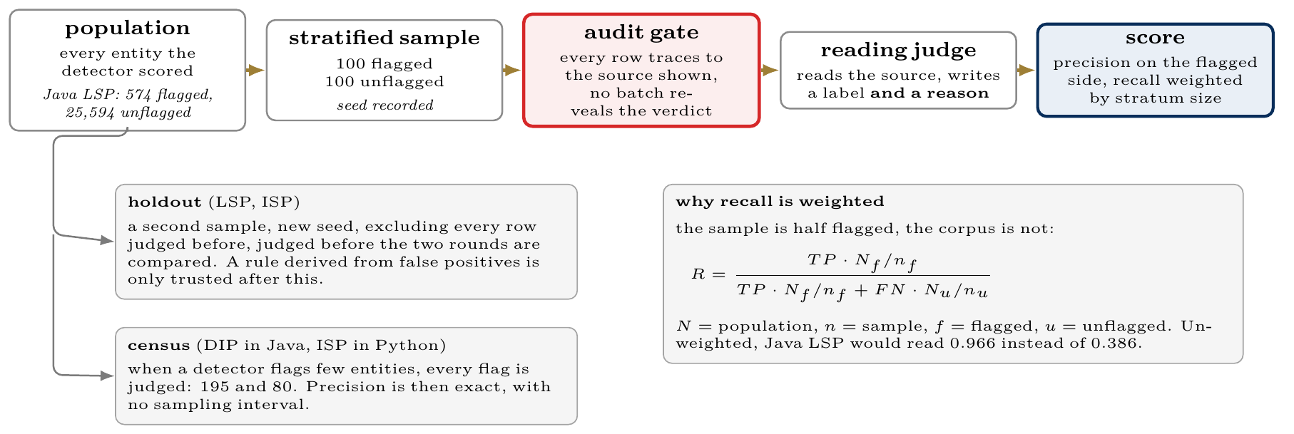
How a detector is validated
Notes:
27/56 How a detector is validated

Slide 28
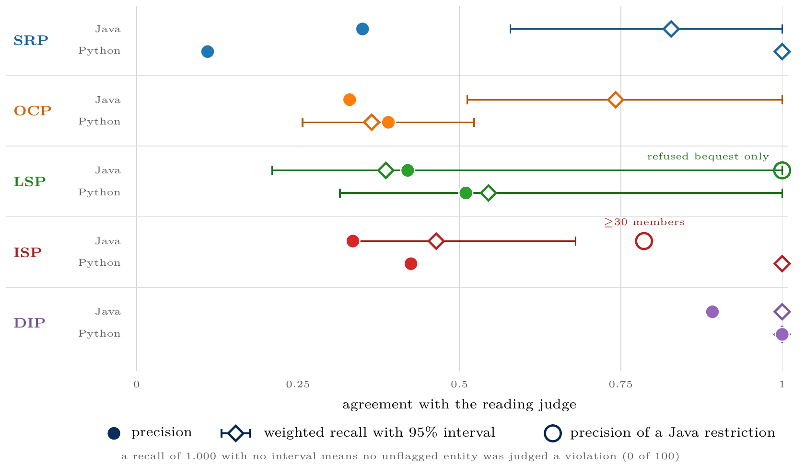
Validation results
2,475 entities judged, each with a written reason. Dependency Inversion is precise in both languages; Single Responsibility, Open/Closed and Interface Segregation are screens.
Notes:
28/56 Validation results

Slide 29
What the judge's disagreements are made of
Why flags fail
What the detectors miss
OCP: the set is fixed by a specification, not by the language (JDBC codes, protobuf types, Unicode blocks, generated parser tables)
Python SRP: classes whose size a framework imposes (model heads, home-automation entities, training callbacks)
ISP in Python: test doubles and unfinished scaffolds that stub on purpose
The three Liskov violations found in the unflagged sample are silent: an override that throws for every argument, one with an empty body, one that assigns null
Structural rules catch refusals that are declared, not refusals that are quiet
89.7%
agreement when 174 Java entities were judged twice
Notes:
29/56 What the judge's disagreements are made of

Slide 30
Two refinements, and the test that separates them
Refinement | Derivation sample | Java holdout | Python, unchanged rule
LSP, refused bequest only | 1.000 (31/31) | 1.000 (33/33) | 0.857 (6/7)
ISP, ≥30 members | 0.862 (25/29) | 0.704 (19/27) | 0.200 (1/5)
Refused bequest is categorical: a body either is only a throw, or it is not.
A width of 30 was chosen where the false positives stopped, and absorbed the noise of that sample.
Both rules were fixed on Java data before any Python label existed, so Python is a second, out-of-language test.
Lesson: a rule that names a shape of code transfers; a tuned number does not.
Notes:
30/56 Two refinements, and the test that separates them

Slide 31
“Three of your detectors are weak. Can you fix them?”
Principle | Can tuning fix it? | Evidence
SRP | Not by a threshold | 0.350 Java, 0.110 Python. The Python false positives are classes whose size a framework imposes: that needs framework awareness, not a new number
OCP | No threshold exists | Precision by branch count: 0.270, 0.391, 0.316, 0.400, 0.364. Flat. A 64-branch switch over protocol codes is closed, a 5-branch one over backends is open
LSP | Already done | 0.420 → 1.000 restricted to refused bequest; holdout 33/33, Python 6/7
ISP | Tried, and it failed | The ≥30 rule: 0.862 where derived, 0.704 on the holdout, 0.200 in Python, outside its own interval
DIP | Nothing to fix | 0.892 on a census of all 195 Java flags, 1.000 in Python
A reported precision is the answer to RQ2, not a defect to hide. Every rate here is already corrected by it: 7,501 SRP flags become about 2,600 genuine ones.
Notes:
31/56 “Three of your detectors are weak. Can you fix them?”

Slide 32
Second check: three published analysers (Java)
God Class detectors, 82,553 types | Cohen's κ
ours vs PMD GodClass | 0.574
ours vs DesigniteJava | 0.531
PMD vs DesigniteJava | 0.384
Open/Closed, 63,326 types
ours vs Designite type-conditional | 0.122
150 random repositories, tools at their own default thresholds
Our rubric agrees with each tool more than the two tools agree with each other
68.0% of our flags are confirmed by at least one of them
Cohesion disagrees everywhere, including CK with itself (0.490)
Open/Closed is the exception: it fires 3× as often as Designite's smells and shares only 76 types, so it rests on the judge alone
Rank correlation with CK | ρ
weighted methods | 0.977
lines of code | 0.944
cohesion (LCOM1) | 0.288
Notes:
32/56 Second check: three published analysers (Java)

Slide 33
Part 6
Results
Notes:
33/56 Part 6: Results

Slide 34
How often agents actually violate each principle raw flag rate, corrected by the measured precision of its own detector
 |  | Java |  |  |  | Python
Principle | Unit | flagged | real | prec. | rec. | flagged | real | prec. | rec.
SRP | class touched | 12.2% | 4.3% | 0.350 | 0.828 | 11.6% | 1.3% | 0.110 | 1.000
OCP | pull request | 6.7% | 2.2% | 0.330 | 0.742 | 6.4% | 2.5% | 0.390 | 0.364
LSP | pull request | 0.4% | 0.4% | 1.000ᵃ | 0.386ᵇ | 0.9% | 0.5% | 0.510 | 0.545
ISP | pull request | 6.5% | 2.2% | 0.335 | 0.464 | 0.6% | 0.3% | 0.425ᶜ | 1.000
DIP | pull request | 4.6% | 4.1% | 0.892ᶜ | 1.000 | 3.5% | 3.5% | 1.000 | 1.000
real = flagged × measured precision: the column to quote. ᵃJava Liskov ships as refused bequest only, precision 1.000 on 64 judged flags. ᵇRecall is for the broader three-signal detector the sample was drawn from. ᶜCensus, every flag judged: 195 Java DIP, 80 Python ISP. Recall is stratum-weighted; unweighted, Java LSP would read 0.966.
Nothing exceeds 4.3%. Where a detector is imprecise the correction is large (Python SRP 11.6% to 1.3%); where it is precise the rate barely moves (DIP 4.6% to 4.1%).
Notes:
34/56 How often agents actually violate each principle — raw flag rate, corrected by the measured precision of its own detector

Slide 35
Flag rate by agent, both languages pooled, with the average over repositories in brackets
 | Java |  |  | Python
Principle | Claude | Copilot | Codex | Claude | Copilot | Codex
SRP (authored classes) | 9.5 (8.4) | 5.1 (3.5) | 6.8 (7.4) | 9.6 (11.0) | 6.6 (10.3) | 8.9 (8.1)
OCP | 10.6 (10.1) | 6.4 (3.0) | 2.1 (2.2) | 9.7 (9.6) | 3.5 (3.1) | 5.7 (6.6)
LSP | 0.7 (0.3) | 0.3 (0.1) | 0.0 (0.0) | 1.6 (1.2) | 0.5 (0.3) | 0.8 (0.8)
ISP | 8.7 (6.0) | 6.7 (4.0) | 2.9 (5.0) | 1.3 (1.0) | 0.4 (0.4) | 0.3 (0.1)
DIP | 6.5 (5.1) | 4.1 (2.8) | 3.2 (5.4) | 5.8 (5.6) | 2.0 (1.5) | 2.6 (2.3)
Read this only with the next two slides: the agents do not write changes of the same size, and most of this ordering follows from that.
Notes:
35/56 Flag rate by agent, both languages — pooled, with the average over repositories in brackets

Slide 36
Is the instrument fair to each agent? precision by agent: true positives over flags judged
 | Java |  |  | Python
Principle | Claude | Copilot | Codex | Claude | Copilot | Codex
SRP | 18/55 | 10/38 | 7/7 | 6/46 | 2/26 | 3/28
OCP | 23/68 | 7/25 | 3/7 | 20/45 | 7/19 | 12/36
LSP | 53/106 | 22/68 | 9/26 | 29/73 | 11/15 | 11/12
ISP | 35/83 | 26/93 | 6/24 | 23/48 | 6/17 | 5/15
DIP | 57/72 | 94/98 | 23/25 | 53/53 | 16/16 | 31/31
Claude Code's flags are confirmed more often on four of five Java principles, so its higher rates are not produced by the detector.
Dependency Inversion is the exception in Java (0.792 against 0.959).
The judge is a Claude model and one agent is Claude Code: leniency would show up as fewer of its flags confirmed, and it does not.
Notes:
36/56 Is the instrument fair to each agent? — precision by agent: true positives over flags judged

Slide 37
Change size explains most of the difference
Mean files per pull request: Java: Claude 46.4, Copilot 18.5, Codex 10.9 Python: Claude 16.5, Copilot 7.7, Codex 9.6
The ordering holds only among the largest changes.
Among changes of three files or fewer, Copilot leads on Open/Closed and Codex on Dependency Inversion.
A delta detector has more chances to fire when more code changes, so size has to be adjusted for, not just described.
 | Files | Claude | Copilot | Codex
OCP | 1–3 | 1.3% | 1.9% | 0.4%
 | 4–10 | 7.0% | 3.5% | 1.9%
 | 11+ | 31.3% | 19.3% | 8.9%
DIP | 1–3 | 0.4% | 0.5% | 0.8%
 | 4–10 | 1.8% | 2.4% | 3.7%
 | 11+ | 22.3% | 13.7% | 12.1%
Notes:
37/56 Change size explains most of the difference

Slide 38


The joint model
Change size dominates every principle in both languages.
One agent difference replicates: Claude Code on Open/Closed.
Six agent coefficients are tested in Java and ten in Python. Java alone would not pass a Bonferroni correction; Python does, so the claim rests on the replication.
Python's import-cycle effect (1.88, p=0.0096) does not pass and is reported as unconfirmed.
estimated by GEE, exchangeable within repository, cluster-robust errors; Copilot is the reference.
 | Java | Python
odds per doubling of files | 1.88–1.95 | 2.01–2.18
Claude Code, OCP | 2.22 | 2.09
95% interval | 1.21–4.07 | 1.44–3.04
p | 0.010 | 0.0001
time, per month | ≈1 | ≈1
Notes:
38/56 The joint model

Slide 39
Merged against unmerged code
Java, same recovery method
Python, same recovery method
Stratum | n | OCP | DIP
merged | 1,521 | 8.3% | 4.6%
unreviewed | 1,006 | 7.5% | 5.6%
reviewed, closed | 135 | 12.6% | 12.6%
Stratum | n | OCP | DIP
merged | 1,734 | 4.9% | 3.1%
unreviewed | 1,300 | 9.1% | 4.5%
reviewed, closed | 163 | 7.4% | 8.6%
Merged code is indistinguishable from code closed without review.
Merged code is cleaner: unmerged odds 1.57 (OCP) and 2.43 (LSP) after size and agent.
Only 171 of 1,177 unmerged Java requests and 196 of 1,496 Python ones were ever reviewed, so neither result shows what reviewers select on.
Notes:
39/56 Merged against unmerged code

Slide 40
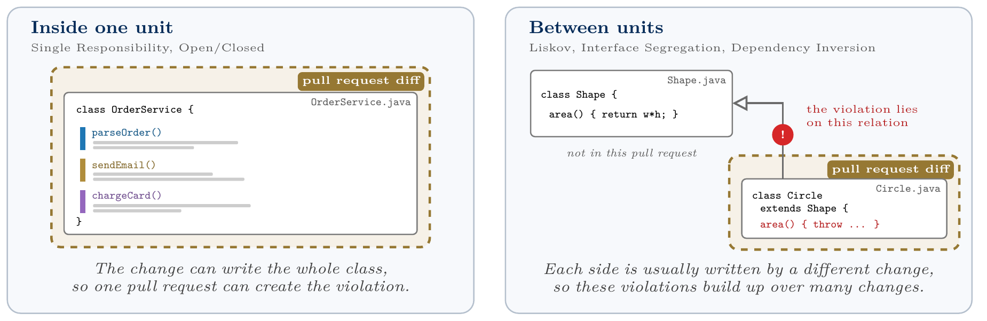
Where the problems live
Notes:
40/56 Where the problems live

Slide 41
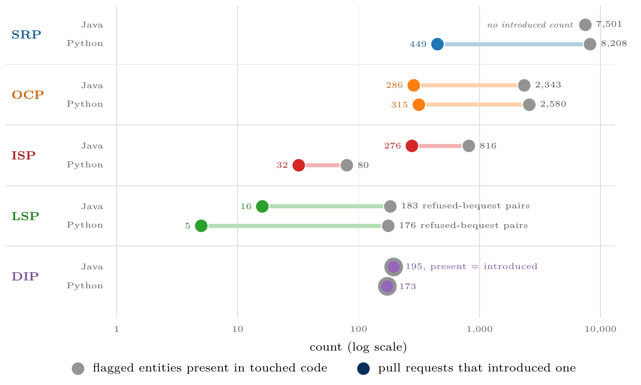
Most violations were there before the change
Refused bequest: 183 present against 16 introducing pull requests in Java, 176 against 5 in Python. After correcting for precision, 0.4% to 4.1% of Java requests introduce a violation.
Notes:
41/56 Most violations were there before the change

Slide 42
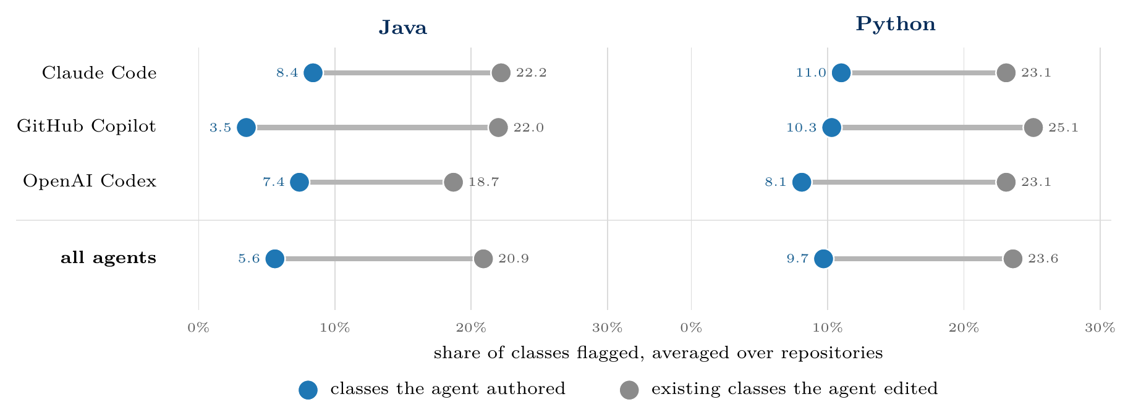
Agent-written classes are flagged less than the code they edit
Pooled: 7.7% against 13.5% in Java, 8.9% against 12.1% in Python. New classes are also smaller and younger, so this describes the corpus; it does not rank agents against people.
Notes:
42/56 Agent-written classes are flagged less than the code they edit

Slide 43
Do agents repair design, or damage it? cycles in the touched code, before against after
 | Java (4,245 PRs) | Python (4,946 PRs)
more cycles after | 188 (4.4%) | 58 (1.2%)
fewer cycles after | 20 (0.5%) | 32 (0.6%)
unchanged | 4,037 (95.1%) | 4,856 (98.2%)
total cycles, before → after | 8,028 → 8,398 | 1,485 → 1,516
Agents add cycles more often than they remove them, by about nine to one in Java. The amounts are small next to the 8,028 already present, and this is the only principle where a repair can be counted, because only Dependency Inversion stores a before count.
Notes:
43/56 Do agents repair design, or damage it? — cycles in the touched code, before against after

Slide 44
Part 7
Findings and conclusions
Notes:
44/56 Part 7: Findings and conclusions

Slide 45
RQ4: what holds in both languages
Result | Java | Python
Change size dominates | OR 1.88–1.95 | holds 2.01–2.18
Claude Code on Open/Closed | 2.22 (1.21–4.07) | holds 2.09 (1.44–3.04)
Present far exceeds introduced | 183 vs 16 | holds 176 vs 5
Authored flagged less than edited | 7.7% vs 13.5% | holds 8.9% vs 12.1%
Shape rule transfers, number does not | 1.000 vs 0.704 | holds 0.857 vs 0.200
Compiler removes a family of LSP faults | inferred from Java | confirmed 46 of 51
Merged equals unreviewed | yes | does not hold
SRP screen precision | 0.350 | drops to 0.110
Notes:
45/56 RQ4: what holds in both languages

Slide 46
Findings
[1] What a compiler enforces decides which violations can exist: 46 of 51 confirmed Python Liskov violations are faults javac rejects.
[2] Width predicts Interface Segregation violations and not Open/Closed ones, because one principle is about size and the other about whether a set can grow.
[3] The closed sets that matter are fixed by specifications, not by the language.
[4] Most flagged problems in the touched code predate the change.
[5] Classes the agents wrote are flagged less often than the classes they edit.
[6] Merged code is not a biased sample of unreviewed agent code in Java, but it is cleaner than abandoned code in Python.
Notes:
46/56 Findings

Slide 47
Against the state of the art: what we confirm
Earlier finding | What we measured | Outcome
Volume-Quality Inverse Law (Zhu, Yuecai) | Each doubling of files touched multiplies the odds of a flag by 1.88–1.95 (Java) and 2.01–2.18 (Python), on every modelled principle | Confirmed. Our strongest result, in both languages
Agent differences vanish after churn normalisation (Cynthia et al.) | After adjusting for files, repository and time, only Claude Code on Open/Closed survives: 2.22 Java, 2.09 Python | Confirmed, with one exception that replicates
Passing tests ≠ a change a maintainer accepts (Whitfill et al.) | Merged Java pull requests are structurally indistinguishable from those closed without review | Consistent. Merge status carries little structural information
91% correct, yet thousands of design issues (Kashif et al.) | Violations already present outnumber those introduced by about 11:1 (Java) and 35:1 (Python) | Consistent, though they build new projects and we edit existing ones
Notes:
47/56 Against the state of the art: what we confirm

Slide 48
Against the state of the art: where we differ
Earlier finding | What we measured | Outcome
SRP easiest to detect, DIP hardest (Pehlivan et al.) | For structural detectors the order reverses: DIP is the most precise (0.892 Java, 1.000 Python), SRP the least (0.350, 0.110) | Reversed, because a model reads examples while a static rule computes a whole-repository graph
Agents succeed at only 4.3% of dependency-control tasks, in C++ (Zhu, Haichao, NITR) | Agents seldom introduce dependency or responsibility violations into existing Java and Python repositories | Different question: that benchmark asks agents to repair structure, we ask whether they damage it
Erosion grows across 77% of long-horizon trajectories (SlopCodeBench) | The time coefficient is inert for every delta principle, in both languages | Not tested: our unit is one pull request, not a trajectory of successive edits
Taken together with Pehlivan: a graph-based detector and a reading model fail on opposite principles, so combining them beats choosing one.
Notes:
48/56 Against the state of the art: where we differ

Slide 49
Contributions and practical use
Contributions
For a review check
A validated SOLID instrument over real agent pull requests, all five principles
A corpus with merged, rejected and open requests
A map of which principles a rule measures and which it only screens
Evidence in two languages on where design risk sits
A replication with the same agents in a second language
Add refused bequest: 64/64 in Java, 6/7 in Python
In dynamic languages, also check that an override still accepts the base's calls
Do not rely on interface-width thresholds
Treat SRP and OCP flags as prompts for discussion, not as blockers
Structural checks cannot see relation-level damage: that needs repository history
Notes:
49/56 Contributions and practical use

Slide 50
Limitations
SOLID adherence is not measured design quality or cost; nothing here observes an outcome
Labels come from an LLM judge of the same family as one agent; 89.7% self-agreement bounds every figure
No independent-tool check for OCP, ISP, or for Python at all
Agents chose their own tasks: these are associations, not causes
Few reviewed rejections (171 Java, 196 Python)
One snapshot per pull request: slow erosion is invisible
Both corpora come from one dataset; 7.0% of Python source is gone
Small counts for the relation-level principles, so their intervals are wide
Python Interface Segregation is defined differently, so raw rates are not comparable
Notes:
50/56 Limitations

Slide 51
Conclusion and future work
Most design problems in the code these agents touch were there before them, and how much an agent changes matters more than which agent it is. Both results hold in Java and in Python.
Next steps
Narrow recall by sampling unflagged entities
Re-judge Python samples, and add a judge from another model family
A corpus with many reviewed rejections
Repository history as the unit of analysis
Recognise specification-fixed sets for Open/Closed, and a churn signal for what is not closed
An Open/Closed proxy that agrees with published smells (κ=0.122 today)
A framework-aware responsibility screen for Python
Notes:
51/56 Conclusion and future work

Slide 52
Thank you
Notes:
52/56 Thank you

Slide 53
Backup
Additional material
Notes:
53/56 Backup: Additional material

Slide 54
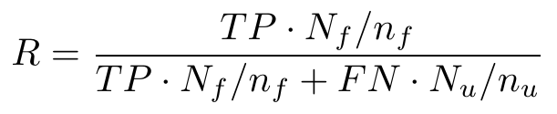
Backup: why recall must be weighted
Each sample is half flagged, the population is not. For Java Liskov it holds 574 flagged override pairs and 25,594 unflagged ones.
The intervals are wide because a weighted recall rests on the few violations found in the unflagged stratum (three for Liskov, in 200 rows).
This is why more labelling would help recall, not precision.
Counting the strata as equally common gives 0.966. Weighting gives 0.386. The population is the one the sample was drawn from: production entities, counted once each.
Notes:
54/56 Backup: why recall must be weighted

Slide 55
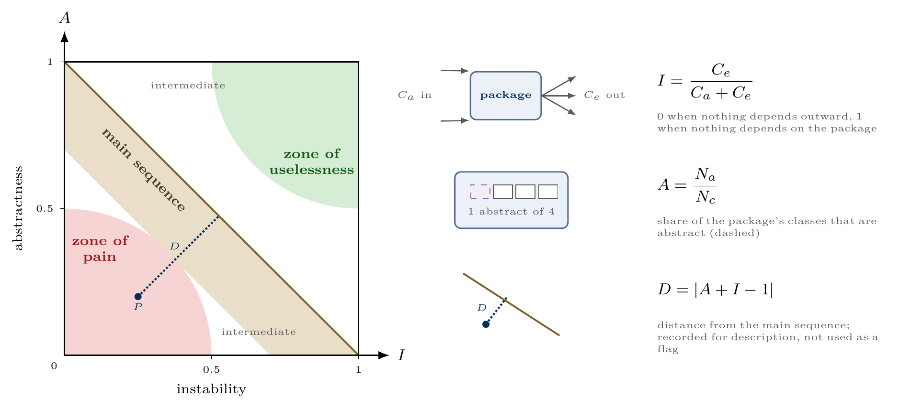
Backup: package zones (descriptive only)
Distance from the main sequence was tested as a change signal and confirmed none of 17 flags, so packages are described by position and never flagged.
Notes:
55/56 Backup: package zones (descriptive only)

Slide 56
Backup: corrected rates, with SRP split by authorship
Principle | Unit |  | Java |  | Python
 |  |  | flagged | corrected | flagged | corrected
SRP | class, authored |  | 7.7% | 2.7% | 8.9% | 1.0%
SRP | class, all touched |  | 12.2% | 4.3% | 11.6% | 1.3%
OCP | pull request |  | 6.7% | 2.2% | 6.4% | 2.5%
LSP | pull request |  | 0.4% | 0.4% | 0.9% | 0.5%
ISP | pull request |  | 6.5% | 2.2% | 0.6% | 0.3%
DIP | pull request |  | 4.6% | 4.1% | 3.5% | 3.5%
Corrected = flag rate multiplied by measured precision. The Java Liskov row is the shipped flag, refused bequest only, whose precision is 1.000.
Notes:
56/56 Backup: corrected rates, with SRP split by authorship

