Slide 1

Notes:
1/56 Evaluating Coding Agent Quality

Slide 2
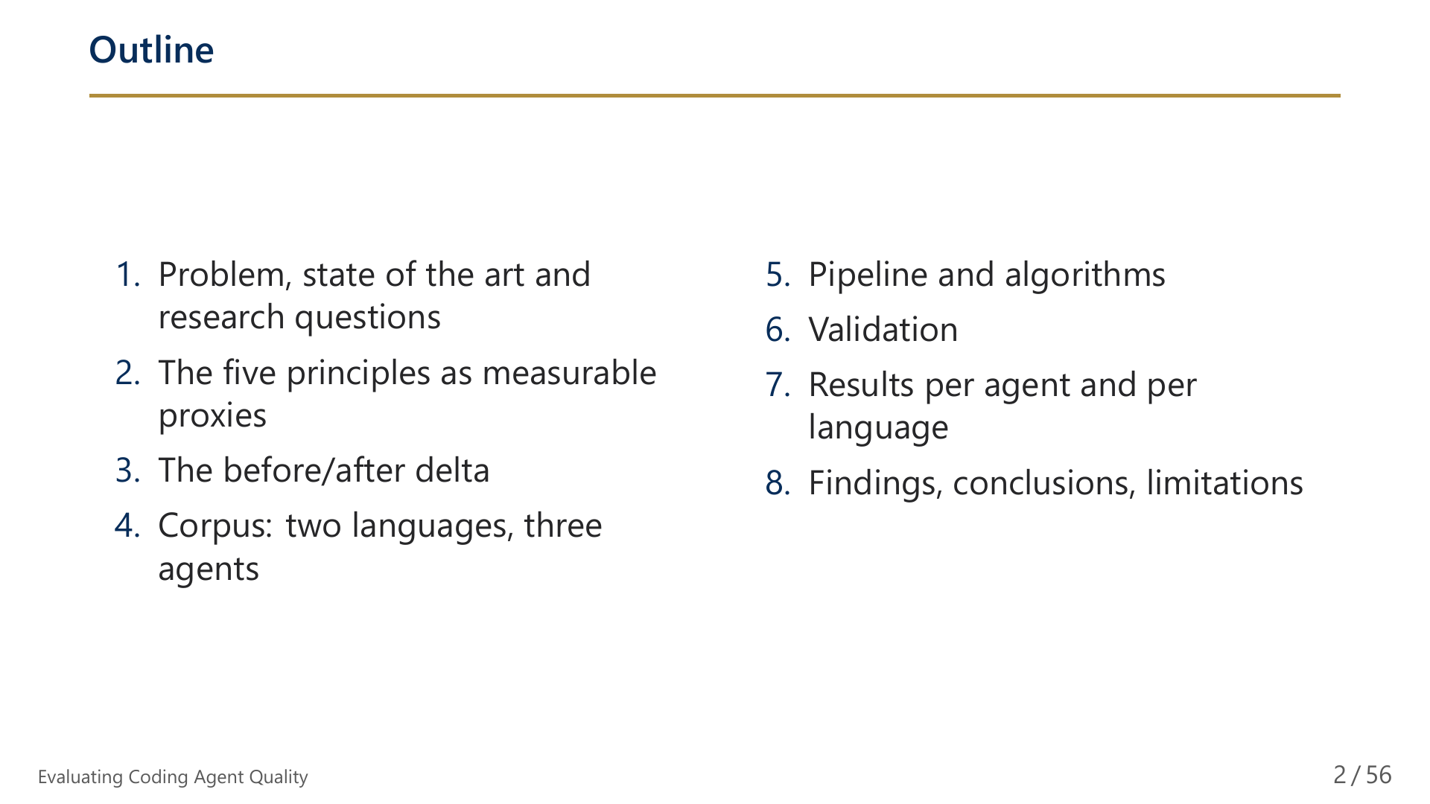
Notes:
2/56 Outline

Slide 3
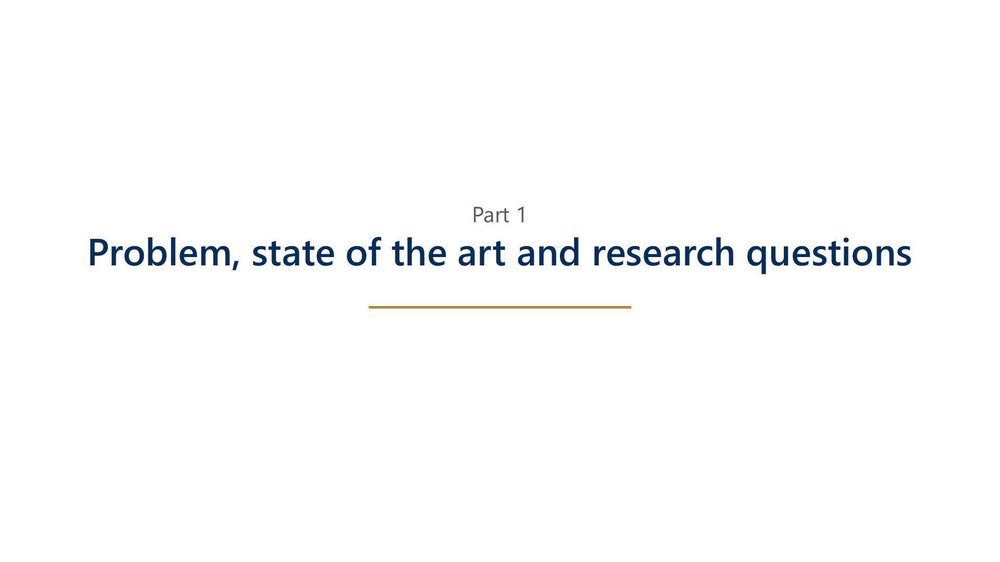
Notes:
3/56 Part 1: Problem, state of the art and research questions

Slide 4
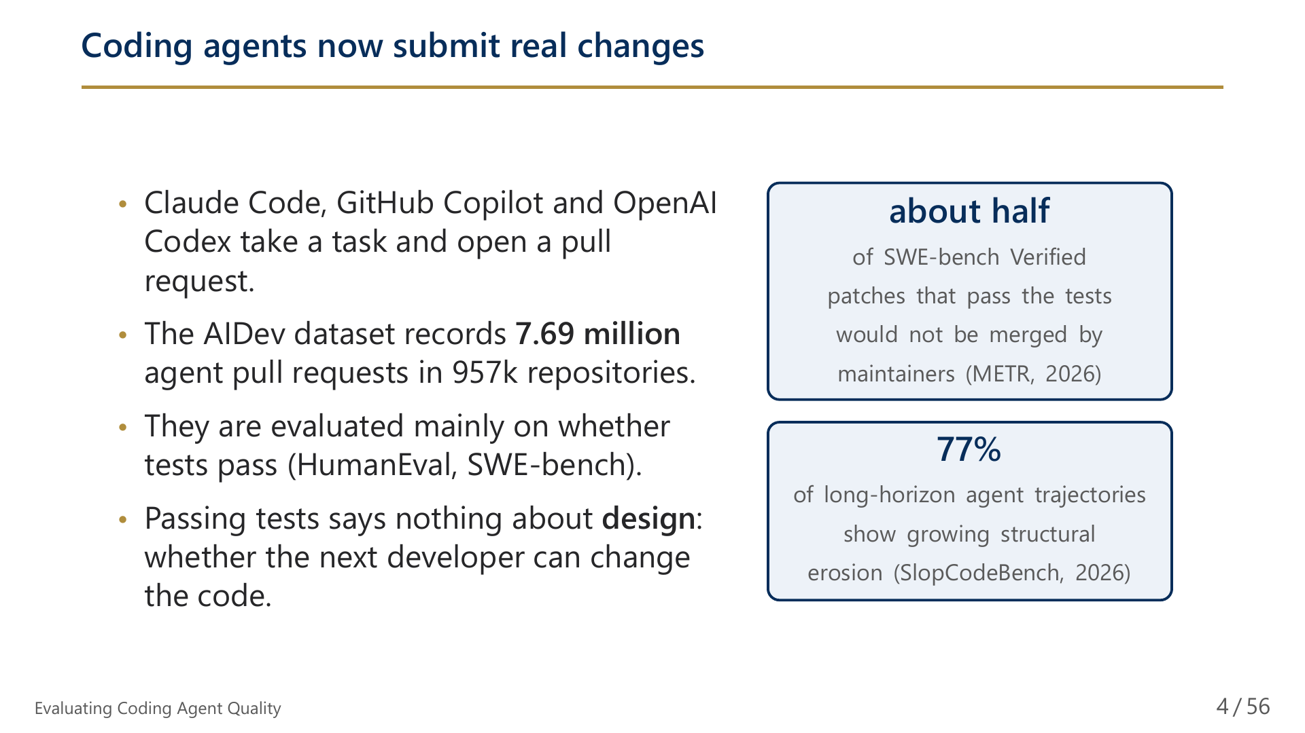
Notes:
4/56 Coding agents now submit real changes

Slide 5
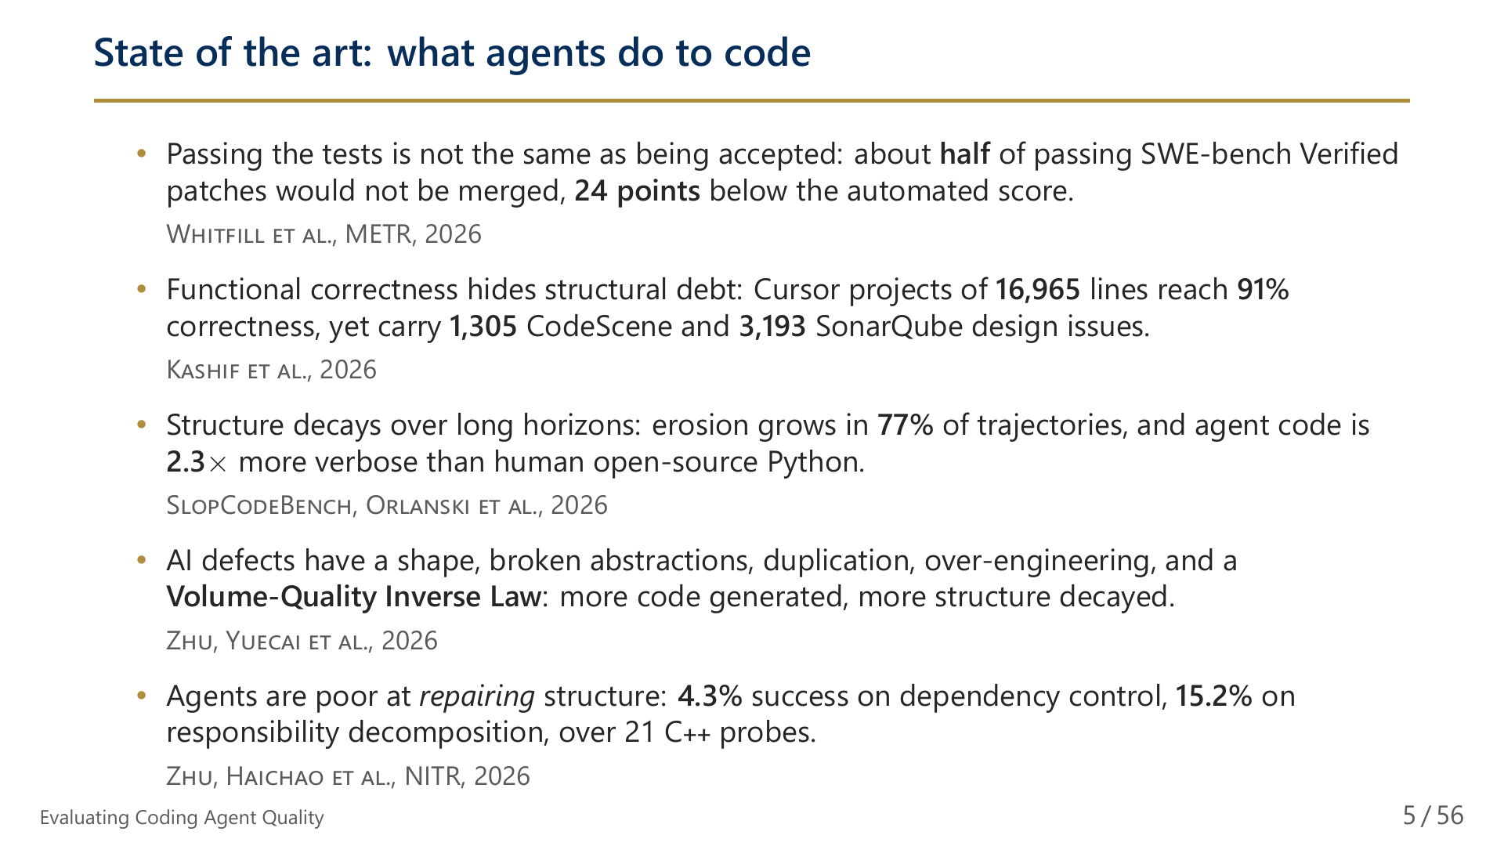
Notes:
5/56 State of the art: what agents do to code

Slide 6
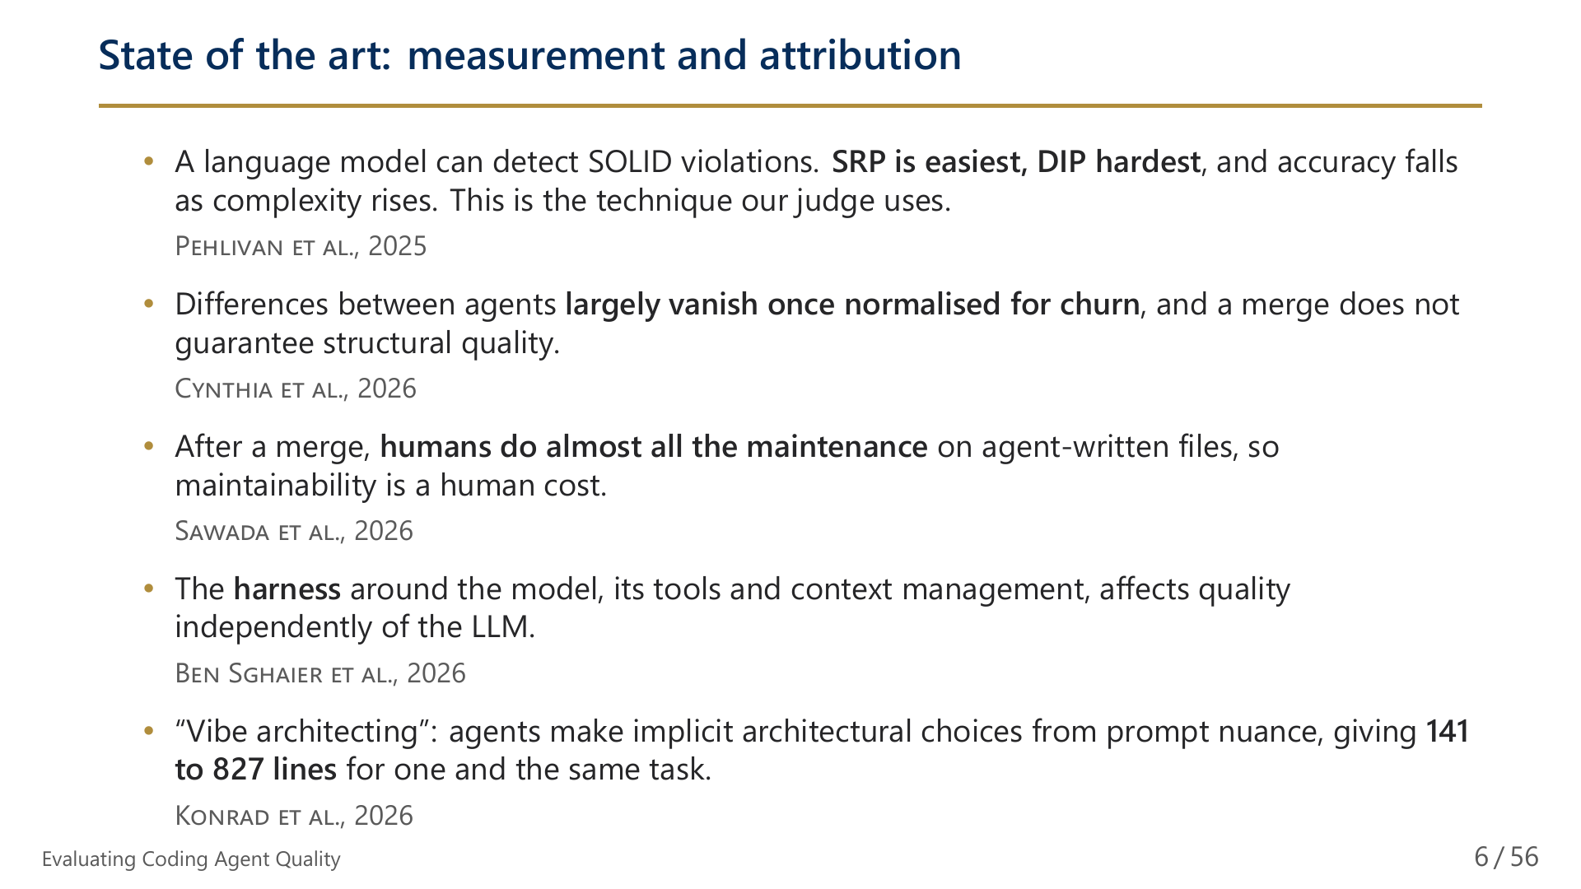
Notes:
6/56 State of the art: measurement and attribution

Slide 7
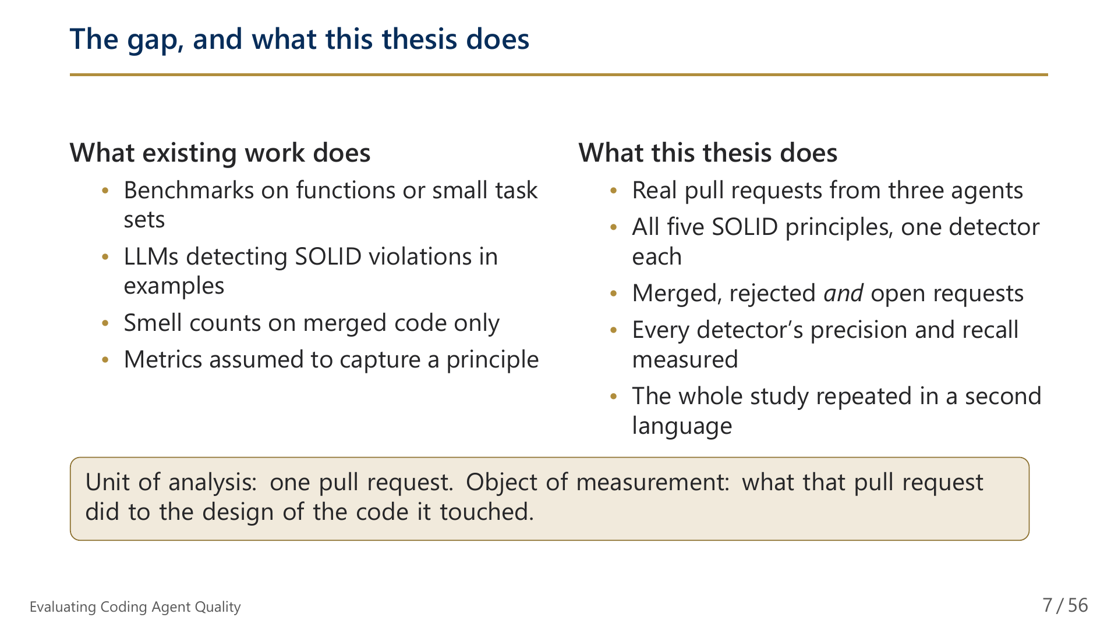
Notes:
7/56 The gap, and what this thesis does

Slide 8
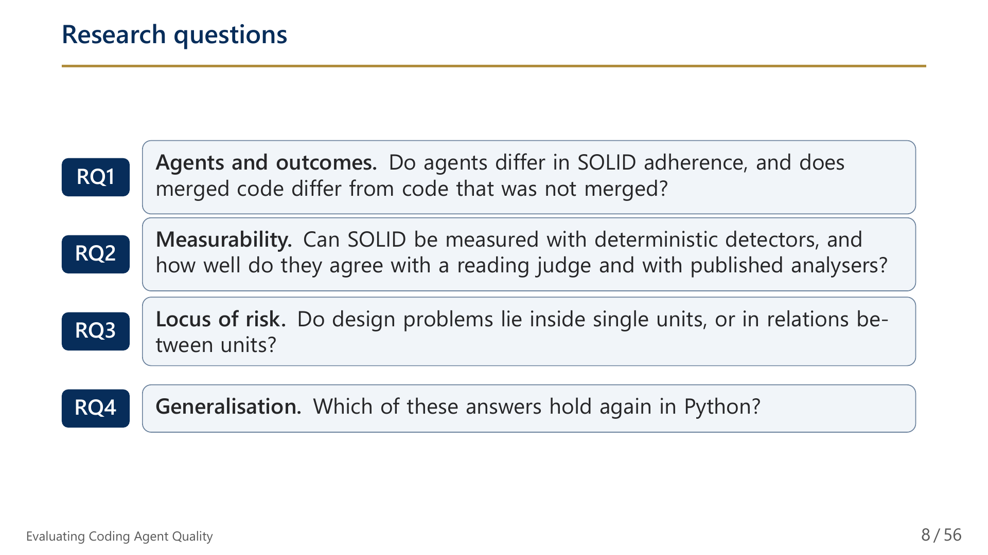
Notes:
8/56 Research questions

Slide 9
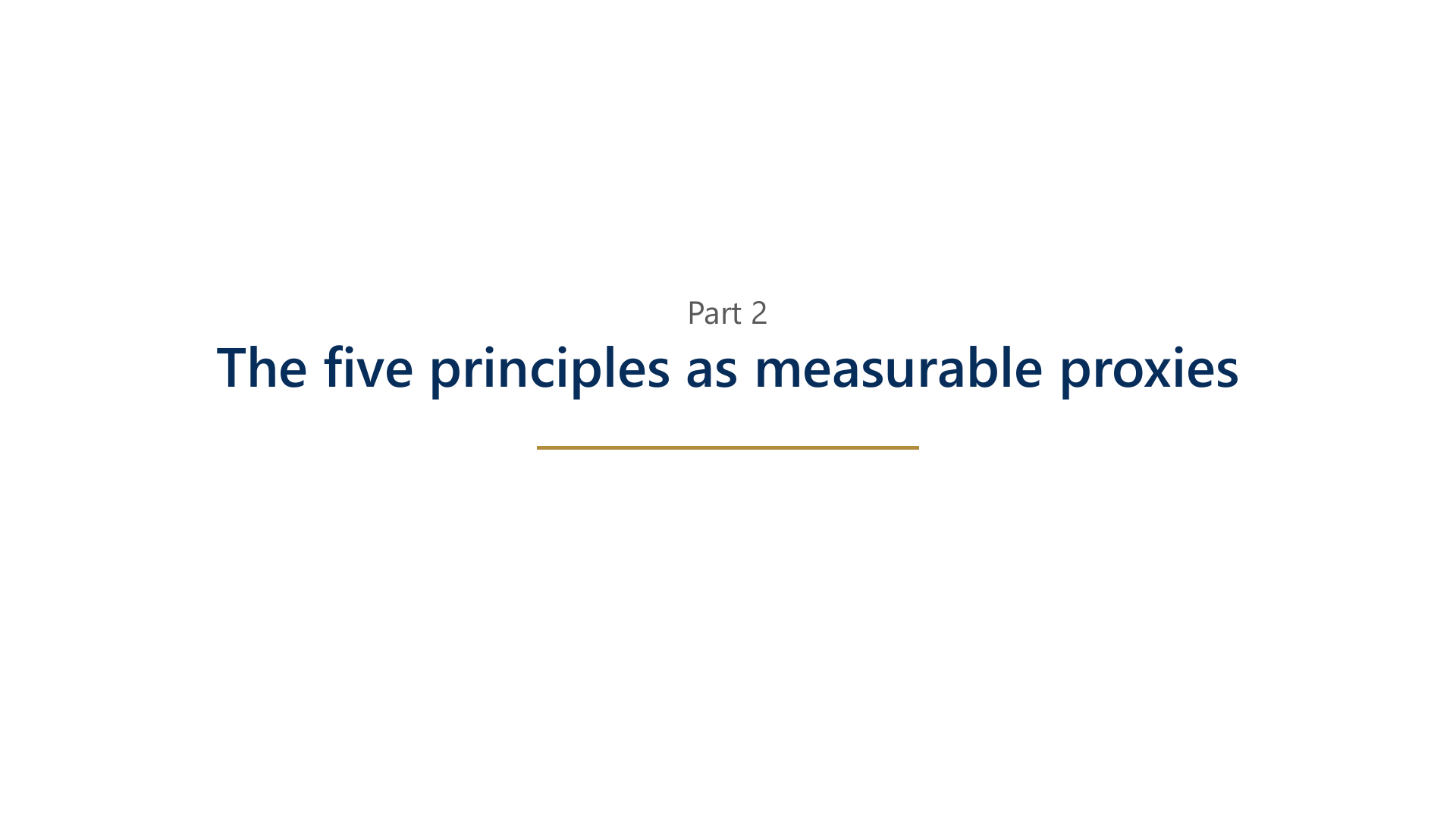
Notes:
9/56 Part 2: The five principles as measurable proxies

Slide 10
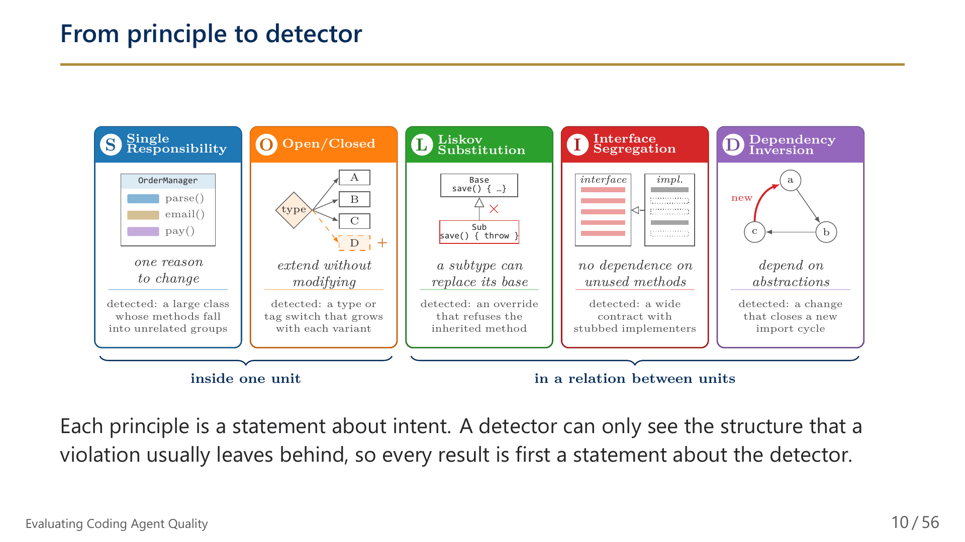
Notes:
10/56 From principle to detector

Slide 11
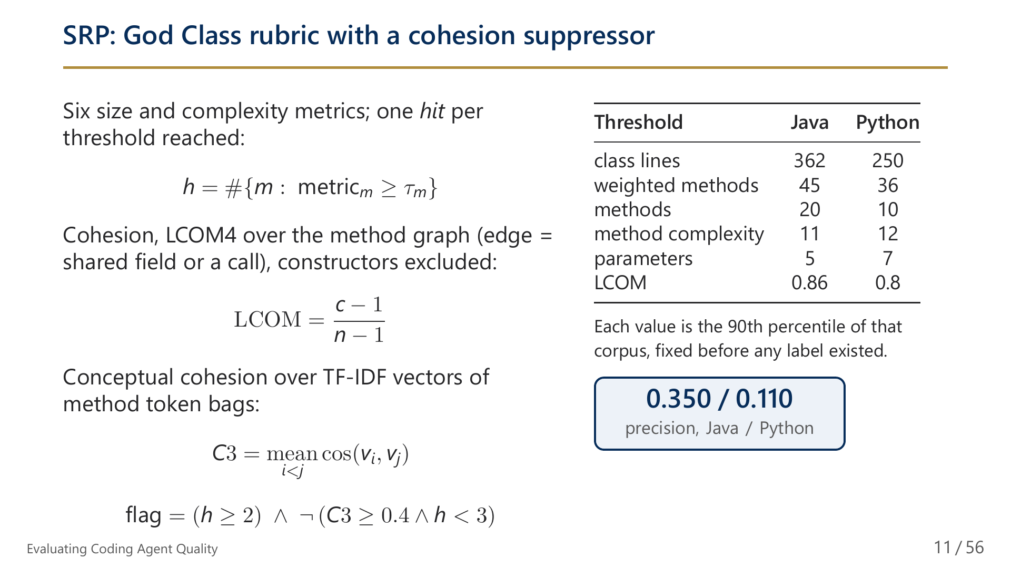
Notes:
11/56 SRP: God Class rubric with a cohesion suppressor

Slide 12
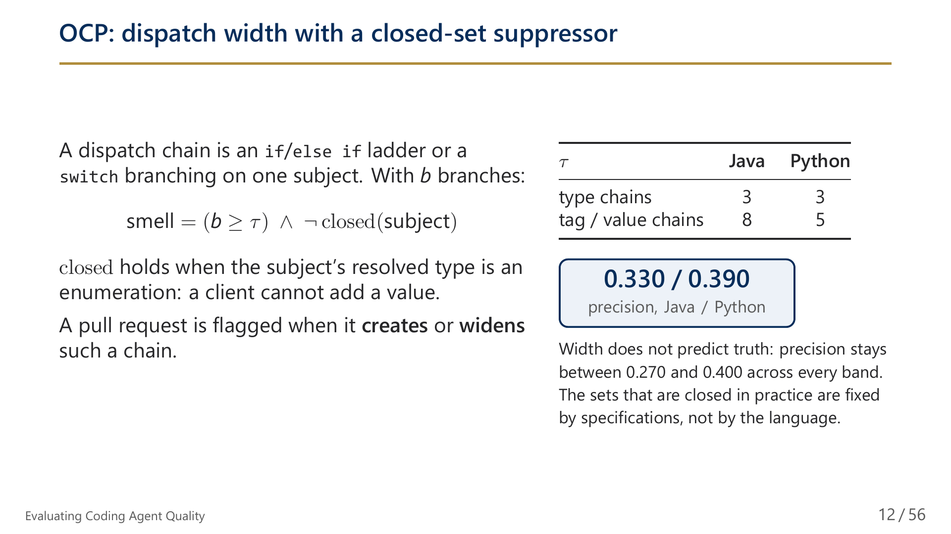
Notes:
12/56 OCP: dispatch width with a closed-set suppressor

Slide 13
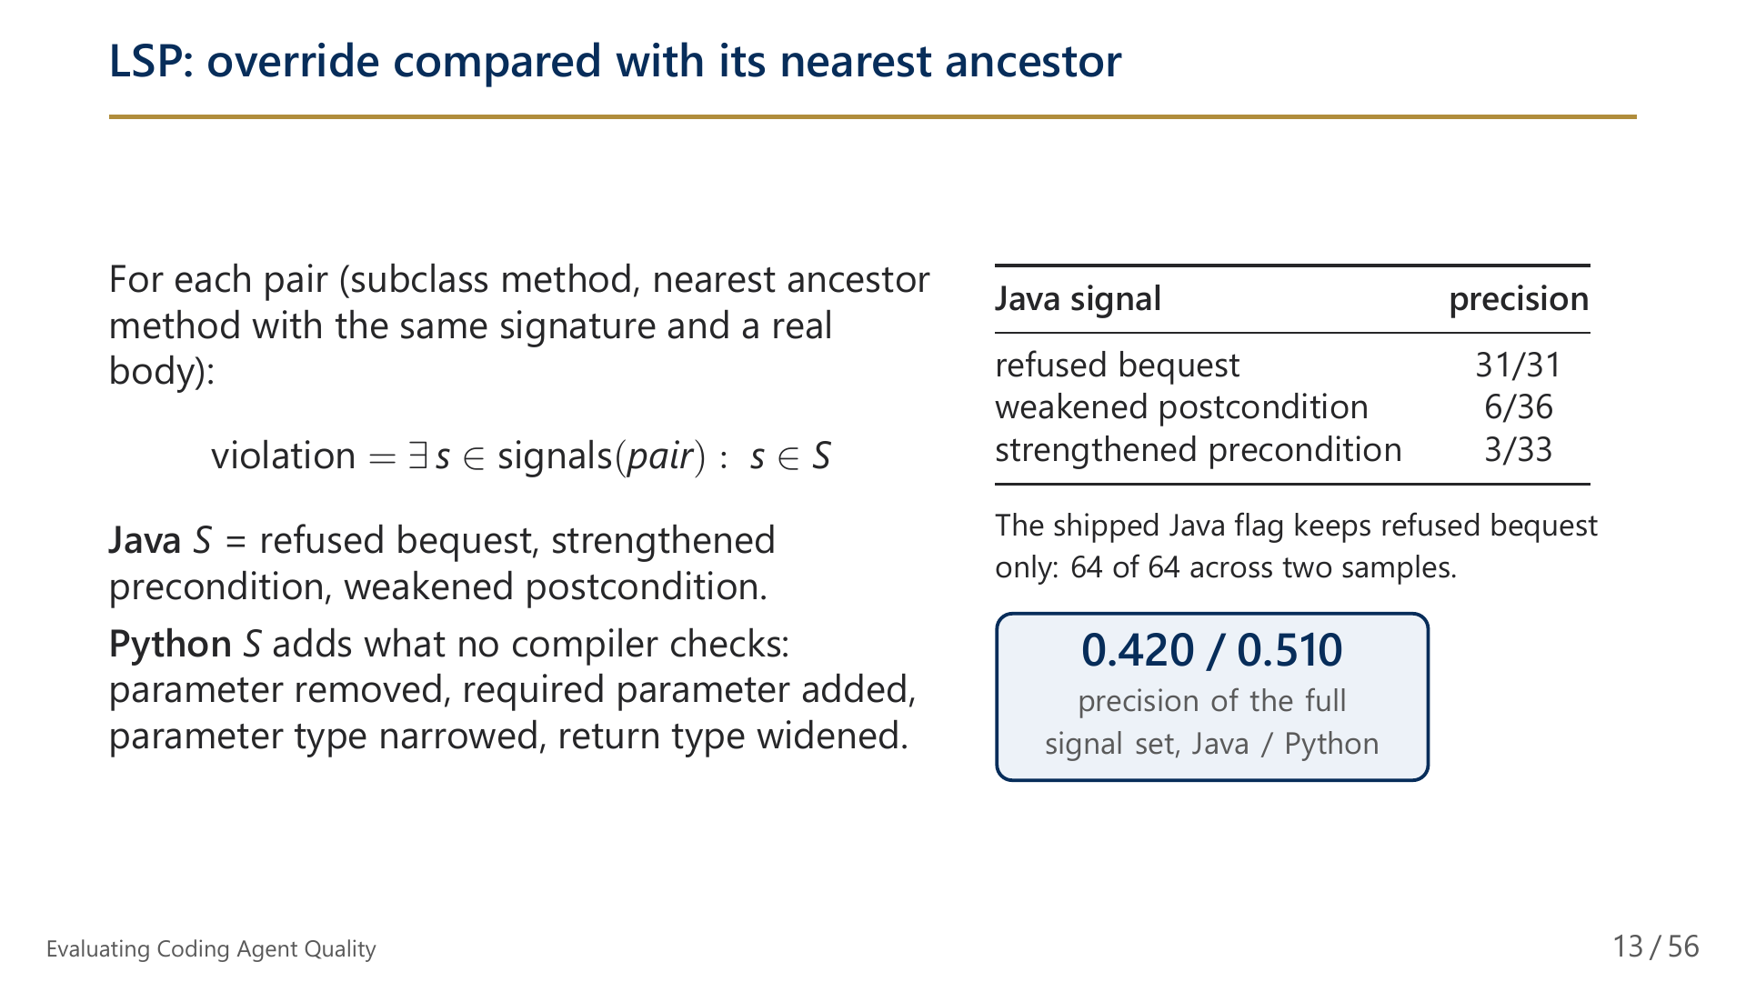
Notes:
13/56 LSP: override compared with its nearest ancestor

Slide 14
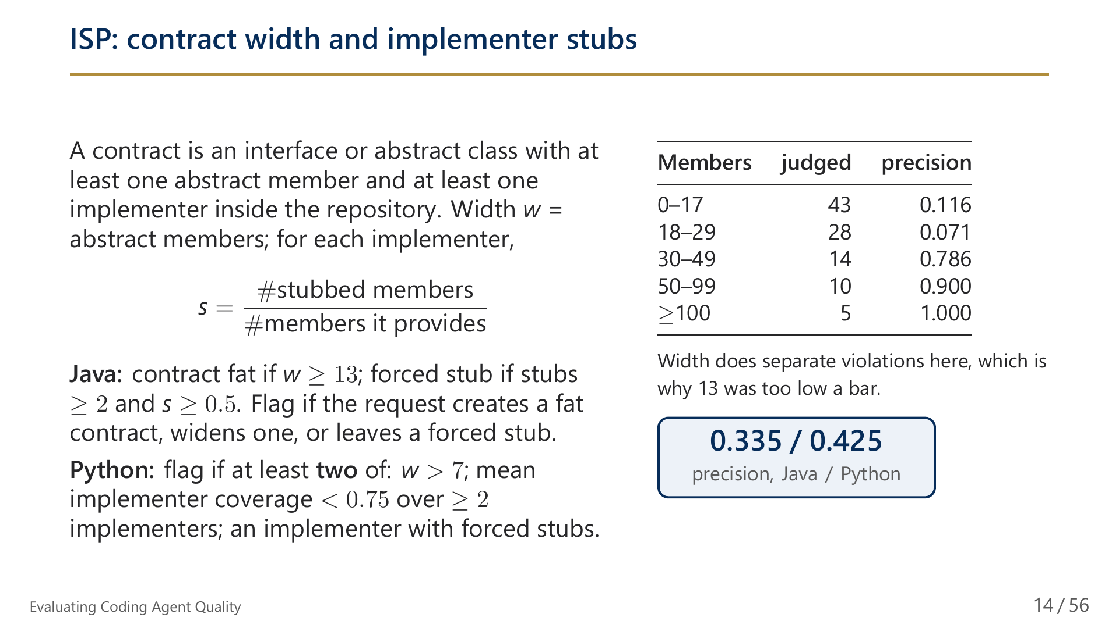
Notes:
14/56 ISP: contract width and implementer stubs

Slide 15
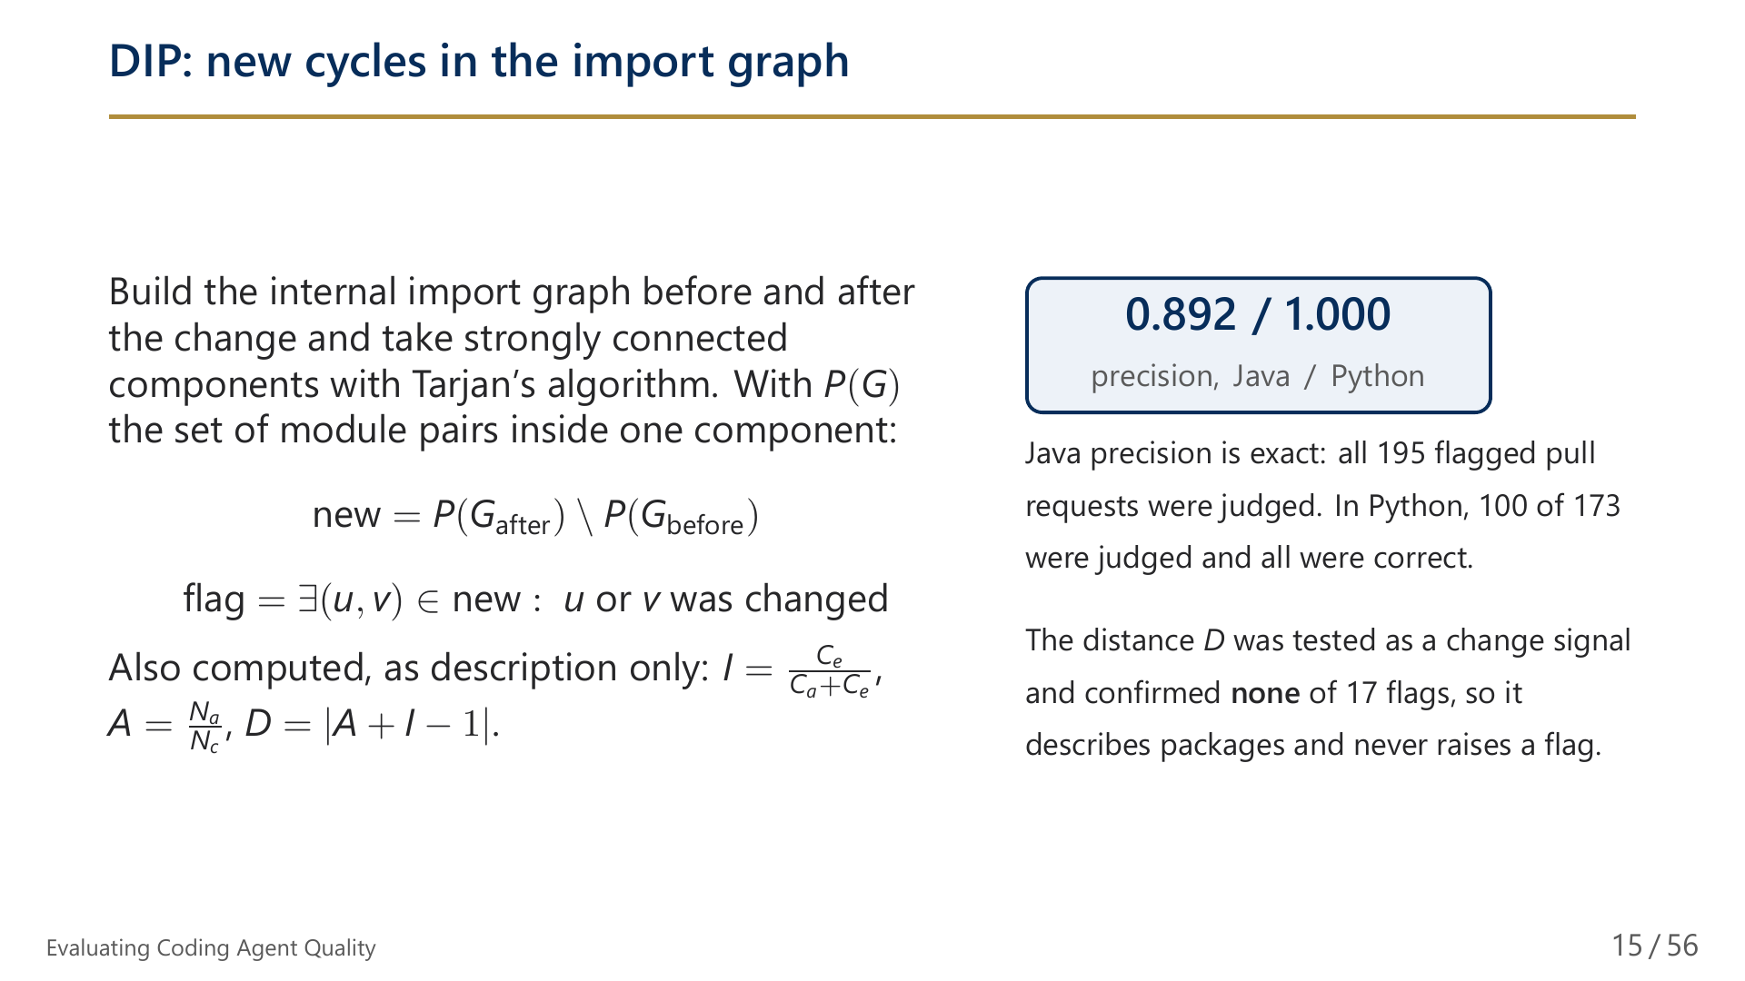
Notes:
15/56 DIP: new cycles in the import graph

Slide 16
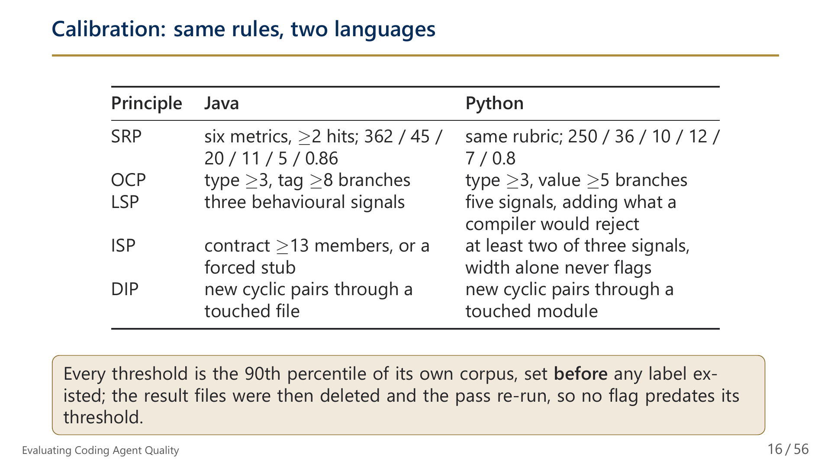
Notes:
16/56 Calibration: same rules, two languages

Slide 17
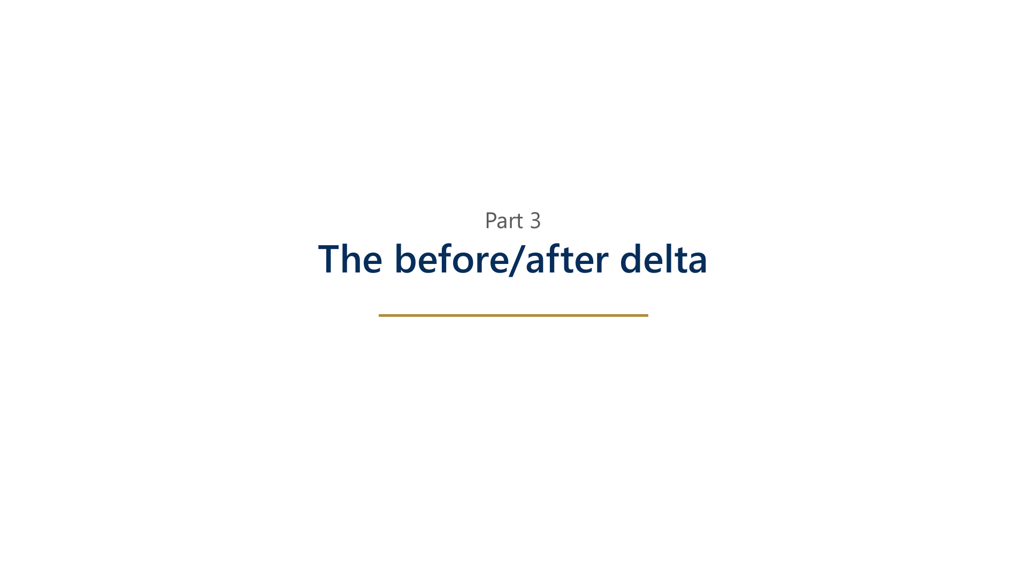
Notes:
17/56 Part 3: The before/after delta

Slide 18
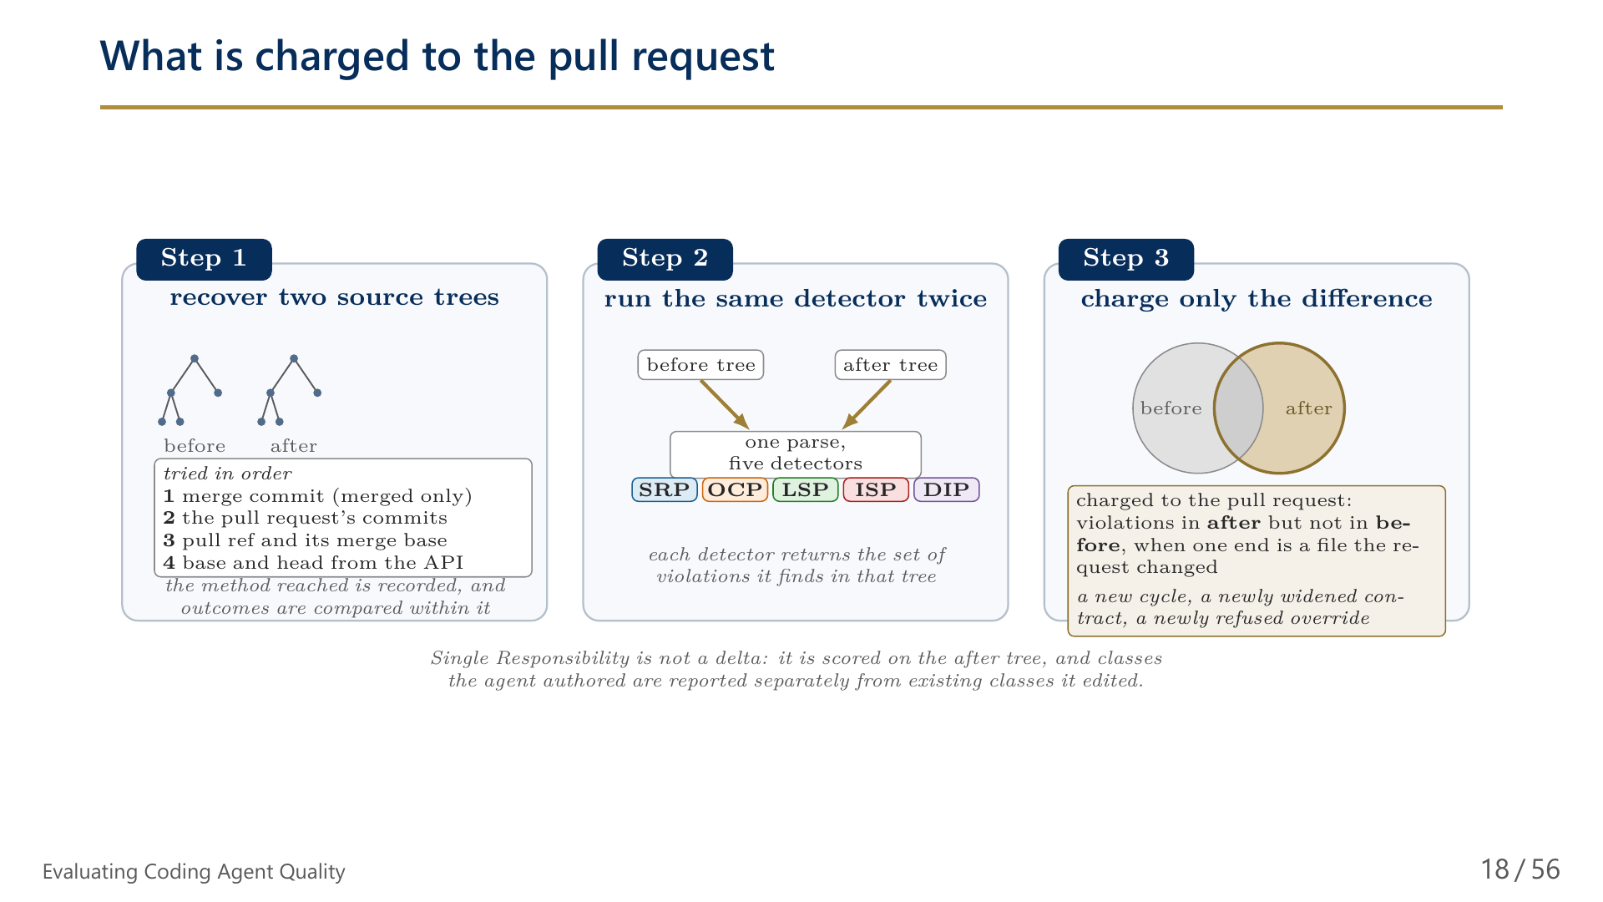
Notes:
18/56 What is charged to the pull request

Slide 19
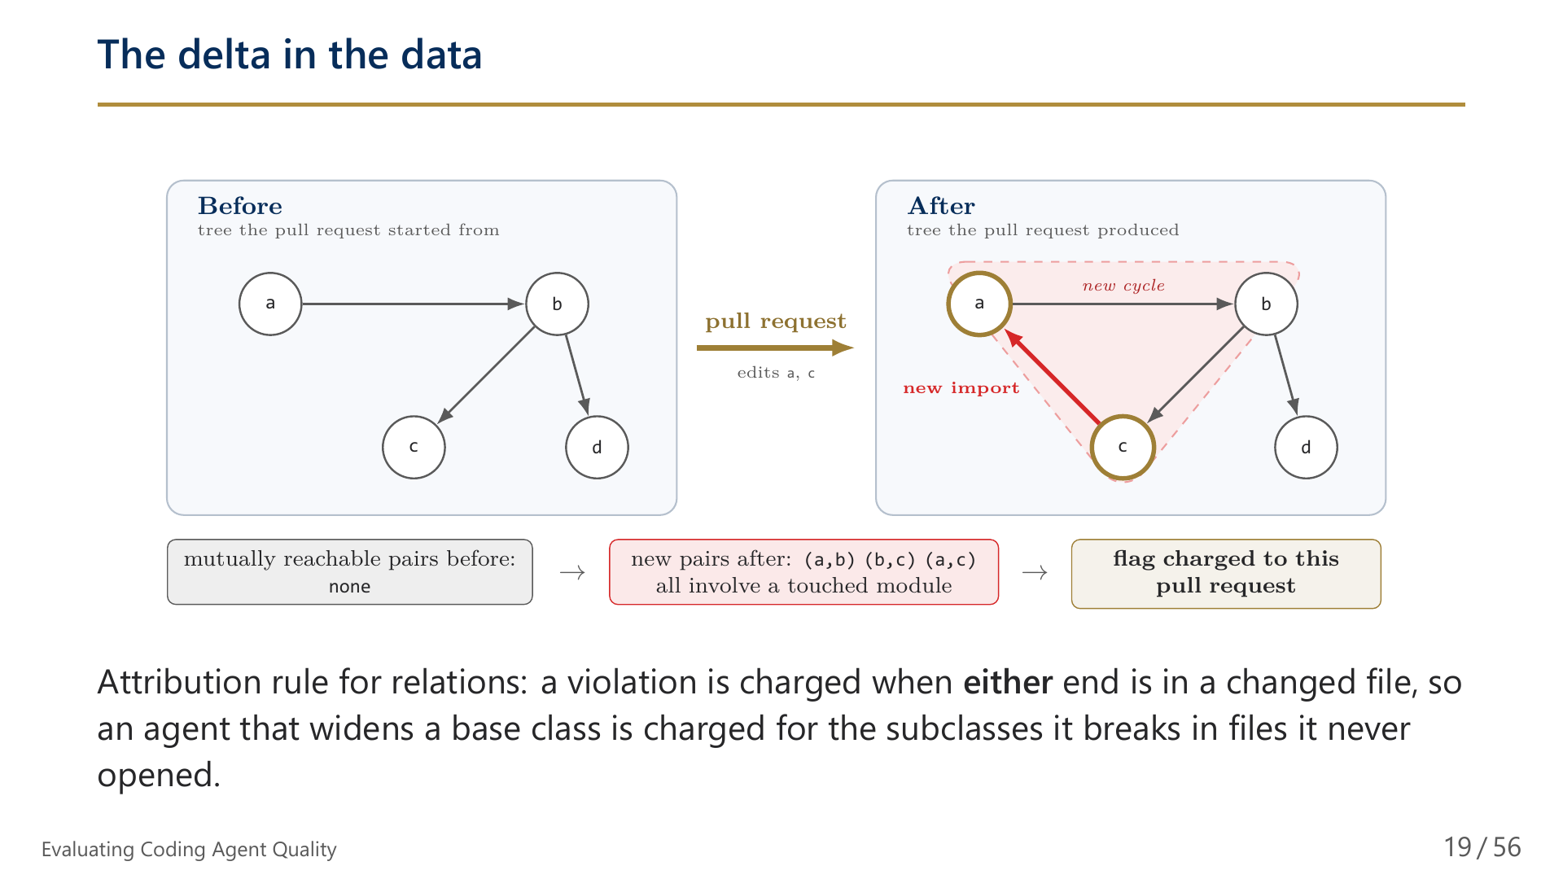
Notes:
19/56 The delta in the data

Slide 20
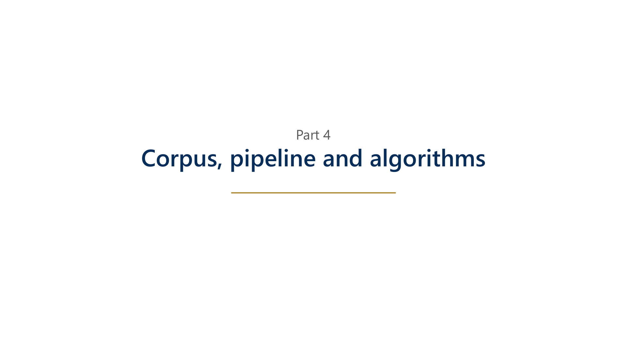
Notes:
20/56 Part 4: Corpus, pipeline and algorithms

Slide 21
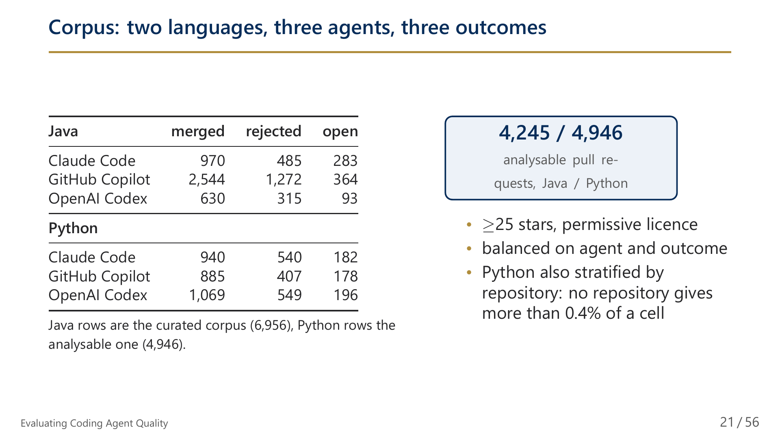
Notes:
21/56 Corpus: two languages, three agents, three outcomes

Slide 22
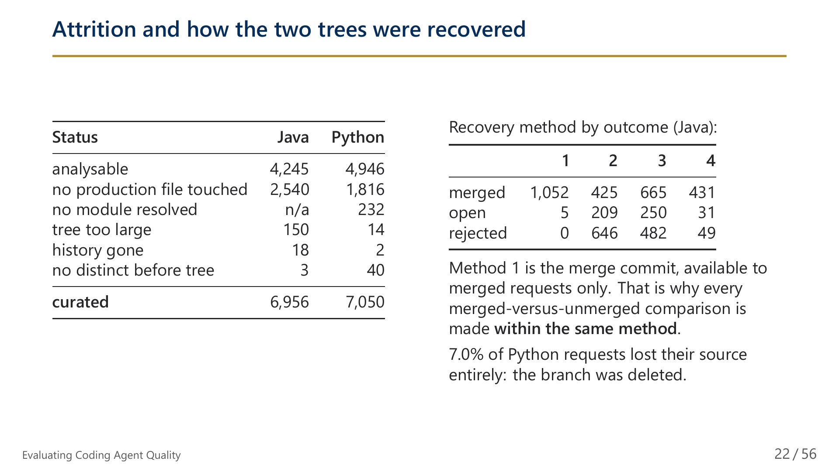
Notes:
22/56 Attrition and how the two trees were recovered

Slide 23
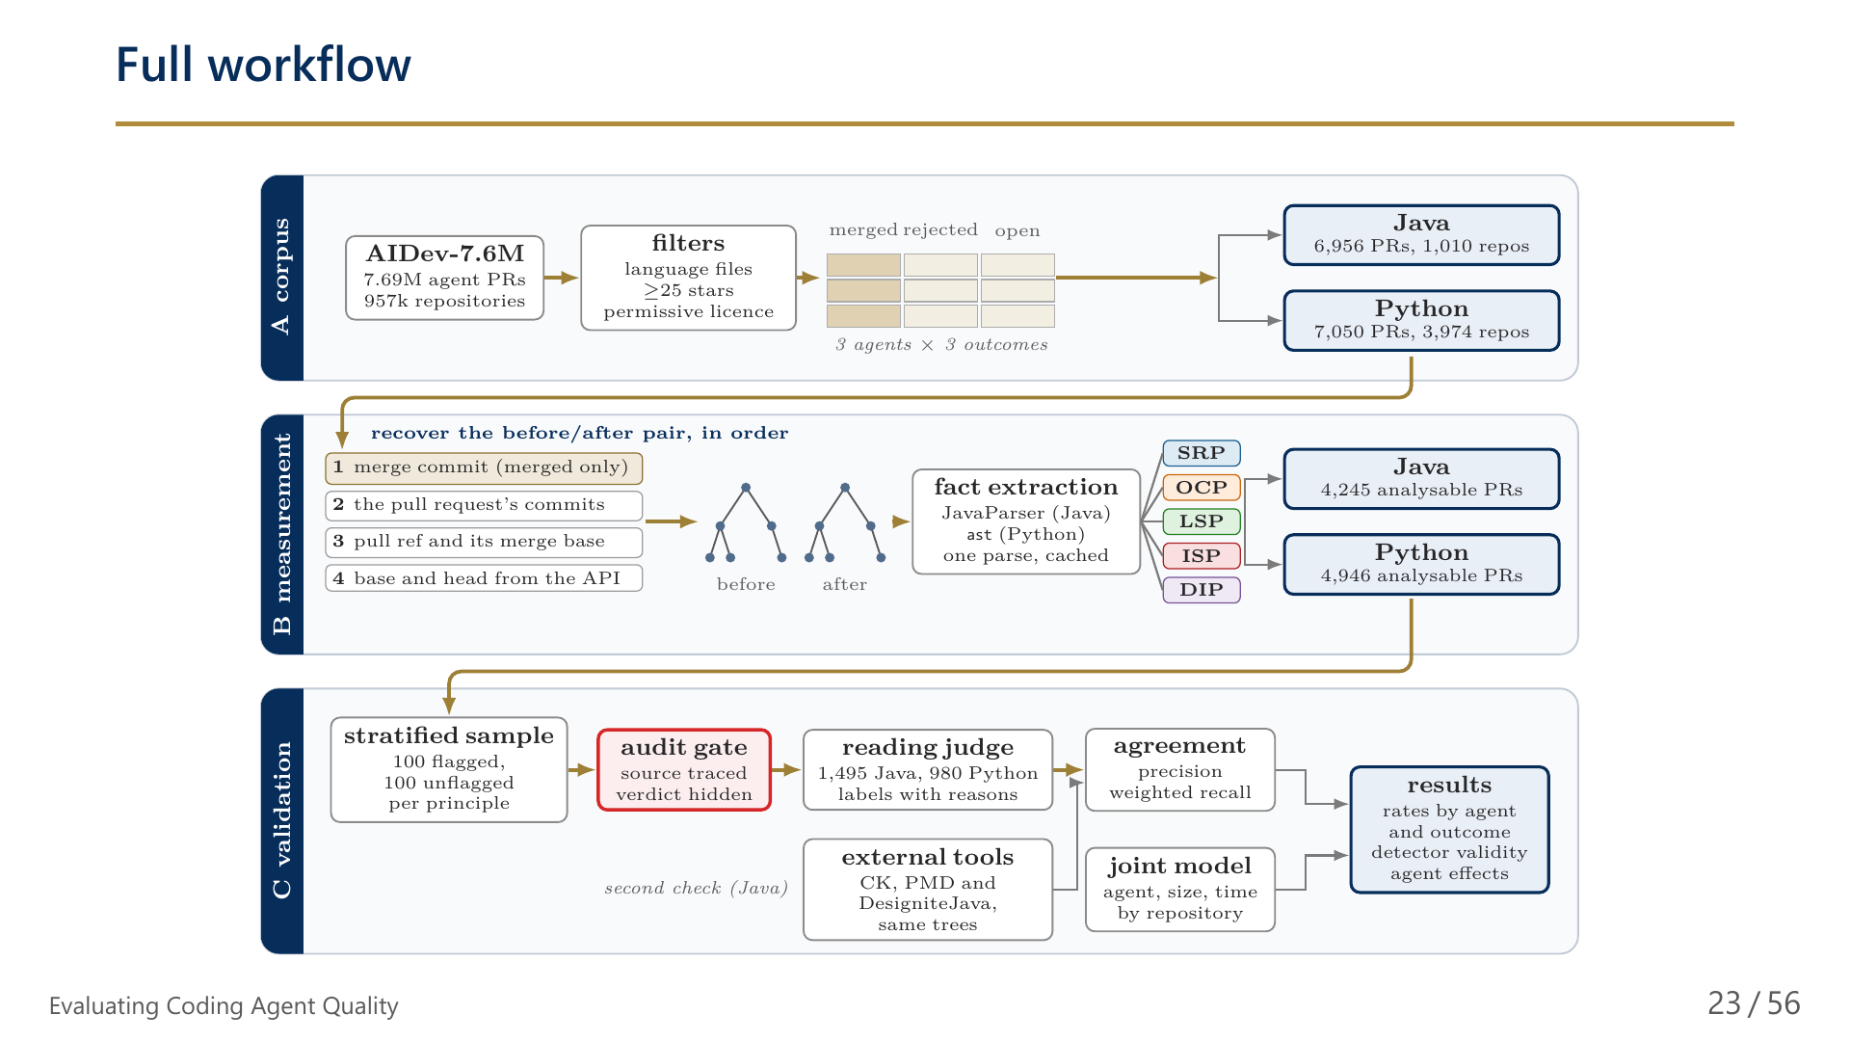
Notes:
23/56 Full workflow

Slide 24
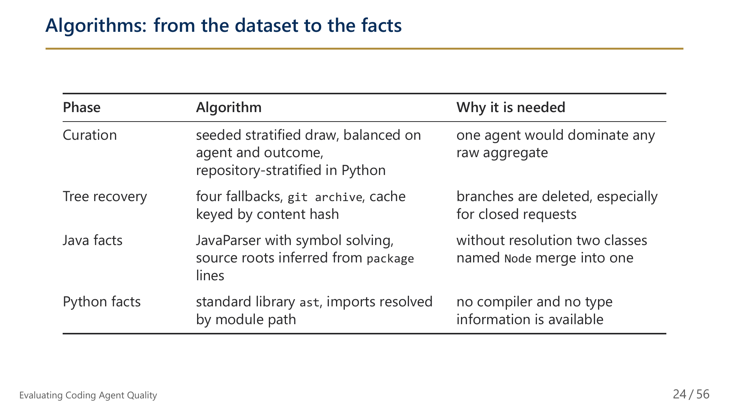
Notes:
24/56 Algorithms: from the dataset to the facts

Slide 25
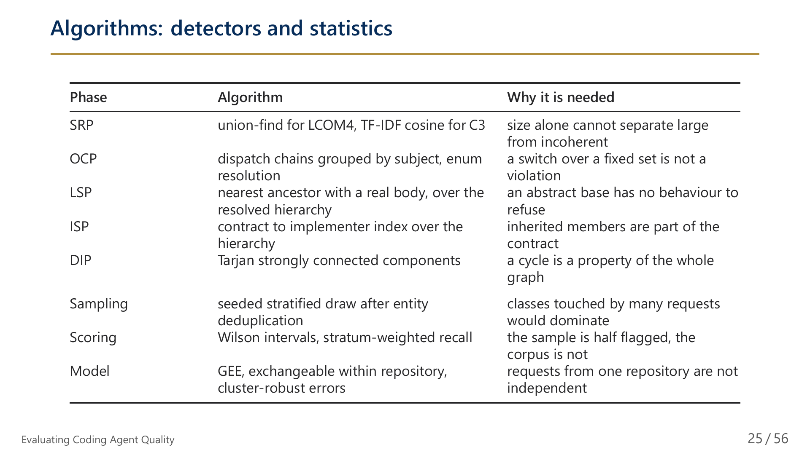
Notes:
25/56 Algorithms: detectors and statistics

Slide 26
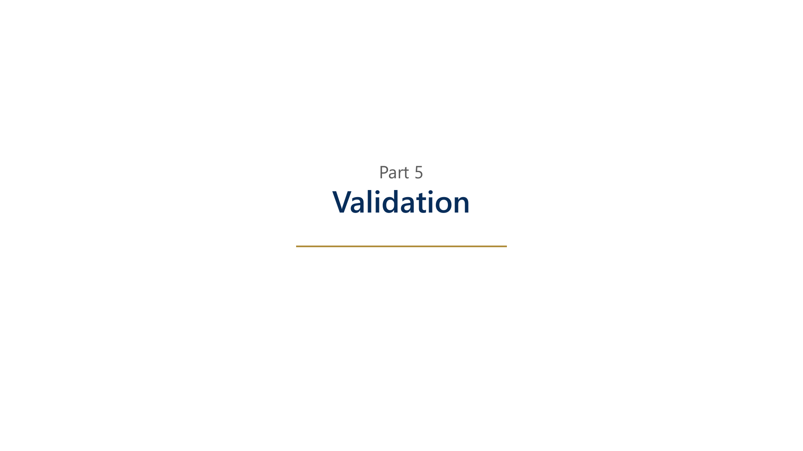
Notes:
26/56 Part 5: Validation

Slide 27
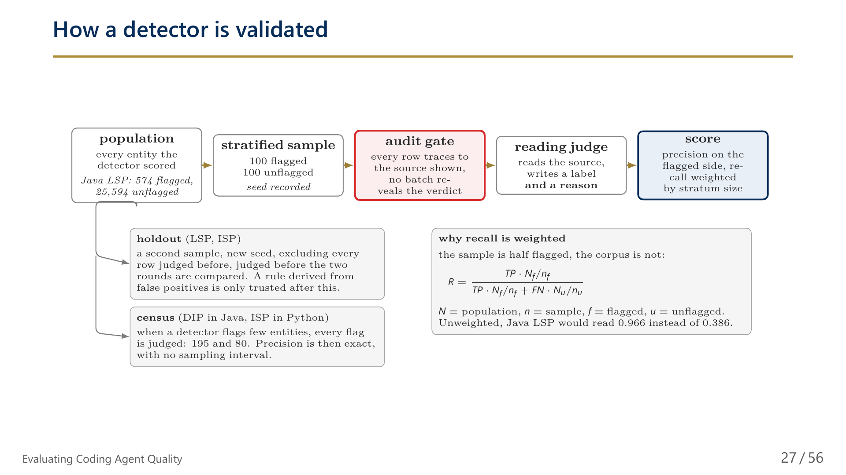
Notes:
27/56 How a detector is validated

Slide 28
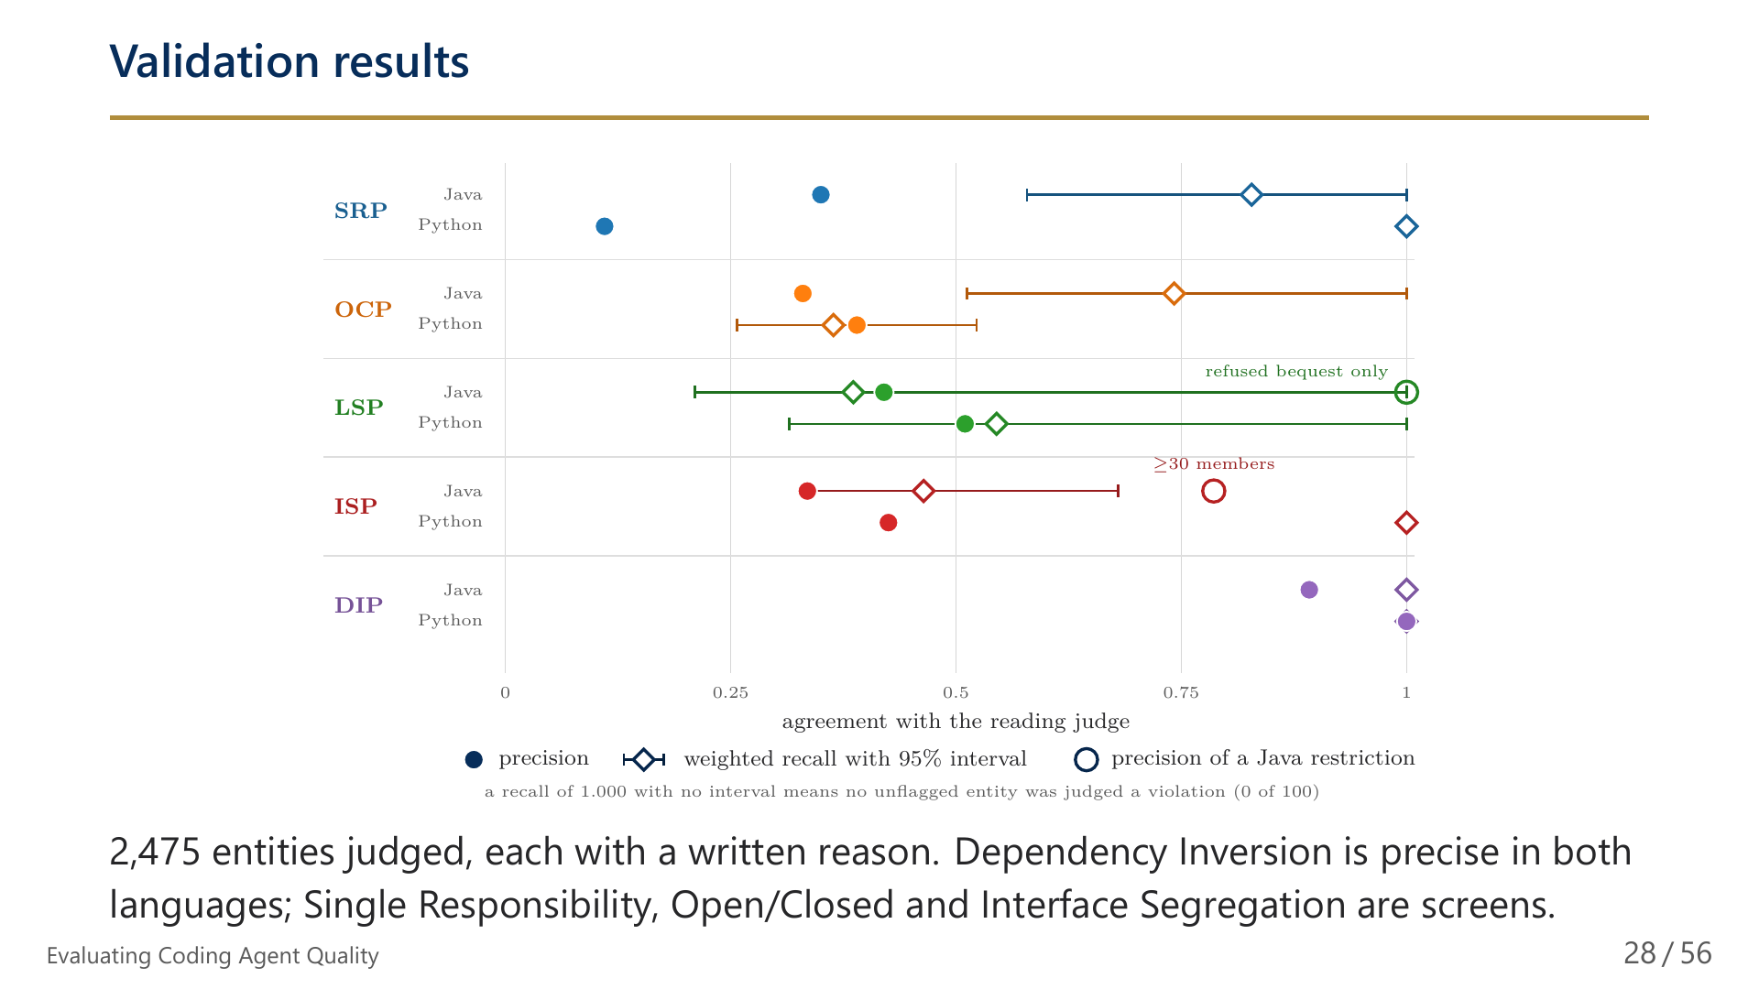
Notes:
28/56 Validation results

Slide 29
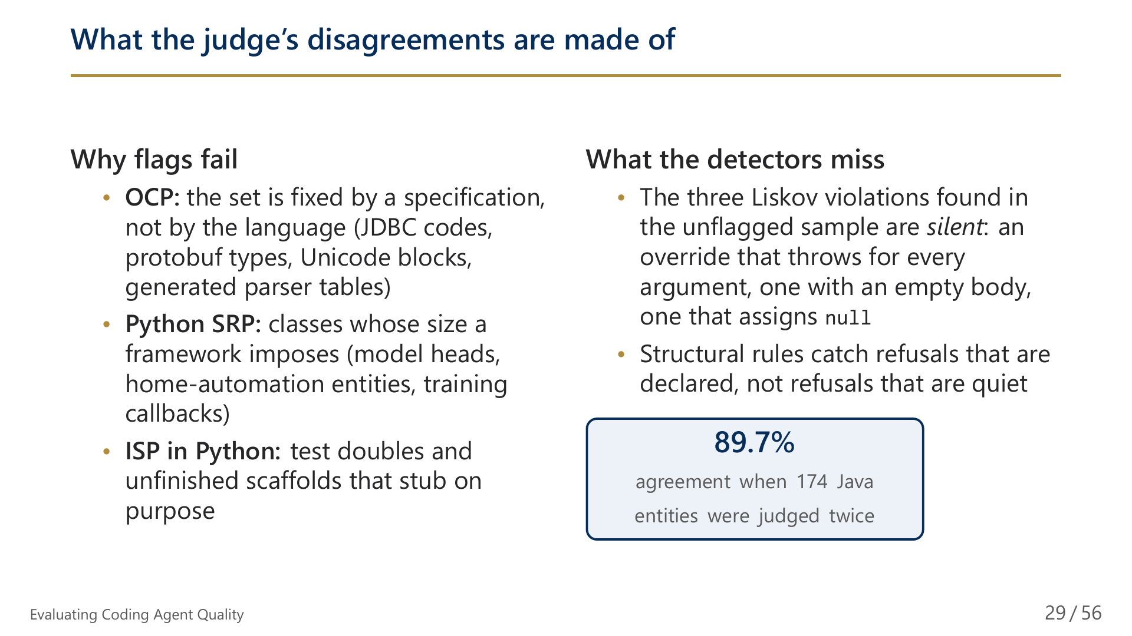
Notes:
29/56 What the judge's disagreements are made of

Slide 30
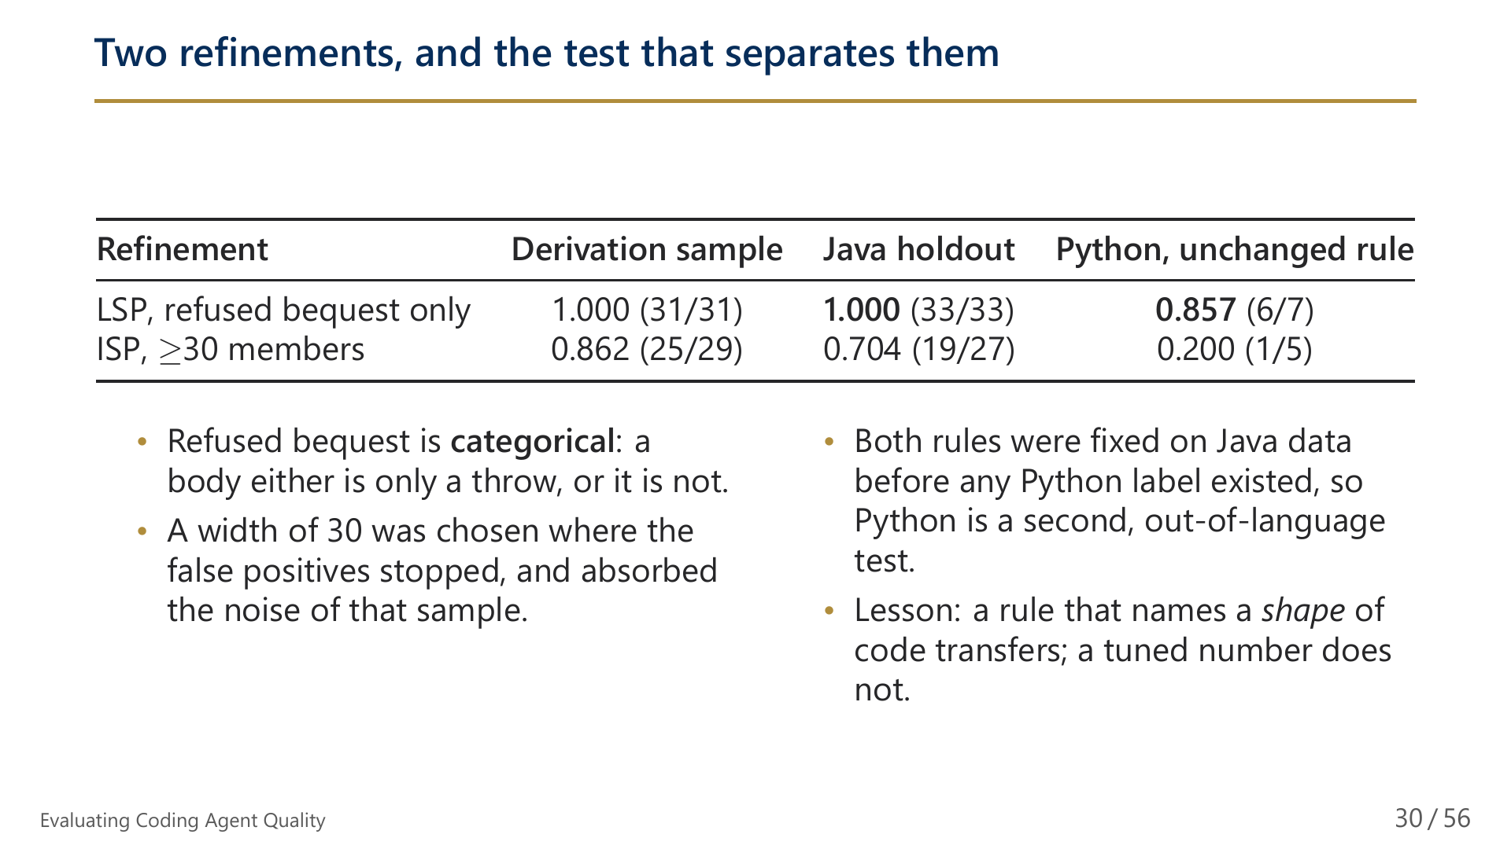
Notes:
30/56 Two refinements, and the test that separates them

Slide 31
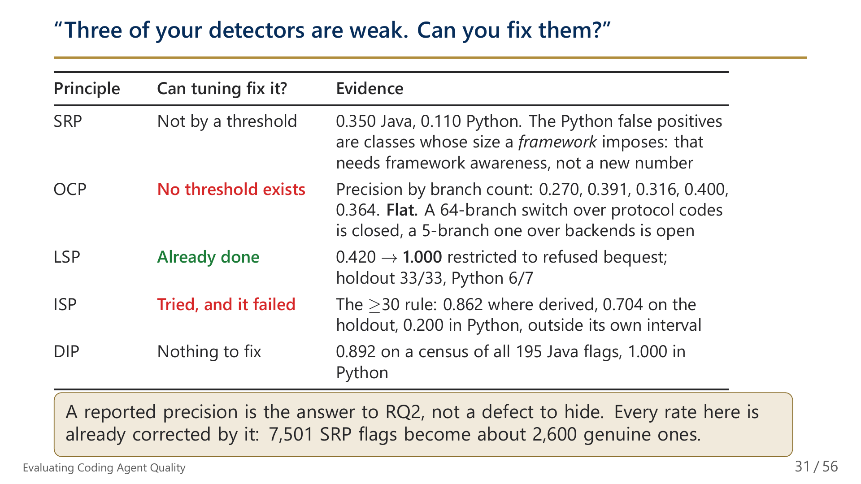
Notes:
31/56 "Three of your detectors are weak. Can you fix them?"

Slide 32
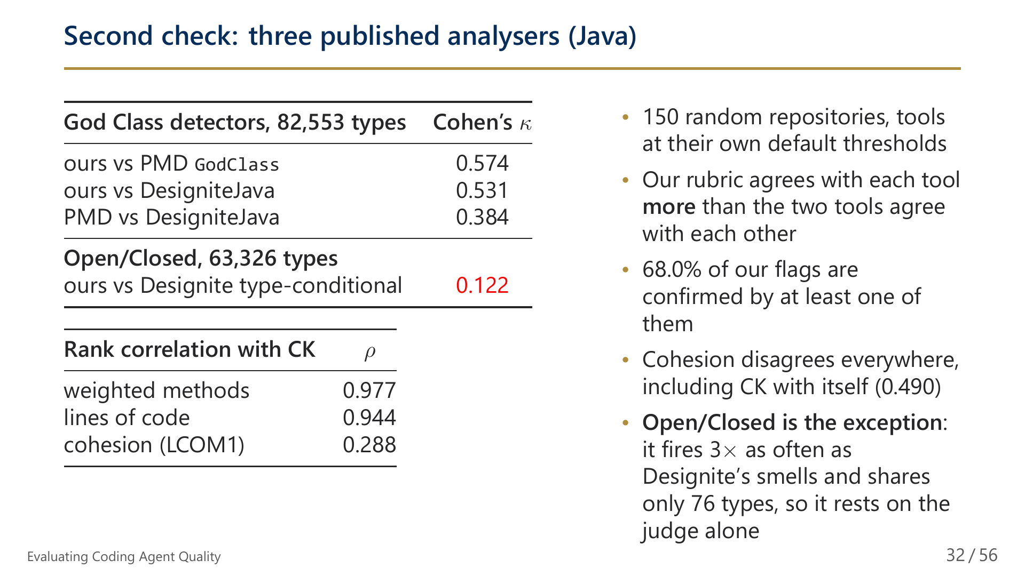
Notes:
32/56 Second check: three published analysers (Java)

Slide 33
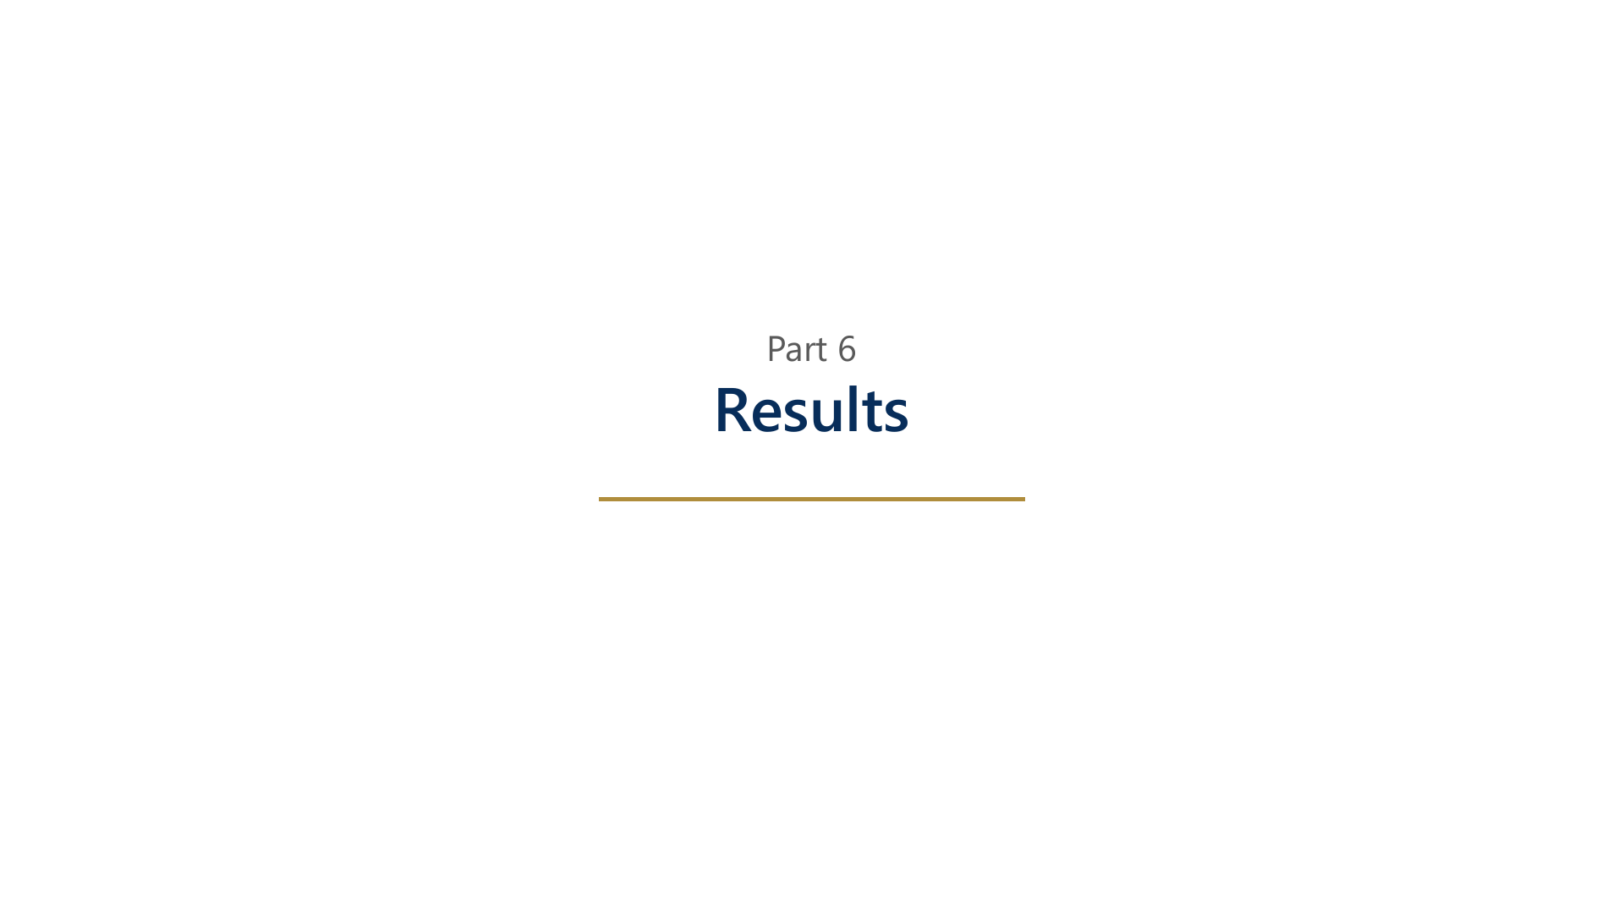
Notes:
33/56 Part 6: Results

Slide 34
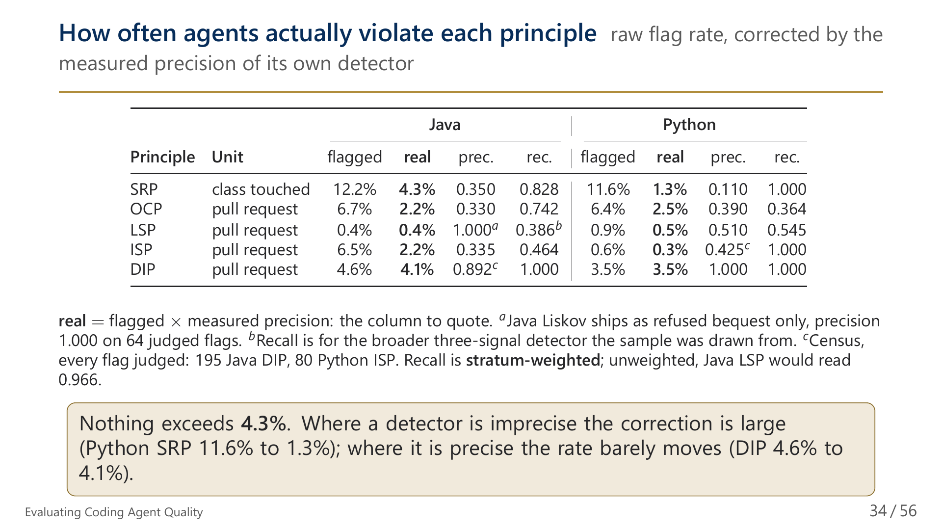
Notes:
34/56 How often agents actually violate each principle

Slide 35
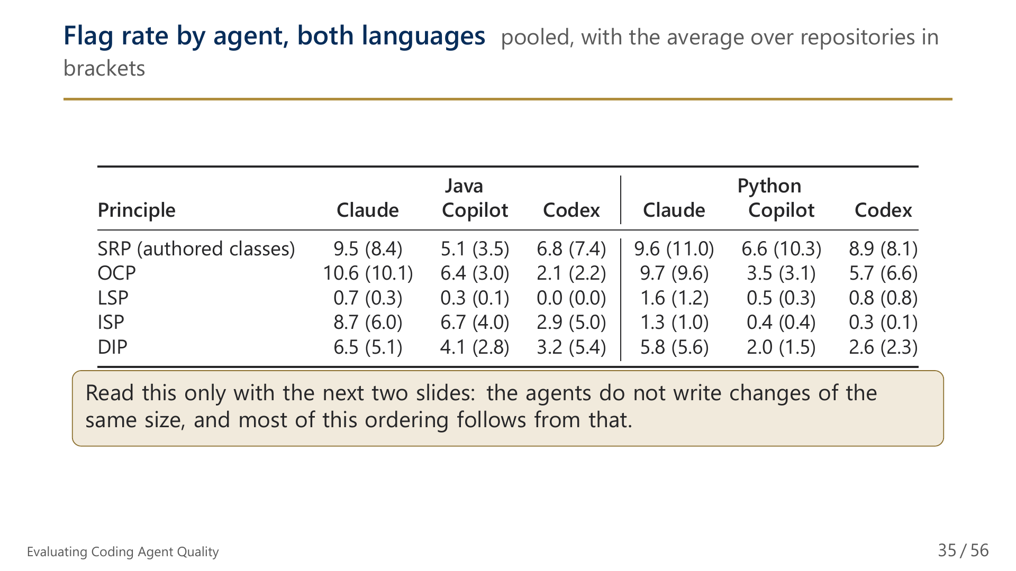
Notes:
35/56 Flag rate by agent, both languages

Slide 36
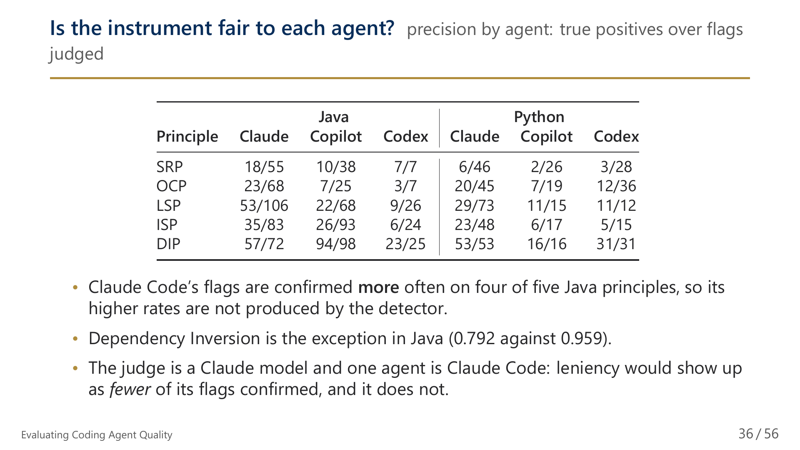
Notes:
36/56 Is the instrument fair to each agent?

Slide 37
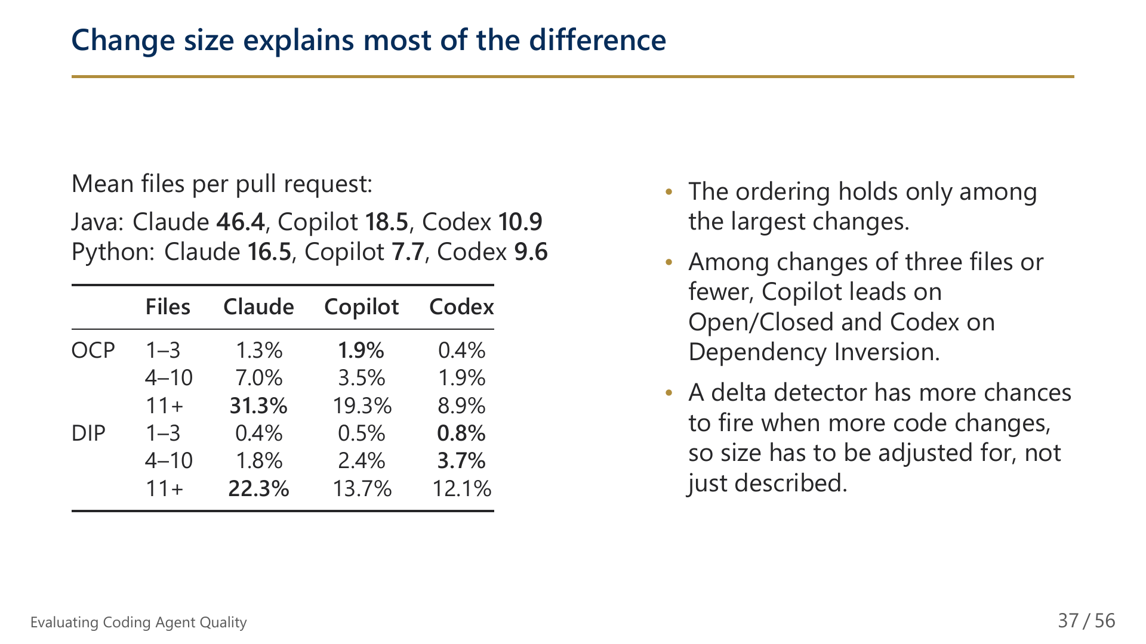
Notes:
37/56 Change size explains most of the difference

Slide 38
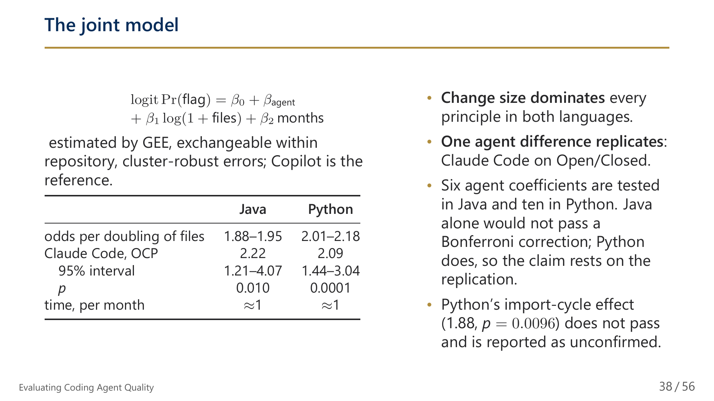
Notes:
38/56 The joint model

Slide 39
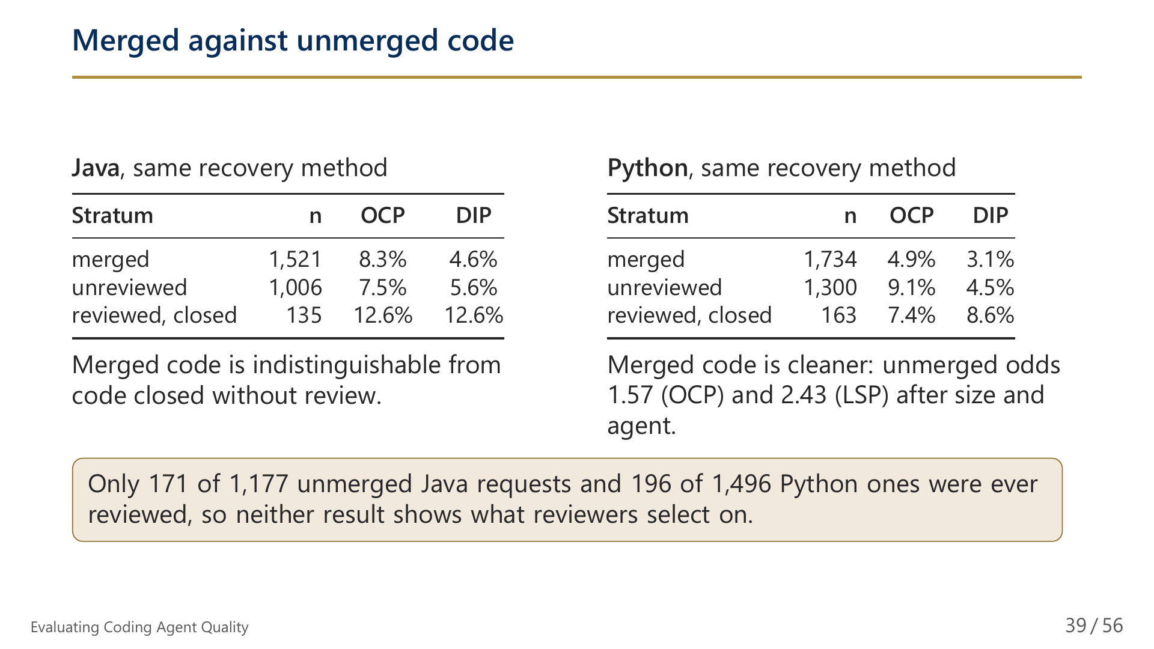
Notes:
39/56 Merged against unmerged code

Slide 40
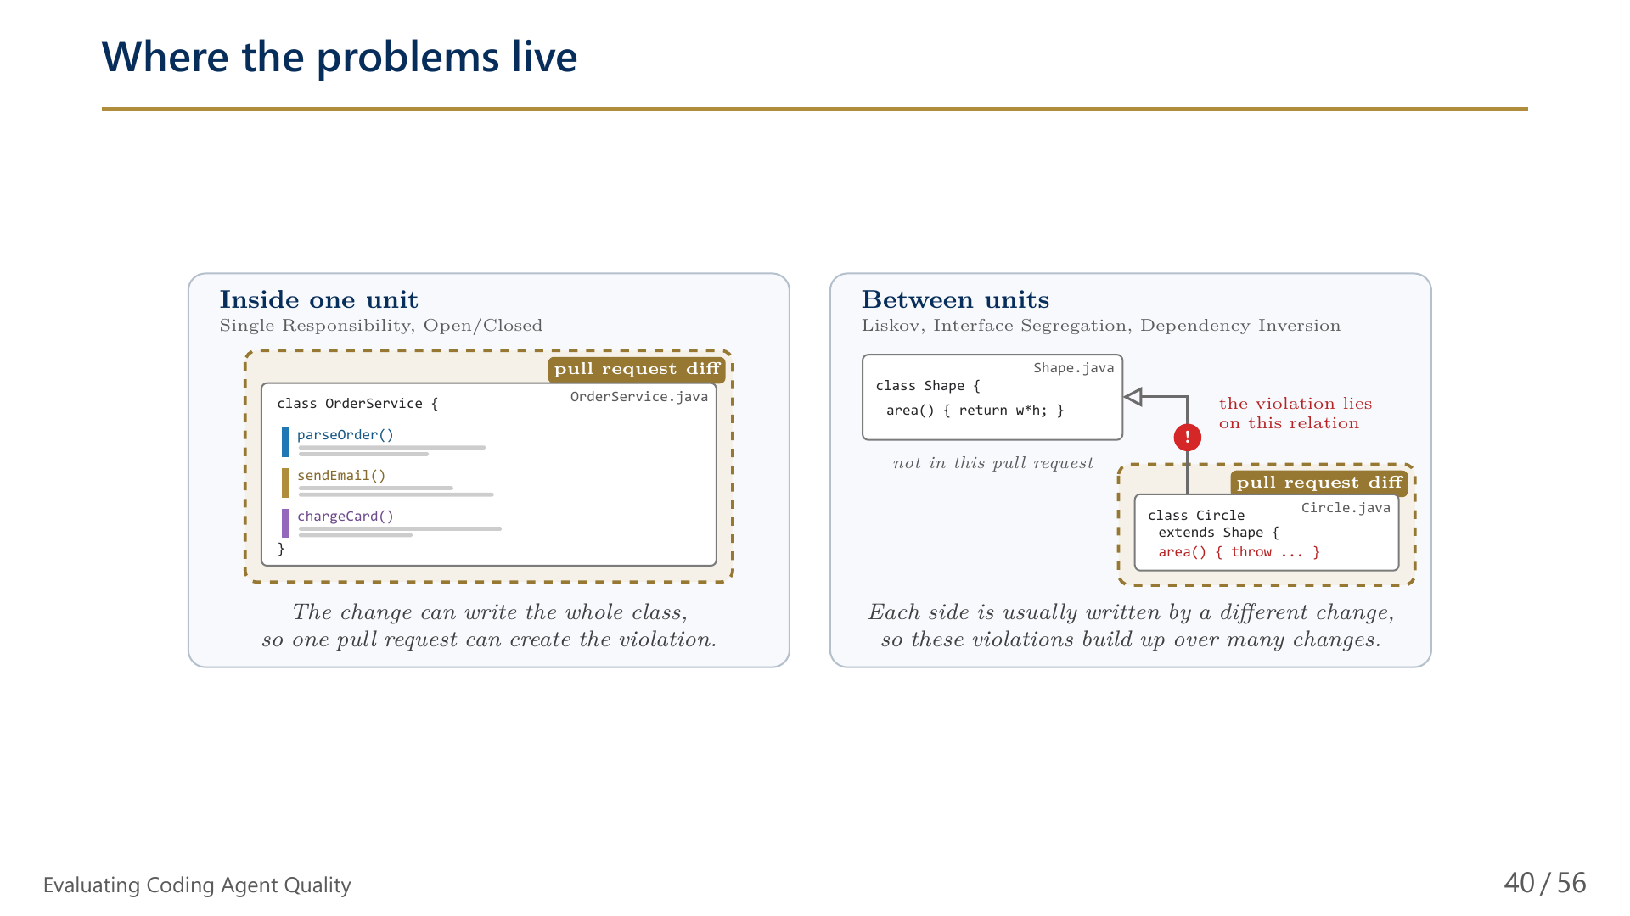
Notes:
40/56 Where the problems live

Slide 41
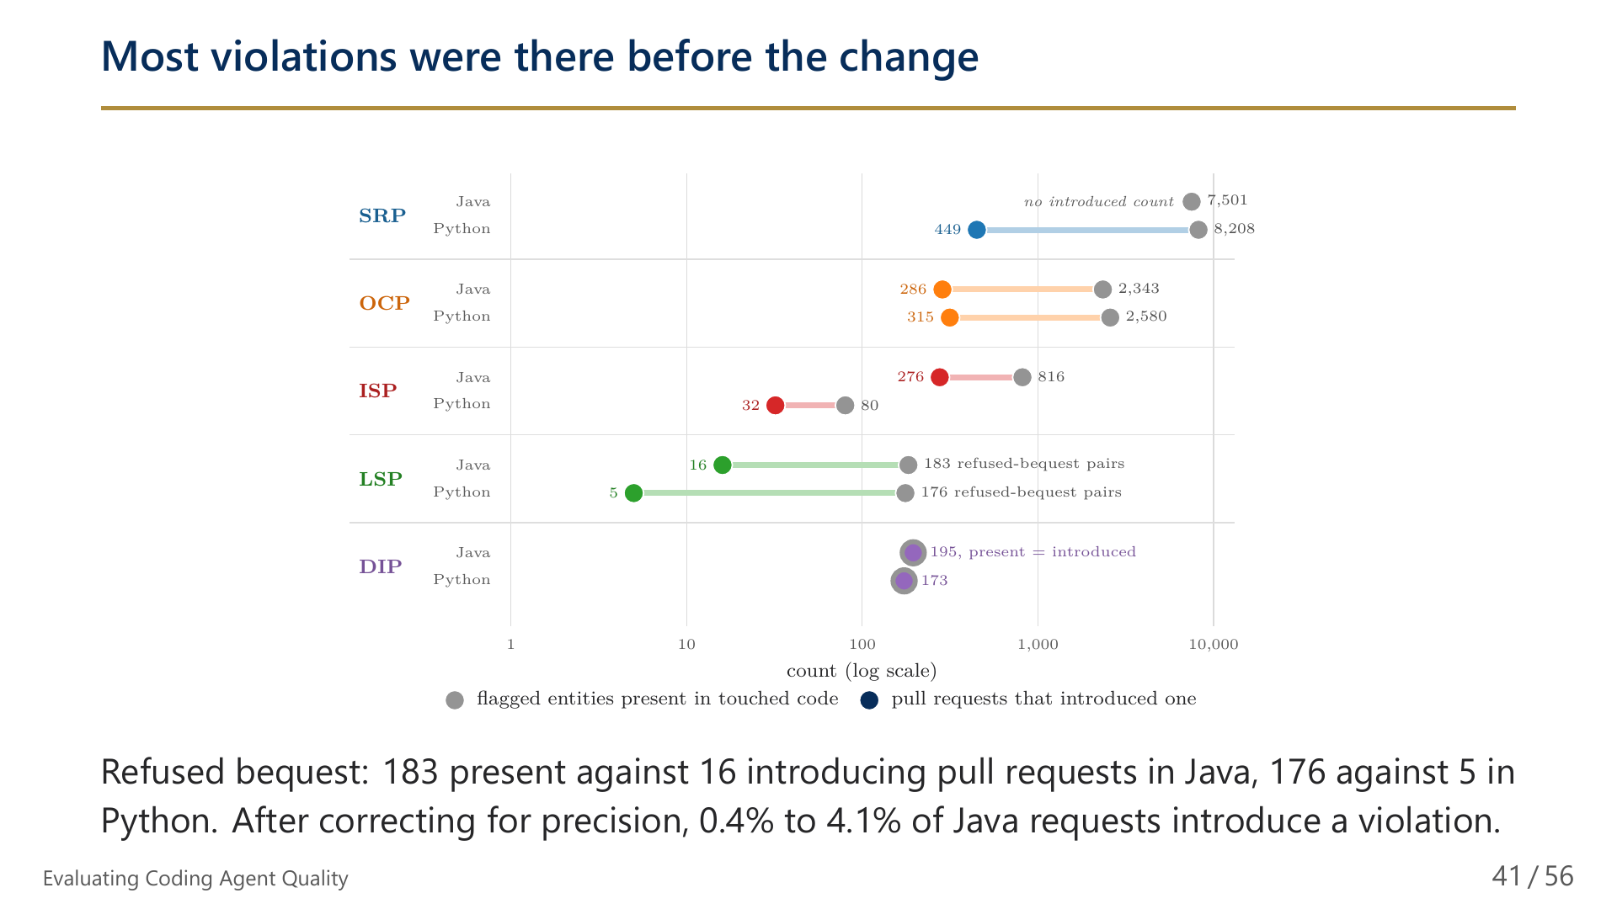
Notes:
41/56 Most violations were there before the change

Slide 42
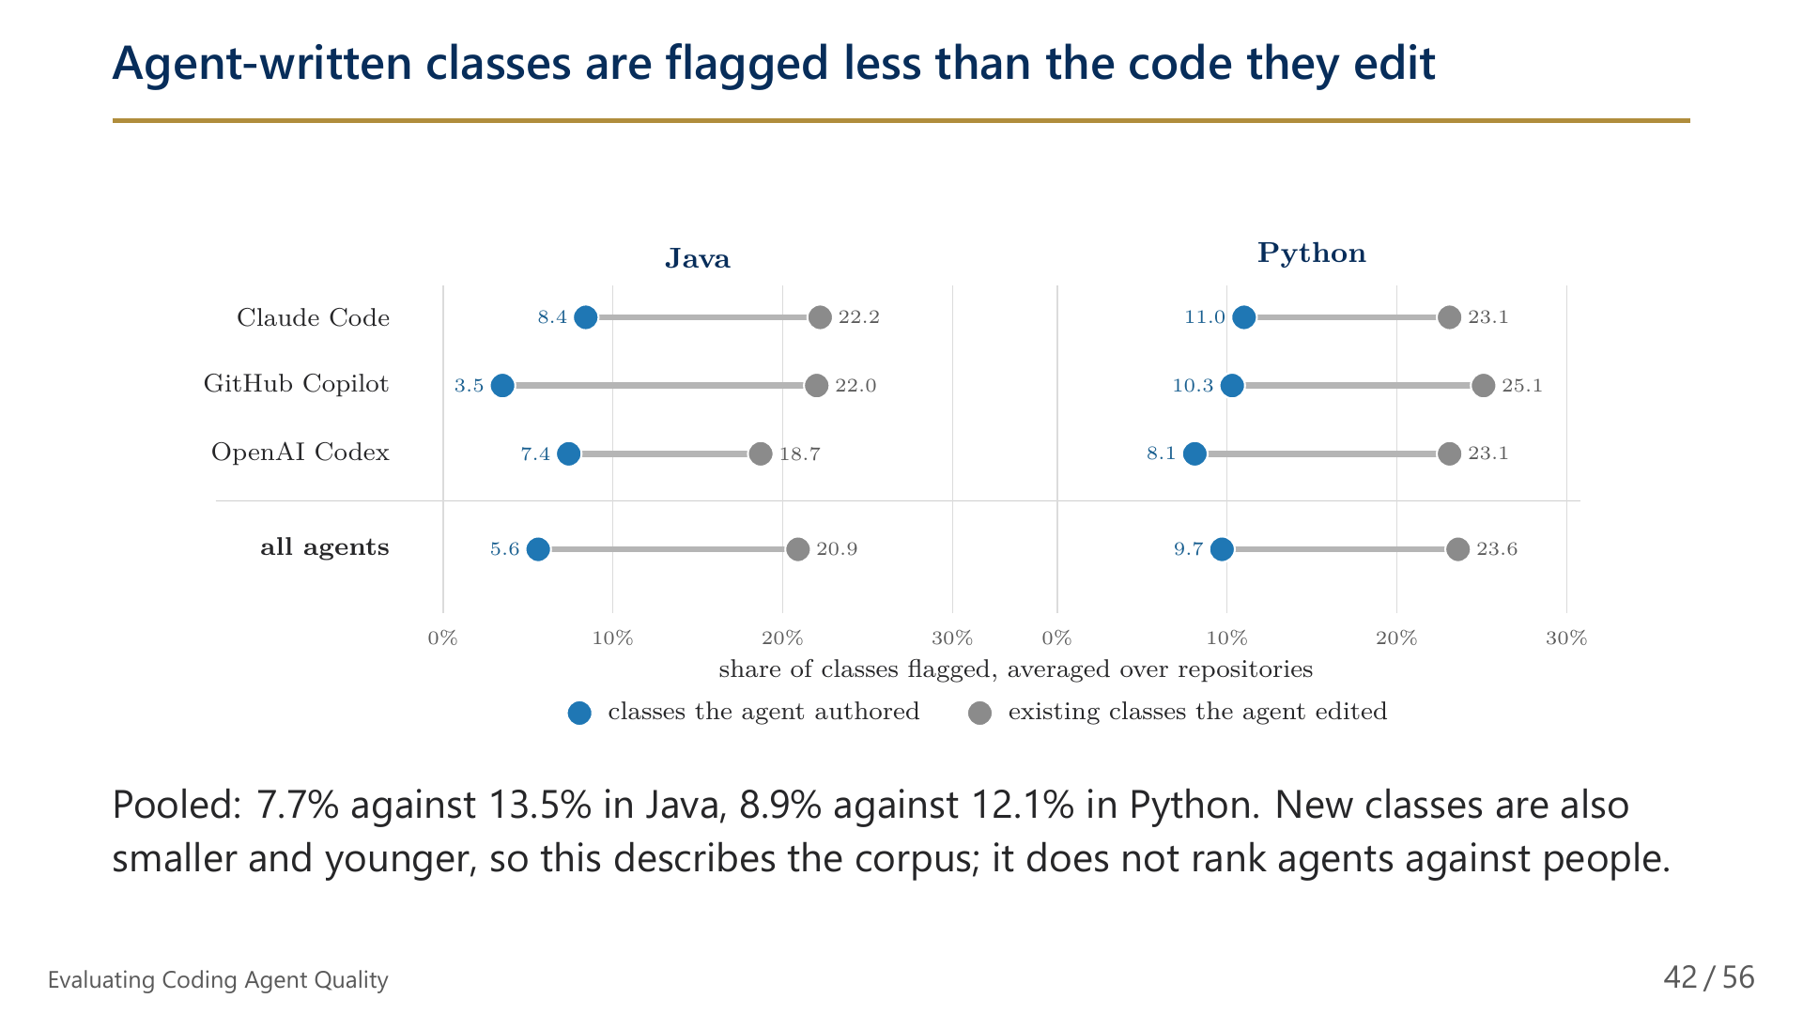
Notes:
42/56 Agent-written classes are flagged less than the code they edit

Slide 43
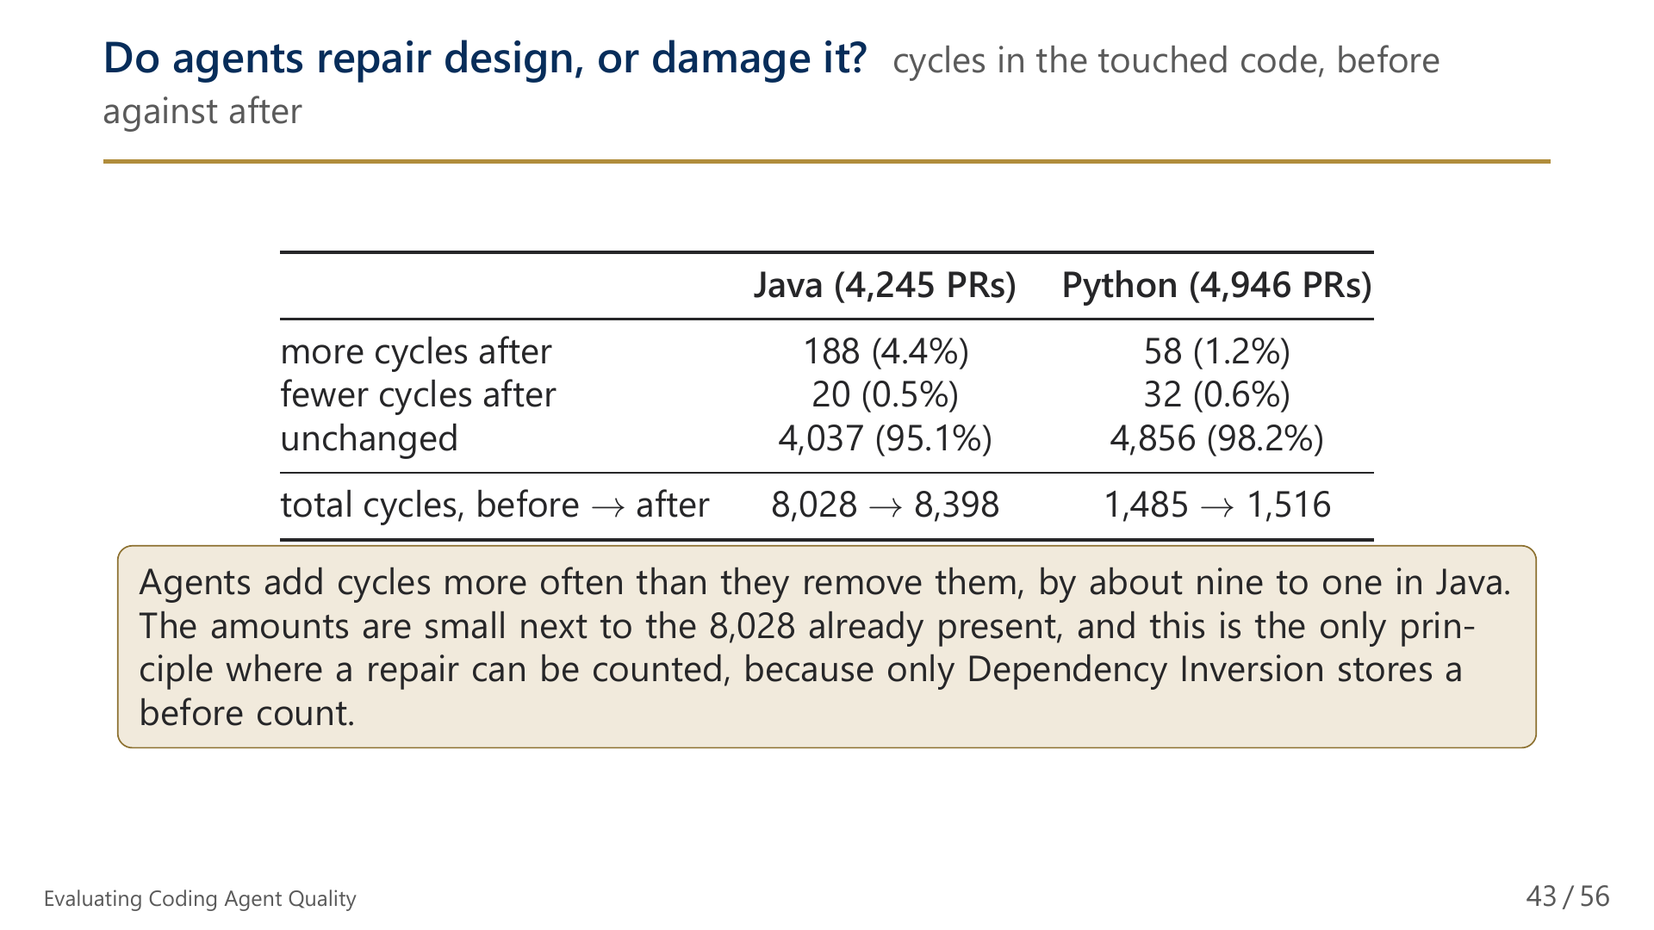
Notes:
43/56 Do agents repair design, or damage it?

Slide 44
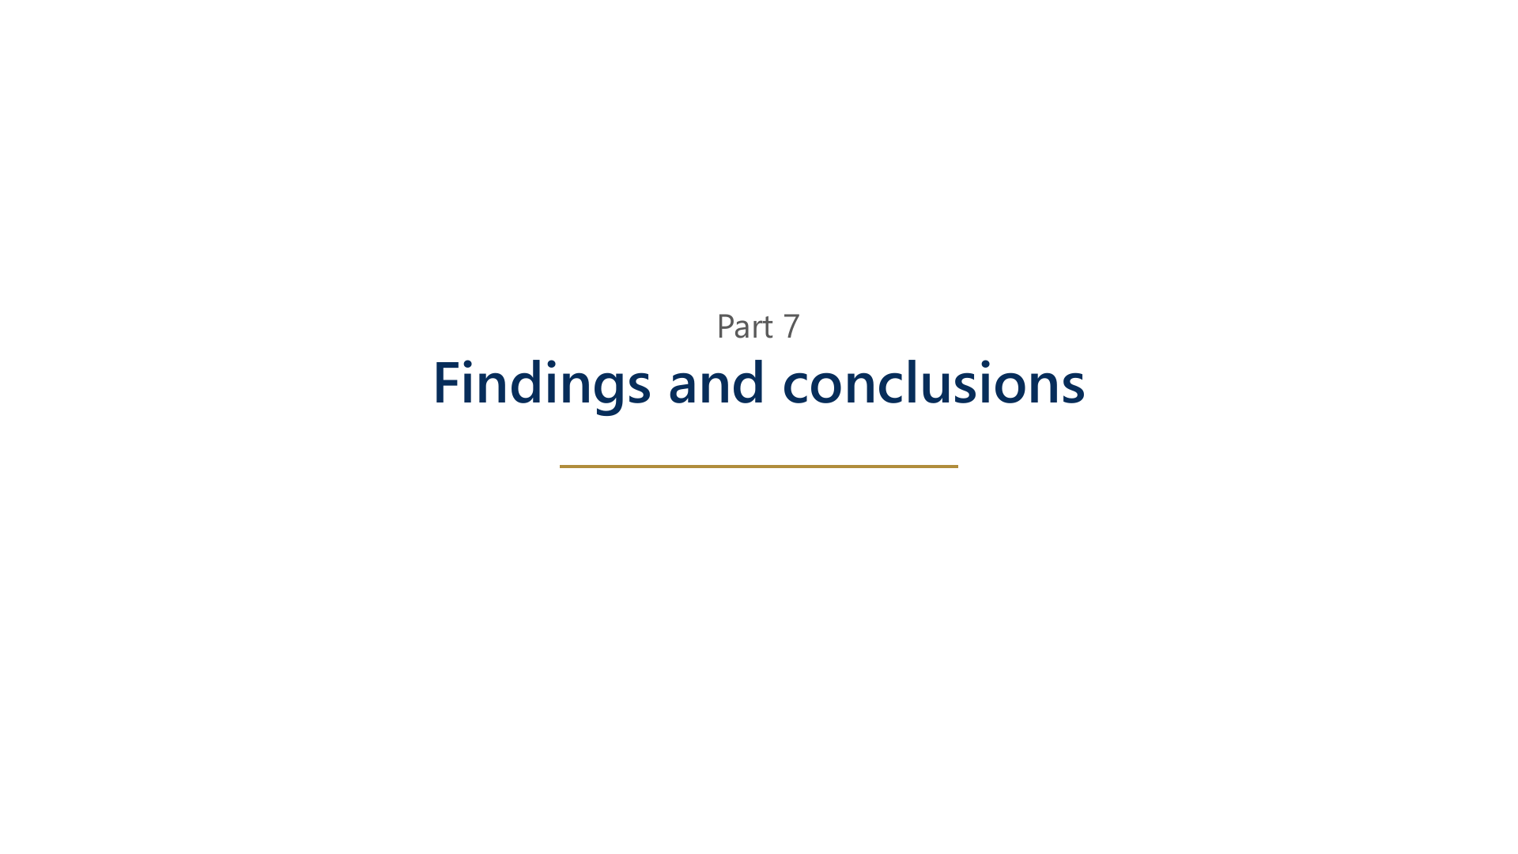
Notes:
44/56 Part 7: Findings and conclusions

Slide 45
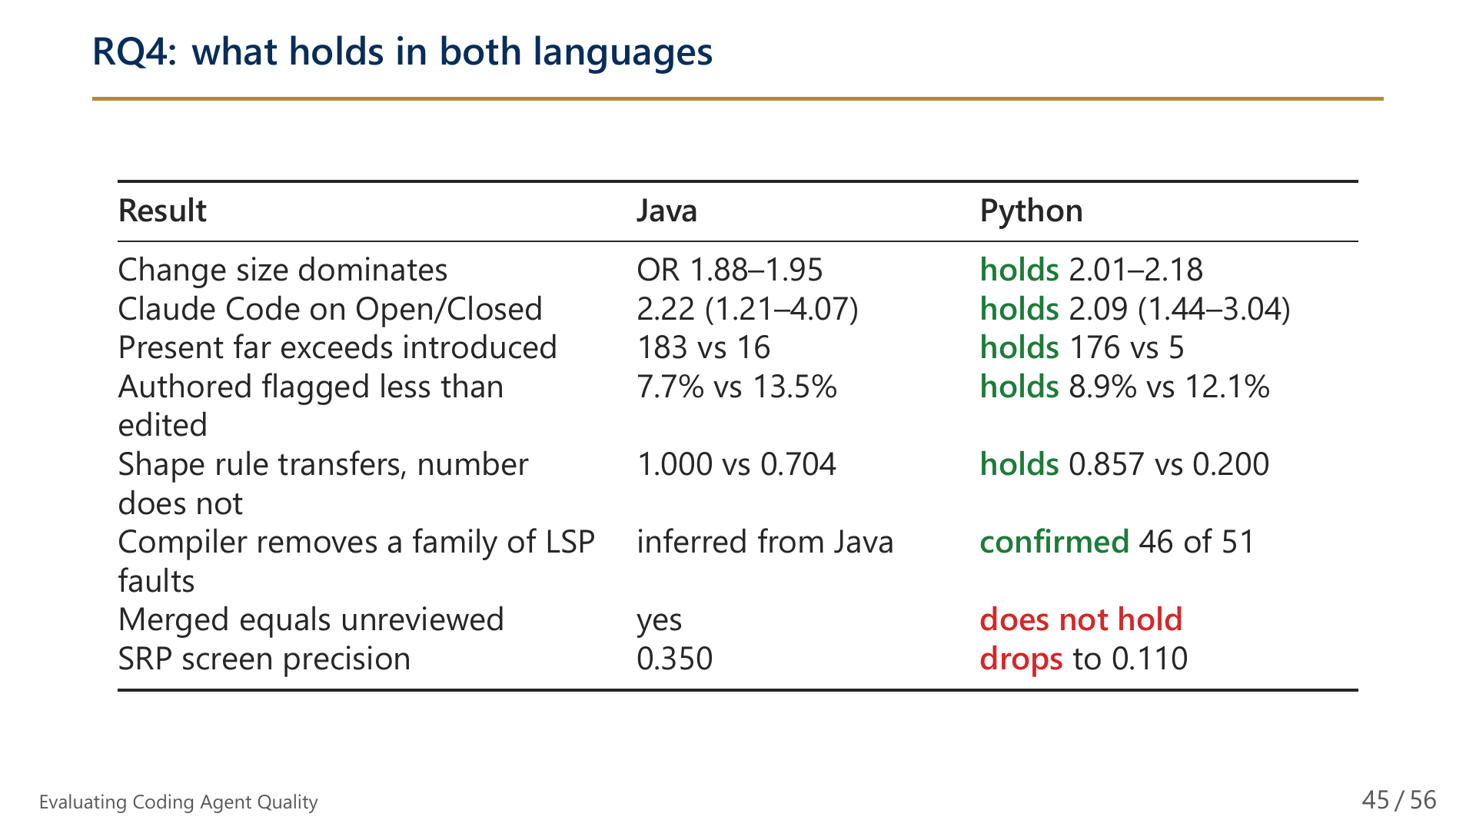
Notes:
45/56 RQ4: what holds in both languages

Slide 46
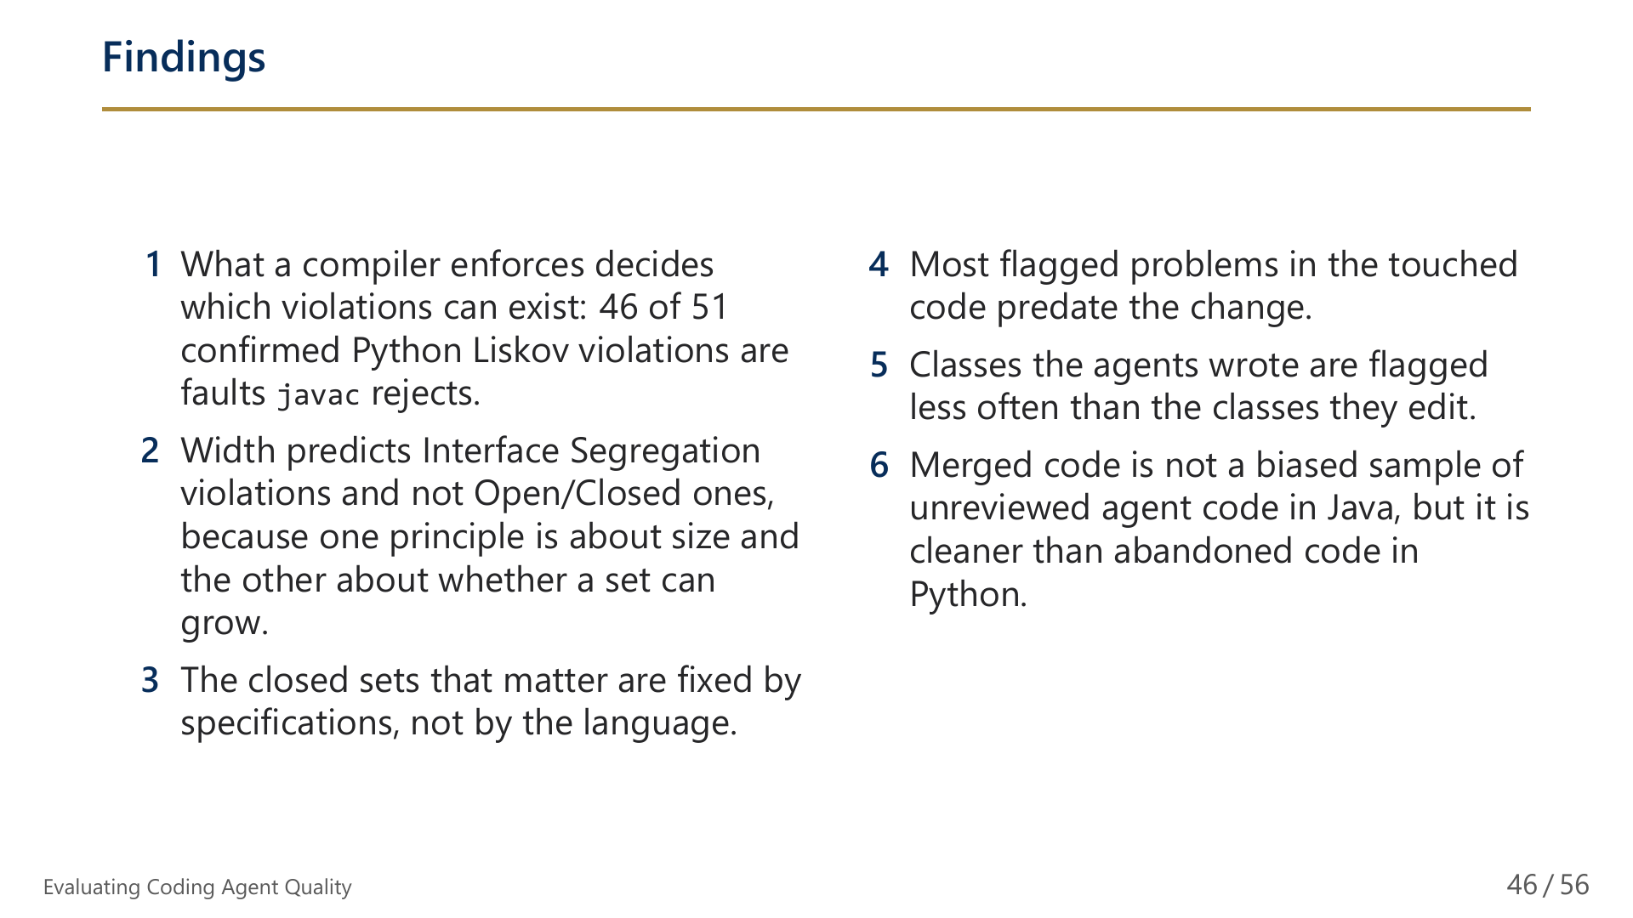
Notes:
46/56 Findings

Slide 47
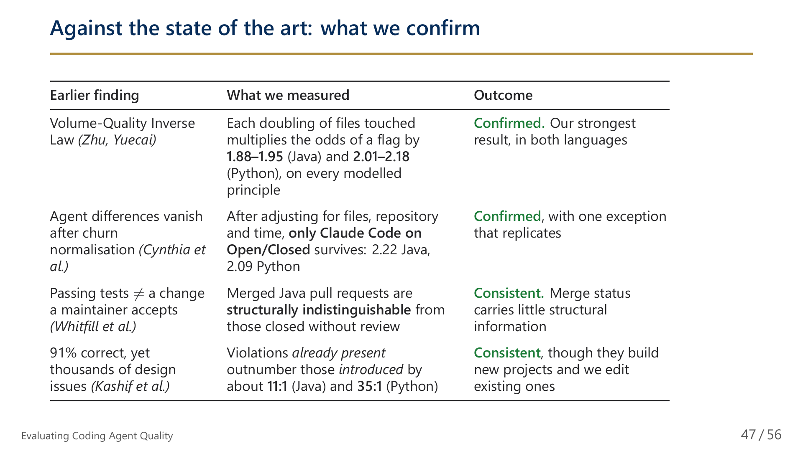
Notes:
47/56 Against the state of the art: what we confirm

Slide 48
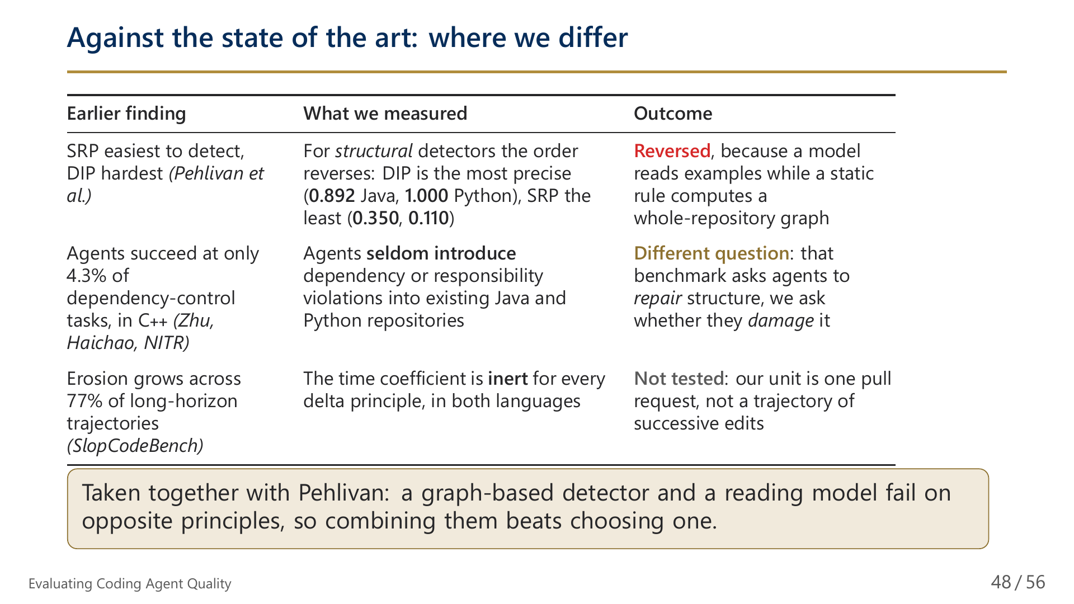
Notes:
48/56 Against the state of the art: what we confirm

Slide 49
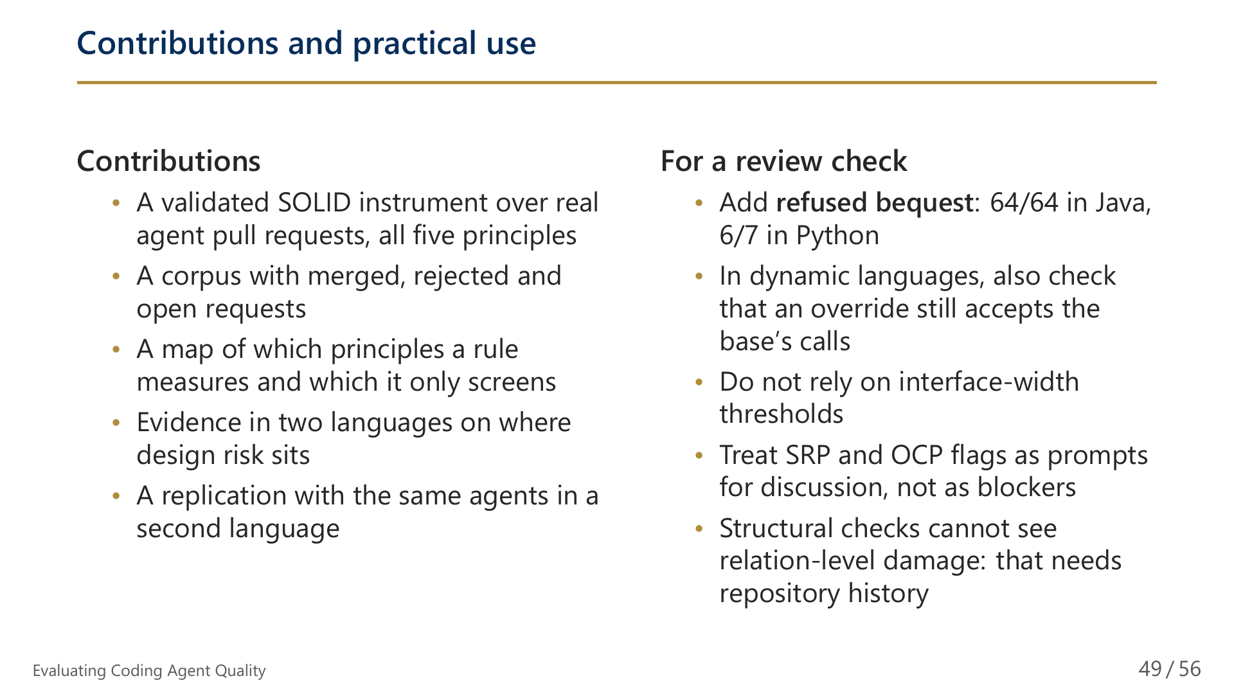
Notes:
49/56 Contributions and practical use

Slide 50
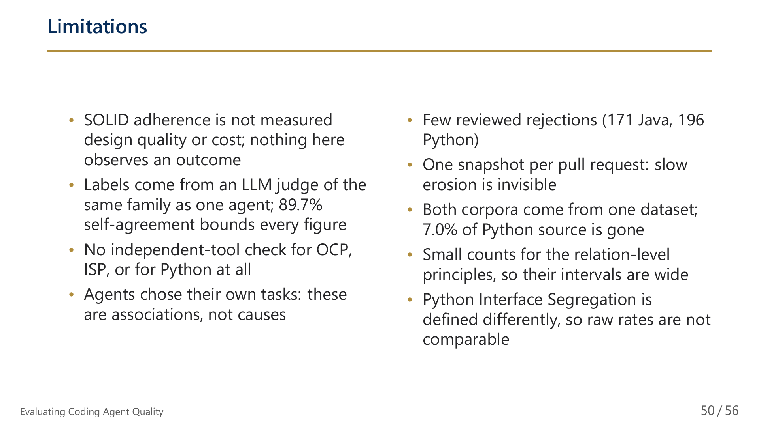
Notes:
50/56 Limitations

Slide 51
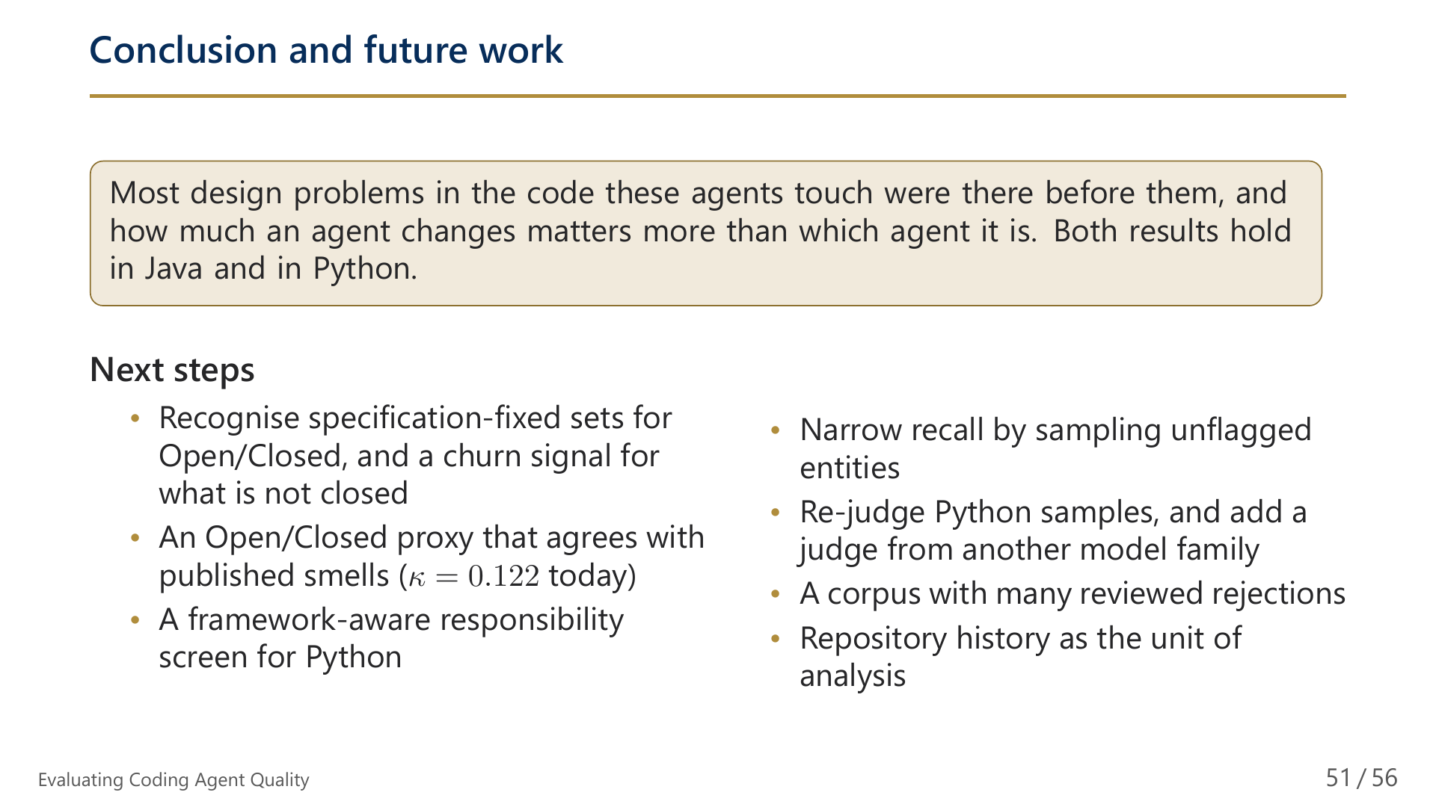
Notes:
51/56 Conclusion and future work

Slide 52

Notes:
52/56 Thank you

Slide 53

Notes:
53/56 Backup: Additional material

Slide 54

Notes:
54/56 Backup: why recall must be weighted

Slide 55

Notes:
55/56 Backup: package zones descriptive only

Slide 56

Notes:
56/56 Backup: corrected rates, with SRP split by authorship

