Slide 1



Evaluating Coding Agent Quality
Application to Software Design Principles
in partial fulfilment of the requirements for the
RESEARCH MASTER’S DEGREE IN COMPUTER SCIENCE
2025/2026
Prepared by Akram Ben Fekih
Supervised by Dr. Maha Khemaja
Jury: ____________________
延时符

Slide 2
1
PART 01
Context and problem
Outline
2
PART 02
State of the art and research questions
3
PART 03
Method: corpus, pipeline, before/after delta
4
PART 04
The five SOLID principles and their proxies
5
PART 05
Validation
6
PART 06
Results per agent and per language
Evaluating Coding Agent Quality
Application to Software Design Principles
7
PART 07
Findings, conclusions, limitations

Slide 3
Coding agents submit real changes
Tests pass, design is unmeasured
Part 1
Context and problem

Slide 4
Context: coding agents now submit real changes
Part 1
Context
From completion to agents. Copilot (2021) and CodeWhisperer (2022) completed the next line. Claude Code, OpenAI Codex and Copilot’s coding agent take a task and return a finished pull request.
7.69 million
1
Vibe coding, vibe architecting. The developer states the intent and the agent writes the implementation; structural decisions follow from the wording of the prompt and leave no recorded rationale (Konrad et al., 2026).
agent pull requests in 957k repositories (AIDev, Li et al., 2025)
2
Real data now exists. The AIDev dataset records agent pull requests on public GitHub repositories, so the structure of agent code can be studied on real, reviewed contributions.
3 agents, 2 languages
3
Design is where the cost is. Code can pass its tests and still be tightly coupled; most of the cost of software is maintenance after the first release. Software engineering already has the vocabulary: Brooks, Martin’s SOLID, Fowler’s code smells.
Claude Code, GitHub Copilot and OpenAI Codex, studied in Java and in Python
4
The question this raises: these agents already write code that is reviewed and merged into real software. Does that code follow the design rules maintainers rely on?
4

Slide 5
The problem: tests pass, design is left unmeasured
Part 1
Context
Benchmarks measure function, not design. HumanEval, MBPP, BigCodeBench and SWE-bench ask whether tests pass, usually for one function or one issue. A pass rate says nothing about whether the code around it is well structured.
about half
1
of SWE-bench Verified patches that pass the tests would not be merged by maintainers (METR, 2026)
Structural quality is rarely compared across agents. Studies ask language models to spot SOLID violations, analyse projects from one tool, or describe defects. None compares several agents on one corpus of real contributions.
2
77%
The agent matters, not only the model. The agent software has an effect of its own (Ben Sghaier et al., 2026), so choosing a tool means choosing an agent.
3
of long-horizon agent trajectories show growing structural erosion (SlopCodeBench, 2026)
Problem addressed: does the code that coding agents contribute to real projects follow established object-oriented design principles, in addition to working, and do the agents differ in this respect?
5

Slide 6
What agents do to code
Measurement and attribution
Related work
Three limits in the literature
Part 2
State of the art and research questions
Research questions
Study design

Slide 7
State of the art: what agents do to code
Part 2
State of the art
Passing the tests is not the same as being accepted: about half of passing SWE-bench Verified patches would not be merged, 24 points below the automated score.
Whitfill et al., METR, 2026
1
Functional correctness hides structural debt: Cursor projects of 16,965 lines reach 91% correctness, yet carry 1,305 CodeScene and 3,193 SonarQube design issues.
Kashif et al., 2026
2
Structure decays over long horizons: erosion grows in 77% of trajectories, and agent code is 2.3× more verbose than human open-source Python.
SlopCodeBench, Orlanski et al., 2026
3
AI defects have a shape, broken abstractions, duplication, over-engineering, and a Volume-Quality Inverse Law: more code generated, more structure decayed.
Zhu, Yuecai et al., 2026
4
Agents are poor at repairing structure: 4.3% success on dependency control, 15.2% on responsibility decomposition, over 21 C++ probes.
Zhu, Haichao et al., NITR, 2026
5
7

Slide 8
State of the art: measurement and attribution
Part 2
State of the art
A language model can detect SOLID violations. SRP is easiest, DIP hardest, and accuracy falls as complexity rises. This is the technique our judge uses.
Pehlivan et al., 2025
1
Differences between agents largely vanish once normalised for churn, and a merge does not guarantee structural quality.
Cynthia et al., 2026
2
After a merge, humans do almost all the maintenance on agent-written files, so maintainability is a human cost.
Sawada et al., 2026
3
The harness around the model, its tools and context management, affects quality independently of the LLM.
Ben Sghaier et al., 2026
4
“Vibe architecting”: agents make implicit architectural choices from prompt nuance, giving 141 to 827 lines for one and the same task.
Konrad et al., 2026
5
8

Slide 9
Related work: what was done, found, and where it stops
Part 2
State of the art
Study | What it did | What it found | Where it stops
Pehlivan et al., 2025 | 4 language models detect SOLID violations in 240 examples | SRP easiest to detect, DIP hardest; accuracy falls with complexity | Detection on examples, not measurement of agent contributions
Kashif et al., 2026 | Design issues in projects generated by Cursor | 91% functional correctness, yet 1,305 CodeScene and 3,193 SonarQube issues | One tool; no comparison between agents
Konrad et al., 2026 | Implicit architectural choices of several agents | “Vibe architecting”: one task gave 141 to 827 lines | Qualitative; no measurement over a corpus
Whitfill et al. (METR), 2026 | Maintainer merge decisions on SWE-bench Verified | About half of passing patches would not be merged | A merge verdict only, no design measure
Zhu, Haichao et al. (NITR), 2026 | Maintainability tasks with a structural oracle, 21 C++ probes | 4.3% success on dependency control, 15.2% on responsibility decomposition | Benchmark tasks in one language, not real contributions
Orlanski et al. (SlopCodeBench), 2026 | 15 agents, erosion across successive checkpoints | Erosion rises in 77% of trajectories | Iterative benchmark tasks; not SOLID-specific
Cynthia et al., 2026 | SonarQube issues in merged agent bug-fix pull requests (AIDev) | Agent differences vanish after churn normalisation | Merged pull requests only; bug fixes only
None of them measures SOLID adherence across several agents on real contributions, and none checks how far its detector can be trusted.
9

Slide 10
Why this experiment: three limits in the literature
Part 2
State of the art
1
Real contributions at scale
2
Unmeasured validity of detectors
3
Agent-level comparison
IN THE LITERATURE
IN THE LITERATURE
IN THE LITERATURE
Tests on functions and single issues, small task sets (20 problems, 21 probes) or newly generated projects, mostly in one language. Rejected and open work is ignored.
Language-model studies report accuracy on curated examples; tool studies count issues without checking that each one violates the principle.
The model is varied and the agent treated as fixed. AIDev studies look at merge rates, bug-fix issues and maintenance, not SOLID adherence.
IN THIS THESIS
IN THIS THESIS
IN THIS THESIS
4,245 Java and 4,946 Python pull requests from AIDev: merged, rejected and open.
One deterministic detector per principle, with precision and recall measured against a reading judge and published analysers.
Three agents on one shared corpus, per principle, adjusting for change size, repository and time.
Unit of analysis: one pull request. Object of measurement: what that pull request did to the design of the code it touched.
10

Slide 11
Research questions
Part 2
State of the art
RQ1
Adherence and differentiation
Do coding agents differ in how well their pull requests adhere to the five SOLID principles, and how many of the design problems in the code they touch do they introduce themselves, in Java and in Python?
Agents
Different structural footprints once repository and change size are controlled?
Outcomes
Merged, rejected, open: does the merge decision filter on design quality?
Locus of risk
Inside one unit or between units: violations present vs introduced
Both languages
Which answers hold in Java and in Python? Only those count as general
RQ2
Measurability (construct validity)
Can SOLID adherence be measured at repository scale with deterministic structural detectors, and how well do these detectors agree with an independent reading judge and with established analysers?
Reading judge
Precision and weighted recall per principle: 2,475 judged entities (1,495 Java, 980 Python)
Published analysers
Java detectors against CK, PMD and DesigniteJava on the same source trees
11

Slide 12
Study design: how each question is answered
Part 2
State of the art
Question | Construct | Evidence
RQ1 | SOLID adherence per principle, per agent and outcome | Rates pooled and per repository; joint regression model (GEE); violations present compared with introduced; 4,245 Java and 4,946 Python pull requests
RQ2 | Detector fidelity | Precision and weighted recall on 1,495 judged Java and 980 judged Python entities, with a Java holdout; agreement of the Java detectors with three external analysers
FOUR DESIGN DECISIONS FRAME THE STUDY
1
Real pull requests
2
All three outcomes
3
Two languages
4
Deterministic detectors
Not newly generated repositories: less control over the tasks, but realistic work, and each pull request belongs to one agent.
Merged, rejected and open, balanced on agent and outcome, so we can see what review filters out.
Java: classes compulsory, nominal subtyping. Python: classes optional, no compiler check. A result is general only if both show it.
Every rate is computed by a program. A language model only reads source and labels a validation sample.
Observational study: no treatment was assigned, so the results are comparisons and associations, not causal claims.
12

Slide 13
Corpus
Attrition and tree recovery
Full workflow
From dataset to facts
Part 3
What is charged to a pull request
Method: corpus, pipeline and algorithms
The delta in the data
Detectors and statistics

Slide 14
Corpus: two languages, three agents, three outcomes
Part 3
Method
 | merged | rejected | open
Java
Claude Code | 970 | 485 | 283
GitHub Copilot | 2,544 | 1,272 | 364
OpenAI Codex | 630 | 315 | 93
Python
Claude Code | 940 | 540 | 182
GitHub Copilot | 885 | 407 | 178
OpenAI Codex | 1,069 | 549 | 196
4,245 / 4,946
analysable pull requests, Java / Python
≥25 stars, permissive licence
1
merged drawn 2:1 against rejected, within each agent
2
Python also stratified by repository: no repository gives more than 0.4% of a cell
3
Java rows are the curated corpus (6,956), Python rows the analysable one (4,946).
14

Slide 15
Attrition and how the two trees were recovered
Part 3
Method
Status | Java | Python
analysable | 4,245 | 4,946
no production file touched | 2,540 | 1,816
no module resolved | n/a | 232
tree too large | 150 | 14
history gone | 18 | 2
no distinct before tree | 3 | 40
curated | 6,956 | 7,050
RECOVERY METHOD BY OUTCOME (JAVA)
 | 1 | 2 | 3 | 4
merged | 1,052 | 425 | 665 | 431
open | 5 | 209 | 250 | 31
rejected | 0 | 646 | 482 | 49
Method 1 is the merge commit, available to merged requests only. That is why every merged-versus-unmerged comparison is made within the same method.
7.0% of Python requests lost their source entirely: the branch was deleted.
15

Slide 16
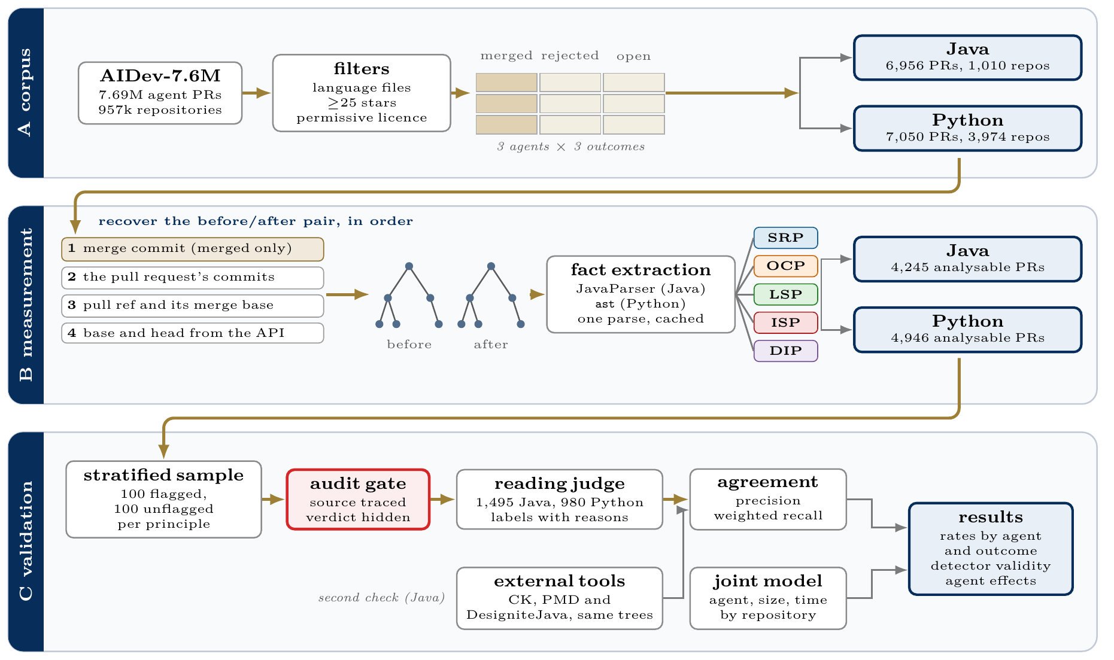
Workflow
Part 3
Method
16

Slide 17
Algorithms: from the dataset to the facts
Part 3
Method
Phase | Algorithm | Why it is needed
Curation | seeded stratified draw, balanced on agent and outcome, repository-stratified in Python | one agent would dominate any raw aggregate
Tree recovery | four fallbacks, git archive, cache keyed by content hash | branches are deleted, especially for closed requests
Java facts | JavaParser with symbol solving, source roots inferred from package lines | without resolution two classes named Node merge into one
Python facts | standard library ast, imports resolved by module path | no compiler and no type information is available
17

Slide 18
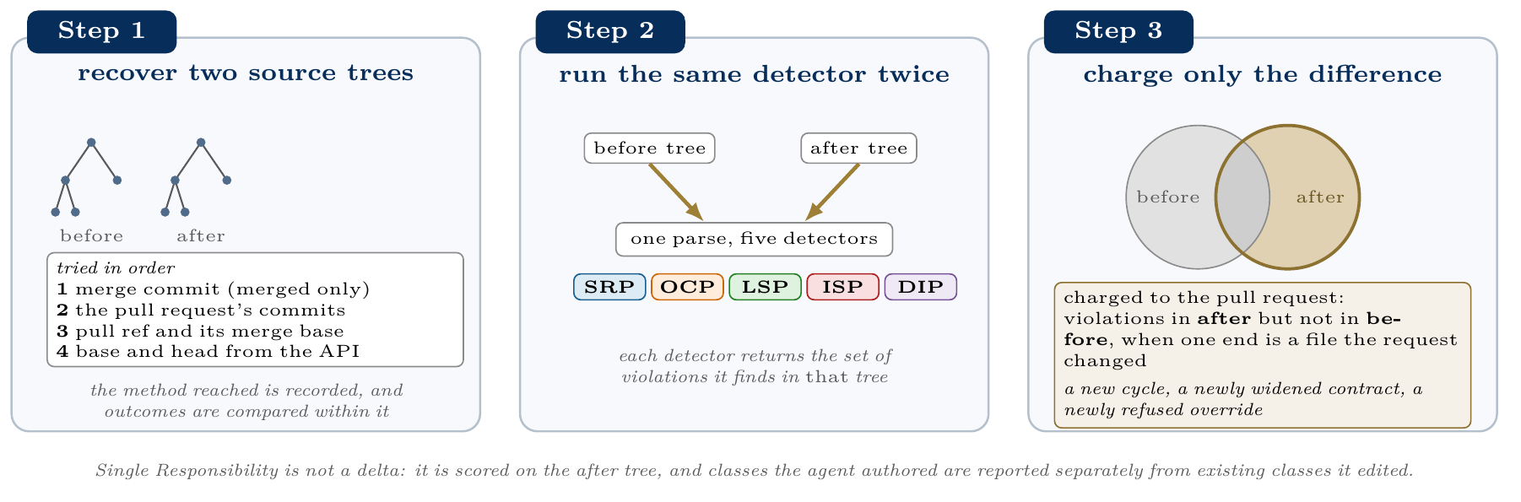
What is charged to the pull request
Part 3
Method
18

Slide 19
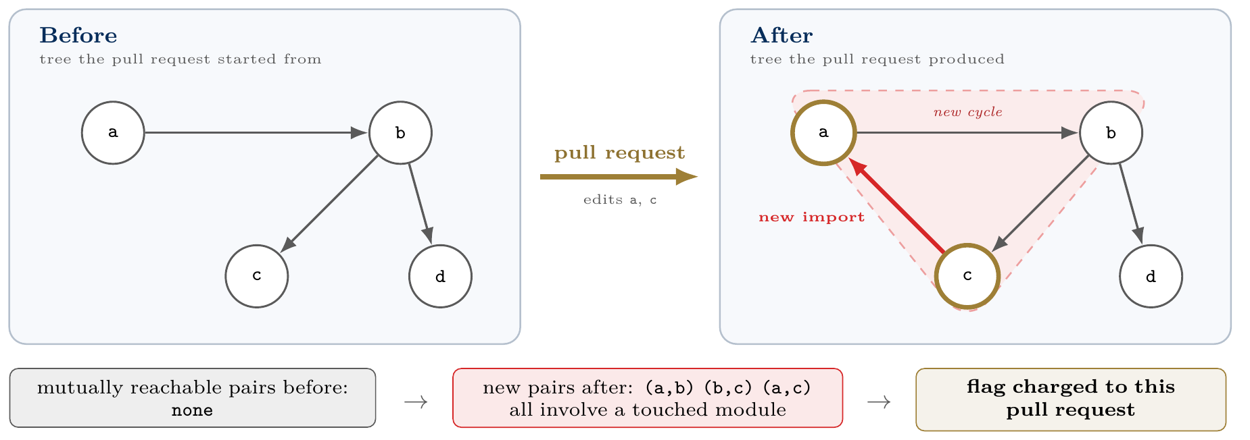
The delta in the data
Part 3
Method
Attribution rule for relations: a violation is charged when either end is in a changed file, so an agent that widens a base class is charged for the subclasses it breaks in files it never opened.
19

Slide 20
Algorithms: detectors and statistics
Part 3
Method
Phase | Algorithm | Why it is needed
SRP | union-find for LCOM4, TF-IDF cosine for C3 | size alone cannot separate large from incoherent
OCP | dispatch chains grouped by subject, enum resolution | a switch over a fixed set is not a violation
LSP | nearest ancestor with a real body, over the resolved hierarchy | an abstract base has no behaviour to refuse
ISP | contract to implementer index over the hierarchy | inherited members are part of the contract
DIP | Tarjan strongly connected components | a cycle is a property of the whole graph
Sampling | seeded stratified draw after entity deduplication | classes touched by many requests would dominate
Scoring | Wilson intervals, stratum-weighted recall | the sample is half flagged, the corpus is not
Model | GEE, exchangeable within repository, cluster-robust errors | requests from one repository are not independent
20

Slide 21
From principle to detector
Five principles, five proxies
SRP: God Class rubric
OCP: dispatch width
LSP: refused bequest
Part 4
The five SOLID principles and their proxies
ISP: contract width
DIP: new import cycles
Calibration across languages

Slide 22
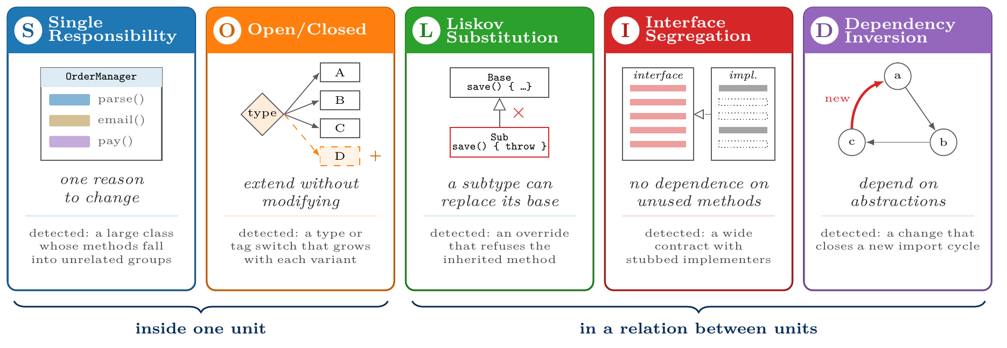
From principle to detector
Part 4
SOLID proxies
Each principle is a statement about intent. A detector can only see the structure that a violation usually leaves behind, so every result is first a statement about the detector.
22

Slide 23
The five principles and the proxy used for each
Part 4
SOLID proxies
Principle | What a violation looks like | Proxy: one deterministic detector | Where it lives
SRP Single Responsibility | God Class: one class doing several unrelated jobs | Six size, complexity and cohesion metrics (at least two thresholds crossed); suppressed when the methods share a vocabulary (conceptual cohesion C3) | Inside one unit
OCP Open/Closed | A type or tag switch that is edited for every new variant | Dispatch-chain width: type chains from 3 branches, tag or value chains from 8 (Java) or 5 (Python); suppressed when the subject is an enumeration | Inside one unit
LSP Liskov Substitution | An override that cannot stand in for its base method | Override against its nearest ancestor: refused bequest, strengthened precondition, weakened postcondition; Python adds signature faults | Between units
ISP Interface Segregation | A wide contract that forces stubs on its implementers | Contract width and implementer stub ratio; a forced stub is direct evidence, width alone is a screen | Between units
DIP Dependency Inversion | Modules that depend on each other in cycles | New cycles in the import graph, before against after, found with Tarjan’s strongly connected components | Between units
A proxy sees the structure a violation leaves behind, not the intent. Every result is first a statement about the detector, which is why each one is validated against a reader (Part 5).
23

Slide 24

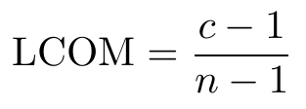

SRP: God Class rubric with a cohesion suppressor
Part 4
SOLID proxies
Six size and complexity metrics; one hit per threshold reached:
Threshold | Java | Python
class lines | 362 | 250
weighted methods | 45 | 36
methods | 20 | 10
method complexity | 11 | 12
parameters | 5 | 7
LCOM | 0.86 | 0.8
Cohesion, LCOM4 over the method graph (edge = shared field or a call), constructors excluded:
Conceptual cohesion over TF-IDF vectors of method token bags:
0.350 / 0.110
precision, Java / Python
Each value is the 90th percentile of that corpus, fixed before any label existed.
24

Slide 25
OCP: dispatch width with a closed-set suppressor
Part 4
SOLID proxies
A dispatch chain is an if/else if ladder or a switch branching on one subject. With b branches:
τ | Java | Python
type chains | 3 | 3
tag / value chains | 8 | 5
0.330 / 0.390
closed holds when the subject’s resolved type is an enumeration: a client cannot add a value. A pull request is flagged when it creates or widens such a chain.
precision, Java / Python
Width does not predict truth: precision stays between 0.270 and 0.400 across every band. The sets that are closed in practice are fixed by specifications, not by the language.
25

Slide 26
LSP: override compared with its nearest ancestor
Part 4
SOLID proxies
For each pair (subclass method, nearest ancestor method with the same signature and a real body):
Java signal | precision
refused bequest | 31/31
weakened postcondition | 6/36
strengthened precondition | 3/33
Java S = refused bequest, strengthened precondition, weakened postcondition. Python S adds what no compiler checks: parameter removed, required parameter added, parameter type narrowed, return type widened.
0.420 / 0.510
precision of the full signal set, Java / Python
The shipped Java flag keeps refused bequest only: 64 of 64 across two samples.
26

Slide 27
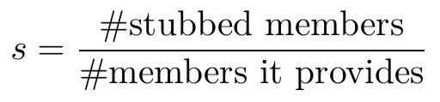
ISP: contract width and implementer stubs
Part 4
SOLID proxies
A contract is an interface or abstract class with at least one abstract member and at least one implementer inside the repository. Width w = abstract members; for each implementer,
Members | judged | precision
0–17 | 43 | 0.116
18–29 | 28 | 0.071
30–49 | 14 | 0.786
50–99 | 10 | 0.900
≥100 | 5 | 1.000
Java: contract fat if w ≥ 13; forced stub if stubs ≥ 2 and s ≥ 0.5. Flag if the request creates a fat contract, widens one, or leaves a forced stub.
Python: flag if at least two of: w > 7; mean implementer coverage < 0.75 over ≥ 2 implementers; an implementer with forced stubs.
0.335 / 0.425
precision, Java / Python
Width does separate violations here, which is why 13 was too low a bar.
27

Slide 28

DIP: new cycles in the import graph
Part 4
SOLID proxies
Build the internal import graph before and after the change and take strongly connected components with Tarjan’s algorithm. With P(G) the set of module pairs inside one component:
0.892 / 1.000
precision, Java / Python
Java precision is exact: all 195 flagged pull requests were judged. In Python, 100 of 173 were judged and all were correct.
Also computed, as description only: I = C_{e}/(C_{a} + C_{e}), A = N_{a}/N_{c}, D = |A + I − 1|.
The distance D was tested as a change signal and confirmed none of 17 flags, so it describes packages and never raises a flag.
28

Slide 29
Calibration: same rules, two languages
Part 4
SOLID proxies
Principle | Java | Python
SRP | six metrics, ≥2 hits; 362 / 45 / 20 / 11 / 5 / 0.86 | same rubric; 250 / 36 / 10 / 12 / 7 / 0.8
OCP | type ≥3, tag ≥8 branches | type ≥3, value ≥5 branches
LSP | three behavioural signals | five signals, adding what a compiler would reject
ISP | contract ≥13 members, or a forced stub | at least two of three signals, width alone never flags
DIP | new cyclic pairs through a touched file | new cyclic pairs through a touched module
Every threshold is the 90th percentile of its own corpus, set before any label existed; the result files were then deleted and the pass re-run, so no flag predates its threshold.
29

Slide 30
Why a reading judge
How a detector is validated
Validation results
What the disagreements are made of
Part 5
Two refinements
Validation
Can tuning fix the weak ones?
Three published analysers

Slide 31
Why a reading judge: from checking by hand to an LLM judge
Part 5
Validation
1
2
3
4
Check by hand
Automate the checking
LLM as judge
Make the task easier
We started by reading the flagged results ourselves, to see whether each detector did a good job. It worked, but it was a very long process.
So we asked whether a data-science approach could do the checking at scale instead of a person reading everything.
Research shows that language models can judge SOLID violations (Pehlivan et al., 2025: four models, 240 manually validated examples).
The judge does not analyse repositories. It reads an already exported sample of results, the source of each entity, and returns a label and a written reason.
Consequence: every precision and recall figure is agreement between a detector and the judge. Because the judge can err in the same direction as a detector, a second check was added: three independent analysers (CK, PMD, DesigniteJava).
31

Slide 32
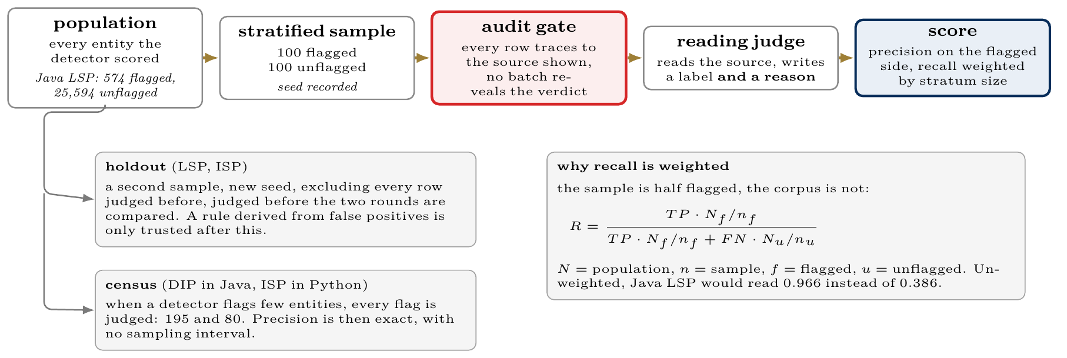
How a detector is validated
Part 5
Validation
32

Slide 33
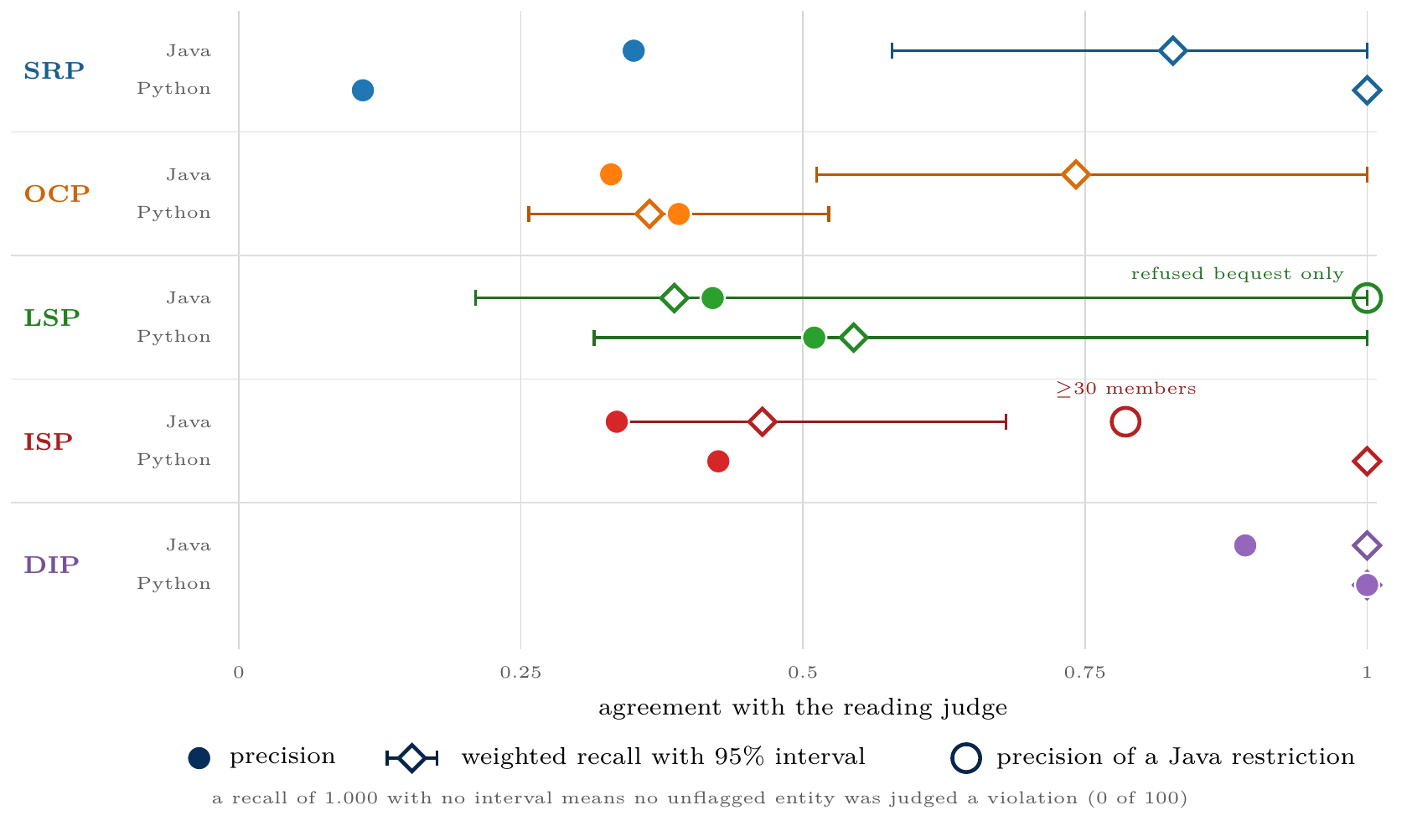
Validation results
Part 5
Validation
2,475
entities judged, each with a written reason
Dependency Inversion is precise in both languages; Single Responsibility, Open/Closed and Interface Segregation are screens.
33

Slide 34
What the judge’s disagreements are made of
Part 5
Validation
Why flags fail
What the detectors miss
OCP: the set is fixed by a specification, not by the language (JDBC codes, protobuf types, Unicode blocks, generated parser tables)
Python SRP: classes whose size a framework imposes (model heads, home-automation entities, training callbacks)
ISP in Python: test doubles and unfinished scaffolds that stub on purpose
The three Liskov violations found in the unflagged sample are silent: an override that throws for every argument, one with an empty body, one that assigns null
Structural rules catch refusals that are declared, not refusals that are quiet
89.7%
agreement when 174 Java entities were judged twice
34

Slide 35
Two refinements, and the test that separates them
Part 5
Validation
Refinement | Derivation sample | Java holdout | Python, unchanged rule
LSP, refused bequest only | 1.000 (31/31) | 1.000 (33/33) | 0.857 (6/7)
ISP, ≥30 members | 0.862 (25/29) | 0.704 (19/27) | 0.200 (1/5)
Refused bequest is categorical: a body either is only a throw, or it is not.
A width of 30 was chosen where the false positives stopped, and absorbed the noise of that sample.
Both rules were fixed on Java data before any Python label existed, so Python is a second, out-of-language test.
Lesson: a rule that names a shape of code transfers; a tuned number does not.
35

Slide 36
“Three of your detectors are weak. Can you fix them?”
Part 5
Validation
Principle | Can tuning fix it? | Evidence
SRP | Not by a threshold | 0.350 Java, 0.110 Python. The Python false positives are classes whose size a framework imposes: that needs framework awareness, not a new number
OCP | No threshold exists | Precision by branch count: 0.270, 0.391, 0.316, 0.400, 0.364. Flat. A 64-branch switch over protocol codes is closed, a 5-branch one over backends is open
LSP | Already done | 0.420 → 1.000 restricted to refused bequest; holdout 33/33, Python 6/7
ISP | Tried, and it failed | The ≥30 rule: 0.862 where derived, 0.704 on the holdout, 0.200 in Python, outside its own interval
DIP | Nothing to fix | 0.892 on a census of all 195 Java flags, 1.000 in Python
A reported precision is the answer to RQ2, not a defect to hide. Every rate here is already corrected by it: 7,501 SRP flags become about 2,600 genuine ones.
36

Slide 37
Second check: three published analysers (Java)
Part 5
Validation
God Class detectors, 82,553 types | Cohen’s κ
ours vs PMD GodClass | 0.574
ours vs DesigniteJava | 0.531
PMD vs DesigniteJava | 0.384
Open/Closed, 63,326 types
ours vs Designite type-conditional | 0.122
Rank correlation with CK | ρ
weighted methods | 0.977
lines of code | 0.944
cohesion (LCOM1) | 0.288
150 random repositories, tools at their own default thresholds
Our rubric agrees with each tool more than the two tools agree with each other
68.0% of our flags are confirmed by at least one of them
Cohesion disagrees everywhere, including CK with itself (0.490)
Open/Closed is the exception: it fires 3× as often as Designite’s smells and shares only 76 types, so it rests on the judge alone
37

Slide 38
How often principles are violated
Flag rate by agent
Is the instrument fair?
Change size and the joint model
Part 6
Merged against unmerged code
Results
Where the problems live
Repair or damage?

Slide 39
How often agents actually violate each principle
Part 6
Results
raw flag rate, corrected by the measured precision of its own detector
Principle | Unit | Java |  |  |  | Python
 |  | flagged | real | prec. | rec. | flagged | real | prec. | rec.
SRP | class touched | 12.2% | 4.3% | 0.350 | 0.828 | 11.6% | 1.3% | 0.110 | 1.000
OCP | pull request | 6.7% | 2.2% | 0.330 | 0.742 | 6.4% | 2.5% | 0.390 | 0.364
LSP | pull request | 0.4% | 0.4% | 1.000ª | 0.386^{b} | 0.9% | 0.5% | 0.510 | 0.545
ISP | pull request | 6.5% | 2.2% | 0.335 | 0.464 | 0.6% | 0.3% | 0.425^{c} | 1.000
DIP | pull request | 4.6% | 4.1% | 0.892^{c} | 1.000 | 3.5% | 3.5% | 1.000 | 1.000
real = flagged × measured precision: the column to quote. ª Java Liskov ships as refused bequest only, precision 1.000 on 64 judged flags. ^{b} Recall is for the broader three-signal detector the sample was drawn from. ^{c} Census, every flag judged: 195 Java DIP, 80 Python ISP. Recall is stratum-weighted; unweighted, Java LSP would read 0.966.
Nothing exceeds 4.3%. Where a detector is imprecise the correction is large (Python SRP 11.6% to 1.3%); where it is precise the rate barely moves (DIP 4.6% to 4.1%).
39

Slide 40
Flag rate by agent, both languages
Part 6
Results
pooled, with the average over repositories in brackets
Principle | Java |  |  | Python
 | Claude | Copilot | Codex | Claude | Copilot | Codex
SRP (authored classes) | 9.5 (8.4) | 5.1 (3.5) | 6.8 (7.4) | 9.6 (11.0) | 6.6 (10.3) | 8.9 (8.1)
OCP | 10.6 (10.1) | 6.4 (3.0) | 2.1 (2.2) | 9.7 (9.6) | 3.5 (3.1) | 5.7 (6.6)
LSP | 0.7 (0.3) | 0.3 (0.1) | 0.0 (0.0) | 1.6 (1.2) | 0.5 (0.3) | 0.8 (0.8)
ISP | 8.7 (6.0) | 6.7 (4.0) | 2.9 (5.0) | 1.3 (1.0) | 0.4 (0.4) | 0.3 (0.1)
DIP | 6.5 (5.1) | 4.1 (2.8) | 3.2 (5.4) | 5.8 (5.6) | 2.0 (1.5) | 2.6 (2.3)
Read this only with the next two slides: the agents do not write changes of the same size, and most of this ordering follows from that.
40

Slide 41
Is the instrument fair to each agent?
Part 6
Results
precision by agent: true positives over flags judged
Principle | Java |  |  | Python
 | Claude | Copilot | Codex | Claude | Copilot | Codex
SRP | 18/55 | 10/38 | 7/7 | 6/46 | 2/26 | 3/28
OCP | 23/68 | 7/25 | 3/7 | 20/45 | 7/19 | 12/36
LSP | 53/106 | 22/68 | 9/26 | 29/73 | 11/15 | 11/12
ISP | 35/83 | 26/93 | 6/24 | 23/48 | 6/17 | 5/15
DIP | 57/72 | 94/98 | 23/25 | 53/53 | 16/16 | 31/31
Claude Code’s flags are confirmed more often than Copilot’s on four of five Java principles, so its higher rates are not produced by the detector.
Dependency Inversion is the exception in Java (0.792 against 0.959).
The judge is a Claude model and one agent is Claude Code: leniency would show up as fewer of its flags confirmed, and it does not.
41

Slide 42
Change size explains most of the difference
Part 6
Results
Mean files per pull request: Java: Claude 46.4, Copilot 18.5, Codex 10.9 · Python: Claude 16.5, Copilot 7.7, Codex 9.6
Files | Claude | Copilot | Codex
OCP
1–3 | 1.3% | 1.9% | 0.4%
4–10 | 7.0% | 3.5% | 1.9%
11+ | 31.3% | 19.3% | 8.9%
DIP
1–3 | 0.4% | 0.5% | 0.8%
4–10 | 1.8% | 2.4% | 3.7%
11+ | 22.3% | 13.7% | 12.1%
The ordering holds only among the largest changes.
Among changes of three files or fewer, Copilot leads on Open/Closed and Codex on Dependency Inversion.
A delta detector has more chances to fire when more code changes, so size has to be adjusted for, not just described.
42

Slide 43


The joint model
Part 6
Results
Change size dominates every principle in both languages.
estimated by GEE, exchangeable within repository, cluster-robust errors; Copilot is the reference.
One agent difference replicates: Claude Code on Open/Closed.
 | Java | Python
odds per doubling of files | 1.88–1.95 | 2.01–2.18
Claude Code, OCP | 2.22 | 2.09
95% interval | 1.21–4.07 | 1.44–3.04
p | 0.010 | 0.0001
time, per month | ≈1 | ≈1
Six agent coefficients are tested in Java and ten in Python. Java alone would not pass a Bonferroni correction; Python does, so the claim rests on the replication.
Python’s import-cycle effect (1.88, p=0.0096) does not pass and is reported as unconfirmed.
43

Slide 44
Merged against unmerged code
Part 6
Results
JAVA, SAME RECOVERY METHOD
PYTHON, SAME RECOVERY METHOD
Stratum | n | OCP | DIP
merged | 1,521 | 8.3% | 4.6%
unreviewed | 1,006 | 7.5% | 5.6%
reviewed, closed | 135 | 12.6% | 12.6%
Stratum | n | OCP | DIP
merged | 1,734 | 4.9% | 3.1%
unreviewed | 1,300 | 9.1% | 4.5%
reviewed, closed | 163 | 7.4% | 8.6%
Merged code is indistinguishable from code closed without review.
Merged code is cleaner: unmerged odds 1.57 (OCP) and 2.43 (LSP) after size and agent.
Only 171 of 1,177 unmerged Java requests and 196 of 1,496 Python ones were ever reviewed, so neither result shows what reviewers select on.
44

Slide 45
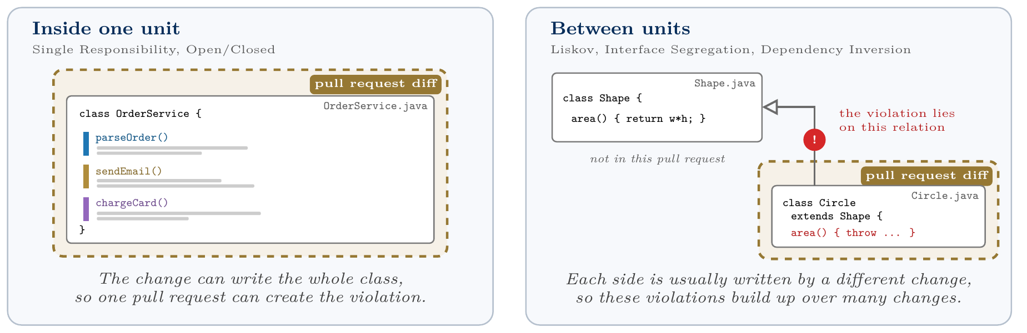
Where the problems live
Part 6
Results
45

Slide 46
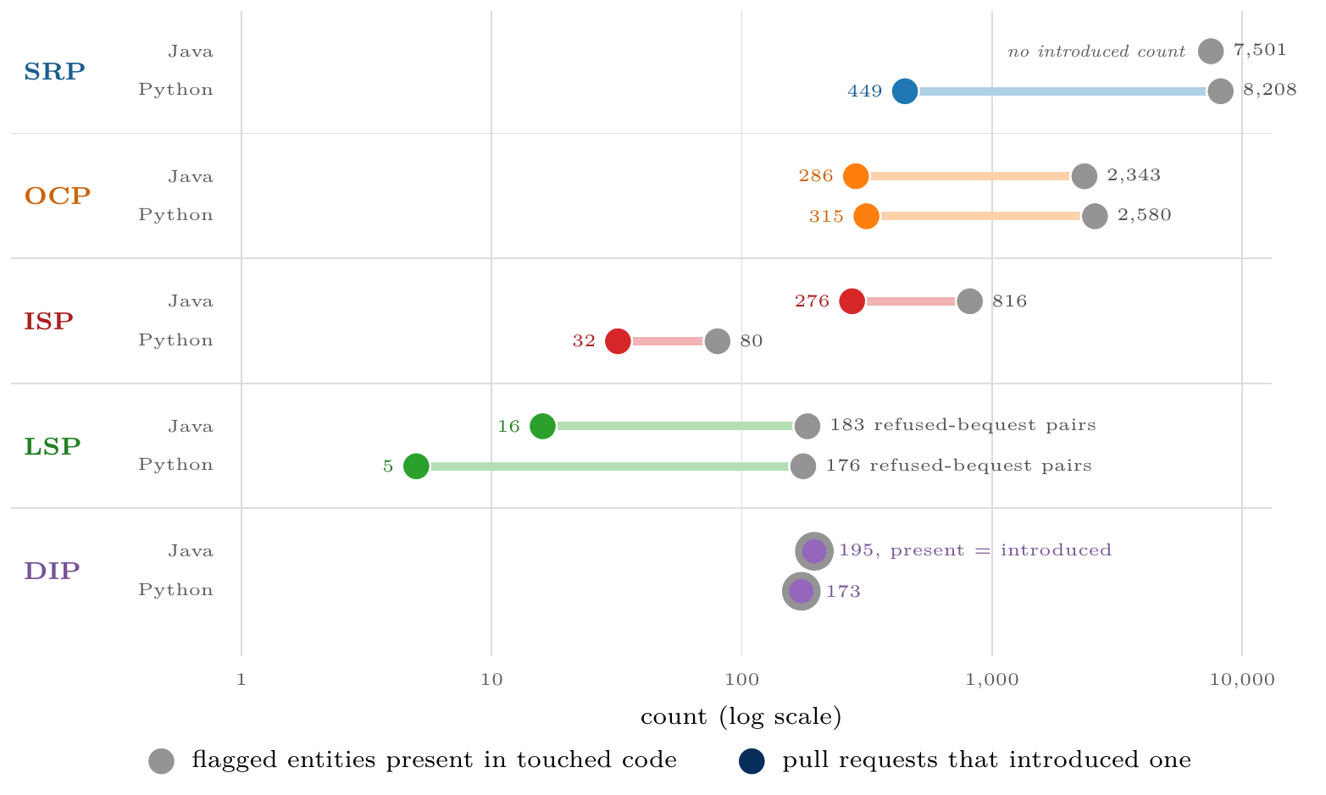
Most violations were there before the change
Part 6
Results
183 vs 16
refused bequest present vs introducing pull requests, Java
176 vs 5
refused bequest present vs introducing pull requests, Python
After correcting for precision, 0.4% to 4.1% of Java requests introduce a violation.
46

Slide 47
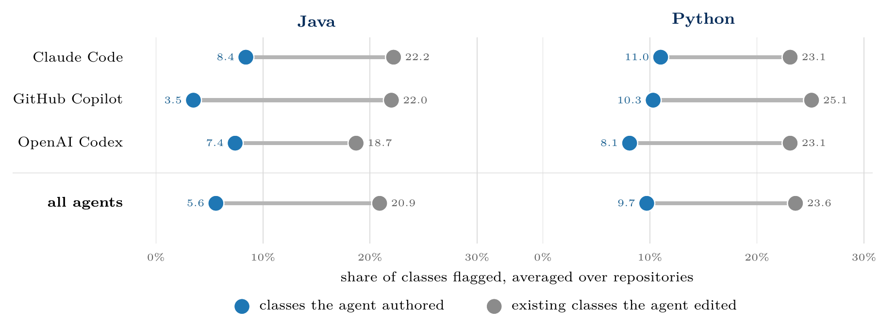
Agent-written classes are flagged less than the code they edit
Part 6
Results
Pooled: 7.7% against 13.5% in Java, 8.9% against 12.1% in Python. New classes are also smaller and younger, so this describes the corpus; it does not rank agents against people.
47

Slide 48
Do agents repair design, or damage it?
Part 6
Results
cycles in the touched code, before against after
 | Java (4,245 PRs) | Python (4,946 PRs)
more cycles after | 188 (4.4%) | 58 (1.2%)
fewer cycles after | 20 (0.5%) | 32 (0.6%)
unchanged | 4,037 (95.1%) | 4,856 (98.2%)
total cycles, before → after | 8,028 → 8,398 | 1,485 → 1,516
≈ 9 : 1
more cycles added than removed in Java (188 against 20)
Agents add cycles more often than they remove them, by about nine to one in Java. The amounts are small next to the 8,028 already present, and this is the only principle where a repair can be counted, because only Dependency Inversion stores a before count.
48

Slide 49
Answers to the research questions
What holds in both languages
Findings
Against the state of the art
Part 7
Contributions and practical use
Findings and conclusions
Limitations
Conclusion and future work

Slide 50
Answers to the two research questions
Part 7
Findings
RQ1
Agents do violate SOLID, rarely, and most problems were already there
Low introduction rate. 0.4% to 4.1% of Java and 0.3% to 3.5% of Python pull requests introduce a violation of a given principle (corrected by measured precision).
Present far exceeds introduced. 183 refused-bequest relations against 16 introducing pull requests in Java, 176 against 5 in Python.
Size beats agent. Each doubling of files touched multiplies the odds of a flag by 1.88–1.95 (Java) and 2.01–2.18 (Python). One agent gap replicates: Claude Code on Open/Closed (2.22 Java, 2.09 Python).
Outcomes. Merged Java code looks like unreviewed code; merged Python code is cleaner.
RQ2
Partly, and the answer differs by principle
Two principles agree with the judge. Dependency Inversion: precision 0.892 Java, 1.000 Python. Liskov restricted to refused bequest: 1.000 on 64 Java flags, 0.857 in Python.
Three are screens. SRP, OCP and ISP have precision 0.110 to 0.425: their flags locate code worth reading, not violations.
Published analysers. The SRP rubric agrees with PMD (κ 0.574) and DesigniteJava (0.531) more than they agree with each other (0.384); no tool corroborates OCP (0.122).
50

Slide 51
RQ1: what holds in both languages
Part 7
Findings
Result | Java | Python
Change size dominates | OR 1.88–1.95 | holds 2.01–2.18
Claude Code on Open/Closed | 2.22 (1.21–4.07) | holds 2.09 (1.44–3.04)
Present far exceeds introduced | 183 vs 16 | holds 176 vs 5
Authored flagged less than edited | 7.7% vs 13.5% | holds 8.9% vs 12.1%
Shape rule transfers, number does not | 1.000 vs 0.704 | holds 0.857 vs 0.200
Compiler removes a family of LSP faults | inferred from Java | confirmed 46 of 51
Merged equals unreviewed | yes | does not hold
SRP screen precision | 0.350 | drops to 0.110
51

Slide 52
Findings
Part 7
Findings
1
2
3
What a compiler enforces decides which violations can exist: 46 of 51 confirmed Python Liskov violations are faults javac rejects.
Width predicts Interface Segregation violations and not Open/Closed ones, because one principle is about size and the other about whether a set can grow.
The closed sets that matter are fixed by specifications, not by the language.
4
5
6
Most flagged problems in the touched code predate the change.
Classes the agents wrote are flagged less often than the classes they edit.
Merged code is not a biased sample of unreviewed agent code in Java, but it is cleaner than abandoned code in Python.
52

Slide 53
Against the state of the art: what we confirm
Part 7
Findings
Earlier finding | What we measured | Outcome
Volume-Quality Inverse Law (Zhu, Yuecai) | Each doubling of files touched multiplies the odds of a flag by 1.88–1.95 (Java) and 2.01–2.18 (Python), on every modelled principle | Confirmed. Our strongest result, in both languages
Agent differences vanish after churn normalisation (Cynthia et al.) | After adjusting for files, repository and time, only Claude Code on Open/Closed survives: 2.22 Java, 2.09 Python | Confirmed, with one exception that replicates
Passing tests ≠ a change a maintainer accepts (Whitfill et al.) | Merged Java pull requests are structurally indistinguishable from those closed without review | Consistent. Merge status carries little structural information
91% correct, yet thousands of design issues (Kashif et al.) | Violations already present outnumber those introduced by about 11:1 (Java) and 35:1 (Python) for refused bequest | Consistent, though they build new projects and we edit existing ones
53

Slide 54
Against the state of the art: where we differ
Part 7
Findings
Earlier finding | What we measured | Outcome
SRP easiest to detect, DIP hardest (Pehlivan et al.) | For structural detectors the order reverses: DIP is the most precise (0.892 Java, 1.000 Python), SRP the least (0.350, 0.110) | Reversed, because a model reads examples while a static rule computes a whole-repository graph
Agents succeed at only 4.3% of dependency-control tasks, in C++ (Zhu, Haichao, NITR) | Agents seldom introduce dependency or responsibility violations into existing Java and Python repositories | Different question: that benchmark asks agents to repair structure, we ask whether they damage it
Erosion grows across 77% of long-horizon trajectories (SlopCodeBench) | The time coefficient is inert for every delta principle, in both languages | Not tested: our unit is one pull request, not a trajectory of successive edits
Taken together with Pehlivan: a graph-based detector and a reading model fail on opposite principles, so combining them beats choosing one.
54

Slide 55
Contributions and practical use
Part 7
Findings
Contributions
For a review check
A validated SOLID instrument over real agent pull requests, all five principles
Add refused bequest: 64/64 in Java, 6/7 in Python
1
1
A corpus with merged, rejected and open requests
In dynamic languages, also check that an override still accepts the base’s calls
2
2
A map of which principles a rule measures and which it only screens
Do not rely on interface-width thresholds
3
3
Evidence in two languages on where design risk sits
Treat SRP and OCP flags as prompts for discussion, not as blockers
4
4
A replication with the same agents in a second language
Structural checks cannot see relation-level damage: that needs repository history
5
5
55

Slide 56
Limitations
Part 7
Findings
SOLID adherence is not measured design quality or cost; nothing here observes an outcome
Few reviewed rejections (171 Java, 196 Python)
5
1
One snapshot per pull request: slow erosion is invisible
Labels come from an LLM judge of the same family as one agent; 89.7% self-agreement bounds every figure
6
2
Both corpora come from one dataset; 7.0% of Python source is gone
7
No tool corroborates OCP (κ 0.122); none exists for ISP or Python
3
Small counts for the relation-level principles, so their intervals are wide
8
Agents chose their own tasks: these are associations, not causes
4
Python Interface Segregation is defined differently, so raw rates are not comparable
9
56

Slide 57
Conclusion and future work
Part 7
Findings
Most design problems in the code these agents touch were there before them, and how much an agent changes matters more than which agent it is. Both results hold in Java and in Python.
NEXT STEPS
Recognise specification-fixed sets for Open/Closed, and a churn signal for what is not closed
4
Narrow recall by sampling unflagged entities
1
5
Re-judge Python samples, and add a judge from another model family
An Open/Closed proxy that agrees with published smells (κ=0.122 today)
2
6
A corpus with many reviewed rejections
A framework-aware responsibility screen for Python
3
7
Repository history as the unit of analysis
57

Slide 58
Dziękuję
Thank you
https://kiraieee.github.io/

Slide 59
Why recall must be weighted
Package zones
Backup
Corrected rates
Additional material

Slide 60
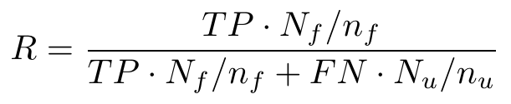
Backup: why recall must be weighted
Backup
Additional
Each sample is half flagged, the population is not. For Java Liskov it holds 574 flagged override pairs and 25,594 unflagged ones.
0.966 → 0.386
unweighted vs weighted recall, Java Liskov
The intervals are wide because a weighted recall rests on the few violations found in the unflagged stratum (three for Liskov, in 200 rows).
Counting the strata as equally common gives 0.966. Weighting gives 0.386. The population is the one the sample was drawn from: production entities, counted once each.
This is why more labelling would help recall, not precision.
60

Slide 61
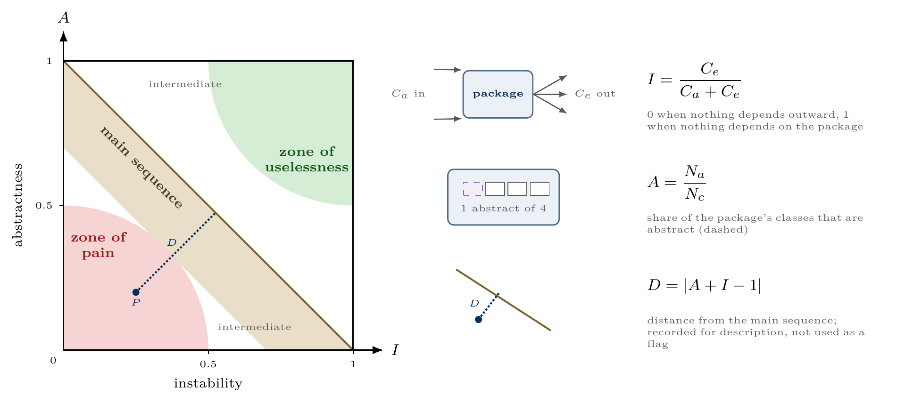
Backup: package zones (descriptive only)
Backup
Additional
Distance from the main sequence was tested as a change signal and confirmed none of 17 flags, so packages are described by position and never flagged.
61

Slide 62
Backup: corrected rates, with SRP split by authorship
Backup
Additional
Principle | Unit | Java |  | Python
 |  | flagged | corrected | flagged | corrected
SRP | class, authored | 7.7% | 2.7% | 8.9% | 1.0%
SRP | class, all touched | 12.2% | 4.3% | 11.6% | 1.3%
OCP | pull request | 6.7% | 2.2% | 6.4% | 2.5%
LSP | pull request | 0.4% | 0.4% | 0.9% | 0.5%
ISP | pull request | 6.5% | 2.2% | 0.6% | 0.3%
DIP | pull request | 4.6% | 4.1% | 3.5% | 3.5%
Corrected = flag rate multiplied by measured precision. The Java Liskov row is the shipped flag, refused bequest only, whose precision is 1.000.
62

