Slide 1

Variants and Rate in SARS-CoV2
Group member Zhang Leyi & Jinqi Duan
Supervisor Palle Villesen & Thomas Bataillon
Department Bioinformatics Research Centre

Slide 2
Introduction
Variants spread considerably fast and quickly displaced in the population.
New variants with several novel mutations emerged suddenly, including those overcompeted[1].
Here we investigate the strength and influence of adaptive evolution in SARS-CoV-2.

Slide 3
Data
Oveview
Data set 1 : 244,812 individuals
Data set 2 : 13,674,098 SNP change records
After cleaning duplicated or wrong values, 8,320,141 left in data set 2
Concern
Spike protein
Key non-synonmous
Variant of concern[2]
Delta
Omicron (BA.1, BA.2, BA.2.12.1, BA.4, BA.5, BA.5.2.1)
Notes:
The branches to these variants are characterized by many amino acid-changing mutations often in the spike protein.

Slide 4
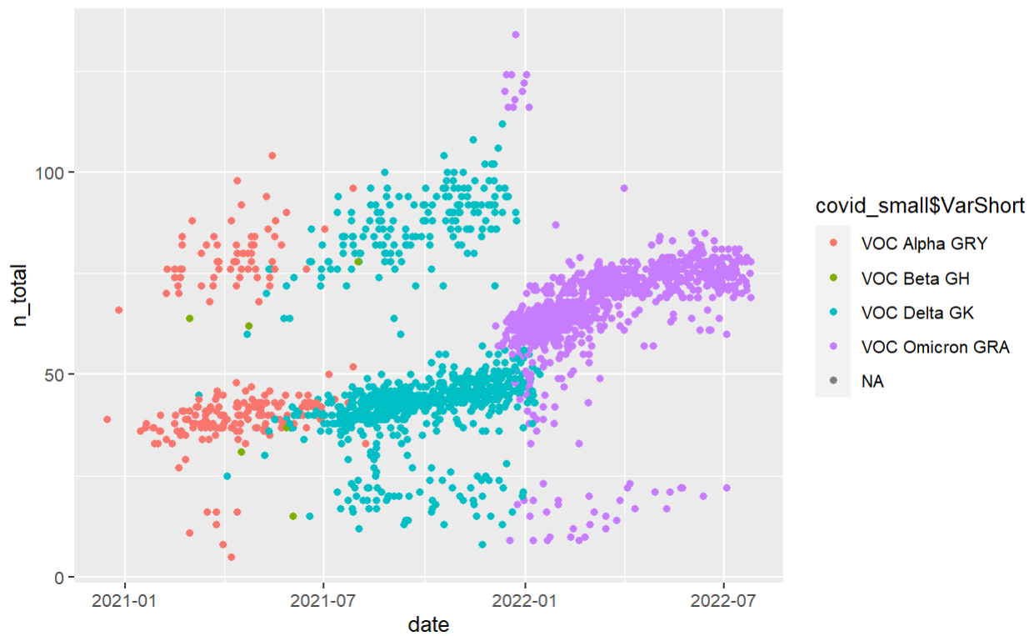
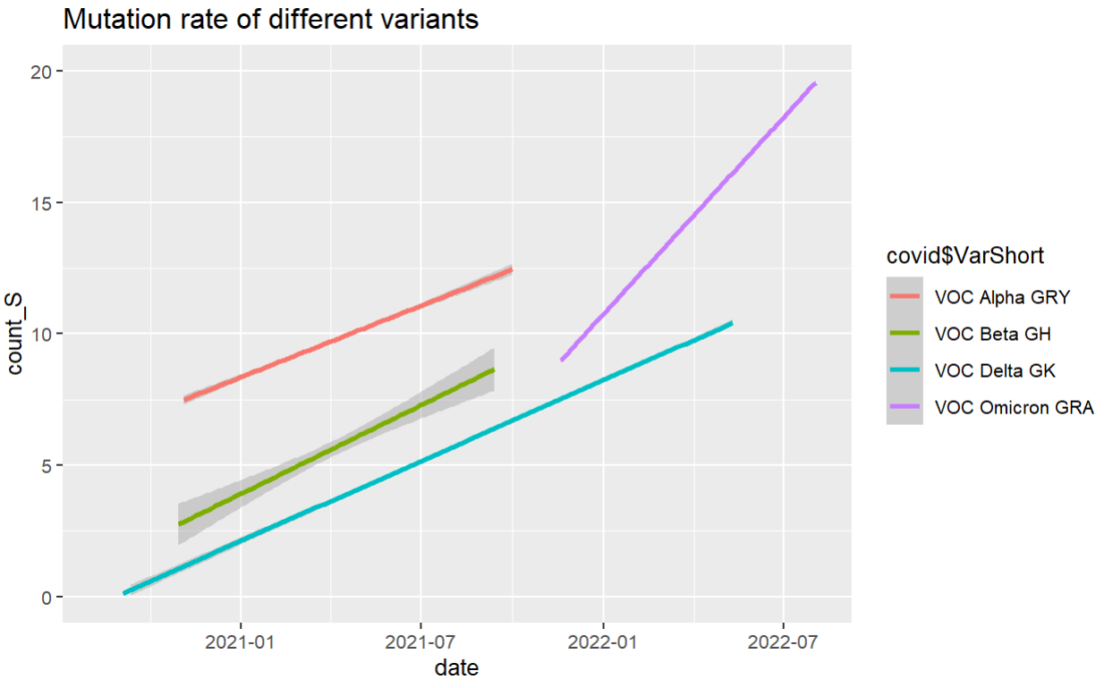
Progress - Number of mutation with date in difference variant of concern(VOC)

Slide 5
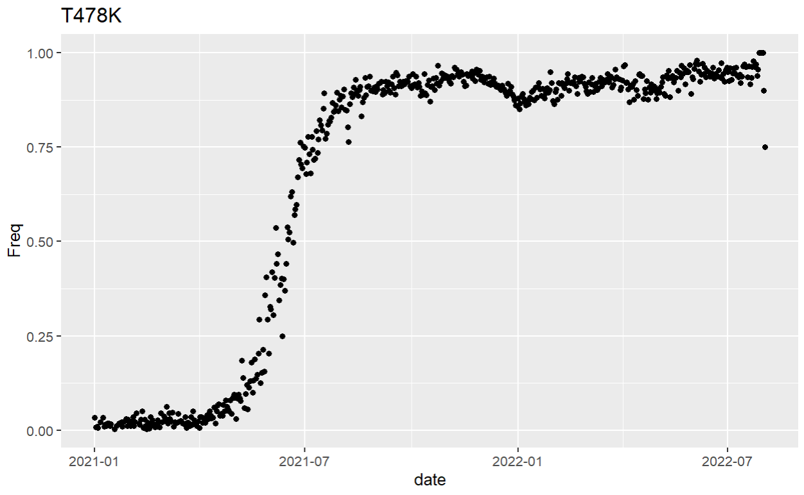
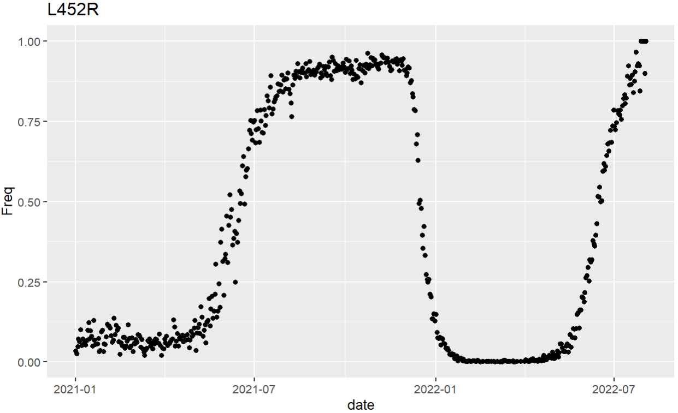
Progress - Frequencies of AA_change(example)

Slide 6
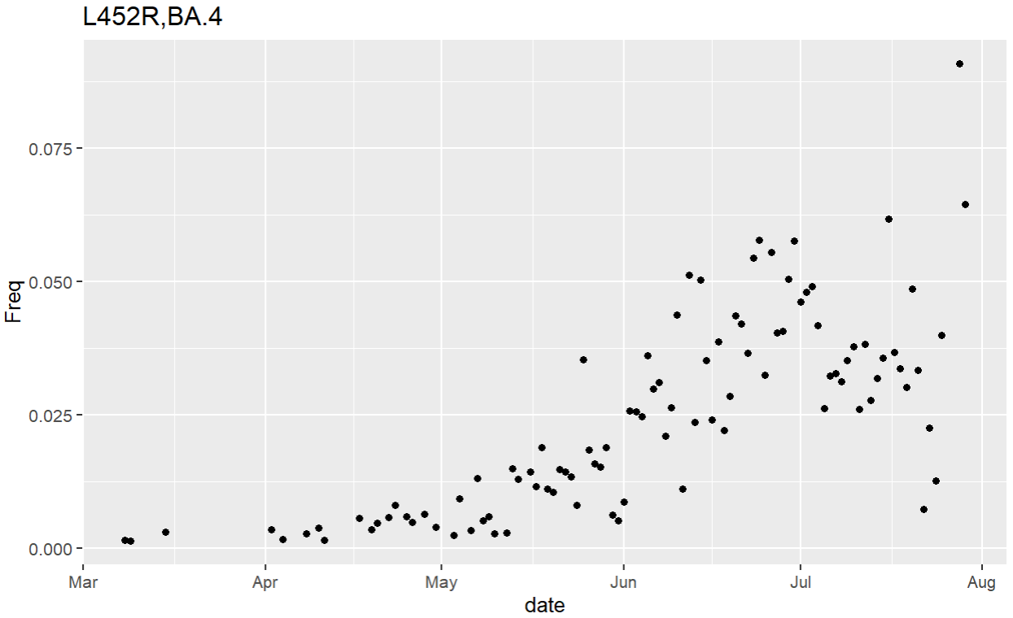
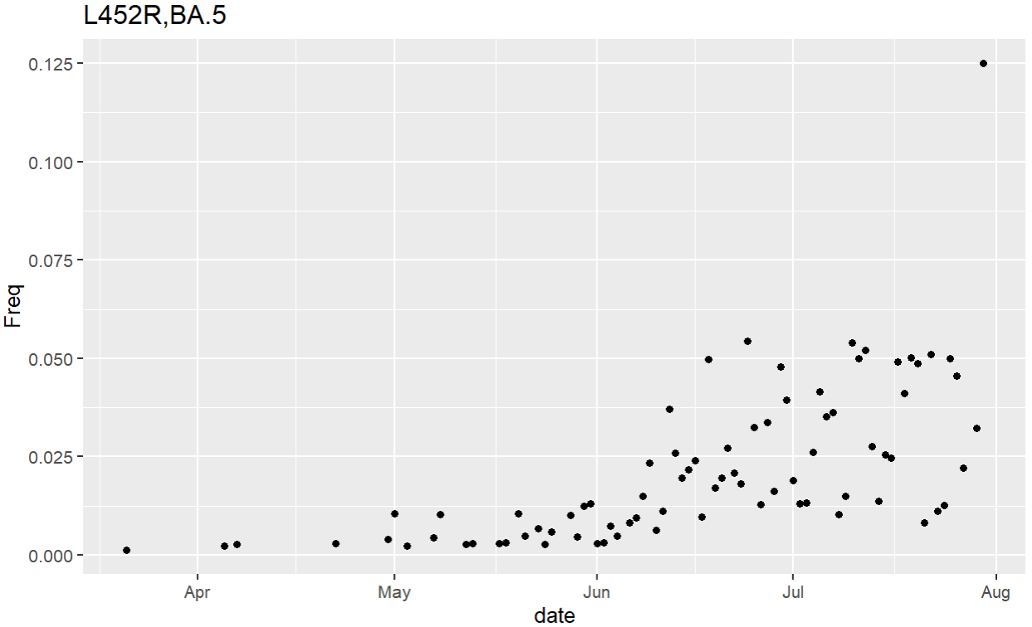
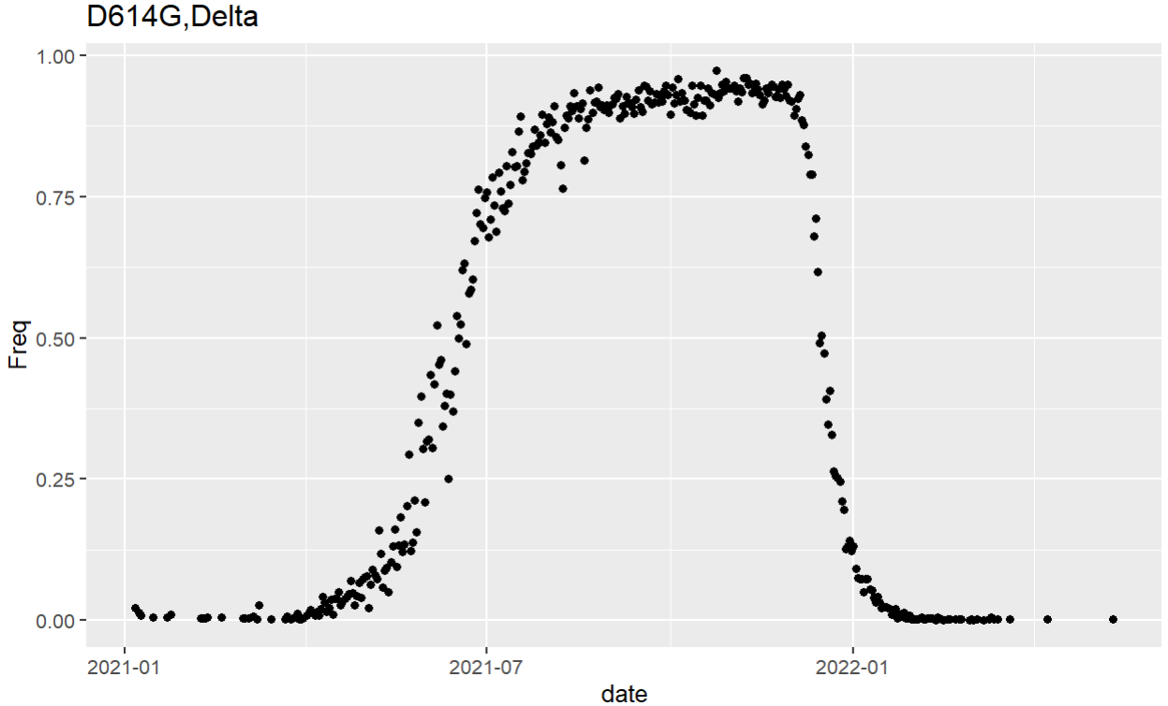
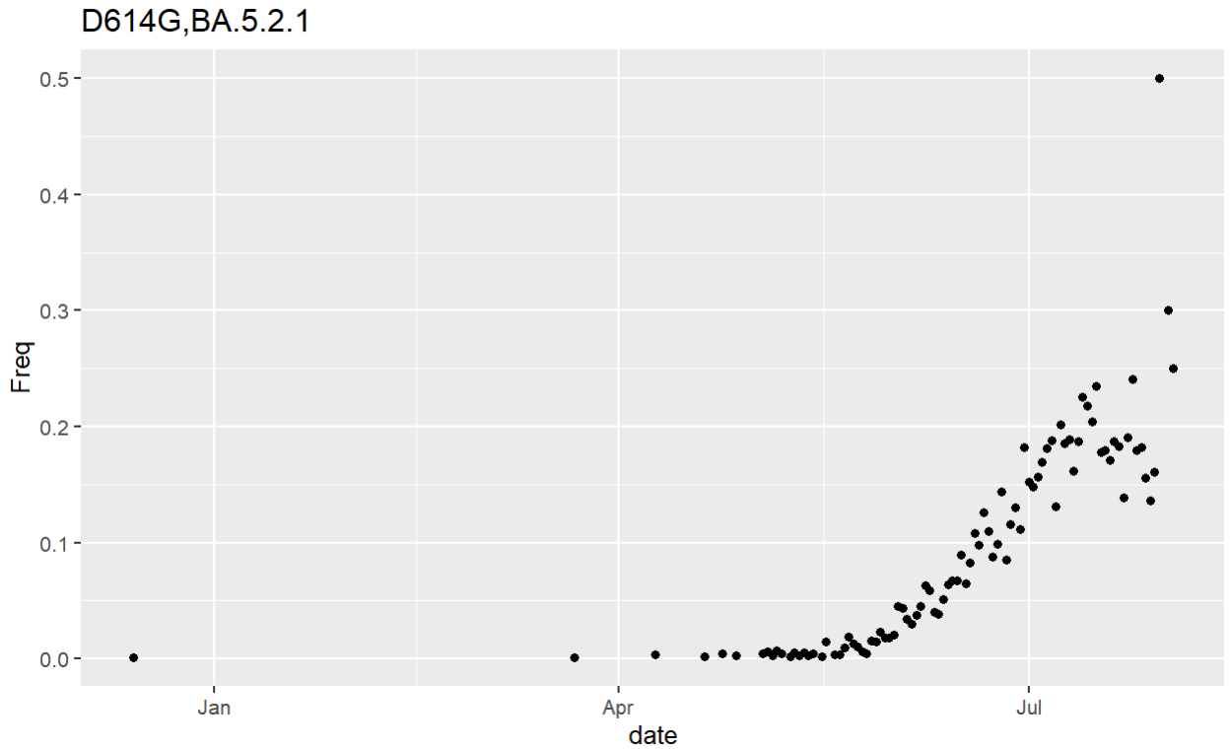
Progress - Convergence and potentially advantage AA_change(example)
Notes:
japan
Aferica

Slide 7
Next
Quantify the strength of adaptive evolution( Method?)
Covid shows punctuating evolution not gradualism.
Proportion of neutral substitutions to all substitutions?
Begin writing report

Slide 8
Reference
[1] Neher, Richard A. “Contributions of Adaptation and Purifying Selection to SARS-COV-2 Evolution.” 2022, https://doi.org/10.1101/2022.08.22.504731.
[2] “SARS-COV-2 Variant Classifications and Definitions.” Centers for Disease Control and Prevention, Centers for Disease Control and Prevention, https://www.cdc.gov/coronavirus/2019-ncov/variants/variant-classifications.html.
[3] Zhang, Yanan, et al. “SARS-COV-2 Spike L452R Mutation Increases Omicron Variant Fusogenicity and Infectivity as Well as Host Glycolysis.” Signal Transduction and Targeted Therapy, vol. 7, no. 1, 2022, https://doi.org/10.1038/s41392-022-00941-z.
[4] Cao, Yunlong, et al. “Imprinted Sars-COV-2 Humoral Immunity Induces Convergent Omicron RBD Evolution.” 2022, https://doi.org/10.1101/2022.09.15.507787.

