Slide 1
Week 8
Zhang Leyi, Duan Jinqi

Slide 2
Lineages and Mutations
BA.2-->BA.5-->BA.5.2-->BF.7 BA.2: 2021-10-22 BA.5: 2022-01-10, South Africa, L452R F486B BA.5.2 2022-04-11: ORF9b: D16G BF.7 2022-05-13 Belgium, R346T
Mutations on RBD are mostly concentrated in R346, R356, K444, L452, N460K, F486.
BA.2.12 from India, BA.2.12.1 from Canada. Spike mutations L452Q and S704L are from antigenic drift, which are hard to accumulate. But in only a month(Feb 2022), 2 mutations are accumulated. S704L also shows convergence, that BA.1, BA.2, BA.5 all have S704L change. And BA.1 + S704L has growth advantage than BA.1

Slide 3
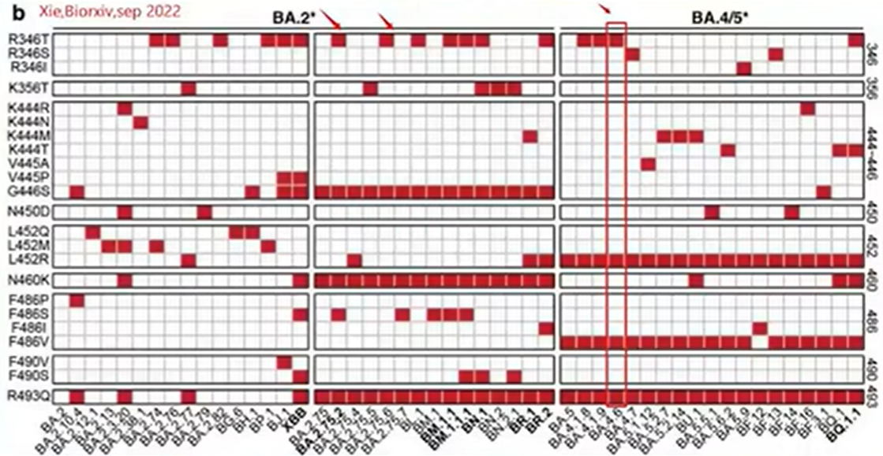

Slide 4
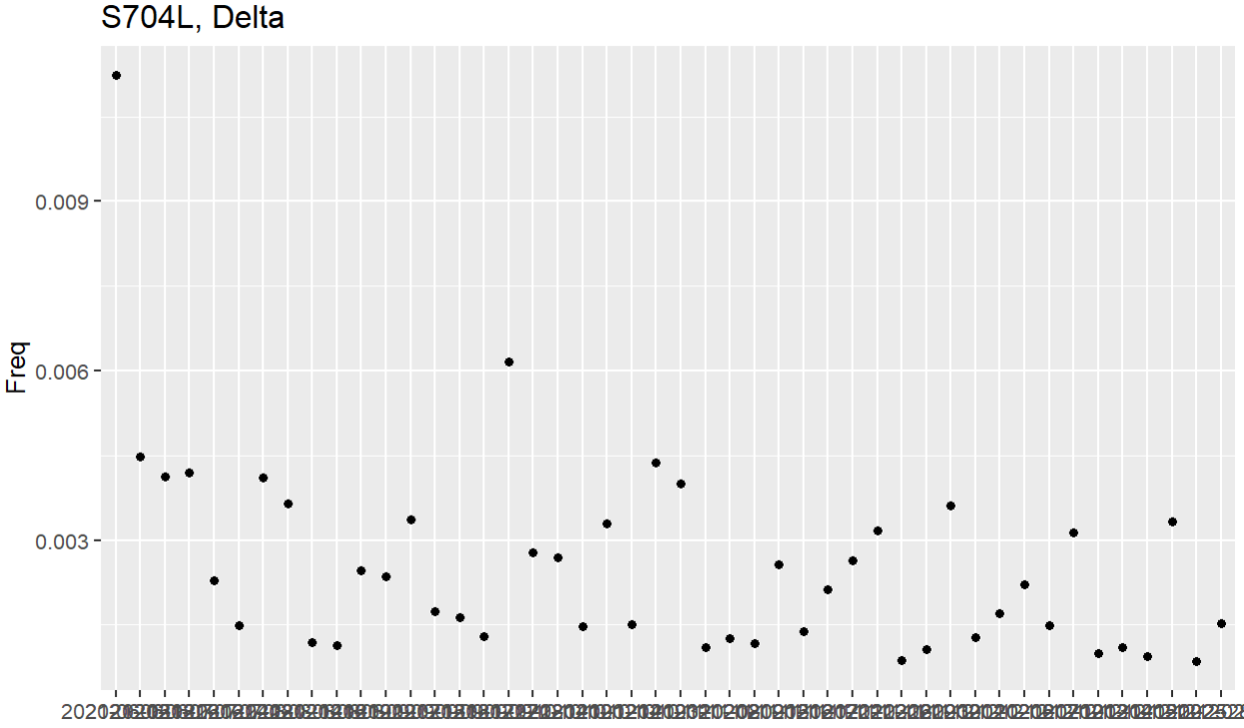
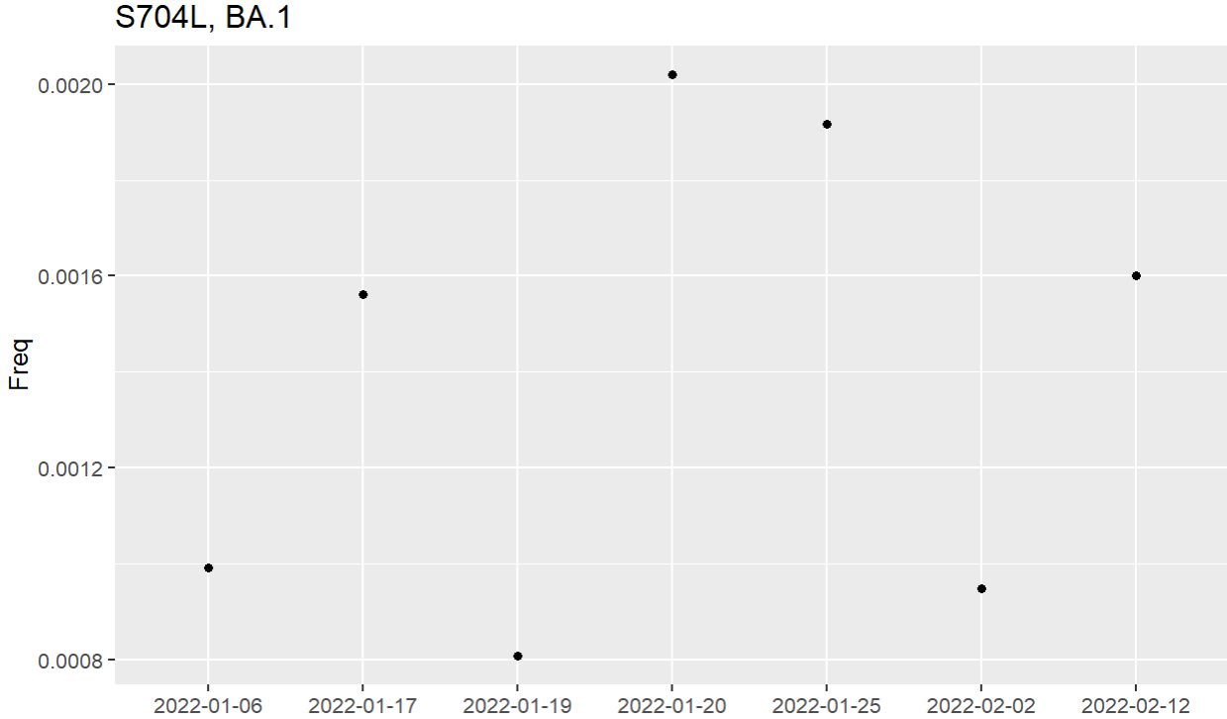
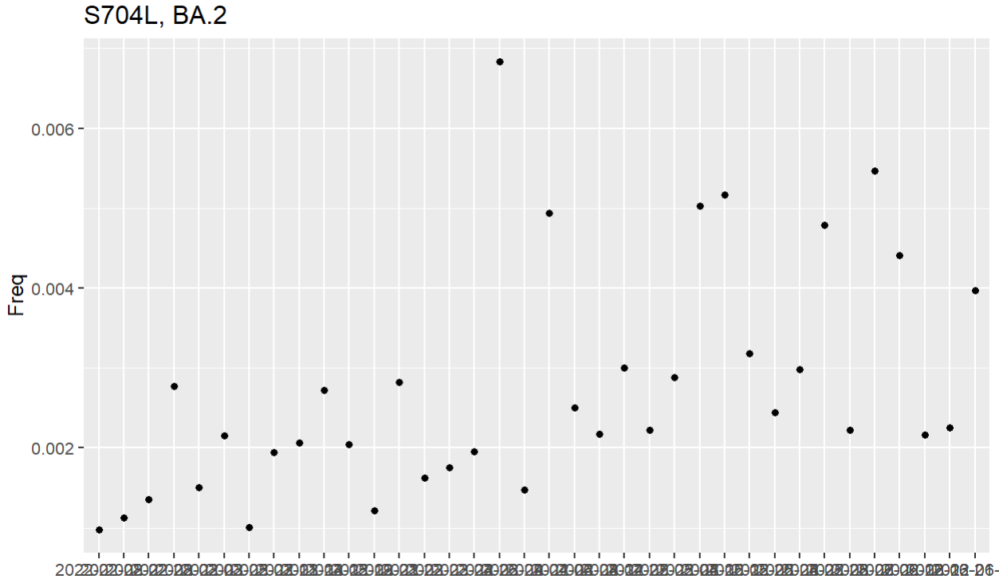
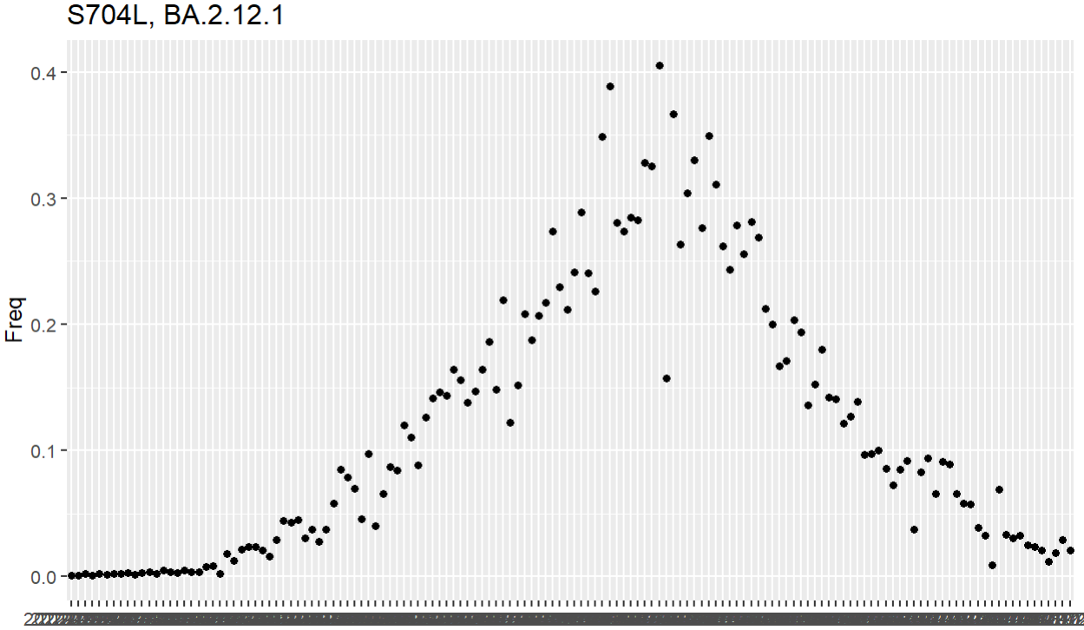
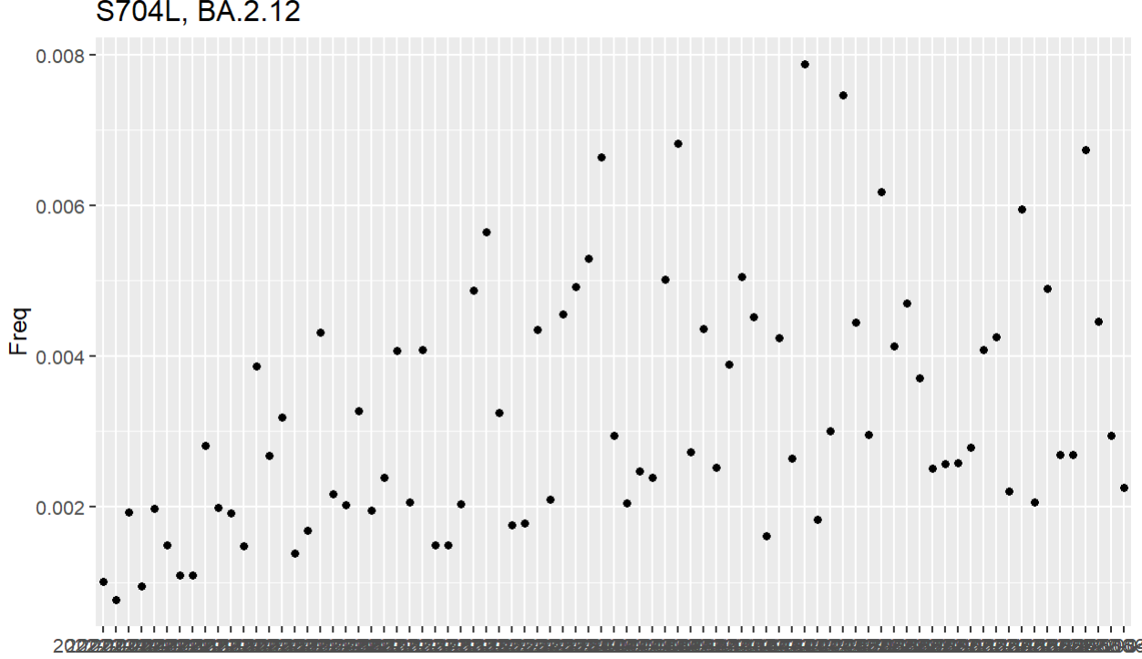
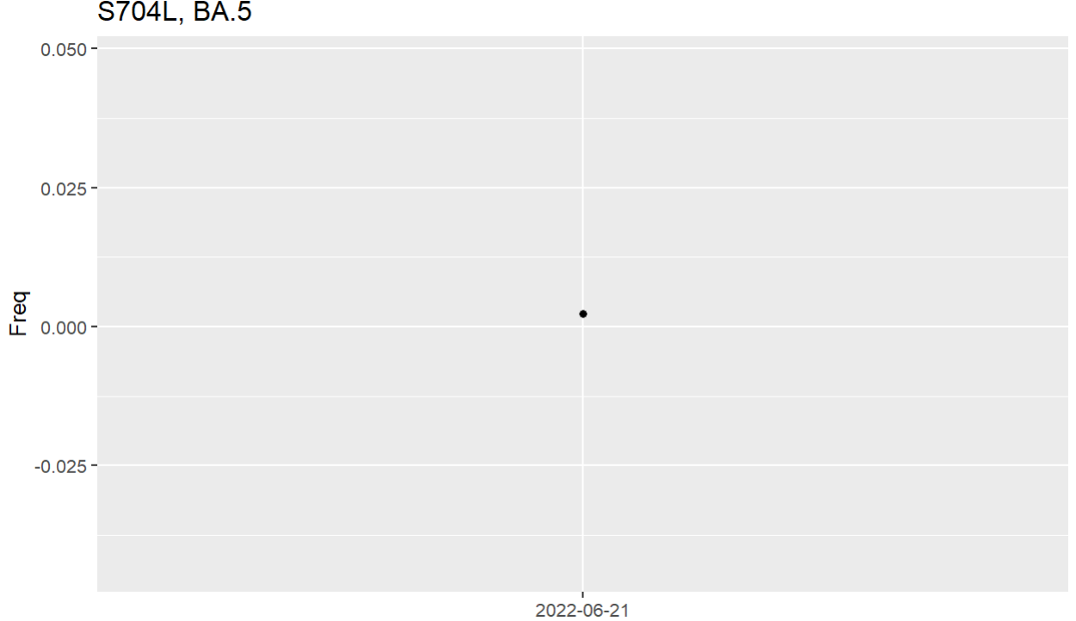
S704L
Only BA.4 does not have S704L mutation.
Different clades have same mutation -> convergence

Slide 5
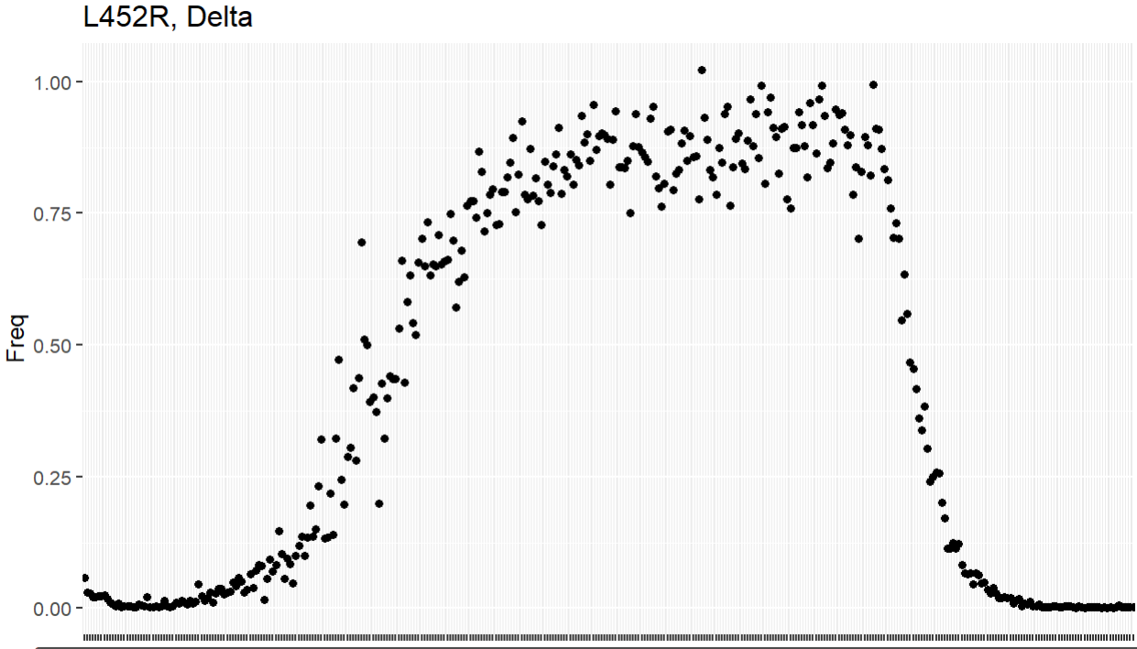
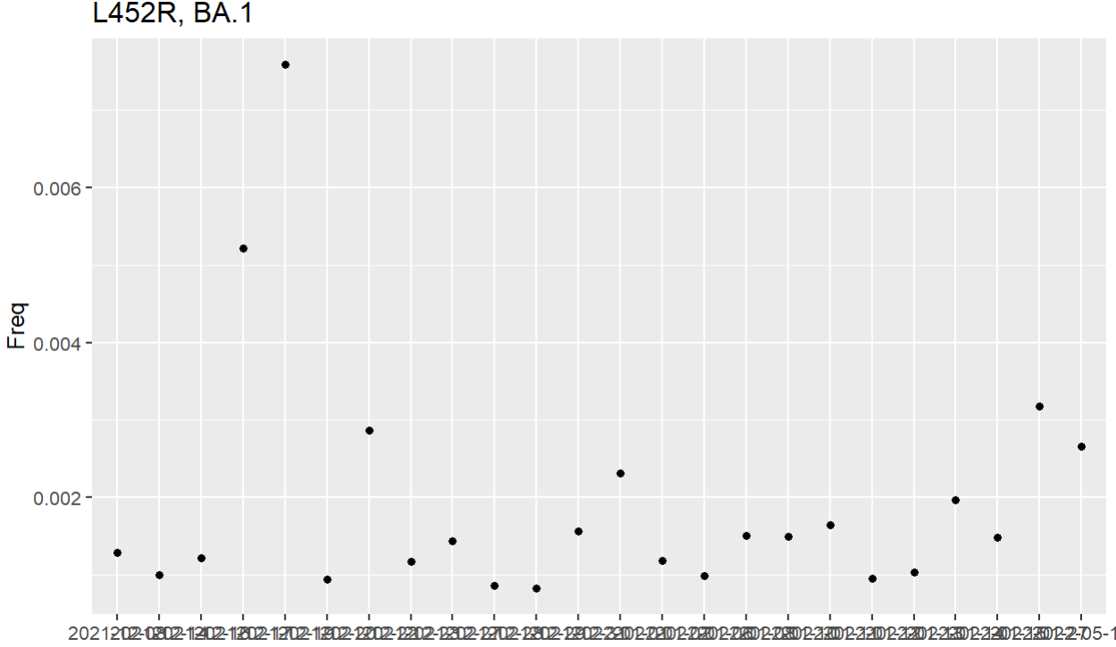
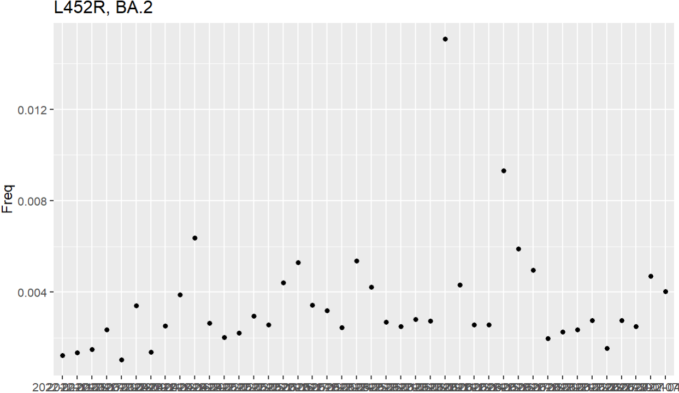
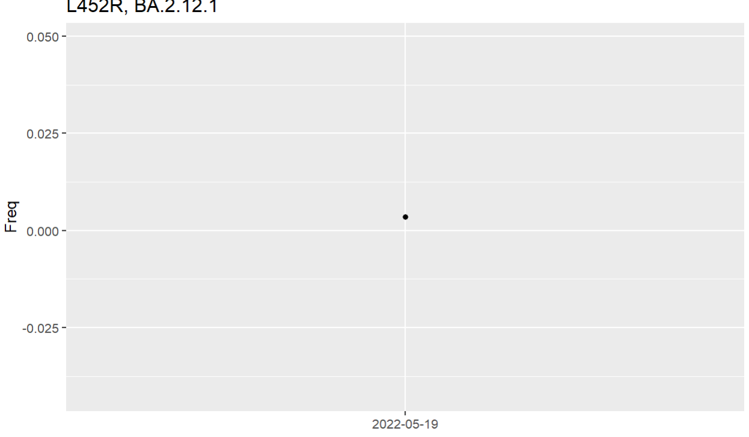
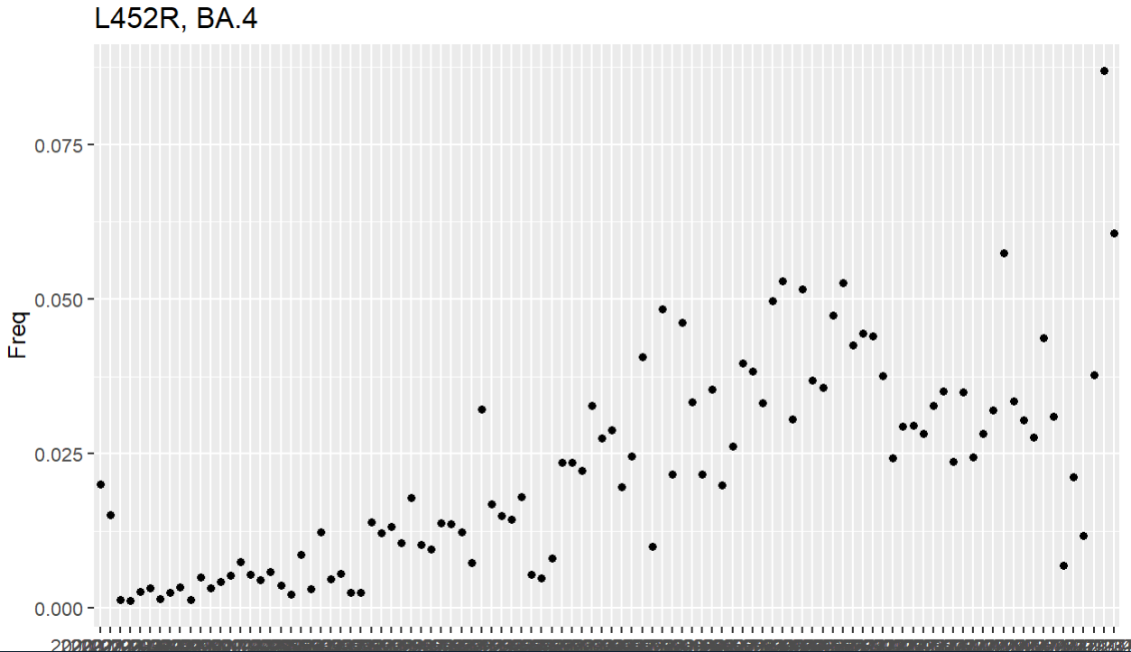
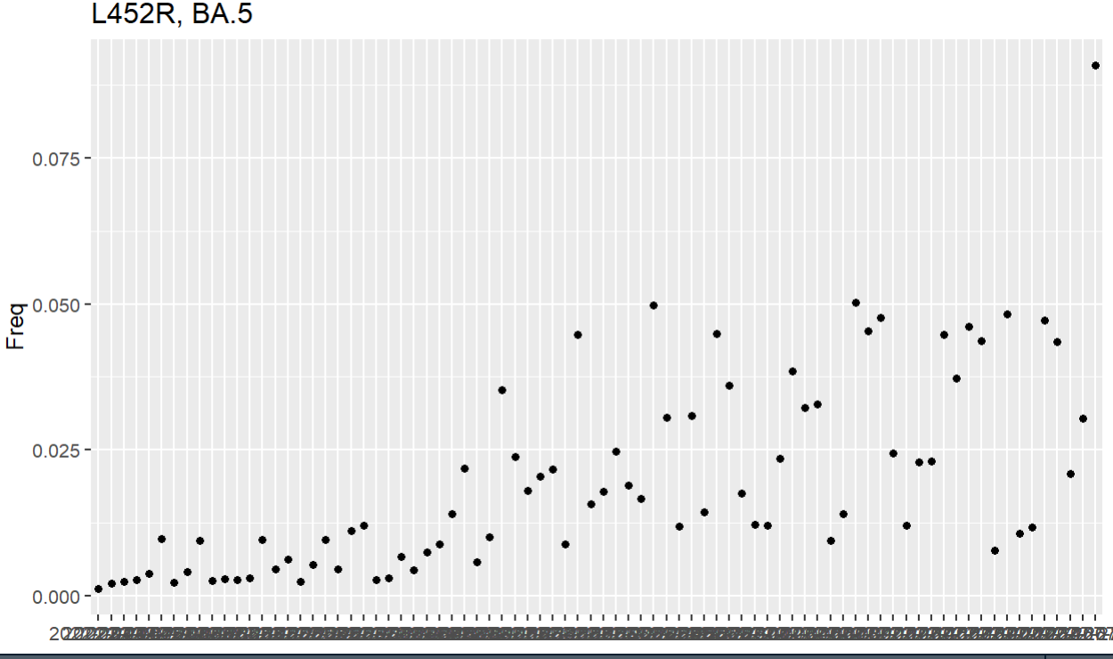
L452R
Rose and fell in Delta, while rise again in Omicron variants.

Slide 6
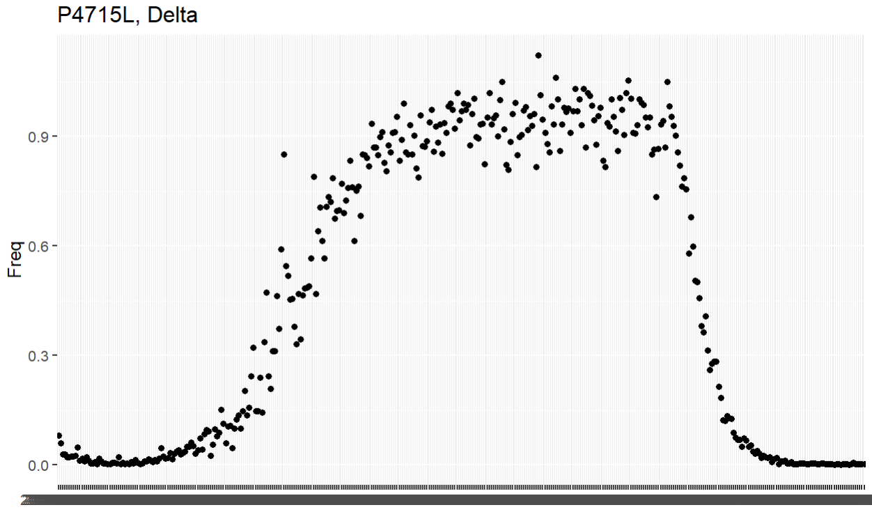
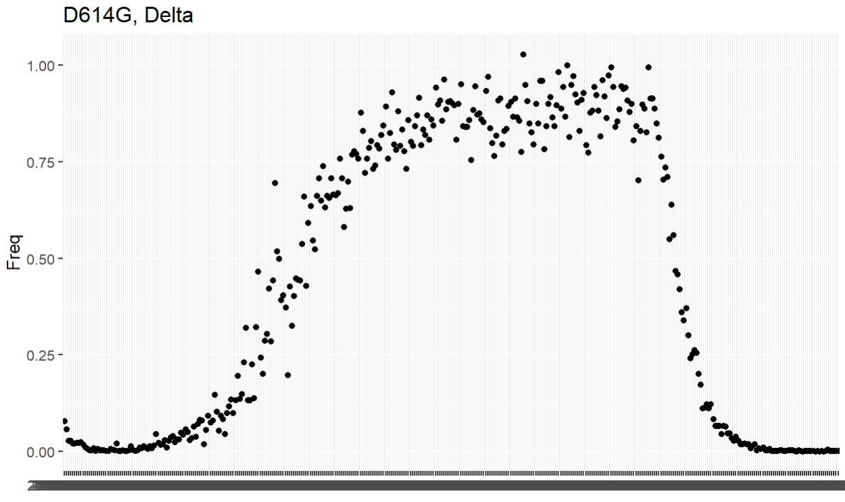
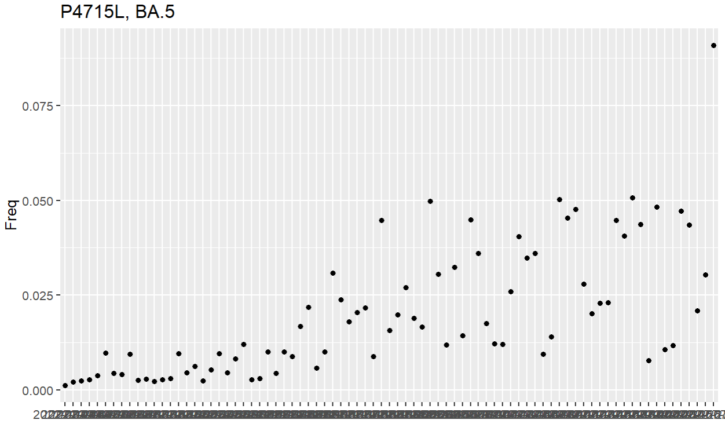
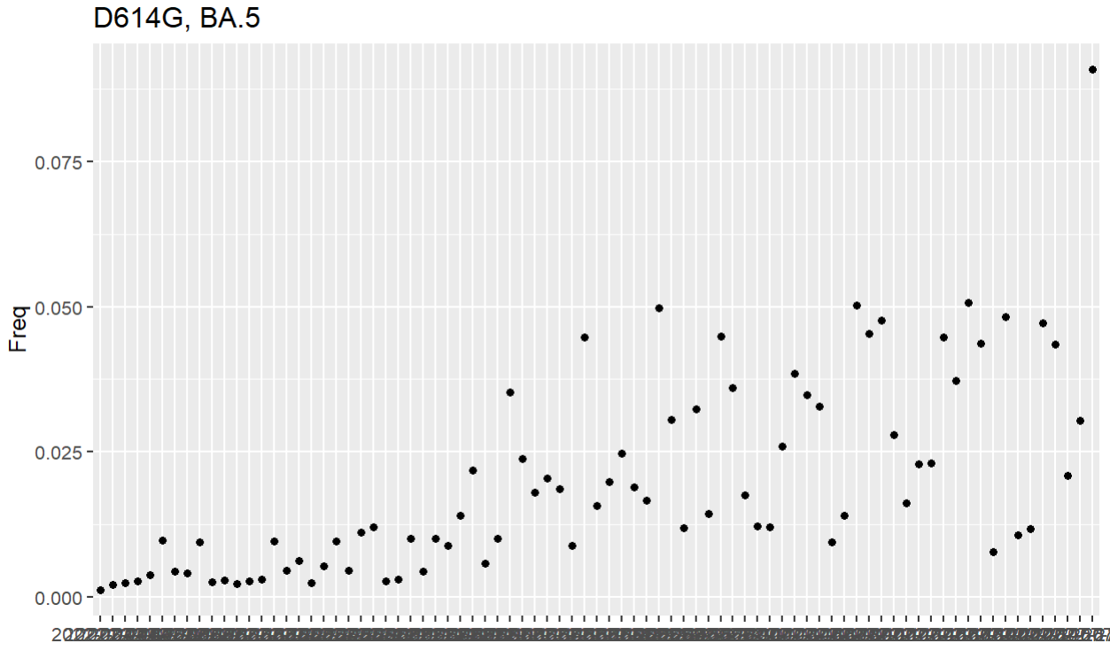
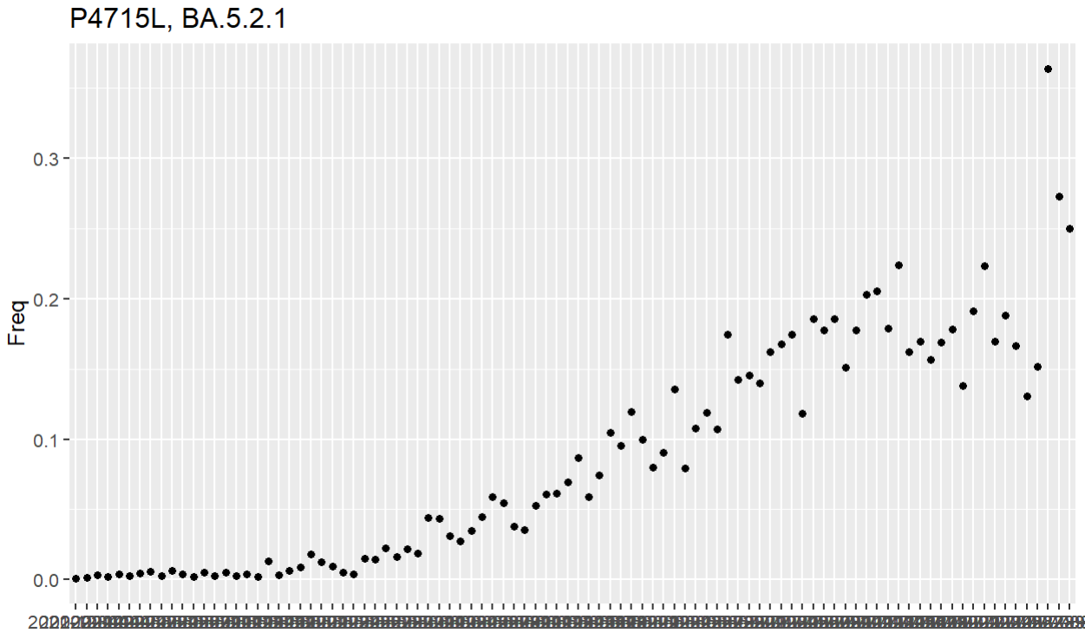
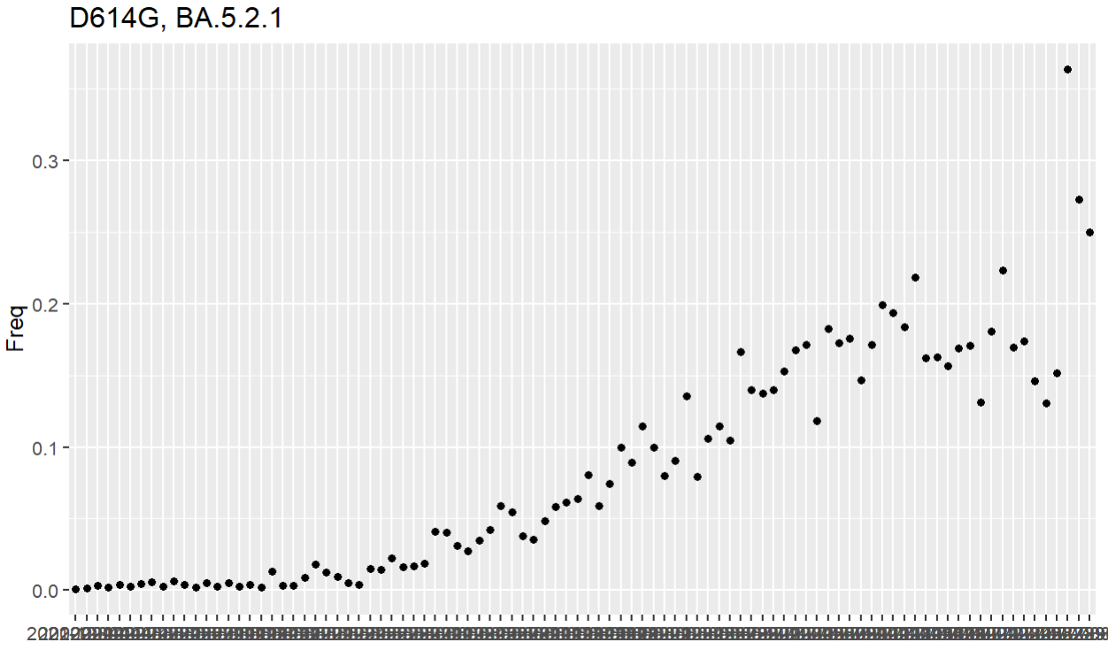
BA5.2.1: clade as parent of BF.7
There appear rising in P4715 and D614G , while in Delta it was in Delta.
I think it is also the proof of the rising of BF.7(aka BA.5.2.1.7)
Then what is the situation in BF.7 or other variants in epidemic?

Slide 7
About D614G:
Through sequence analysis, in the spike protein S of the new coronavirus in the early stage of the outbreak, amino acid 614 was aspartic acid (D), but starting from March 2020, this amino acid was mutated to glycine (G). By June, the frequency of D614G had increased to 75%, and now, the D614G mutant has replaced the earlier virus as the dominant strain worldwide. Clinically, nasopharyngeal swabs from G614-infected individuals detected higher levels of viral RNA than D614-infected individuals, but did not alter the pathogenicity of the virus.
通过序列分析，在疫情爆发早期新冠病毒的刺突蛋白S中，氨基酸614位为天冬氨酸（D），但从2020年3月份开始，该氨基酸突变为甘氨酸（G）。到6月份，D614G的频率已经增加到75%，现在，D614G突变体已经取代早期的病毒，成为世界范围内主要病毒株。在临床上，G614感染者的鼻咽拭子检测到的病毒RNA水平高于D614感染者，但是没有改变病毒的致病性。
https://zhuanlan.zhihu.com/p/350032710

Slide 8
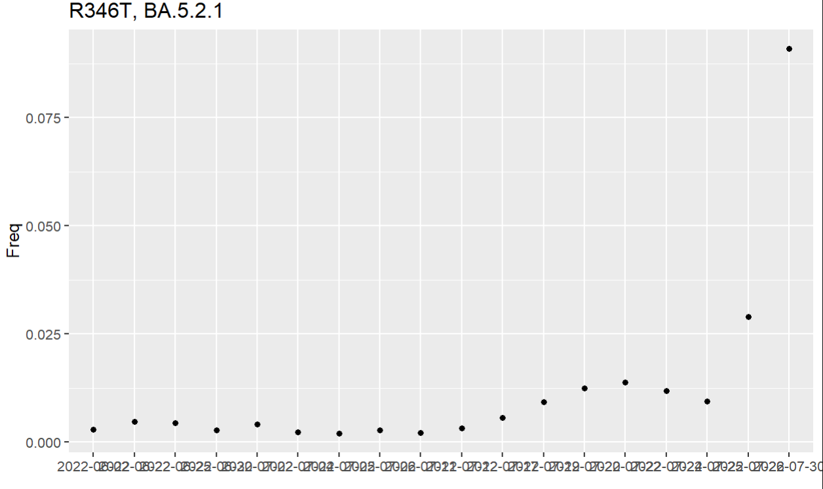
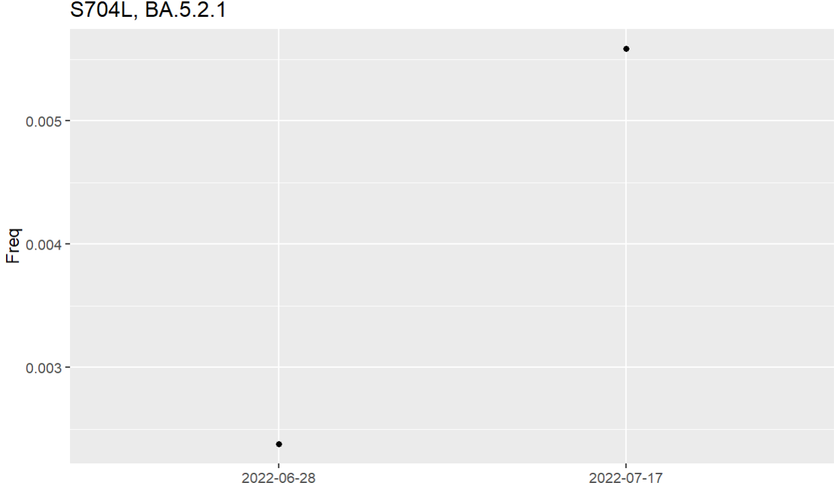
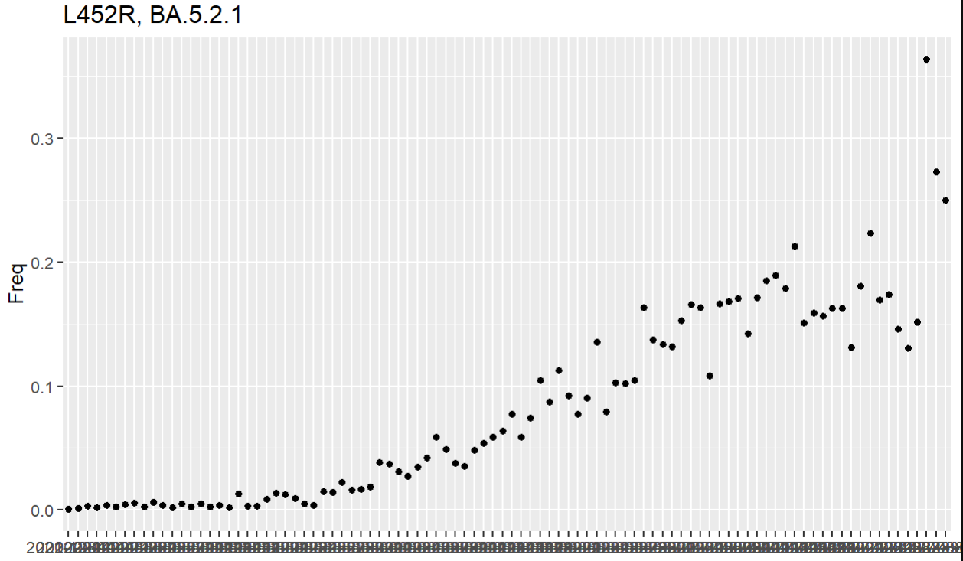
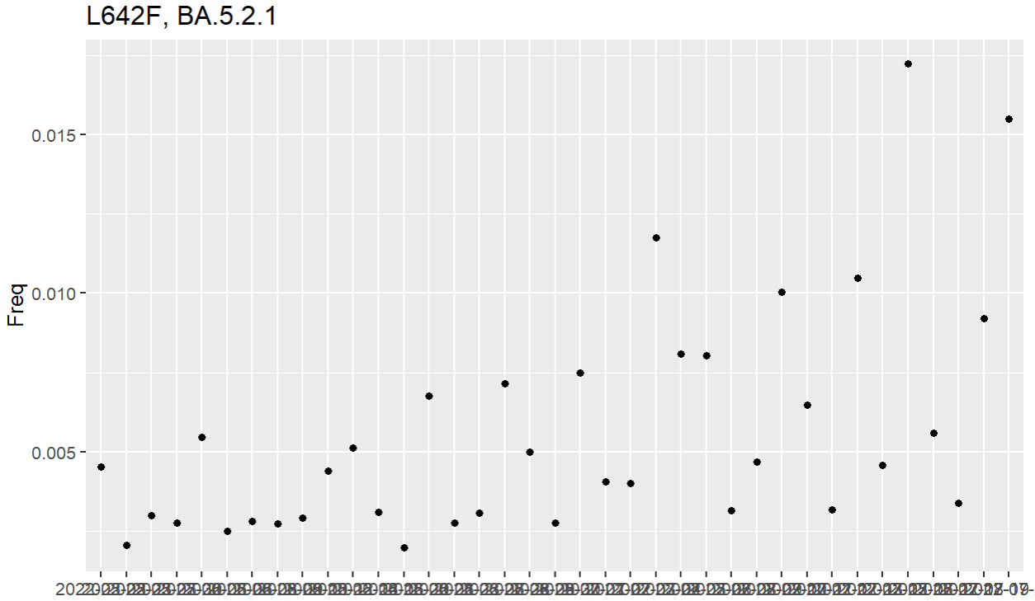
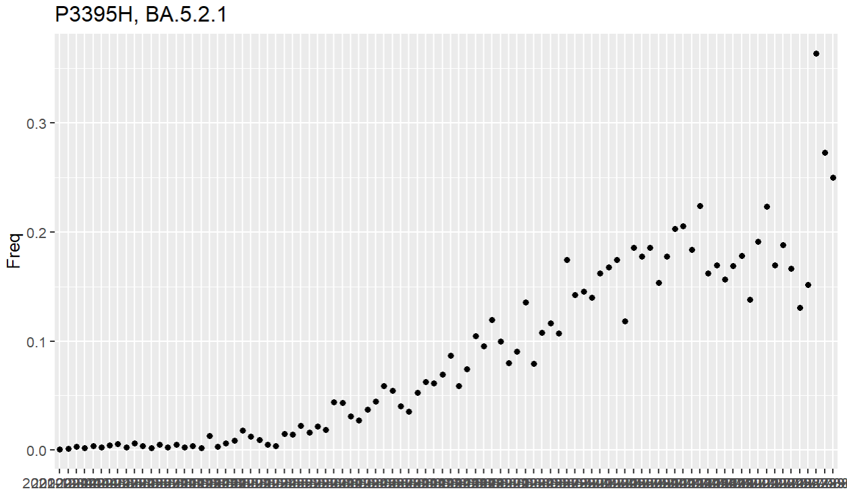
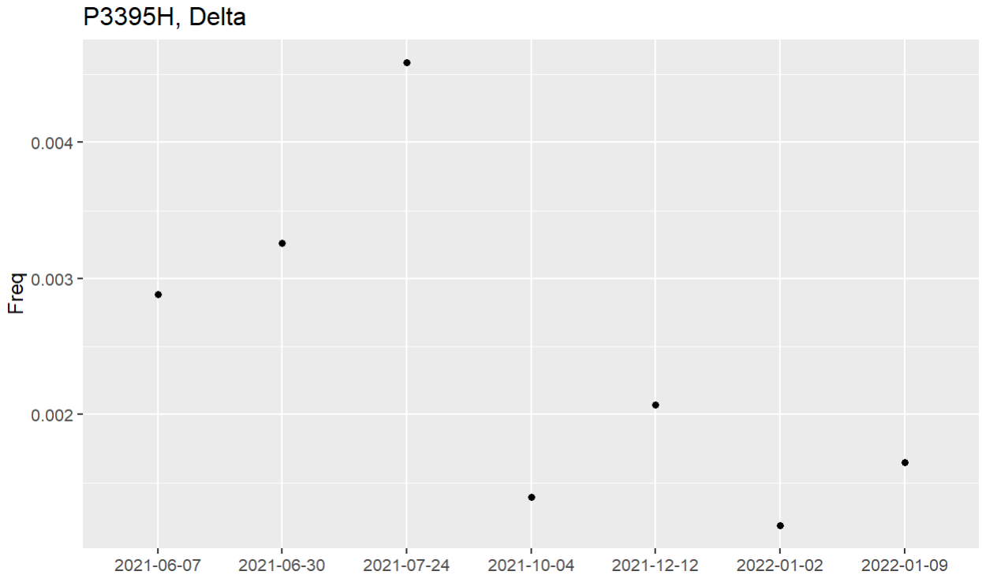
Some other aa_change frequencies in BA.5.2.1
P3395H and L452R rise again in BA5.2.1
Q: Can I focus on the growth advantage: fx. BA5.2.1 + some variant comparing to BA5.2.1
Q: What is the avg mutation rate? In different clades, is this number increasing?

Slide 9
Reference
Zhang, Y., Zhang, T., Fang, Y. et al. SARS-CoV-2 spike L452R mutation increases Omicron variant fusogenicity and infectivity as well as host glycolysis. Sig Transduct Target Ther 7, 76 (2022).
COVID Data Tracker Weekly Review | CDC
bioRxiv 2022.09.15.507787; doi: https://doi.org/10.1101/2022.09.15.507787

