Slide 1
Week 6

Slide 2
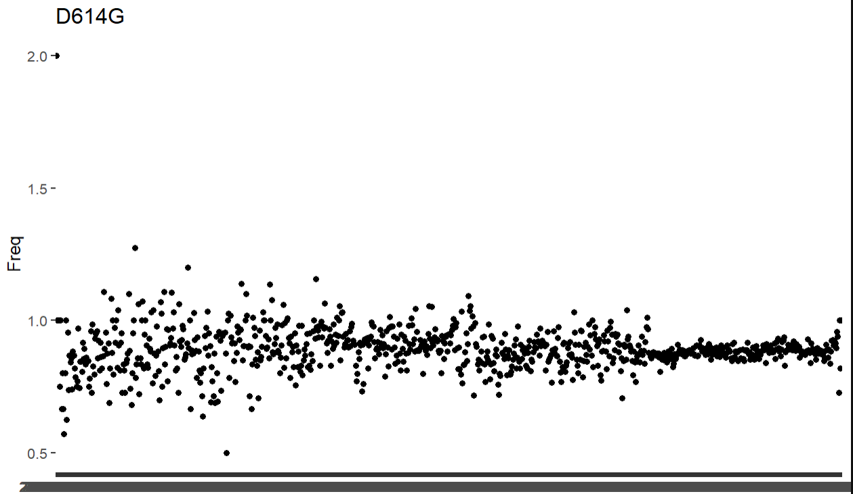
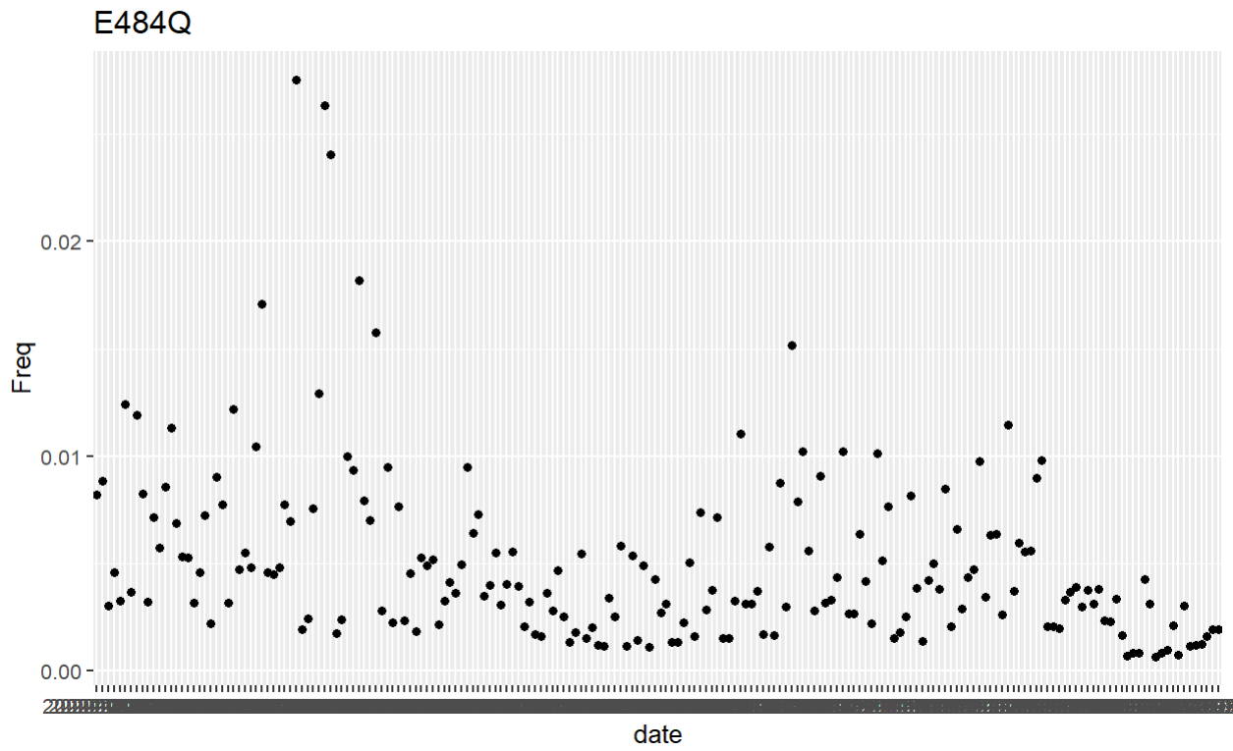
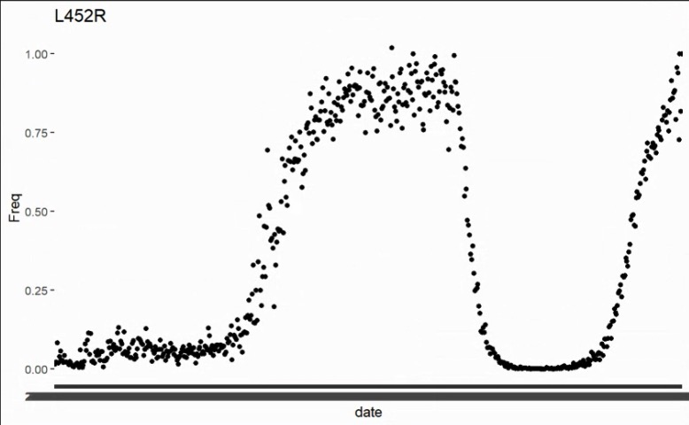
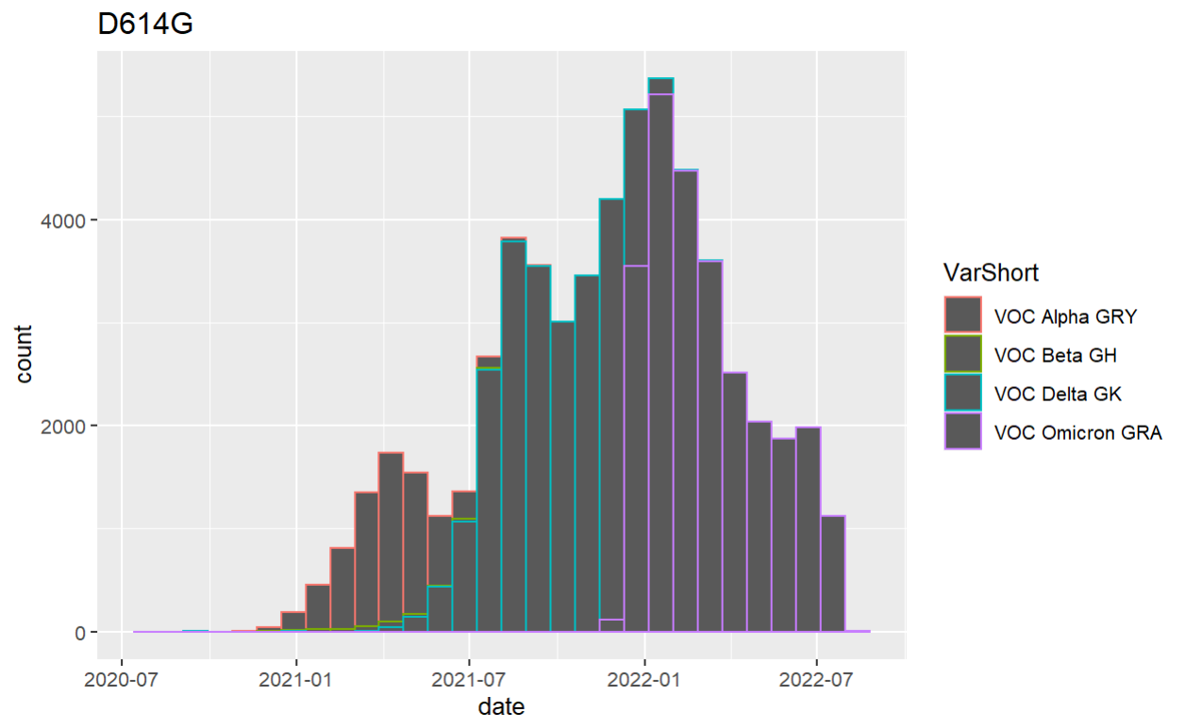
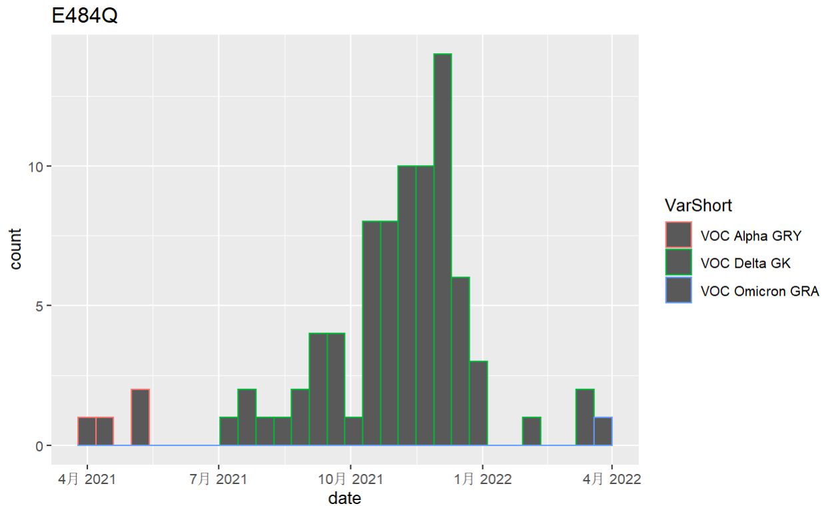
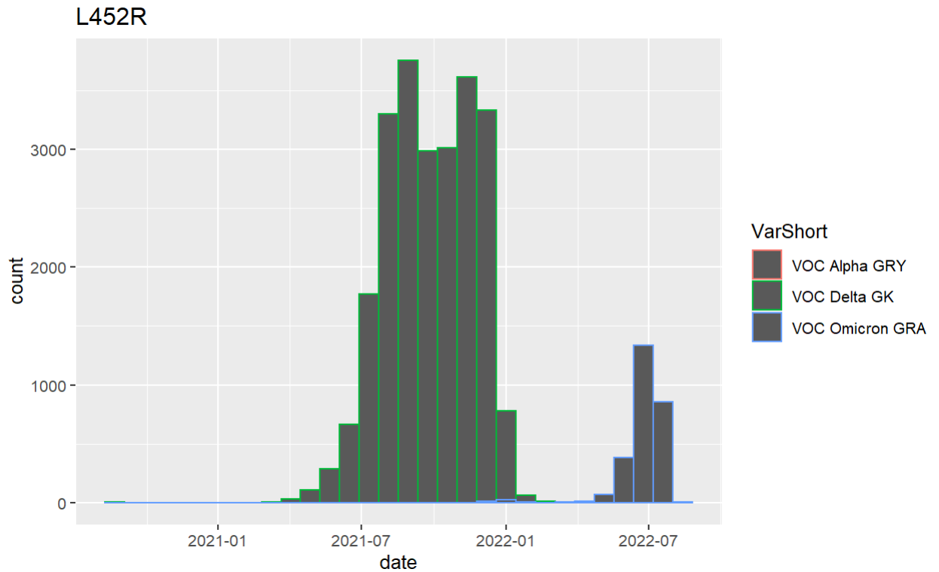
Some aa_change freq

Slide 3
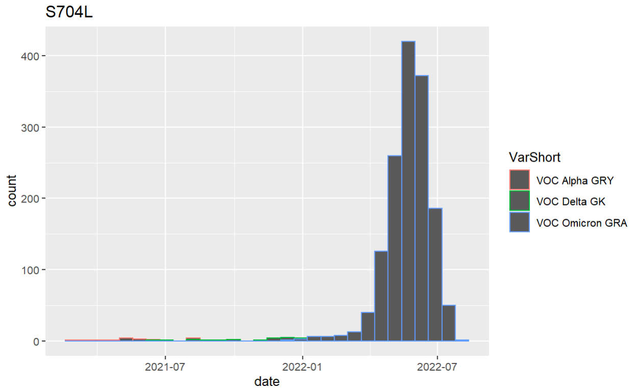
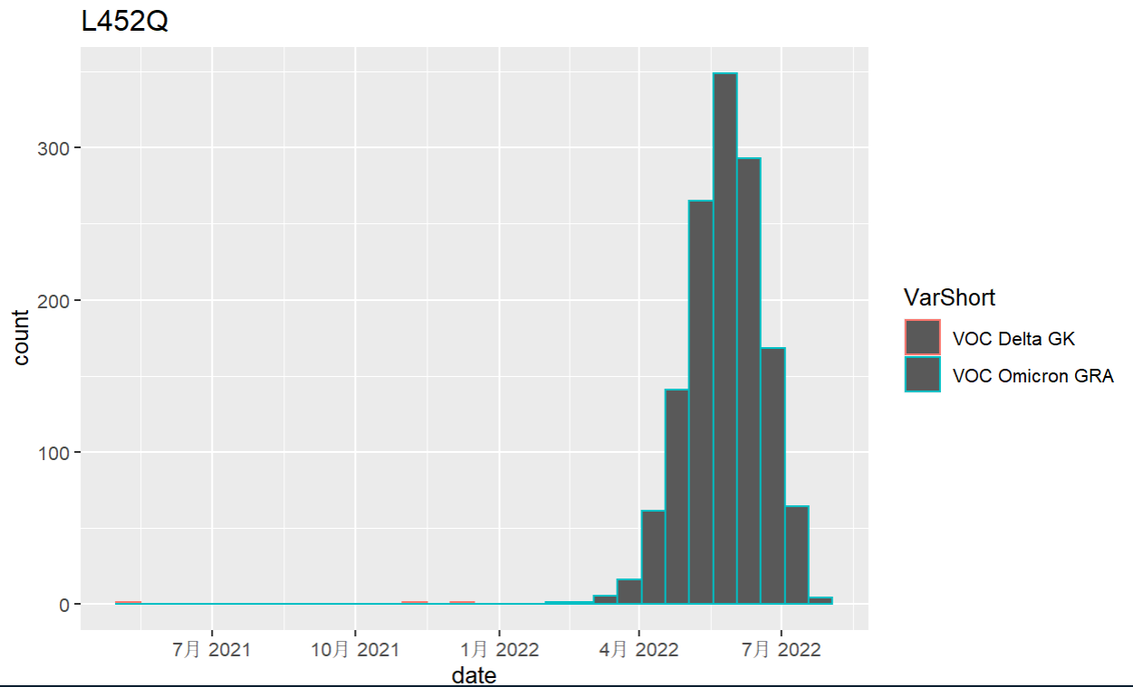
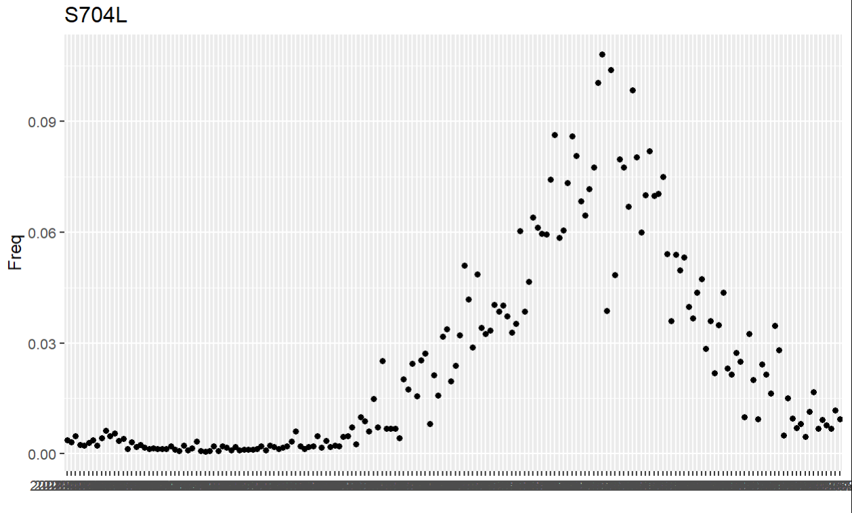
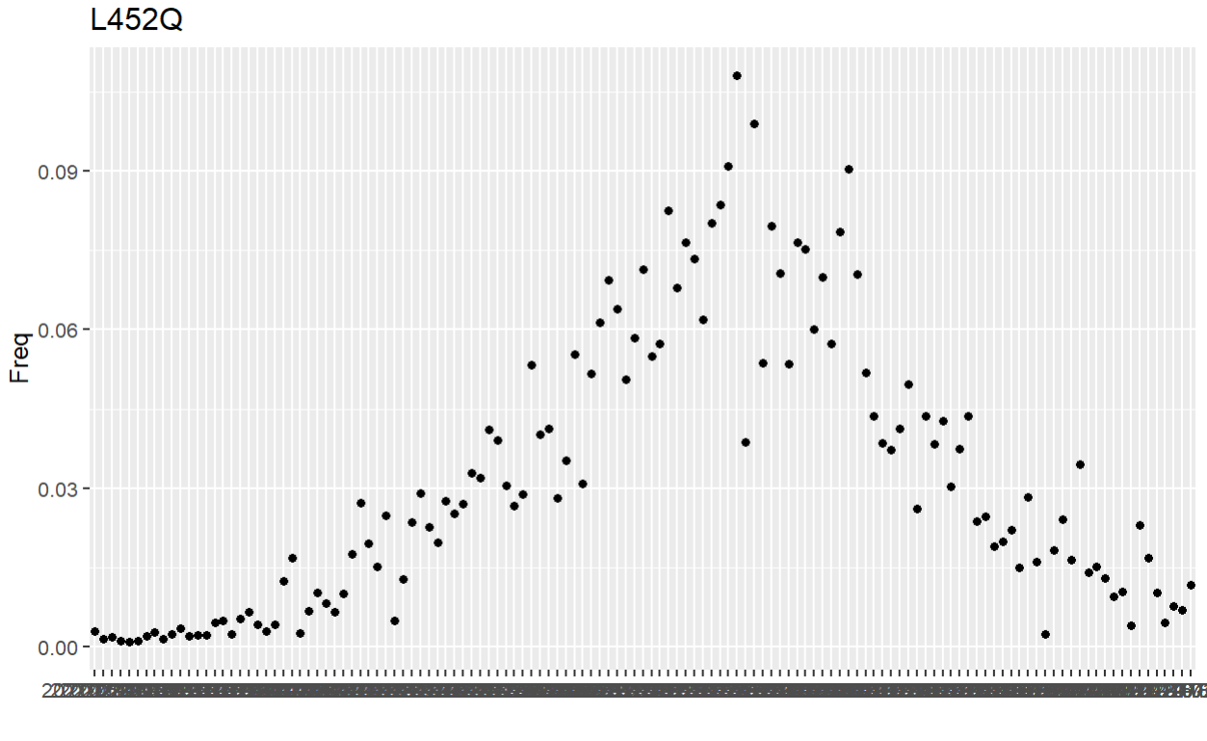
Some aa_change freq
BA.2.11 started in Nov. 2021: India -> Britain -> Europe;
Two new spike mutations: L452Q and S704L
BA.2.11 is the product of antigenic drift, so mutation is relatively difficult to accumulate -> showing the current selection pressure
BA.2.12.1

Slide 4
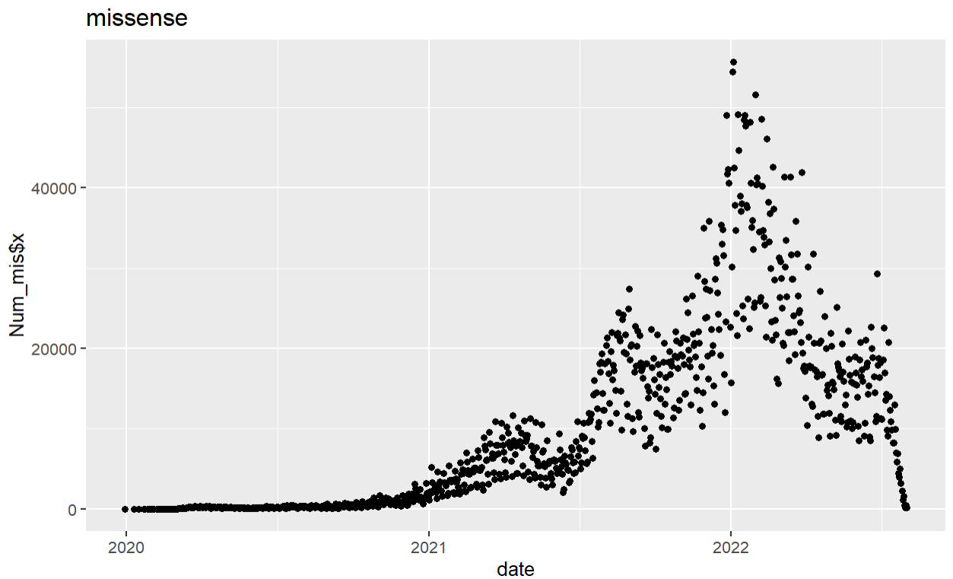
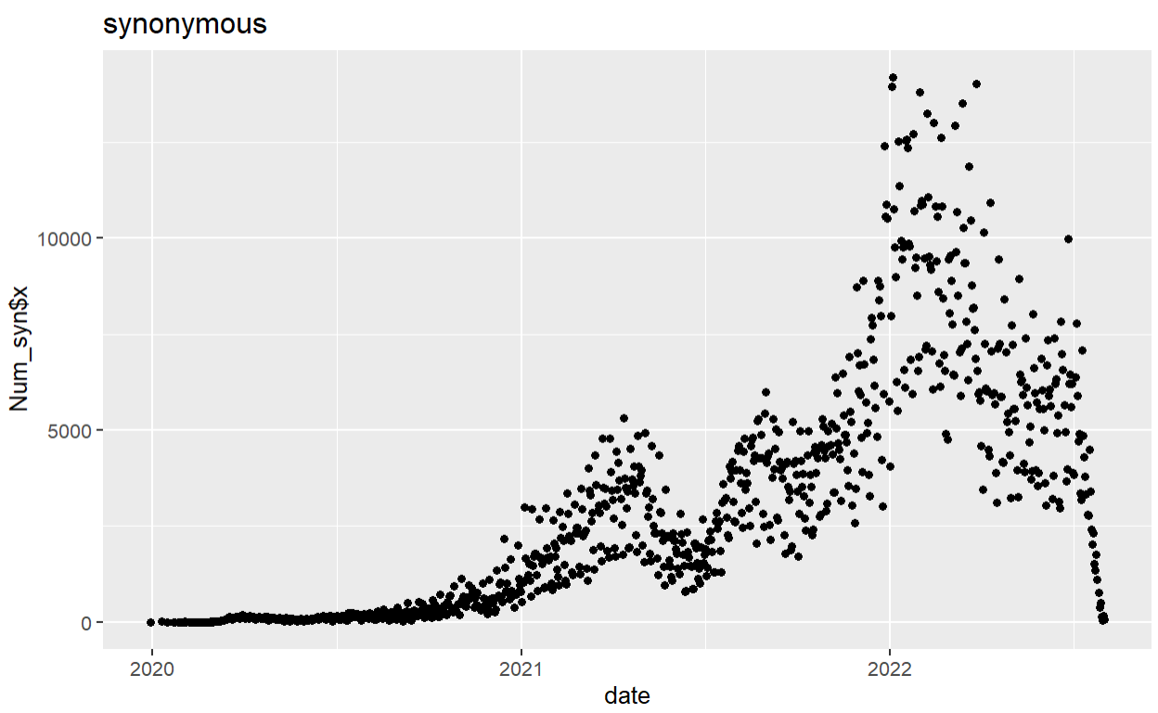
Distribution of Missense/Synonymous with time

Slide 5
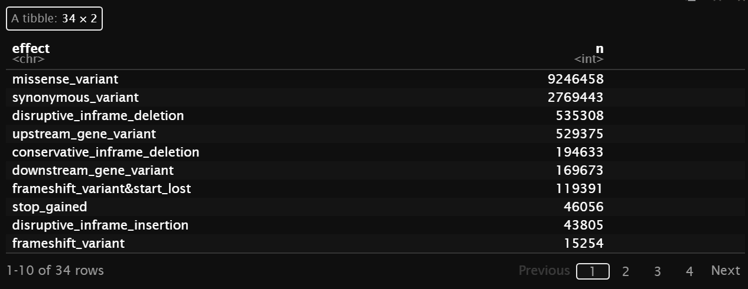
Counting the number of different variants
Theoretically, due to the strong purifying selection, there should be very few Non-syn comparing to Syn. But as shown in the table, # of NS is 4 times as # of Syn.

Slide 6
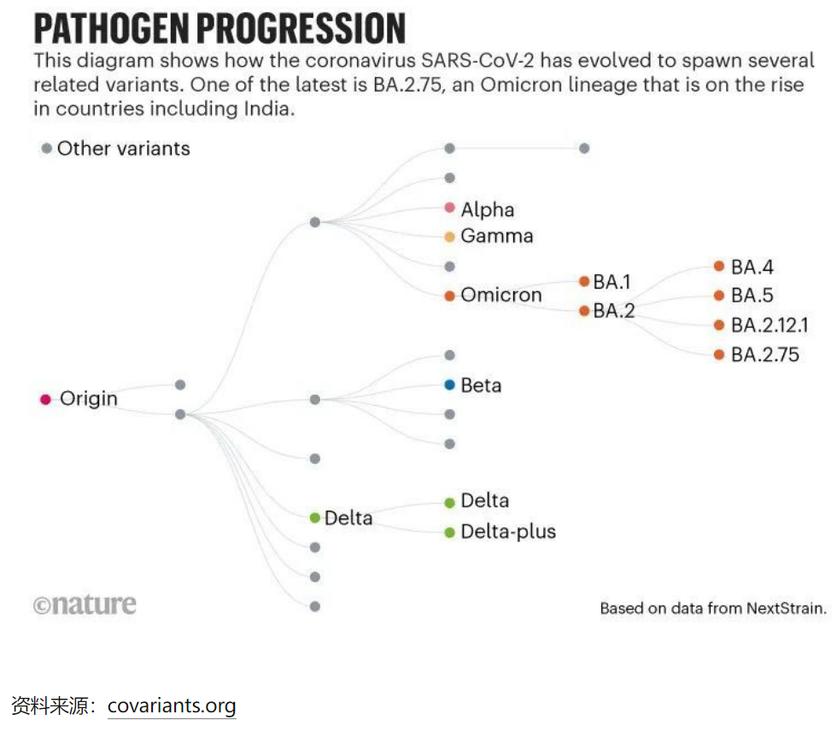

Slide 7
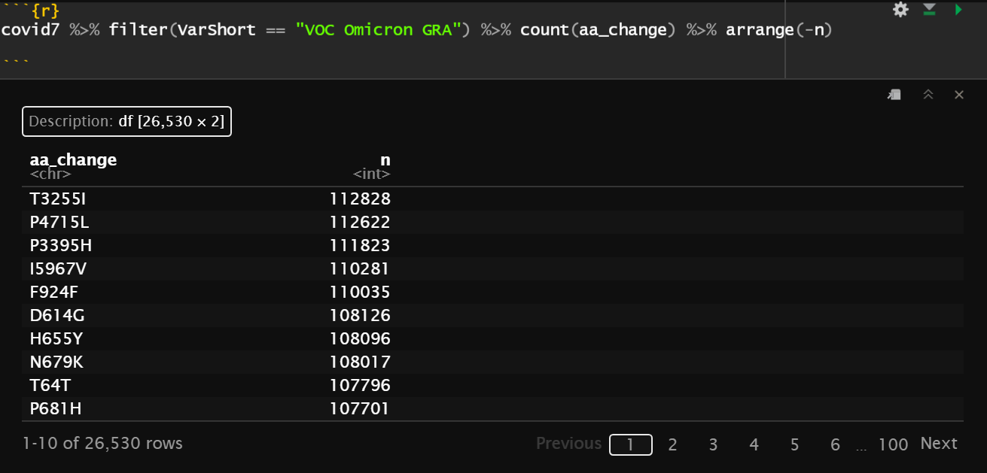
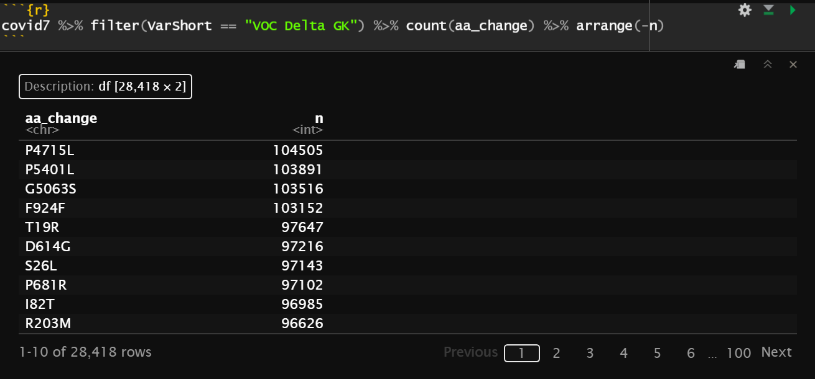
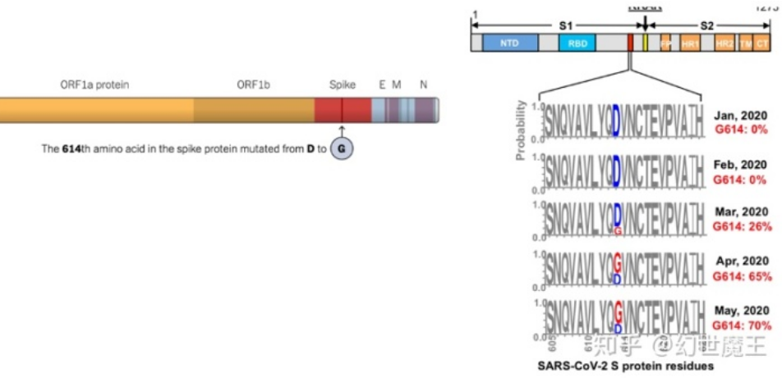
AA_change in Omicron and Delta
T3255I comes newly in Omicron;
P4715L is shared by both;
D614G is shared by both -> Since May 2020, it has already shown
Adaptive Selection???

Slide 8
A small question
SARS-CoV-2 is a RNA virus, why there is Thymine in the data?

Slide 9
Question 1
The power and influence of adaptive selection to SARS-CoV-2?
L452R comes back again
Many missense variants shown
D614G has fixed
Convergence of S704L:
BA.1 + S704L has a better growth than BA.1
Adaptive selection?
BA.2 + S704L becomes BA.2.12.1, in USA, 12 times more detected in 2 weeks.

Slide 10
Question 2
GC content
C -> T/U high frequently
The meaning and consequence?

