Slide 1
Week 6

Slide 2
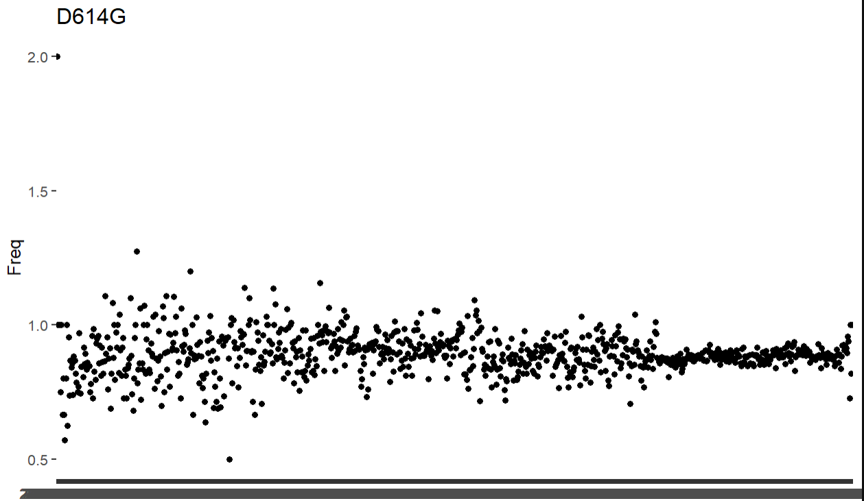
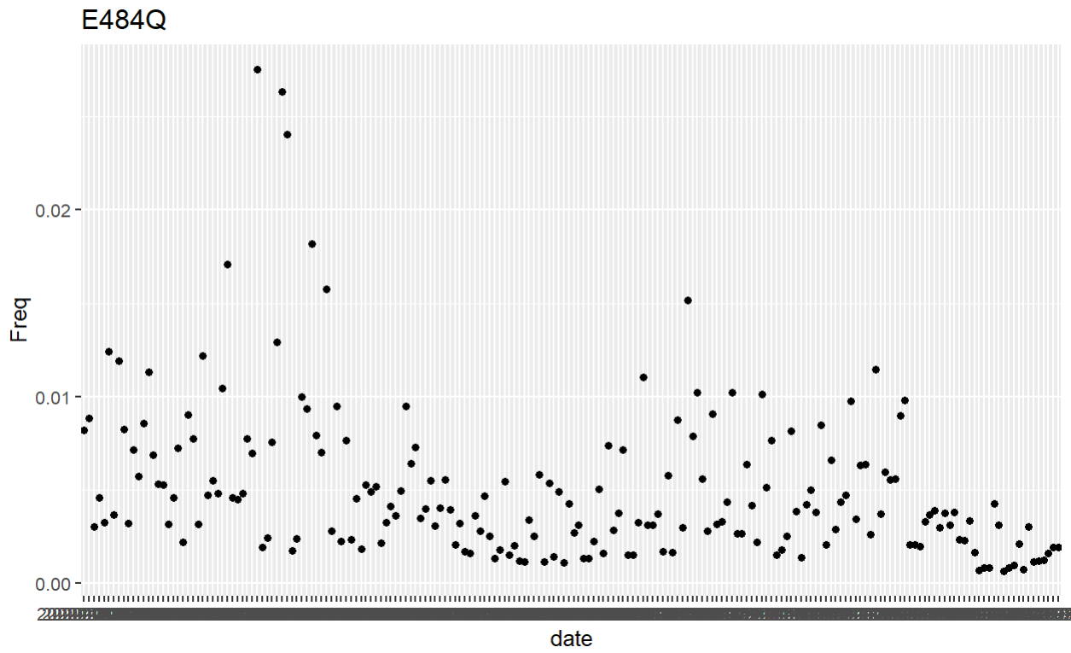
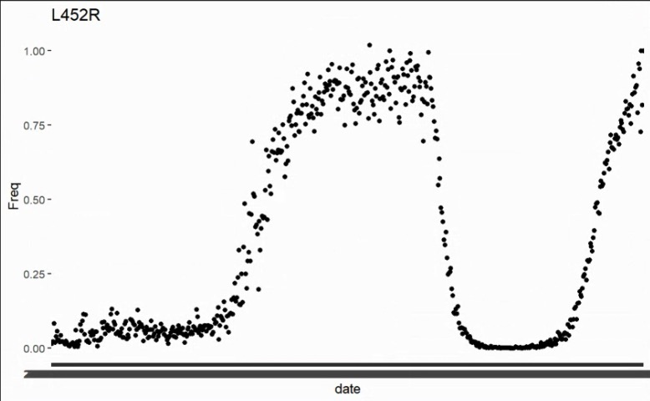
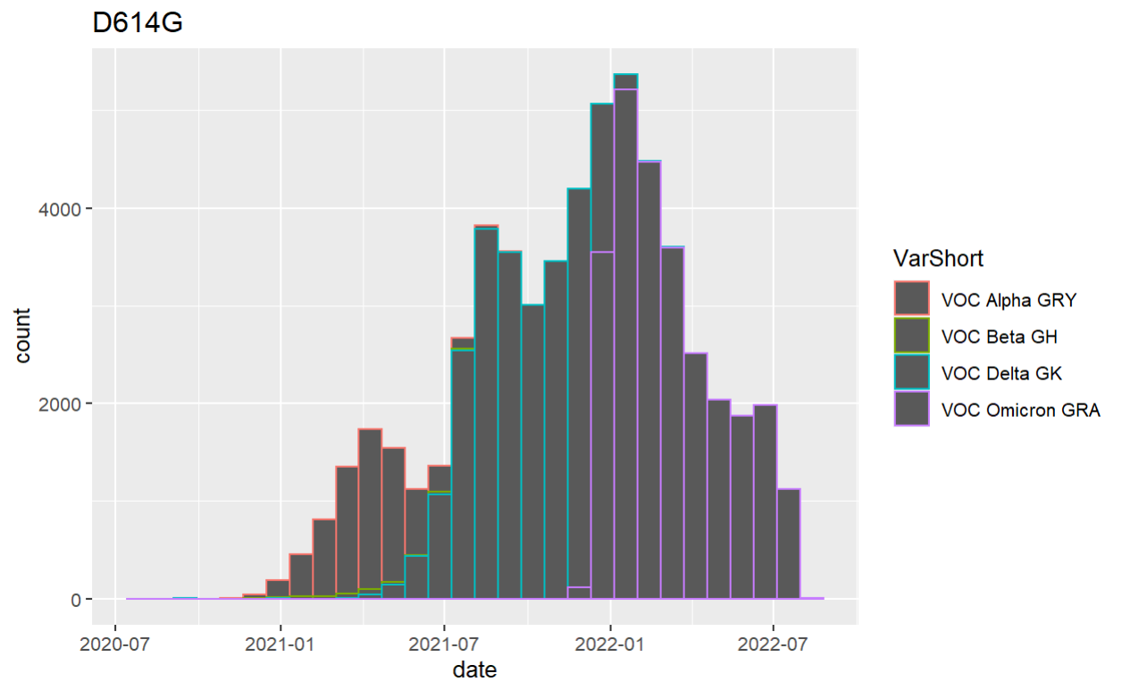
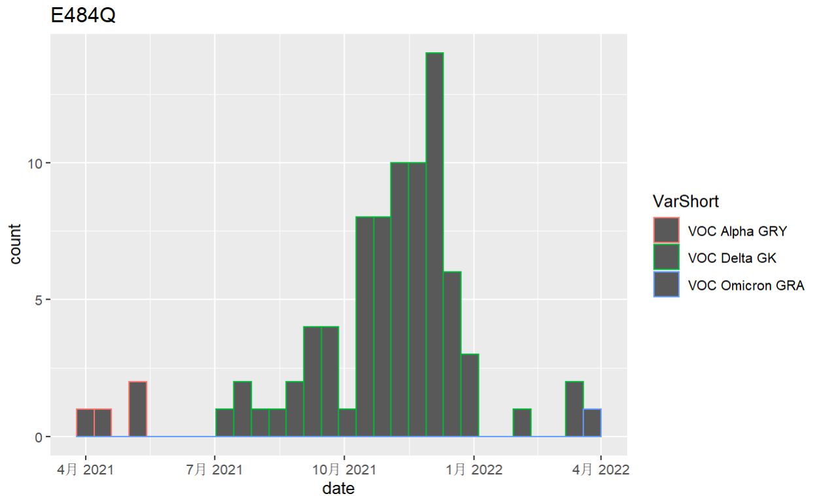
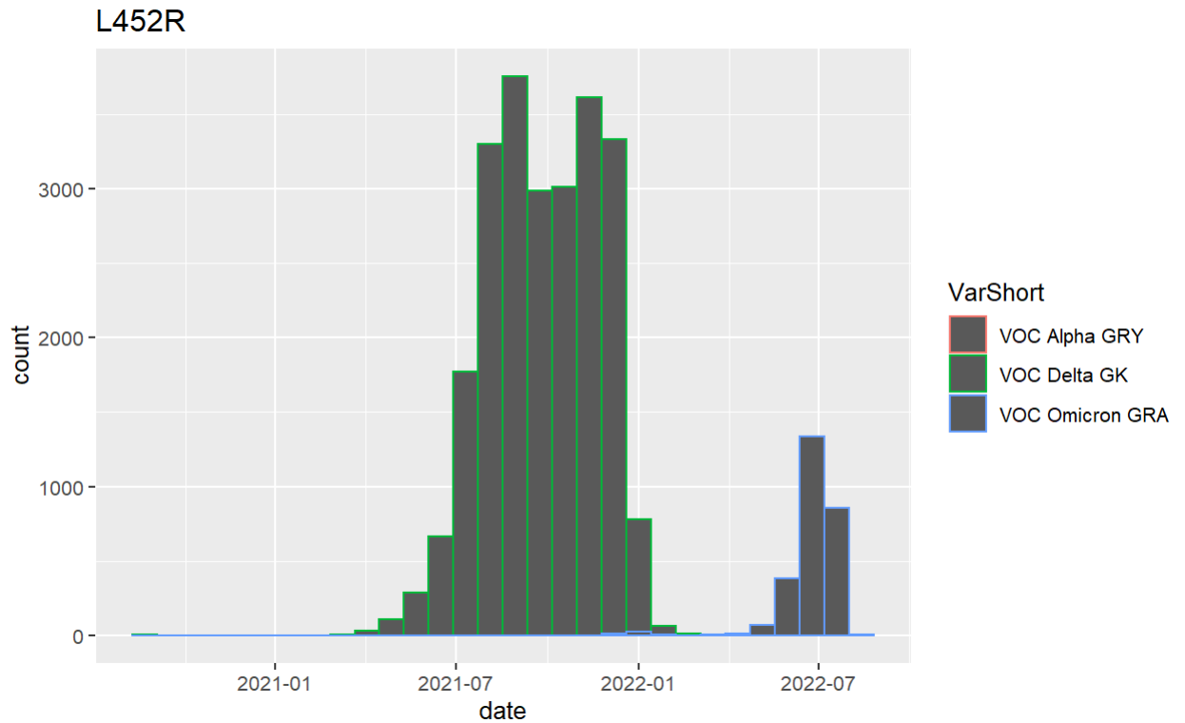
Some aa_change freq

Slide 3
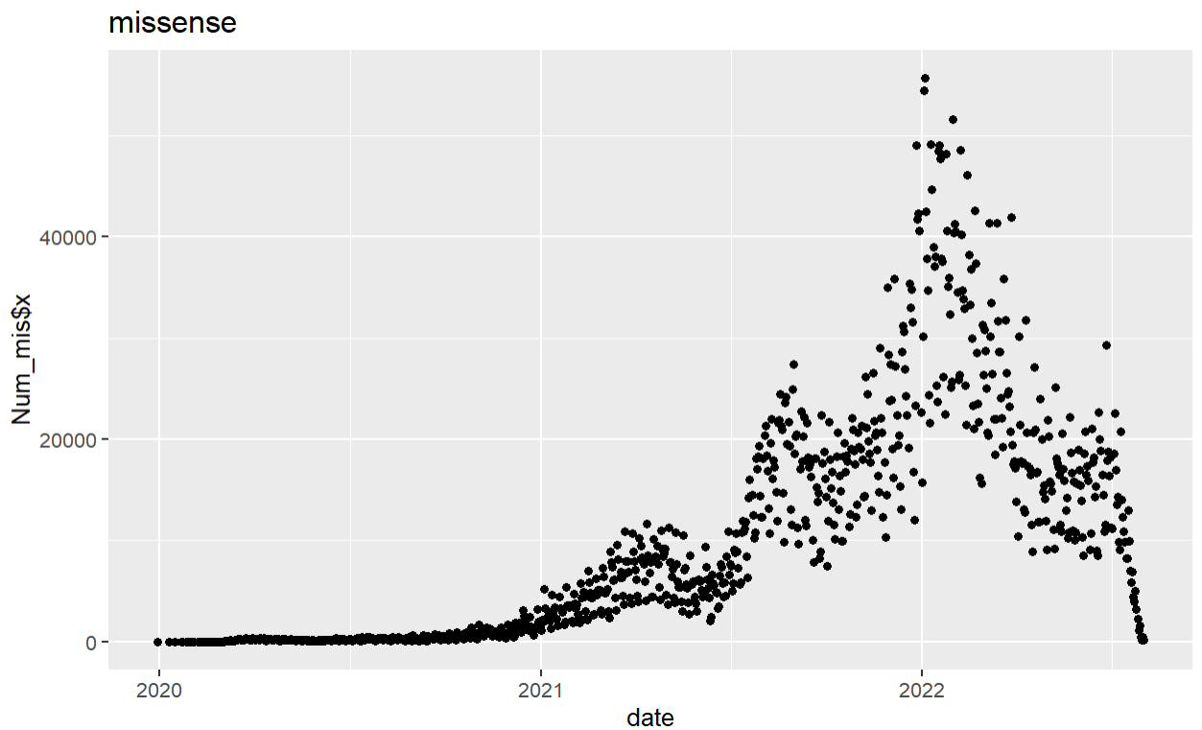
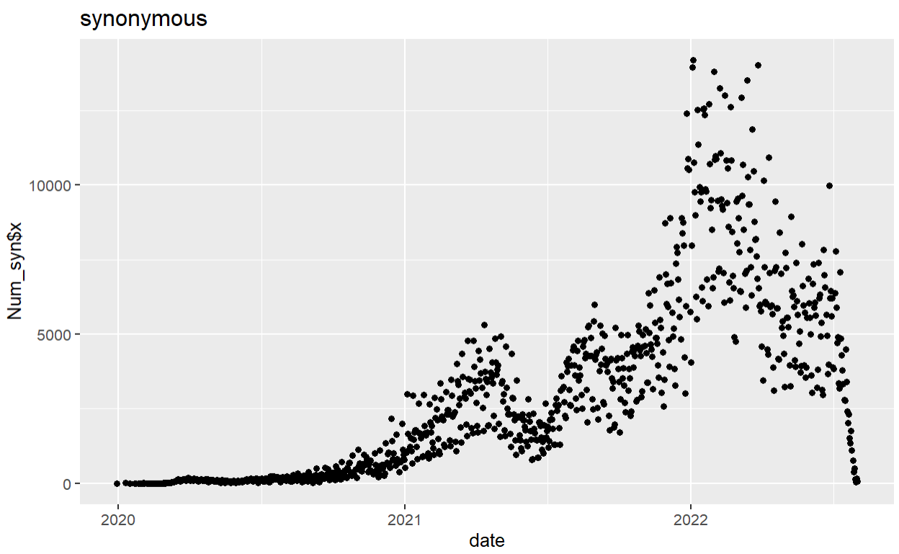
Distribution of Missense/Synonmous with time

Slide 4
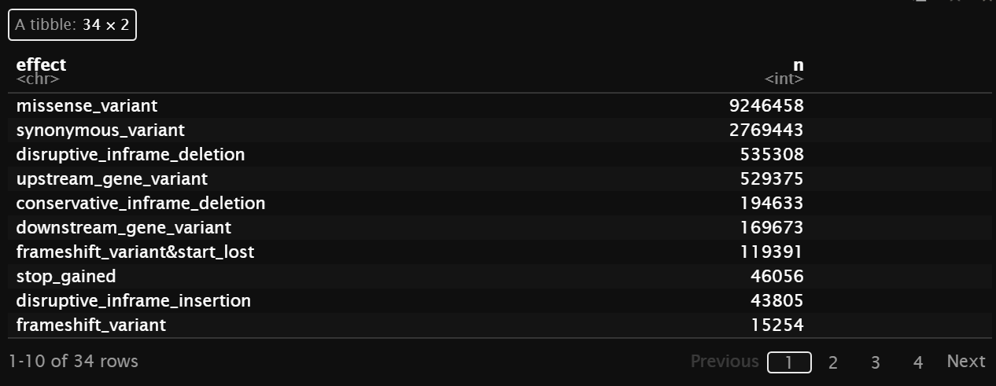
Counting the number of different variants
Theoretically, due to the strong purifying selection, there should be very few Non-syn comparing to Syn. But as shown in the table, # of NS is 4 times as # of Syn.

Slide 5
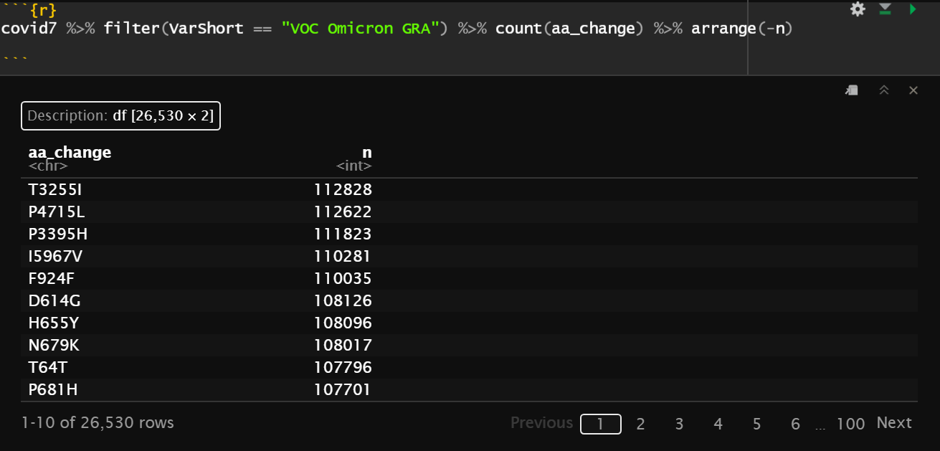
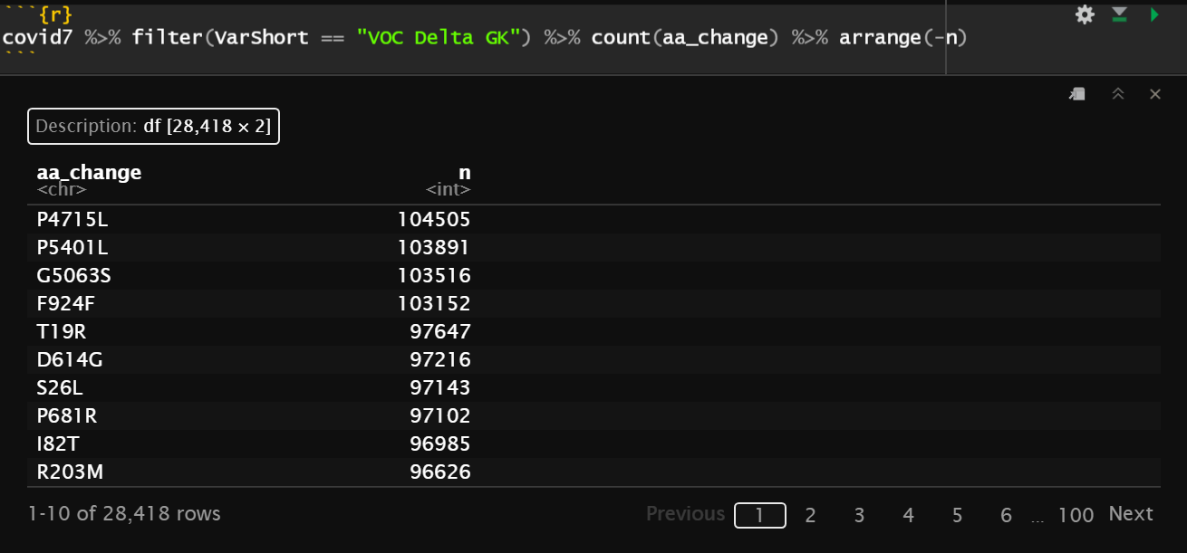
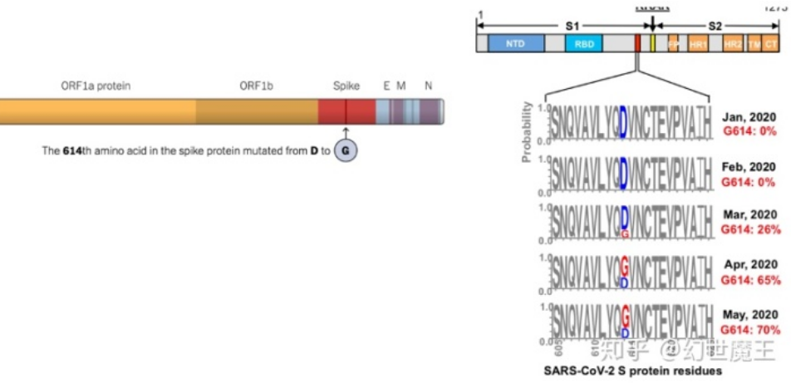
AA_change in Omicron and Delta
T3255I comes newly in Omicron;
P4715L is shared by both;
D614G is shared by both -> Since May 2020, it has already shown
Adaptive Selection???

Slide 6
A small question
SARS-CoV-2 is a RNA virus, why there is Thymine in the data?

Slide 7
Question 1
The strength and influence of adaptive selection to SARS-CoV-2?
L452R comes back again
Many missense variants shown
D614G has fixed

