Slide 1

Cars24 Price Prediction (A Data Science Project) Group – 4 👥 Team Members: Kiran Kumari
Shaik Kiswar Sulthana
Sruthy Elsa Jacob
Nethi Pranay
Yash Singh
M. Bharath Kumar Reddy
Kota Ashwitha

Slide 2
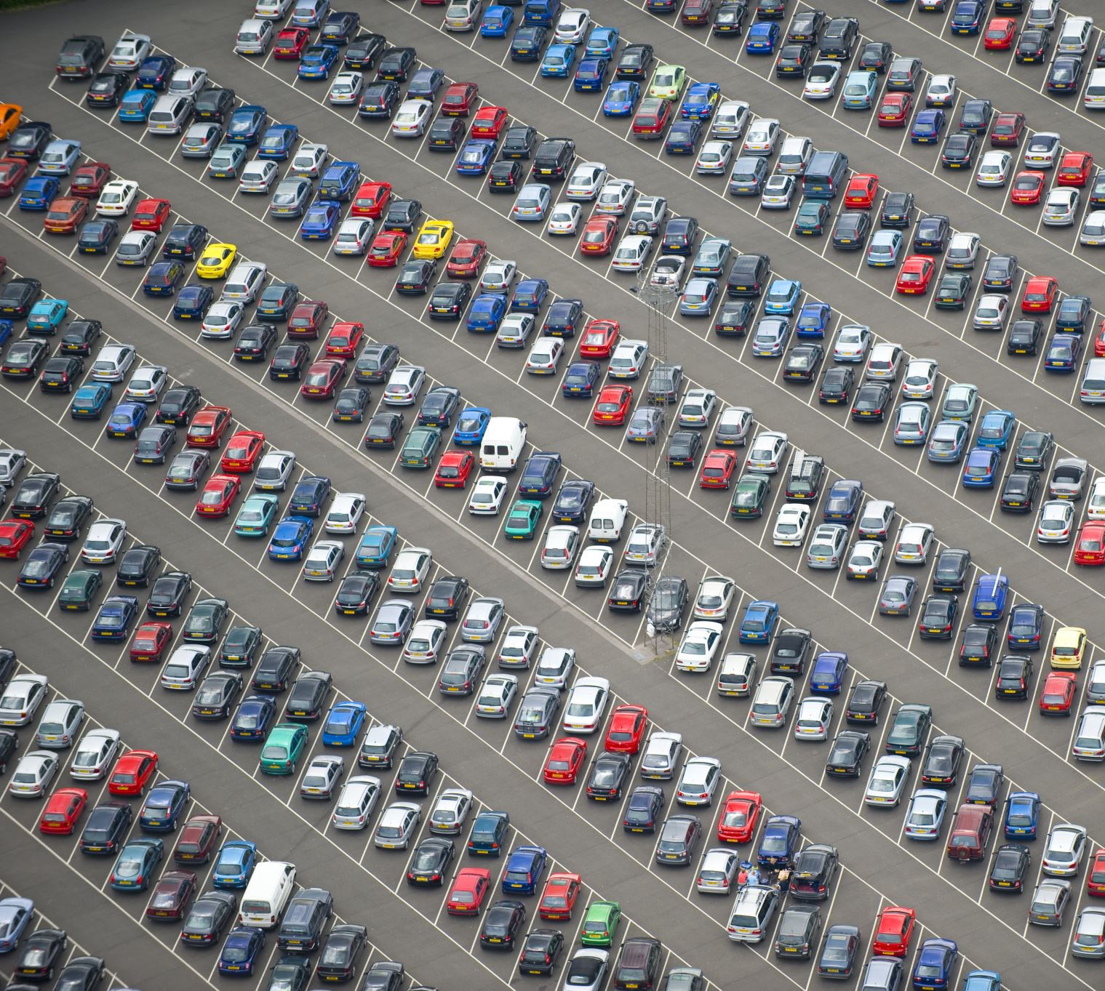
Project Overview
Used car market is highly unorganized and unpredictable
Sellers often demand unrealistic prices
Buyers struggle to identify fair value
Manual price estimation is time-consuming and inaccurate
Lack of structured data → requires Extensive Exploratory Data Analysis (EDA)
Need for a data-driven predictive model to bring transparency in pricing

Slide 3

Problem Statement
Used car market is highly unorganized and unpredictable
Sellers often demand unrealistic prices
Buyers struggle to identify fair value
Manual price estimation is time-consuming and inaccurate
Need for a data-driven predictive model to bring transparency in pricing

Slide 4
Dataset Description
Dataset sourced from Cars24 (used car resale platform)
Contains records of car listings with multiple attributes
Key Features:
Car Name / Brand
Year of Manufacture
Present Price
Kms Driven
Fuel Type (Petrol / Diesel / CNG)
Seller Type (Dealer / Individual)
Transmission (Manual / Automatic)
Owner (Number of previous owners)
Target Variable: Selling Price

Slide 5
Data Processing
Handling Missing Values
Checked for nulls & imputed / removed if necessary
Data Cleaning
Removed irrelevant features (e.g., Car name variations)
Standardized column names & formats
Feature Encoding
Converted categorical variables (Fuel Type, Seller Type, Transmission) using One-Hot Encoding
Feature Scaling
Standardized numerical features (Present Price, Kms Driven, Year) for model consistency
Outlier Treatment
Detected & handled extreme values in Kms Driven and Price

Slide 6

Exploratory Data Analysis (EDA)

Slide 7
Exploratory Data Analysis (EDA)
Univariate Analysis
Distribution of Selling Price, Kms Driven, Car Age
Bivariate Analysis
Relation between Selling Price & Present Price
Price trends with Fuel Type, Transmission, Seller Type
Correlation Analysis
Heatmap used to identify strong correlations (e.g., Present Price ↔ Selling Price)
Key Findings
Higher Present Price generally leads to higher Selling Price
Diesel cars showed higher resale value compared to Petrol
Automatic cars had higher prices but fewer in number

Slide 8

Models Used

Slide 9
Models Used
Linear Regression – Baseline prediction model.
Lasso Regression – Feature selection with L1 regularization.
Ridge Regression – Handles multicollinearity with L2 regularization.
Decision Tree Regressor – Captures non-linear patterns.
Random Forest Regressor – Ensemble of decision trees for better accuracy.
XGBoost Regressor – Gradient boosting, efficient & powerful.
K-Nearest Neighbors (KNN) Regressor – Distance-based prediction.
Support Vector Regressor (SVR) – Works well with high-dimensional data.

Slide 10
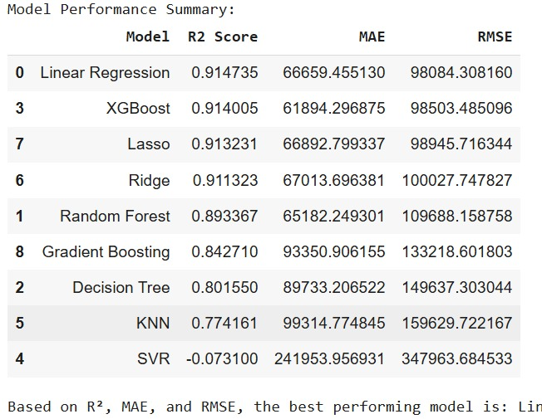
Performance Table of each Model

Slide 11

Best Performing Models
Linear Regression
Simple & interpretable.
Works well with continuous variables.
Provides a strong baseline for comparison.
XGBoost Regressor
Handles complex, non-linear relationships.
High accuracy with boosting technique.
Robust to missing values and outliers.
These two models outperformed others in terms of accuracy and stability.

Slide 12
Model Deployment with Streamlit
Framework Used: Streamlit (Python-based web app framework)
Why Streamlit?
Easy to build interactive dashboards.
Lightweight and fast deployment.
User-friendly interface for non-technical users.
Deployment Process:
Load the trained model (Linear / XGBoost).
Create input fields for features (car details, mileage, etc.).
Predict car price in real-time.
Host the app (Streamlit Cloud / Local server).
Outcome:
End-users can input car details.
Get instant price prediction with just one click.

Slide 13
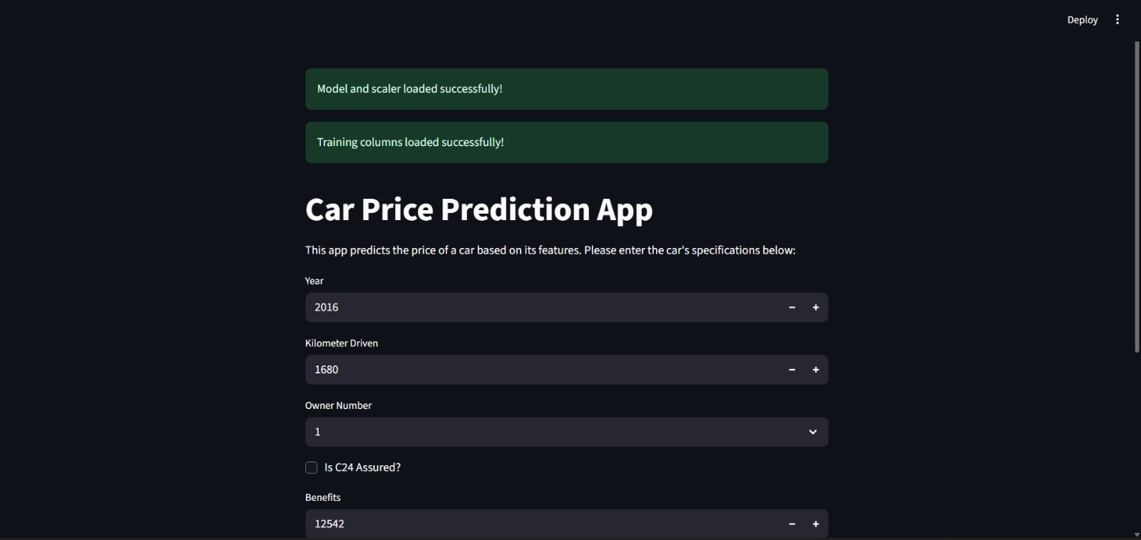
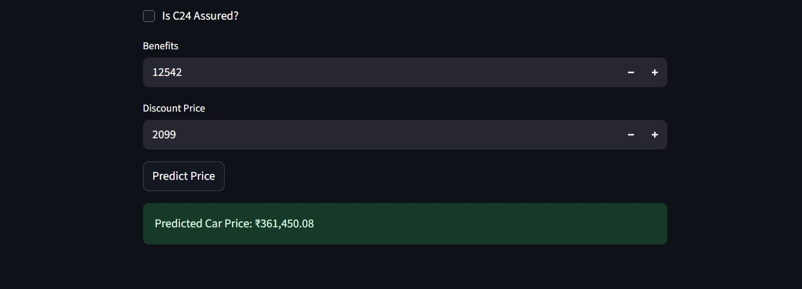
Cars24 Screenshot

Slide 14
Conclusion & Future Work
Conclusion:
Built an end-to-end Car Price Prediction System.
Performed data preprocessing, EDA, and applied 8 ML models.
Linear Regression & XGBoost were identified as the best-performing models.
Deployed the model using Streamlit for interactive, real-time predictions.
Future Work:
Dataset Expansion → Include additional parameters like accident history, service records, insurance claims.
Recommendation Engine → Suggest best time/place to sell for maximum profit.
Apply Hyperparameter Tuning for further accuracy improvement.
Experiment with Deep Learning models for advanced predictive power.
Deploy on Cloud (AWS/GCP/Azure) for scalability and accessibility.

Slide 15

Thank you

