Slide 1


SMART INDIA HACKATHON 2024
TITLE PAGE
Problem Statement ID – 1626
Title - Health Data Information & Management System Mobile Application(HDIMS)
Theme- MedTech/BioTech/HealthTech
PS Category- Software
Team ID-
Team Name- DataSquad

Slide 2
e-HEALTH UPDATE
Data
Squad
Proposed Solution
Uniqueness
Data Entry & Updates: Hospitals and departments can enter and update health data in real-time
Multi-level authority access: Tiered permissions for different health officials to view and analyze aggregated data.
Analytics and visualization: Tools to identify health trends, disease patterns, and demographic insights.
Policy formation support: Features to generate reports, predict outcomes, and suggest evidence-based policy interventions.
Doctor-friendly data entry: Easy-to-use interface for quick and accurate patient information input during consultations.
Quick Policy Check: Instantly verify eligibility for health policies by securely accessing government income and relevant data.
Innovation
The Clinic Portal offers a secure login for local clinics to easily manage patient data with simplified forms.
The Offline Sync feature allows data collection without internet access, automatically syncing with the central database when connectivity returns.

Slide 3
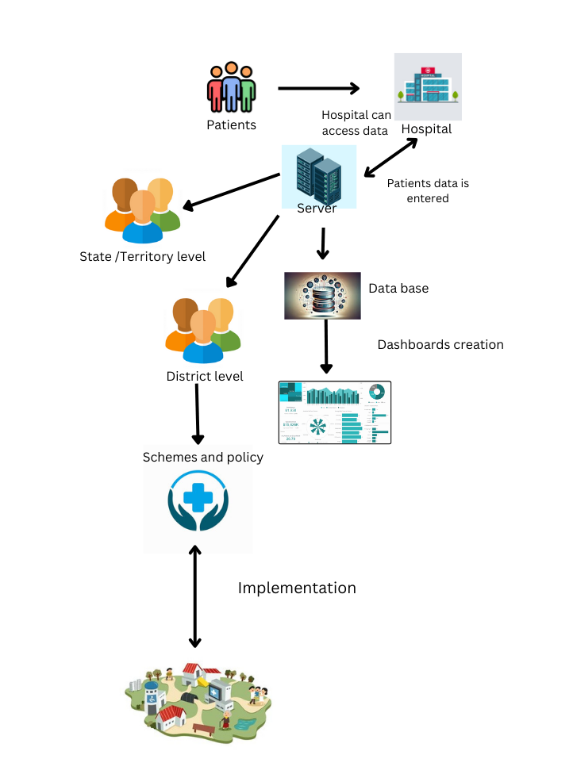
TECHNICAL APPROACH
Data
Squad
App Development :
- Frontend : Android Studio with Java, and React Native.
- Backend : nodeJs for database access and API handling,
Database: Since the data is unstructured mongodb is used.
Model Training: Training a machine learning model using TensorFlow in Python, and then integrate and run it in an Android app.
Dashboards: MPAndroidChart to display data trends and analytics in dynamic dashboards.
Encryption : using HTTPS for secure data transmission and employing Android's EncryptedSharedPreferences or EncryptedFile APIs to encrypt sensitive data stored locally on the device.

Slide 4
FEASIBILITY AND VIABILITY
Data Squad
ANALYSIS OF FEASIBILITY OF THE IDEA
Enhances healthcare delivery and accessibility.
Aligns with government healthcare initiatives.
Potential cost savings through improved efficiency.
POTENTIAL CHALLENGES AND RISKS
Data Accuracy and Completeness
User Training and Adoption
Data Security and Privacy
Interoperability
STRATEGIES FOR OVERCOMING THESE CHALLENGES
Automated data validation rules and real-time error-checking
Comprehensive training program
Advanced encryption methods
Open standards and APIs

Slide 5
IMPACT AND BENEFITS
Data Squad
POTENTIAL IMPACT ON THE TARGET AUDIENCE
Improved access to real-time data.
Data-driven policy formulation.
Informed Decision-Making
BENEFITS OF THE SOLUTION
Cost Efficiency
Improved Healthcaree Access
Scalability and Adaptability
Better Resource Allocation

Slide 6
RESEARCH AND REFERENCES
Data
Squad
https://scihub.se/https://ieeexplore.ieee.org/document/8642592
https://pubmed.ncbi.nlm.nih.gov/24346929/

