Slide 1
Output by the algorithm
Showing the results of the algorithm for modelling intra tumor clonal phylogeny

Slide 2
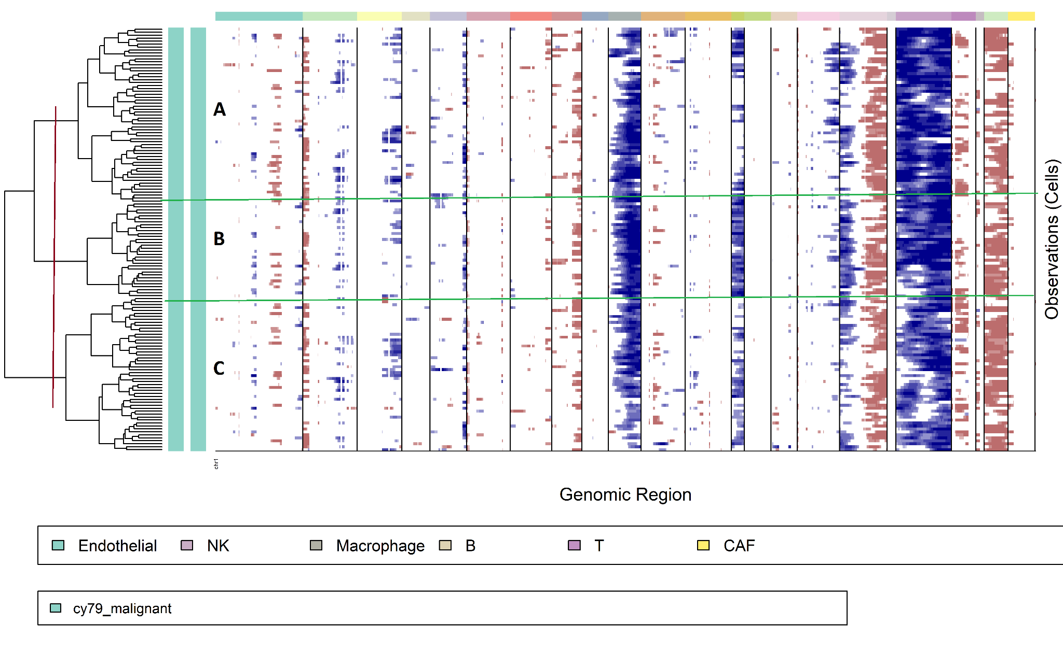
Case 1: Tumor name -> Melanoma
Patient- CY79
Number of clusters within the tumor=3
Resulting Clonal Phylogeny =
C->A->B

Slide 3
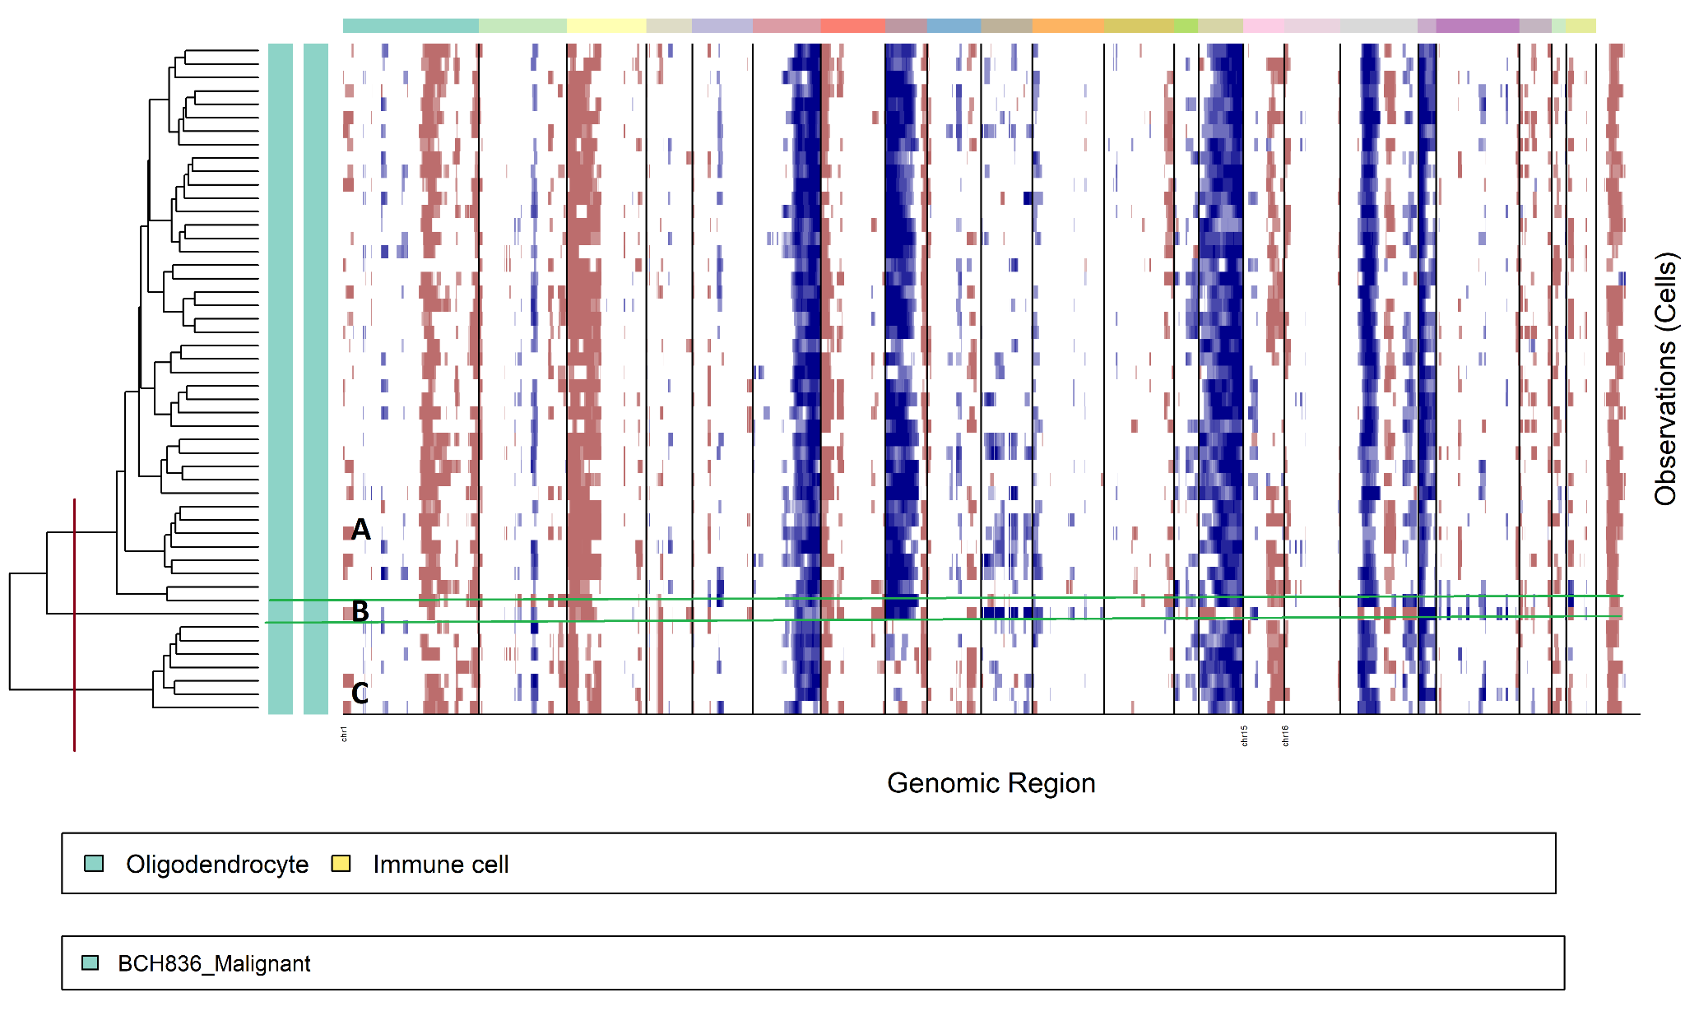
Case 2: Tumor Name-> pediatric_midline_gliomas
Patient- BCH836
No of clusters=3
Resulting Clonal phylogeny=
N - missing clone
N
/ \
C B
/
A
B and C are not directly related

