Slide 1
Power BI
Banking Dashboard

Slide 2
ABOUT THE PROJECT
The project is a banking project where we have used a banking dataset. Here in this dashboard we are going to show features like Loan analysis and Deposit Analysis and summary of the overall dataset.

Slide 3
Total Clients
2940
Some important KPI’s
Total Saving Account
$698.73M
Total Checking Account
$963.28M

Slide 4
Financial Goals
Total Loan
$4.38B
Total Deposit
$3.77B
Total CC Amount
$9.53M

Slide 5
Bank Numbers
$1.77B
$2.01B
$2.6B
Bank Loan
Bank Deposit
Business Lending

Slide 6
$ 89.65 M
FOREIGN CURRENCY AMOUNT

Slide 7
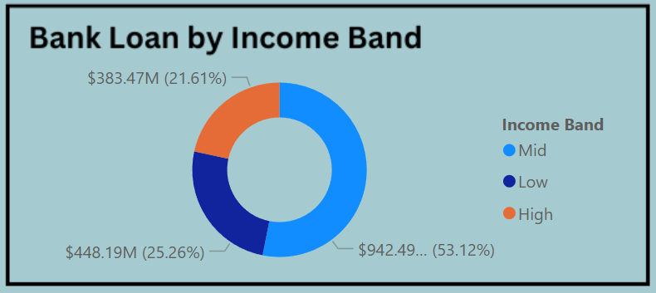
Bank Loan by Income band
What we observe?
Bank loan is highest for Mid Income band and lowest for High Income band.

Slide 8
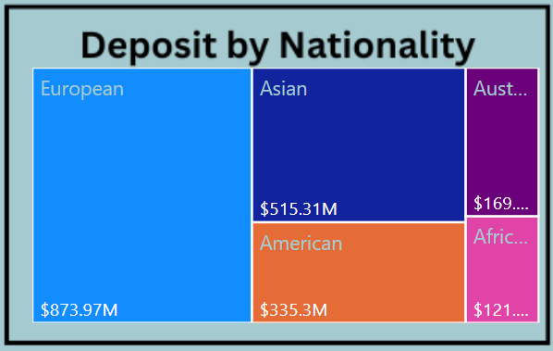
Total Deposit by Nationality
What we observe?
Highest features are in the European countries followed by Asian Countries.
Lowest features are in Australian countries followed by African countries.

Slide 9
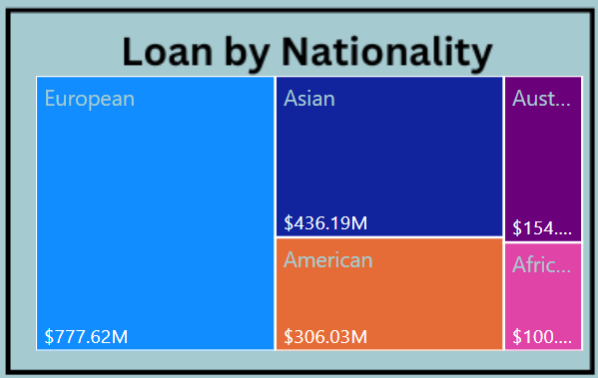
Bank Loan by Nationality
What we observe?
Bank loan is highest for European countries and lowest for African countries.

Slide 10
THANK YOU !

