Slide 1
Real-time Data Backend Conception Designing a Scalable and Robust System
Date : Presented by :

Slide 2
Introduction
High-throughput data ingestion.
Real-time data processing and aggregation.
Scalability and reliability.
Maintainability and security.
Data governance.
Real-time Data Backend Conception Designing a Scalable and Robust System
Date : Presented by :
Notes:
In today's data-driven world, the ability to process and analyze information in real-time is critical for businesses to make quick decisions and gain a competitive edge. This presentation outlines the conception phase for a robust real-time data backend, focused on key considerations for designing a scalable, maintainable, and secure system.

Slide 3
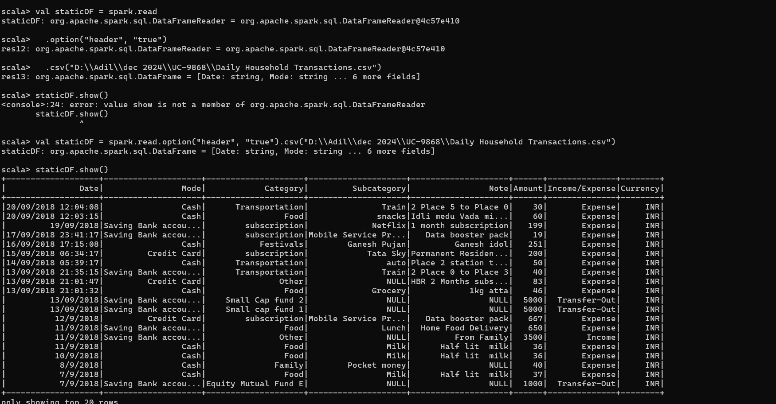
Overview & Key Goals
Reliable, high-throughput data streams via Kafka.
Real-time aggregation and transformation with Spark.
Horizontal scaling, replication, encryption, and compliance.
Notes:
This system will focus on building a real-time data backend. Kafka ensures reliable, high-throughput data ingestion while spark powers real time data processing and transformation. We prioritize scalability through horizontal scaling and data replication, while security is maintained through encryption and compliance with relevant regulations.

Slide 4
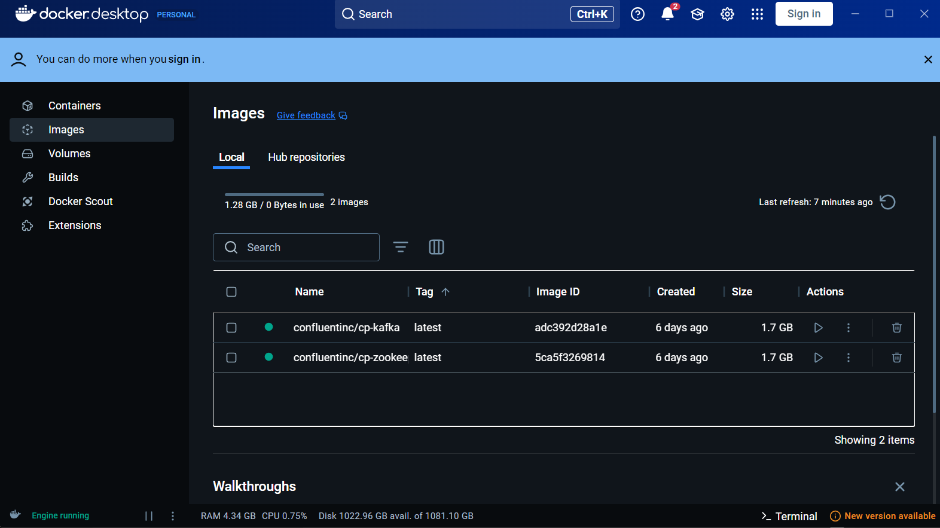
Core Components
Handles real-time data ingestion and acts as a message broker.
Scalable, fault-tolerant, and high-throughput.
Real-time processing with low-latency in-memory capabilities.
Distributed architecture for large dataset handling and complex transformations.
Notes:
The key components focuses on building a real-time data backend. Kafka handles high-throughput data ingestion and acts as a message broker. Spark enables real-time processing with low-latency in-memory capabilities and a distributed architecture for handling large datasets and complex transformations. This combination ensures efficient data flow and powerful analytics for our data-intensive applications.

Slide 5
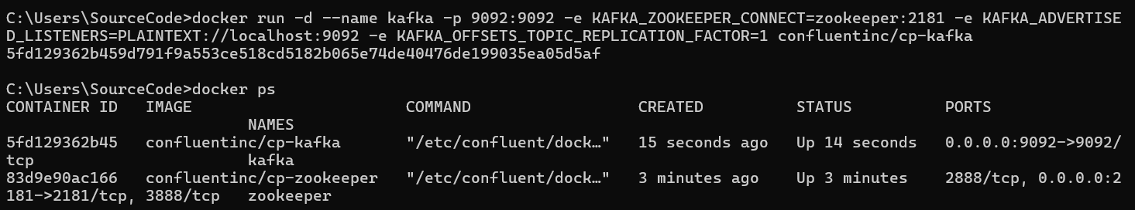
Architecture Design & Scalability
Kafka and Spark checkpointing, data replication.
Horizontal scaling for Kafka partitions and Spark executors.
Automated deployment with Infrastructure as Code (Ansible, Terraform).
Notes:
In the architectural considerations for a real-time data backend, We prioritize reliability through data replication and checkpointing in Kafka and Spark. Scalability is achieved with horizontal scaling. Maintainability is ensured through modular design and Infrastructure as Code.

Slide 6
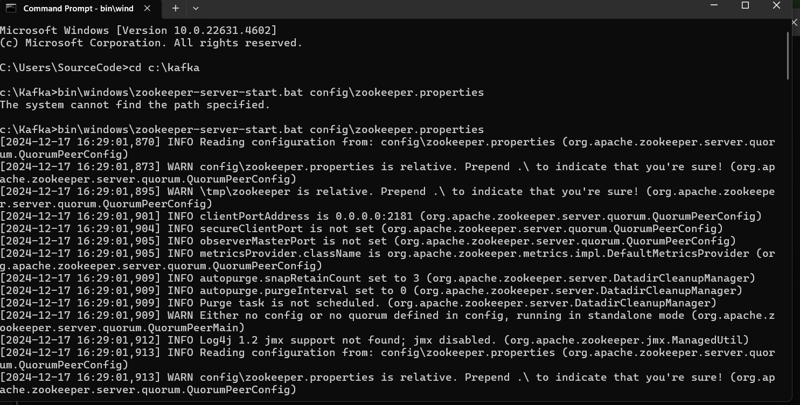
Data Security & Governance
Encryption (SSL/TLS for Kafka communication).
Role-Based Access Control (RBAC) for user permissions.
Compliance with GDPR and use of Apache Atlas for data lineage and metadata tracking.
Notes:
This slide focuses on security and governance for our real-time data backend. We employ encryption (SSL/TLS) for Kafka communication and implement RBAC for user permissions. To ensure compliance with regulations like GDPR, we use Apache Atlas for data lineage and metadata tracking, promoting data security and governance within our system.

Slide 7
Conclusion
Robust architecture for scalable, secure, and real-time data processing.
Kafka and Spark form the backbone of ingestion and aggregation.
Implement the design, validate components, and start development of microservices and integrations.
Notes:
This next steps in our real-time data backend project. We will implement a robust architecture using Kafka and Spark for data ingestion and aggregation. The focus will be on designing, validating, and developing microservices and integrations to bring the system to life.

