Slide 1
Client Reporting Tool using LLMs
Data Flow Overview

Slide 2
Overview of Data Processing Steps
This tool facilitates efficient client-specific reporting using LLMs by following a systematic data processing workflow.

Slide 3
Steps to Process and Query Data
1. Read Data from Azure
2. Filter Data for Specific Client
3. Filter Data for Specific Service
4. Select Time Range
5. Input a Question
6. Submit and Get LLM Response

Slide 4
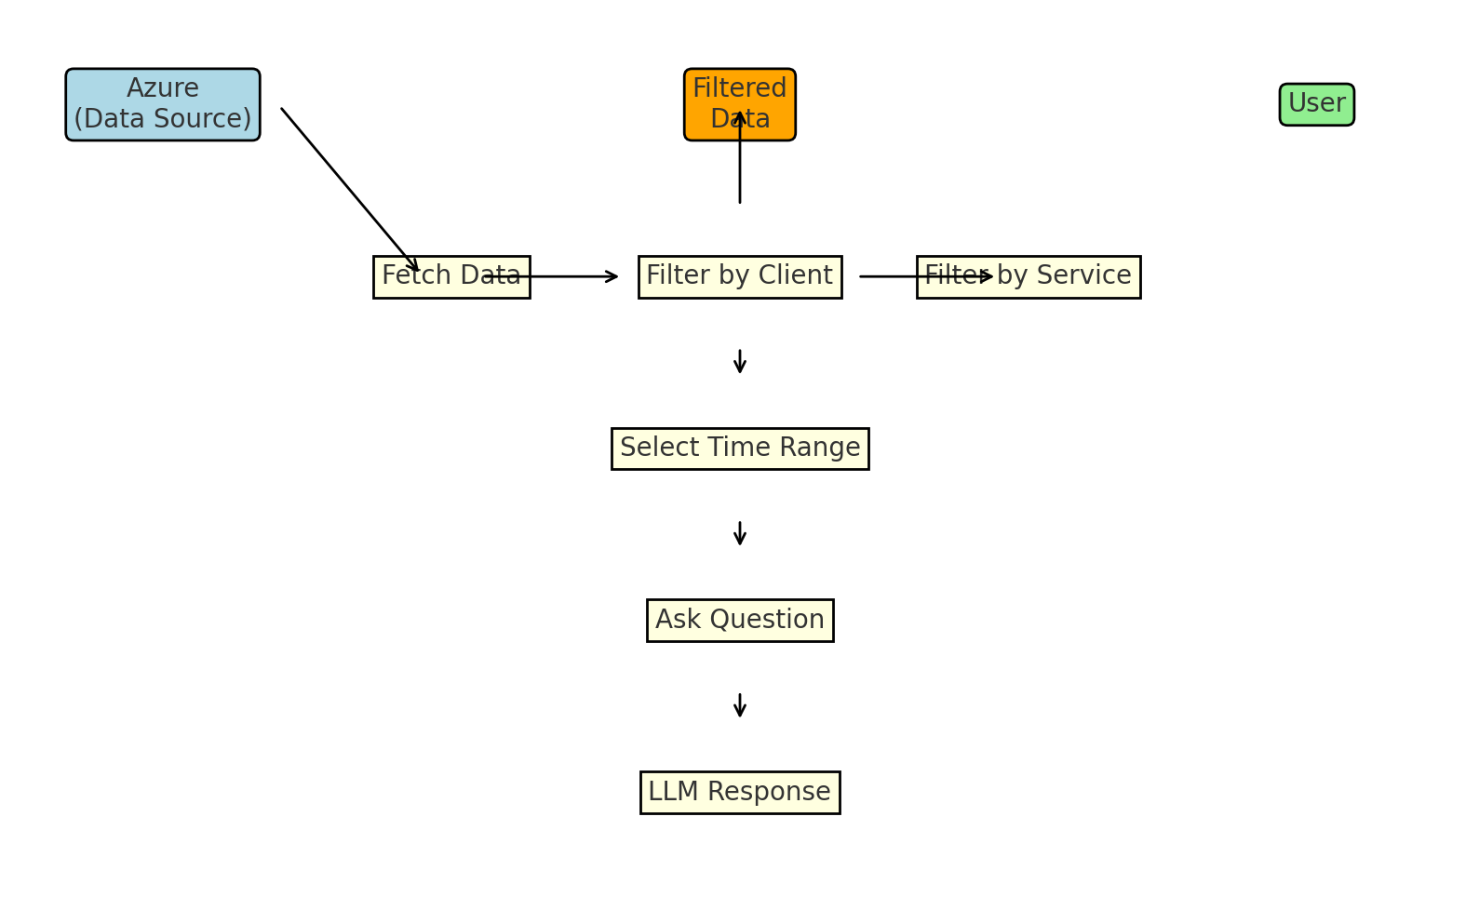
Data Flow Diagram

Slide 5
Why This Tool?
• Customized reporting for clients.
• Leverage LLMs for intelligent responses.
• Flexible filtering options.

