Slide 1
Data Modeling
Data modeling is a process used to define and organize data structure.
In MongoDB, data modeling focuses on representing data in a way that optimizes performance.
Common data modeling considerations include: structure, data access patterns, and scalability.

Slide 2
Operational Factors in Data Models
Operational factors influence the efficiency of data models in MongoDB.
Key factors include read/write patterns, indexing strategies, and data redundancy.
Effective data model design balances performance needs with storage efficiency.

Slide 3
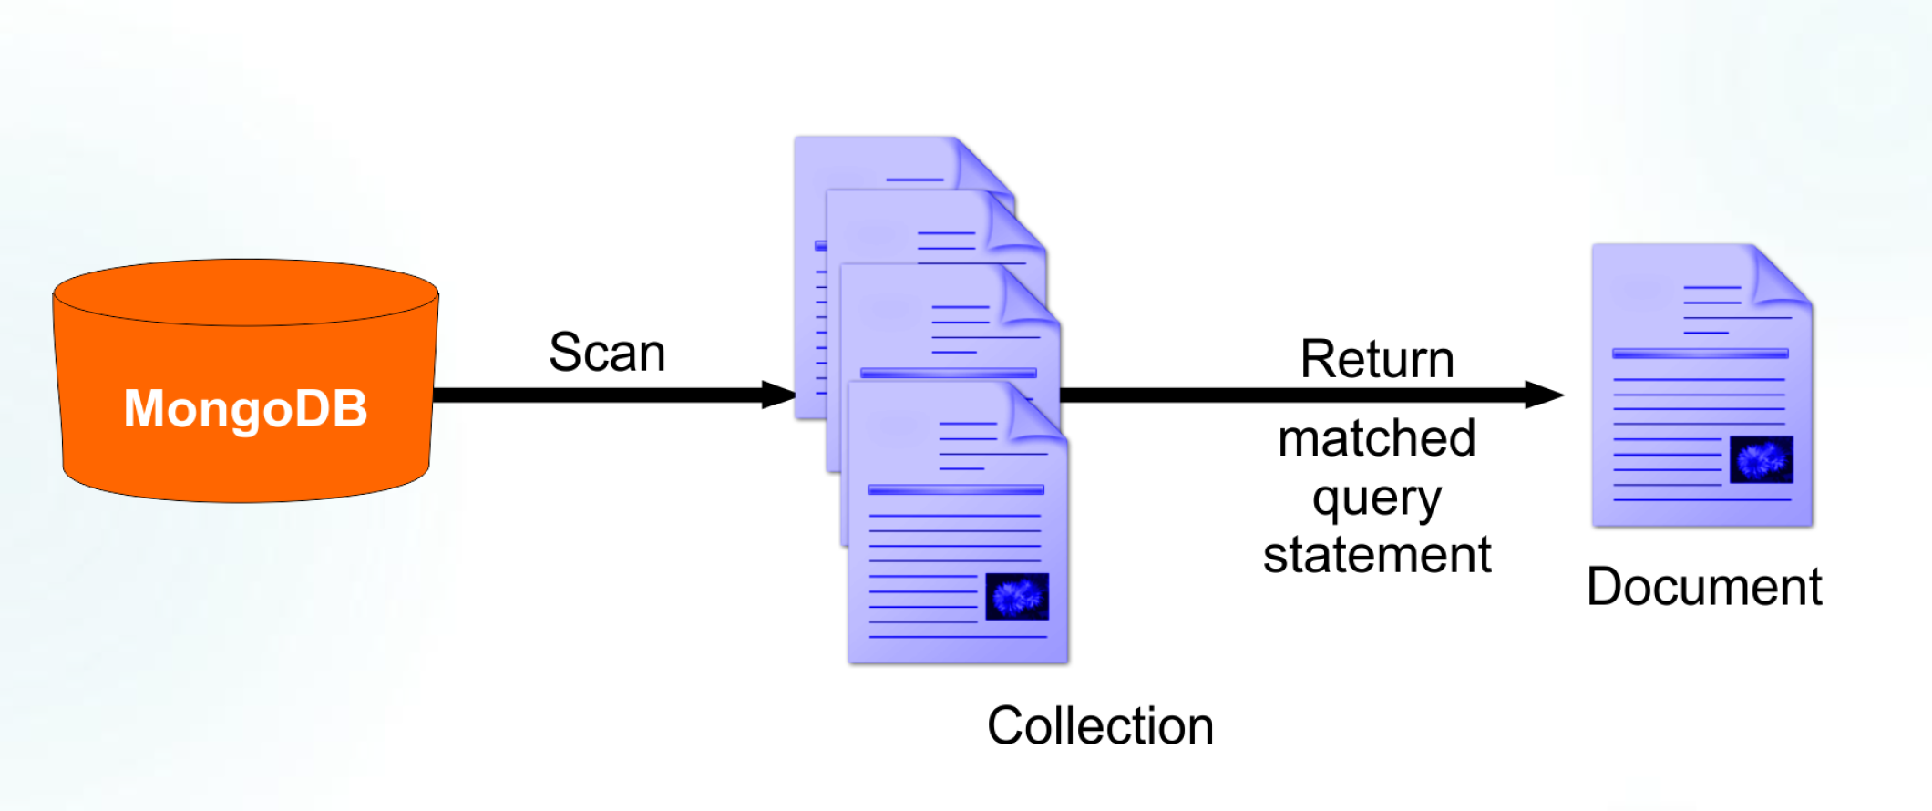
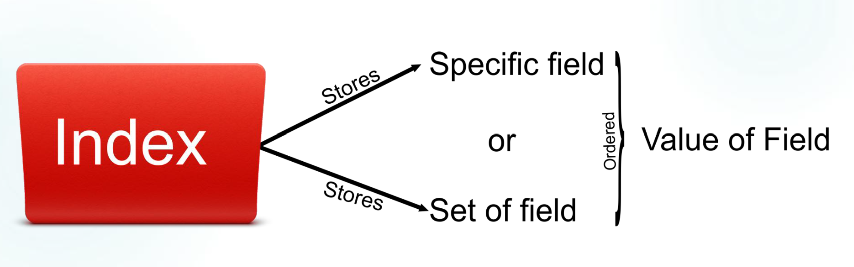
Indexing in MongoDB
Indexes support efficient query execution by organizing data for quick retrieval.
In MongoDB, indexes are created at the collection level, enhancing performance.
Indexes reduce the need for scanning every document in a collection.

Slide 4
Types of Indexes
Default _id Index: Created automatically on the _id field of each collection.
Single Field Index: An index on a single field for efficient filtering.
Compound Index: Supports queries on multiple fields.
Multikey Index: Indexes each value of an array.
Geospatial Indexes: You can use geospatial indexes to improve performance for queries on geospatial data.
Wildcard Indexes: Use wildcard indexes to support queries against arbitrary or unknown fields.
Hashed Indexes: Hashed indexes collect and store hashes of the values of the indexed field.
Text Indexes: Text indexes support text search queries on fields containing string content.

Slide 5
Index Properties
Unique Index: Ensures all documents have a unique value for a specific field.
Sparse Index: Indexes documents with a specific field, even if the field is missing in some documents.
TTL (Time-To-Live) Index: Automatically deletes documents after a specified period.
Hidden Indexes: Hidden indexes are not visible to the query planner and cannot be used to support a query.
Partial Indexes: Partial indexes only index the documents in a collection that meet a specified filter expression. Partial indexes have lower storage requirements and reduced performance costs for index creation and maintenance.

Slide 6
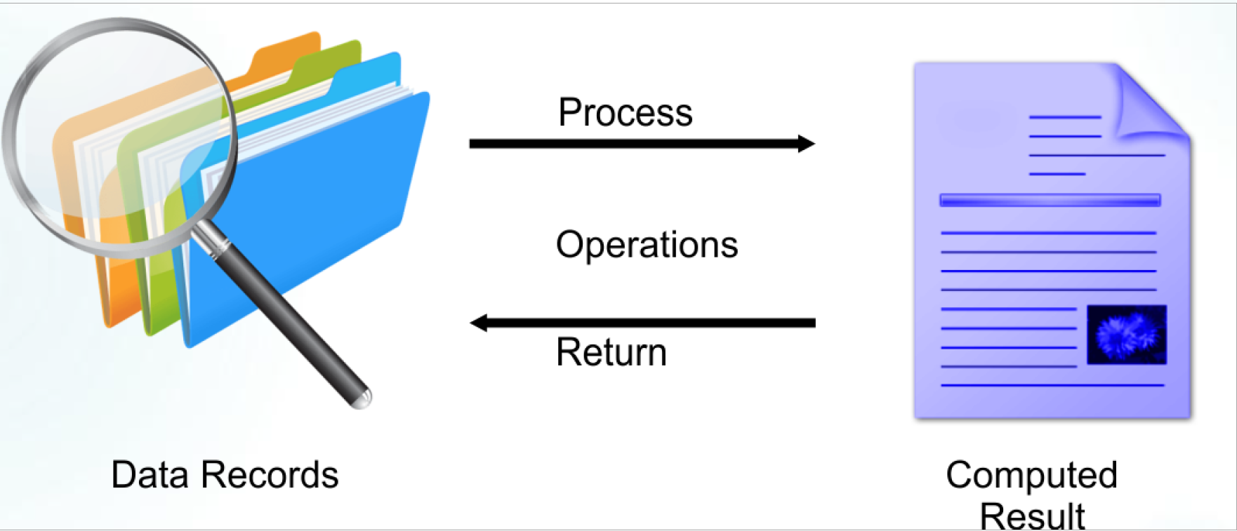
Aggregation Introduction
Its framework lets you transform and combine documents in a collection.
Documents are processed through several building blocks.
Filtering, projecting, grouping, sorting, limiting and skipping.
Aggregation results are limited to 16MB of data.

Slide 7
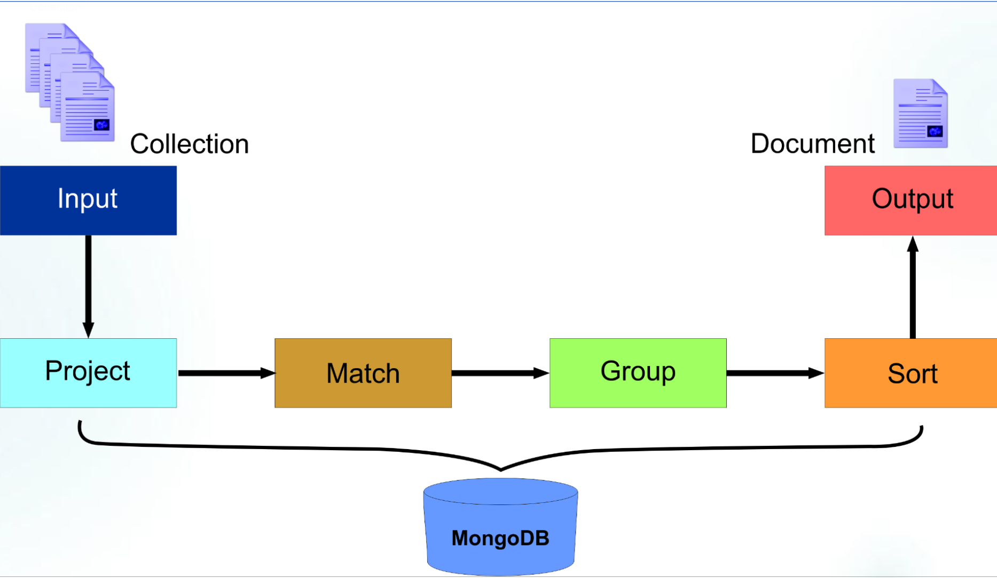
Aggregation Framework
The aggregation framework in MongoDB allows for data transformation and complex calculations.
It processes data in stages, enabling filters, groupings, and calculations on data.
Useful for real-time data processing without additional processing outside MongoDB.

Slide 8
Aggregation Pipeline
The aggregation pipeline is a framework for data aggregation within MongoDB.
It enables data transformation by chaining multiple stages such as $match, $group, and $sort.
Each stage in the pipeline performs a specific operation on the data, creating a streamlined process.

Slide 9
Aggregation Operations
MongoDB provides specific aggregation stages:
$match - Filters documents based on a specified query predicate. Matched documents are passed to the next pipeline stage.
$group - The $group stage separates documents into groups according to a "group key". The output is one document for each unique group key.
$limit - Limits the number of documents passed to the next stage in the pipeline.
$project - Passes along the documents with the requested fields to the next stage in the pipeline. The specified fields can be existing fields from the input documents or newly computed fields.
$skip - Skips over the specified number of documents that pass into the stage and passes the remaining documents to the next stage in the pipeline.
$sort - Sorts all input documents and returns them to the pipeline in sorted order.

