Slide 1



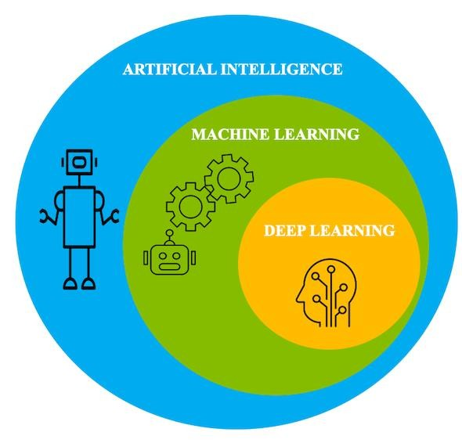


Lambton College
School of Computer Studies
AML-3104 Neural Networks
and Deep Learning

Slide 2
Explore
Machine
Learning Algorithms

Slide 3
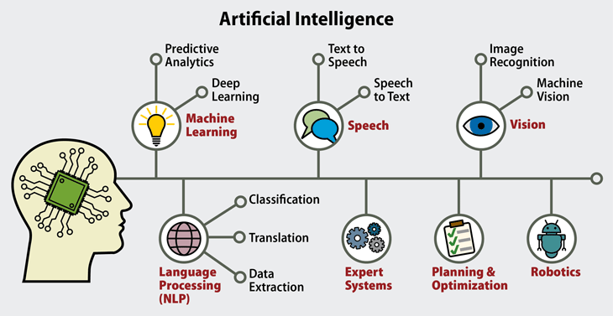
AI and ML

Slide 4
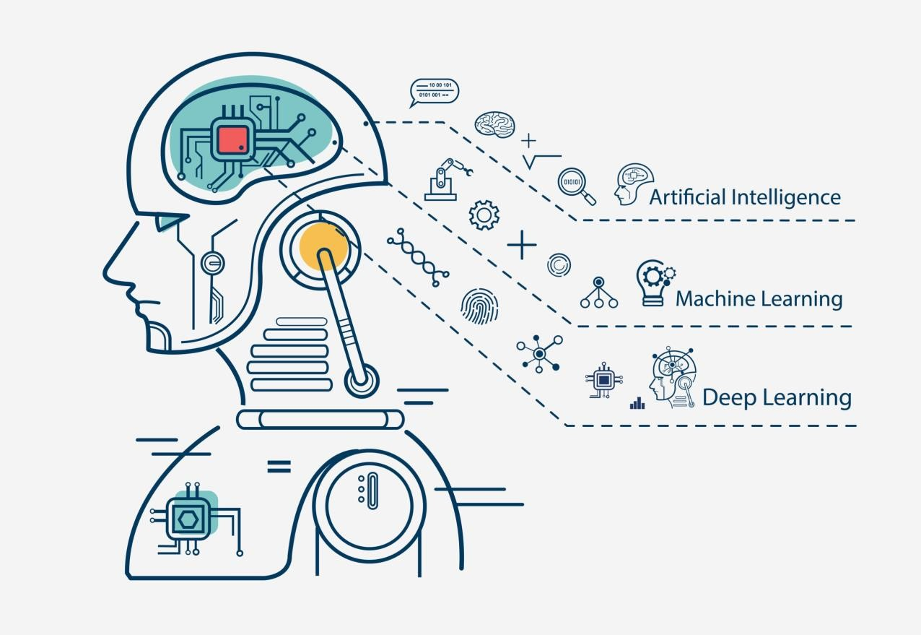
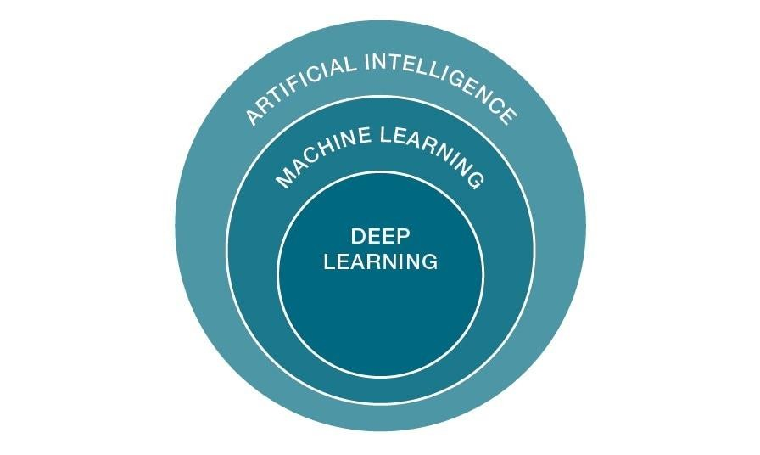
Machine Learning

Slide 5
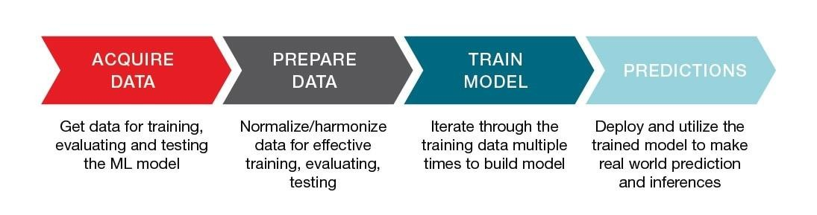
ML Process

Slide 6
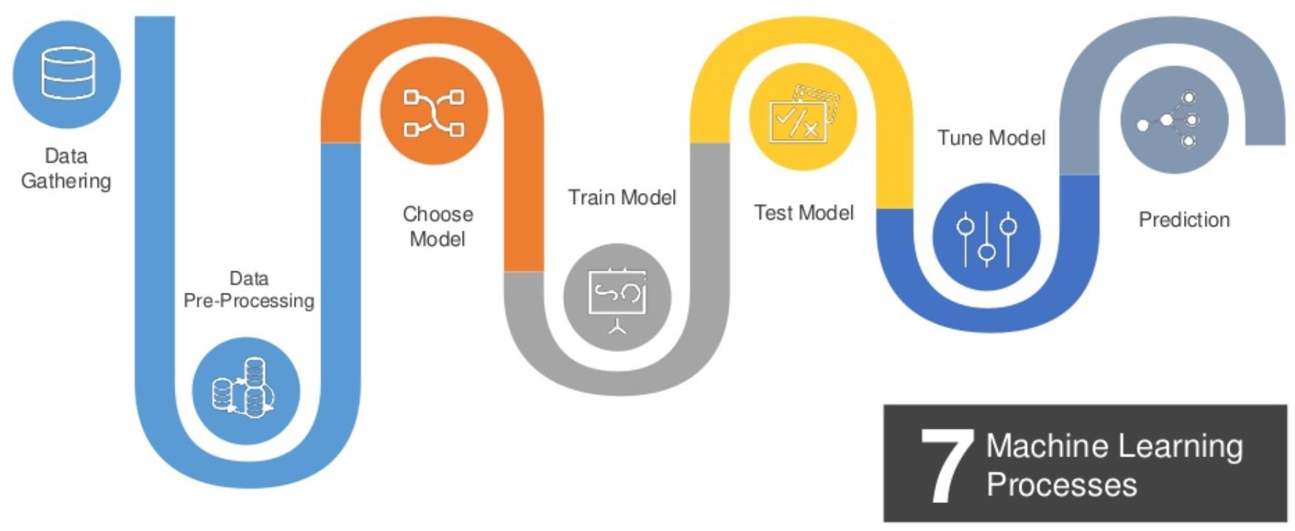
ML Process

Slide 7
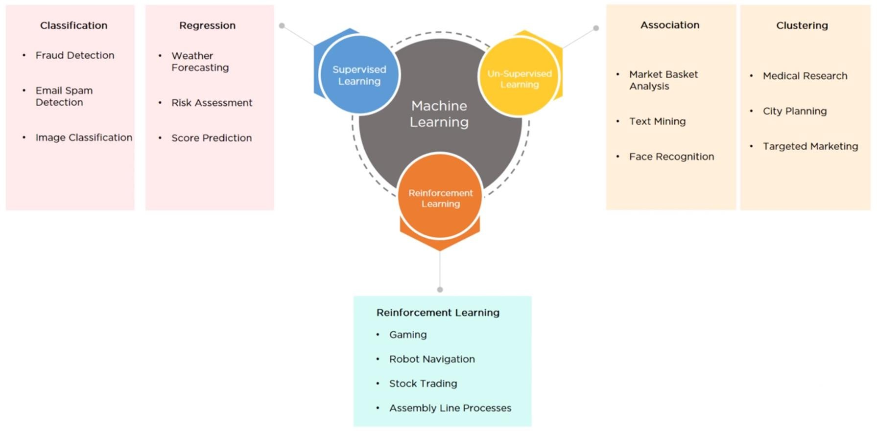
ML Algorithm Types

Slide 8
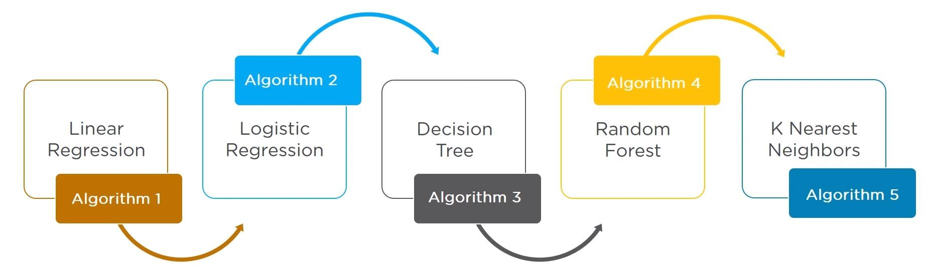
ML Algorithms

Slide 9
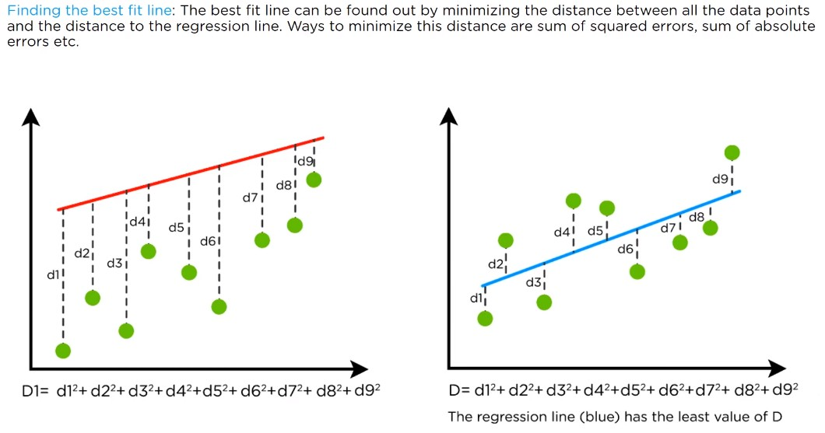
Linear Regression

Slide 10
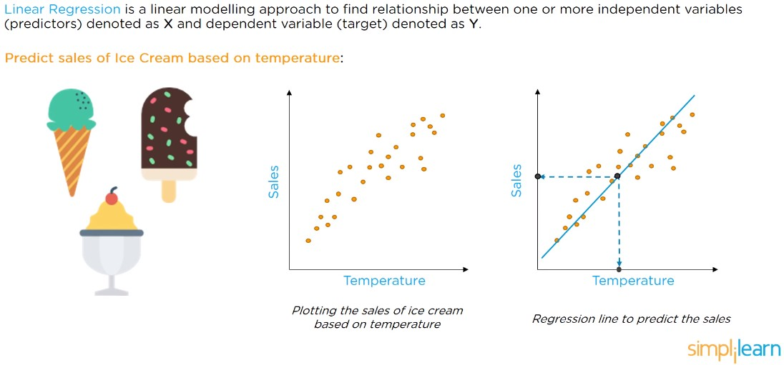
Linear Regression

Slide 11
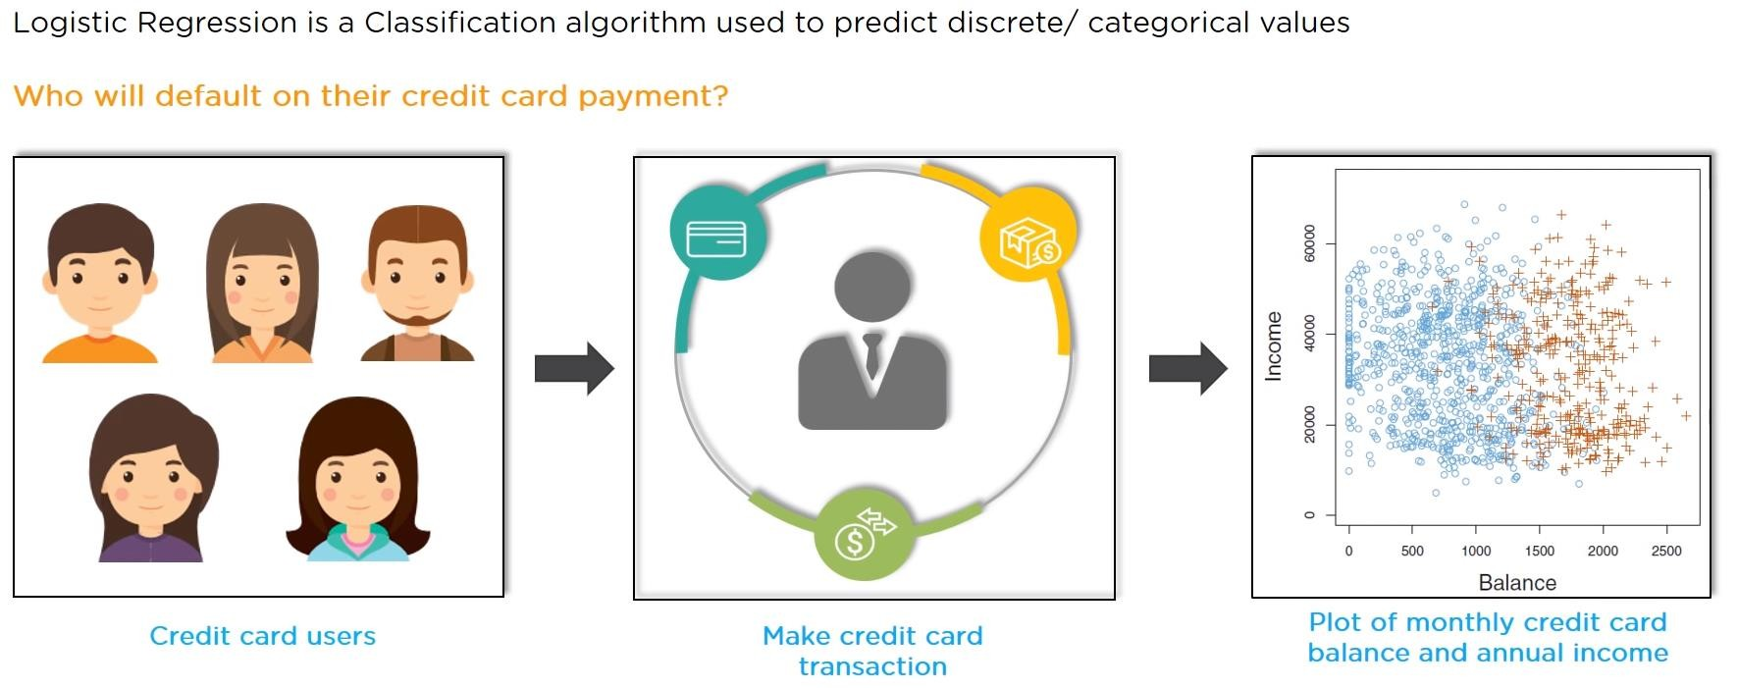
Logistic Regression

Slide 12
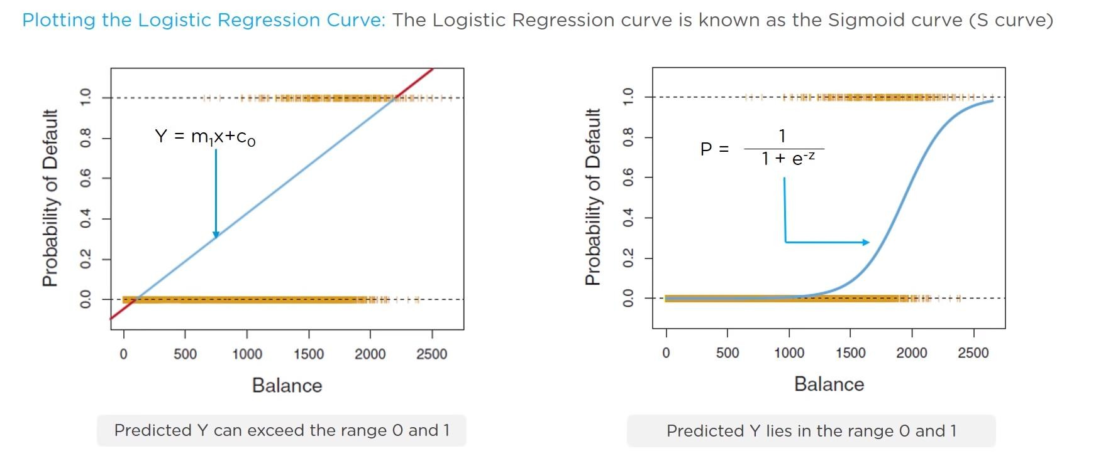
Logistic Regression

Slide 13
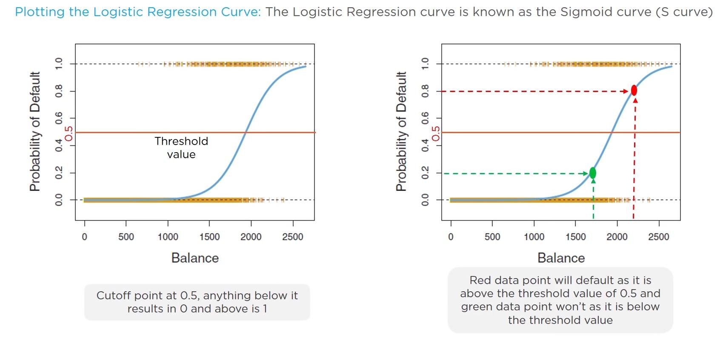
Logistic Regression

Slide 14
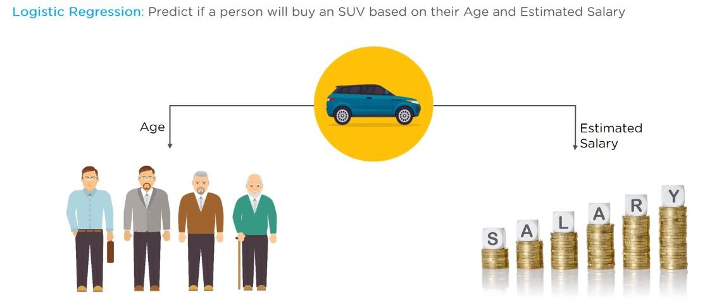
Logistic Regression

