Slide 1
Channabasaveshwara Institute Of Technology
Presentation Of : “Recruitment App”.
Presented By : Namratha P
Kiran Chand C

Slide 2
DRAWBACKS
In general, some company or organization have Recruiting team.
The data of each candidate cannot be centralized.

Slide 3
Main Objectives
To overcome this problem , we decided to develop an APP which can manage complete recruitment procedure.
Only members of recruitment team can access this system to operate.

Slide 4
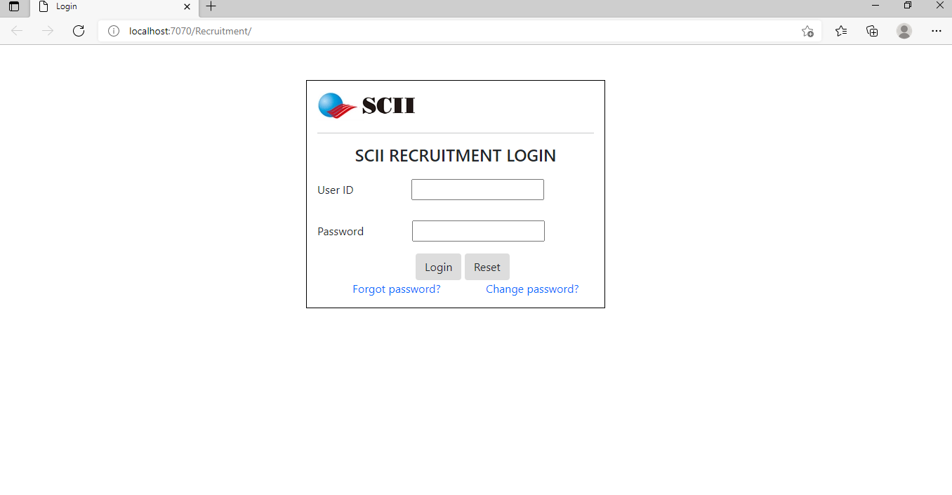
Login
-> Here User or Employee can Login through user_id and Password .

Slide 5
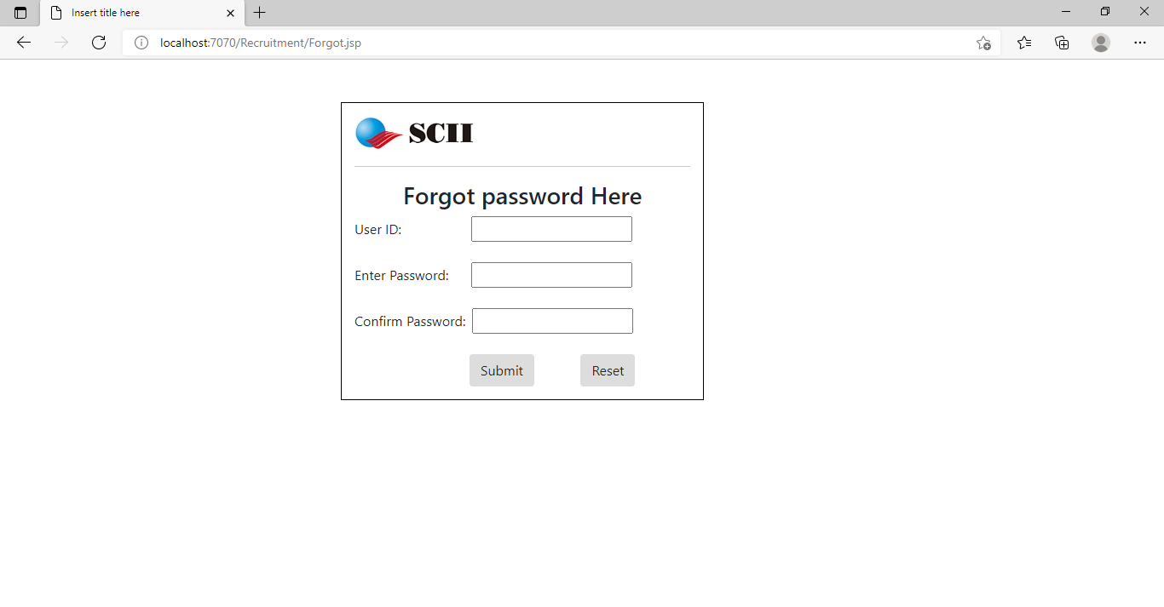
Forgot Password
->If User or Employee fails to remember the password , then user can reset their password

Slide 6
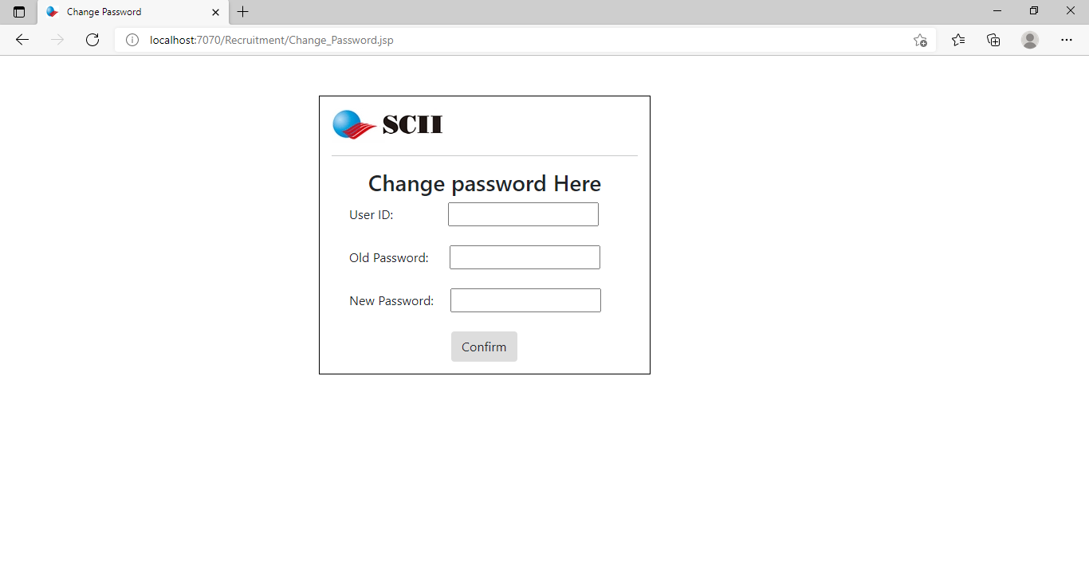
Change Password
->If User or Employee feels that there is no safe or password is known for others, then user can change their password

Slide 7
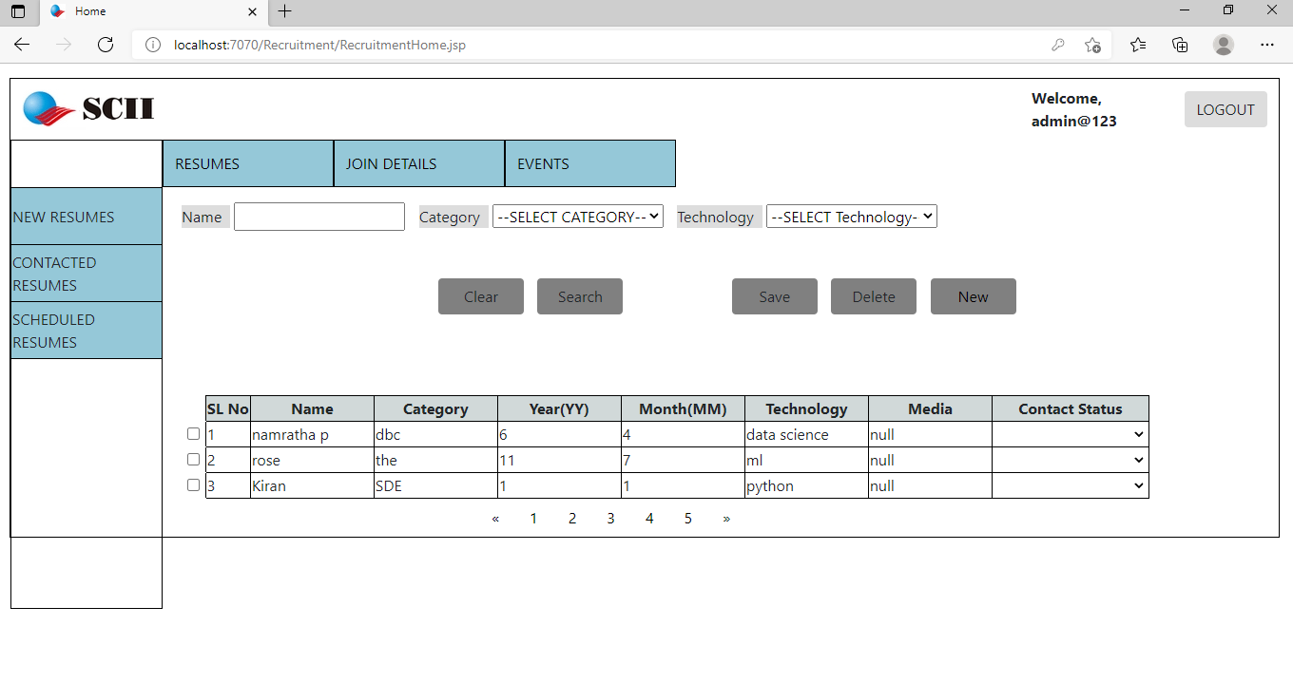
Resume Home
->If User/Employee logged in successfully then he/she will be redirected to Resume home page.

Slide 8
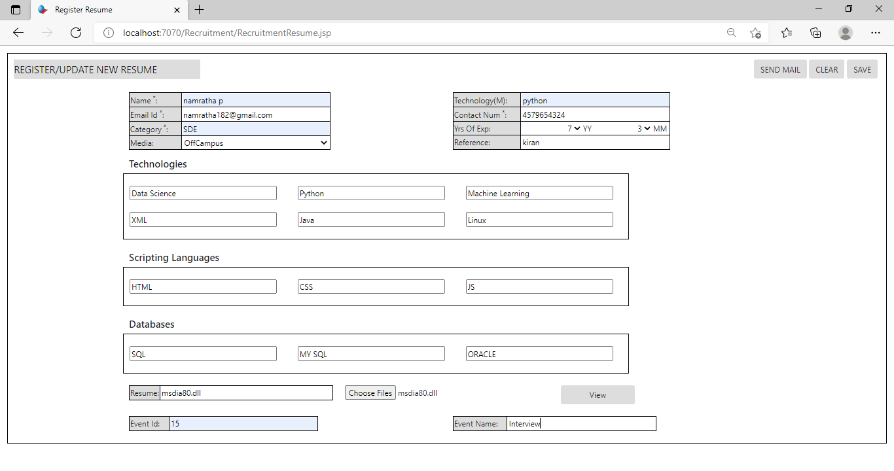
Resume Register
->Here Employee or User can register their Resume and their details and are stored in database.

Slide 9
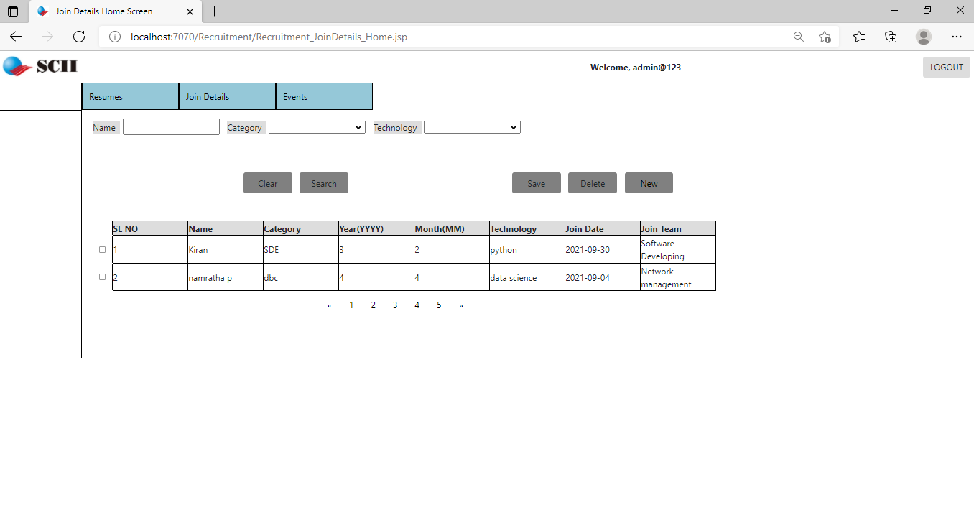
Join Details Home
-> Here Higher Authority can see which employees are allotted to respective team

Slide 10
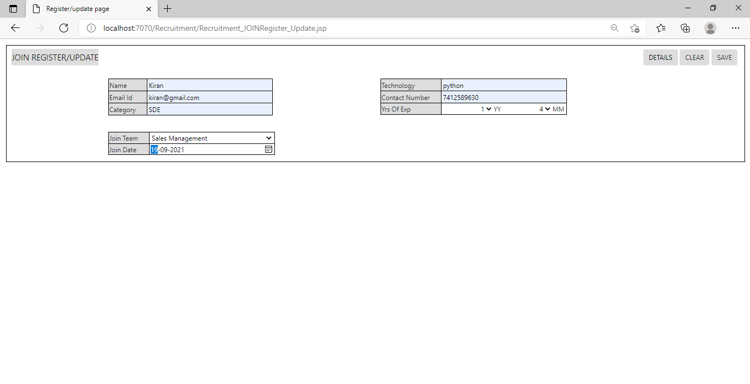
Join Details Register
->Higher Authority has to register employee to their respective teams.

Slide 11
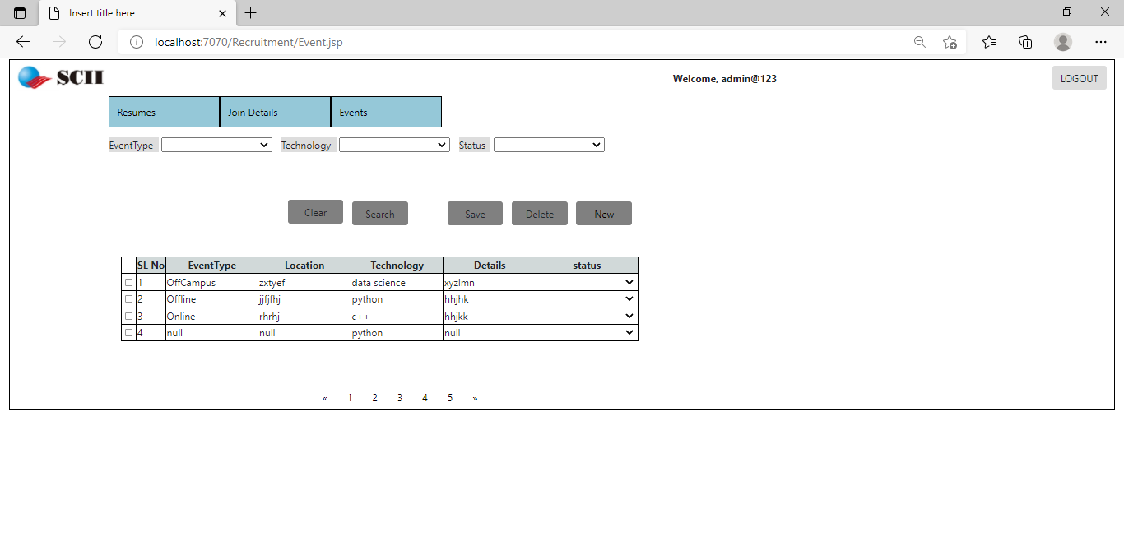
Event Home
->Recruiter can see which events are registered and upcoming events.

Slide 12
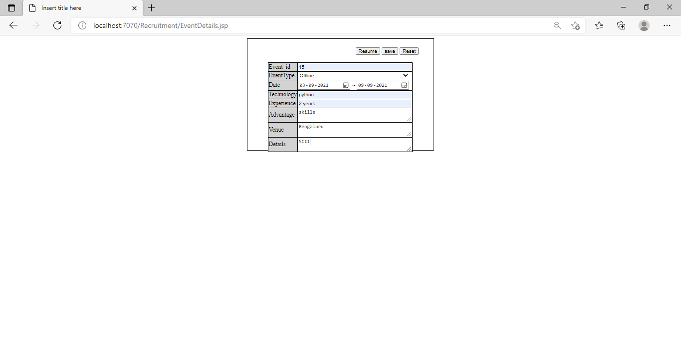
Event Register
-> Recruiter can register the events for Hiring employees or candidates.

Slide 13
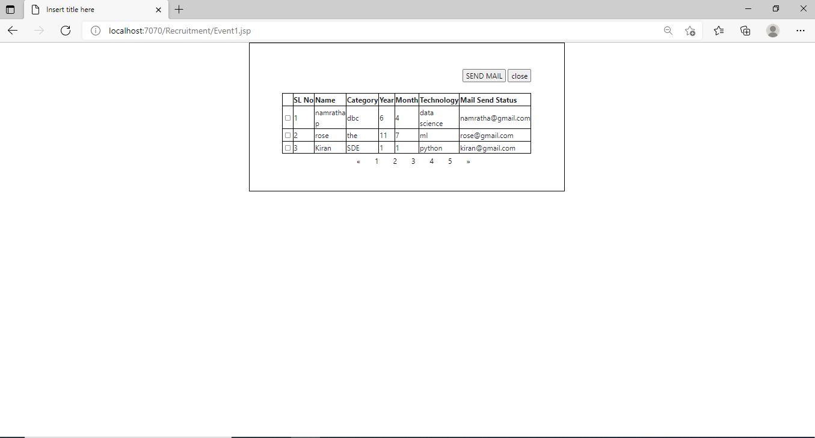
Event Resume
-> Resumes of the all the candidates can be seen here

Slide 14
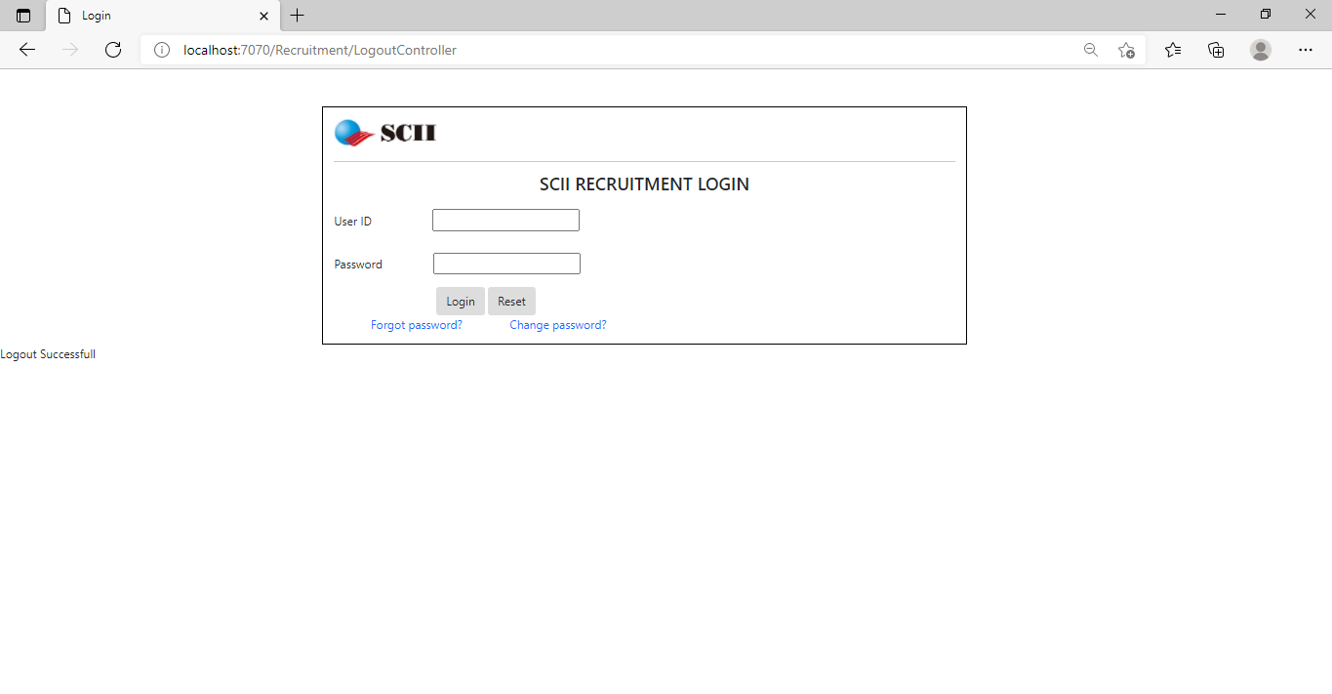
Logout
->Employee or User can logout after completing their Operation

Slide 15
Conclusion
Online recruitment has been a tool widely used by Humans Resource Manager.
This service has been expanding greatly helping companies to maintain the growth in their curriculum Database.
We find that this Model of Recruitment is useful for Candidates and as well as Company

