Slide 1
1.Dataset Selection
Link for the dataset : https://www.Kaggle.com/jsphyg/weather-dataset-rattle-package
Dataset name : weatherAUS- Rain in Australia
Number of rows : 142193
Number of variables : 24
Number of categorical variables : 7
Number of numerical variables : 17
Number of missing values : 316559

Slide 2
Explanatory Data Analysis :
This dataset contains about 10 years of daily weather observations from numerous Australian weather stations.
1.Date : The date of observation(a date object).
2.Location :The common name of the location of the weather station.
3.MinTemp : The minimum temperature in degrees Celsius.
4.MaxTemp :The maximum temperature in degrees Celsius.
5.Rainfall : The amount of rainfall recorded for the day in mm.
6.WindGustDir : The direction of the strongest wind gust in 24 hours.
7. WindGustSpeed : The speed(km/h) of the strongest wind gust in the 24 hrs.
8.WindDir9am : The direction of the strongest wind gust at 9am.
9.WindDir3pm : The direction of the strongest wind gust at 3pm
10.WindSpeed9am : The speed(km/h) of the strongest wind gust at 9am.
11.WindSpeed3pm : The speed(km/h) of the strongest wind gust at 3pm.

Slide 3
12.Humidity9am : Relative humidity at 9am in (percent).
13.Humidity3pm : Relative humidity at 3pm in (percent).
14.Pressure9am : Atmospheric pressure (hpa) reduced to mean sea level At 9am.
15.Pressure3pm : Atmospheric pressure (hpa) reduced to mean sea level At 3pm
16.Temp9am : Temperature (degrees Celsius) at 9am.
17. Temp3pm : Temperature (degrees Celsius) at 3pm.
18.RainToday : Integer 1 if precipitation (mm) in the 24 hrs 9 am exceeds 1mm,otherwise 0.
19.RISK_MM : The amount of rain. A kind of measure of the “risk” .
20.RainTomorrow : The target variable .Did it rain tomorrow?
21.Evaporation :The so-called class A pan evaporation (mm) in the 24 hrs.
22.Sunshine : The number of hrs of bright sunshine in the day.
23.Cloud9am : Fraction of sky obscured by cloud at 9am. This is measured in “oktas”, which are a unit of eights.It records how many eights of the sky are obscured by cloud. A 0 measure indicates completely clear sky whilst an 8 indicates that is completely overcast.
24.Cloud3pm : Fraction of sky obscured by cloud at 3pm.

Slide 4
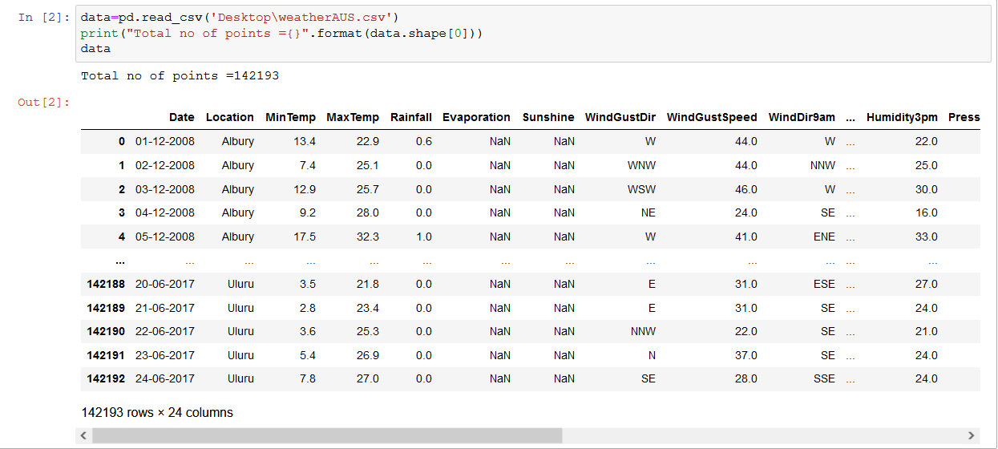
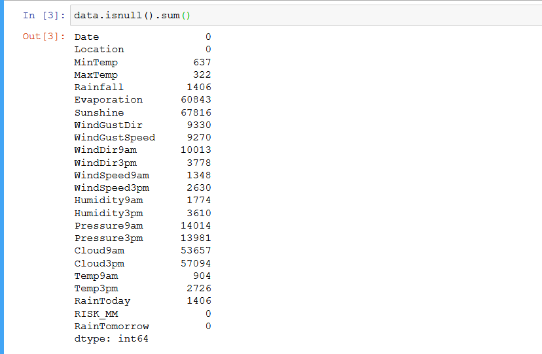
Data cleaning :
Importing dataset to Jupyter notebook →
Checking columns for Missing values →

Slide 5
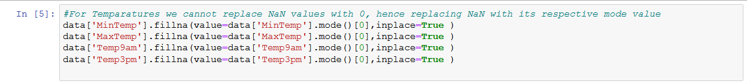
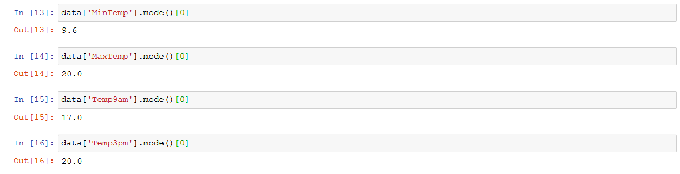
For Temparatures we cannot replace NaN values with 0, hence replacing NaN with its respective mode value.
Respective mode values for MinTemp, MaxTemp, Temp9am and Temp3pm are 9.6 C, 20 C, 17 C, 20 C.

Slide 6
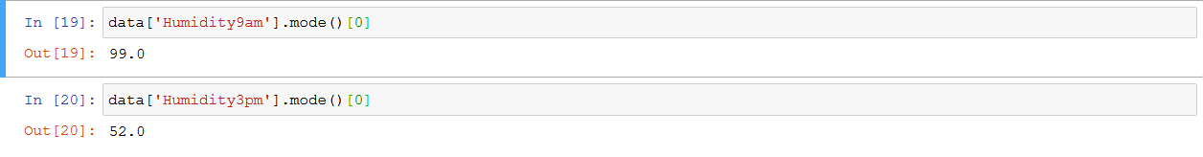
For Humidity also replacing NaN values with mode values.
Respective mode values for Humidiy9am and Humidity3pm are 99% and 52% .
For Rainfall feature we can fill NaN values with 0.0 , which says there is no rain fall .

Slide 7
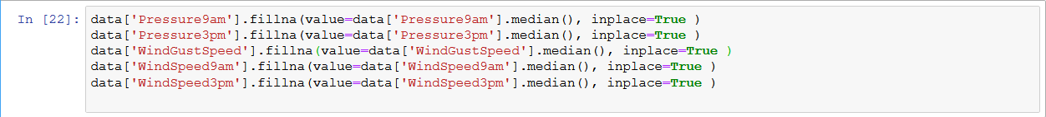
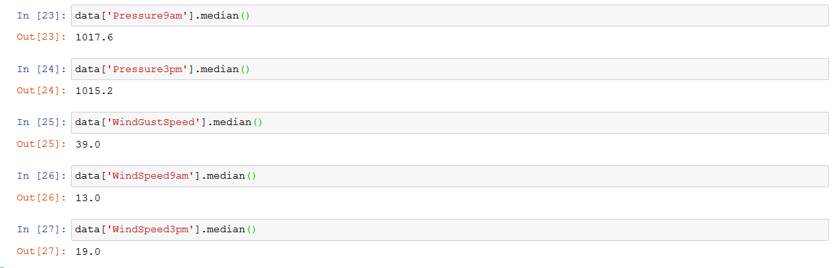
For Pressure and WindSpeed filling NaN values with median.
Respective median values of Pressure9am, Pressure3pm, WindGustSpeed, WindSpeed9am and WindSpeed3pm
are 1017.6 hpa, 1015.2 hpa, 39 km/h, 13km/h and 19 km/h

Slide 8
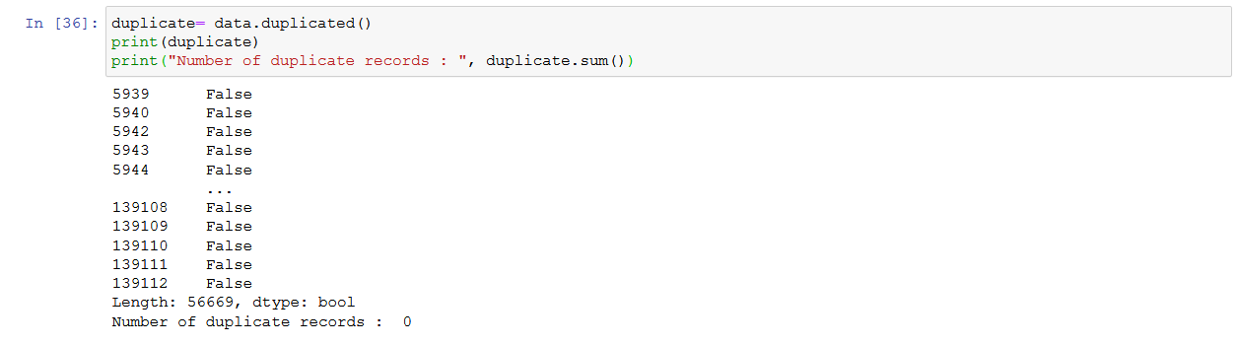
For RainToday feature we cannot fill any value , so dropping the NaN values.
Checking duplicate records : No records found

Slide 9
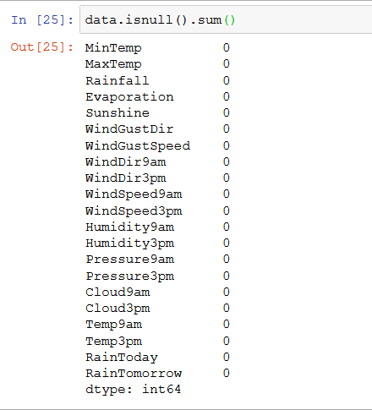
Sorting the data by date
Removing unwanted features Date, Location
Now checking again for null values :

Slide 10
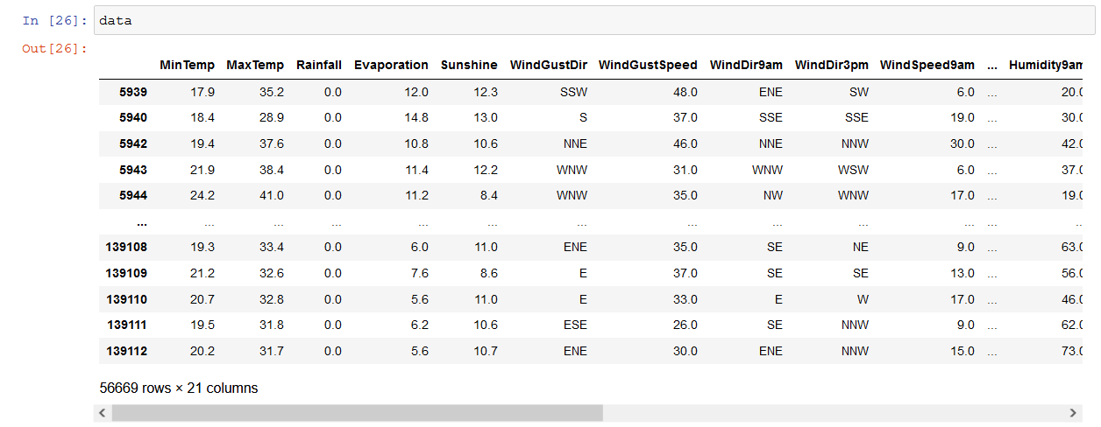
Successfully removed all null values. Remaining rows 56669 and columns 21.

Slide 11
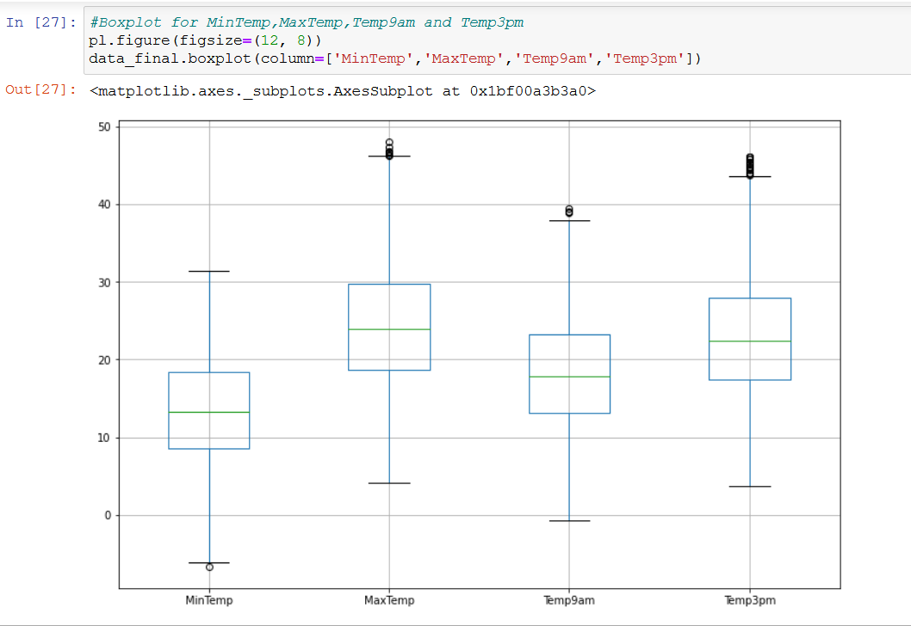
Graph visualization
Using boxplot for numerical variables : Temparature,Evaporation,Sunshine,Humidity,Pressure,Cloud,Rainfall
WindSpeed.
Using barchart for categorical variables :WindGustDir,WindDir9am,WindDir3pm,RainToday.
Boxplot for Temparatures →

Slide 12
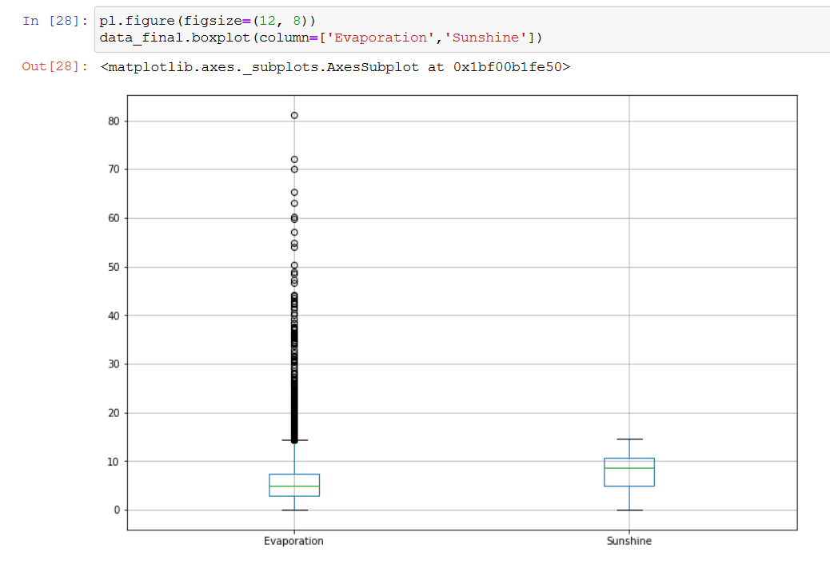
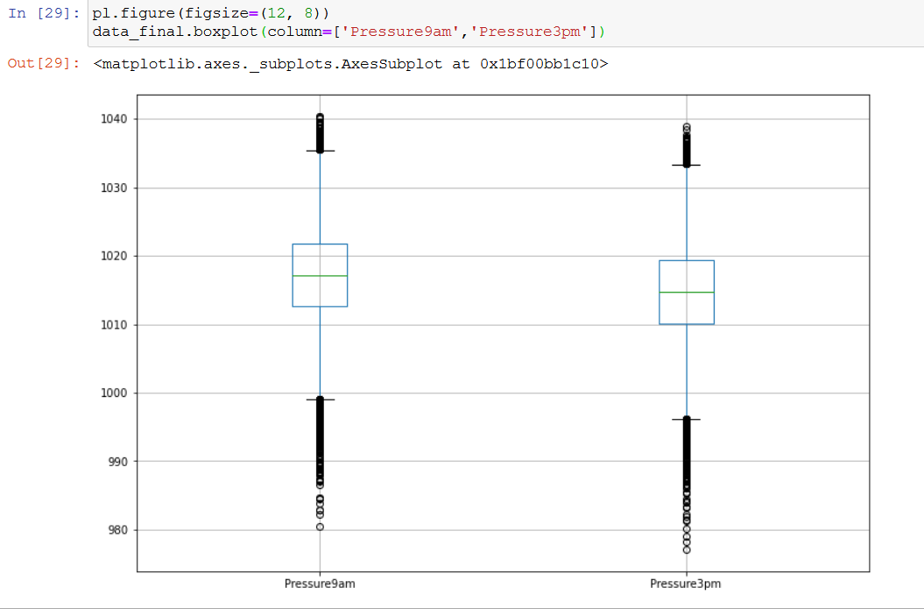
Boxplot for Evaporation and sunshine Boxplot for Pressure :

Slide 13
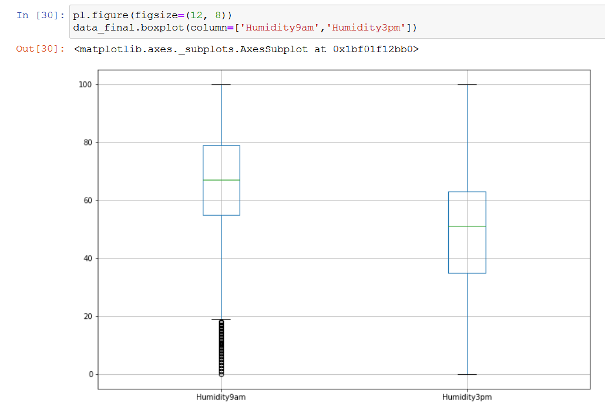
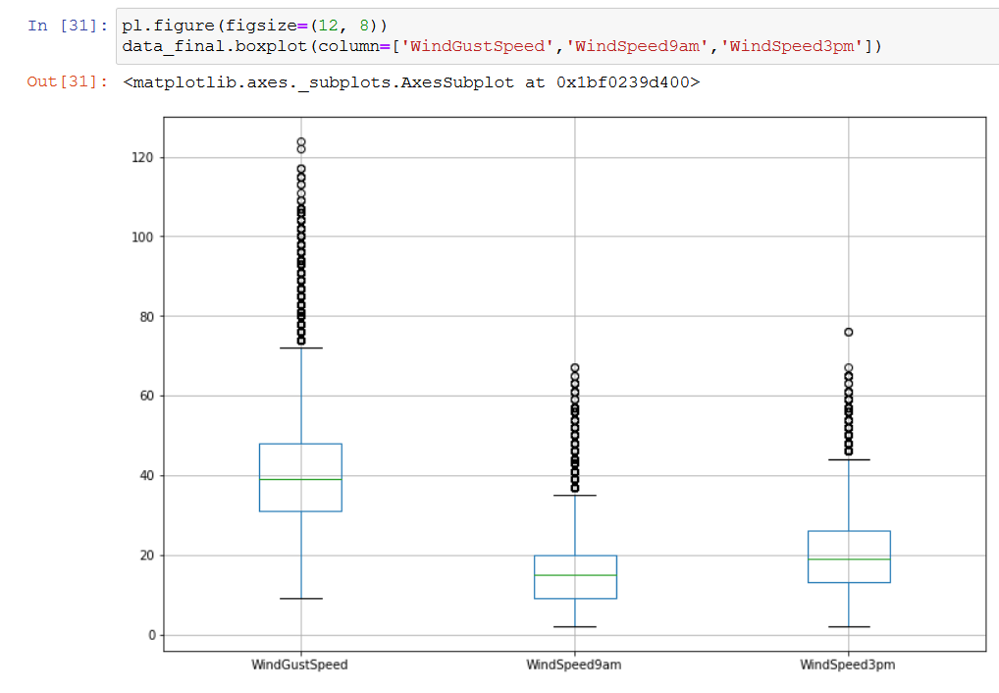
Boxplot for Humidity : Boxplot for WindSpeeds :

Slide 14
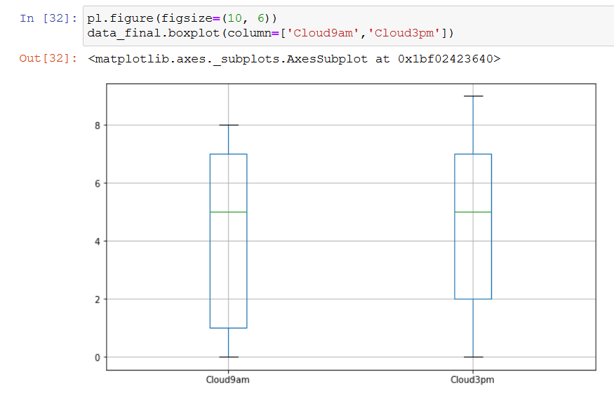
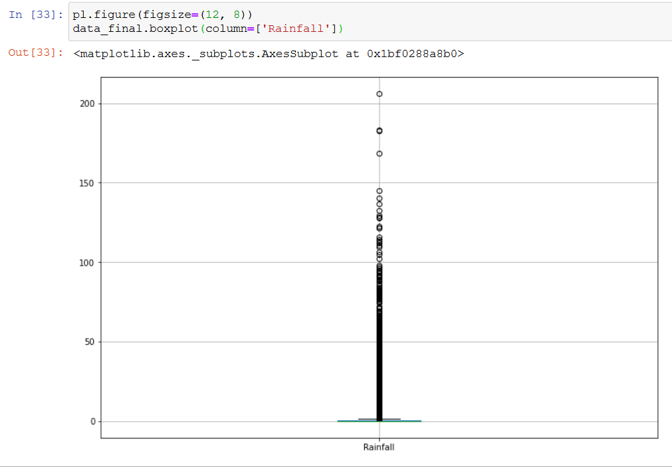
Boxplot for Cloud9am and Cloud3pm : Boxplot for Rainfall :

Slide 15
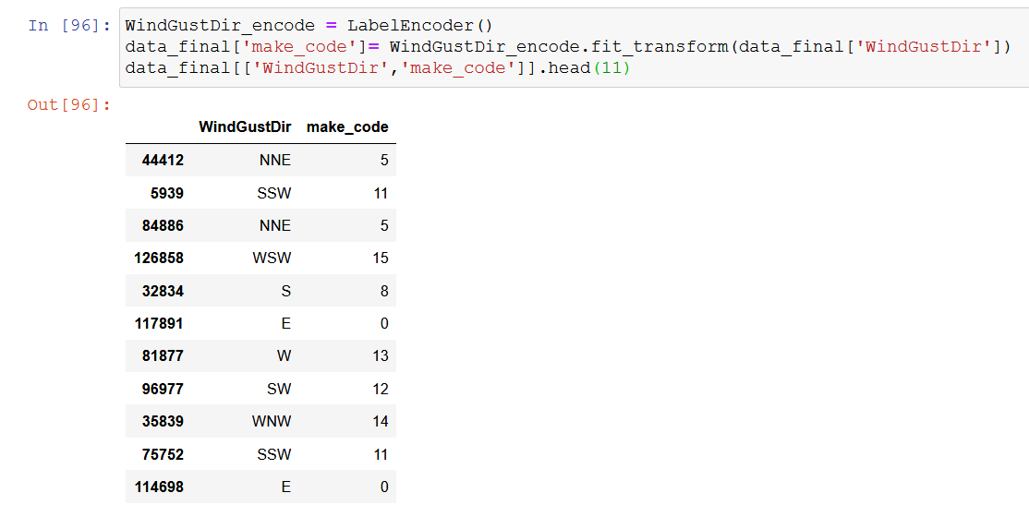
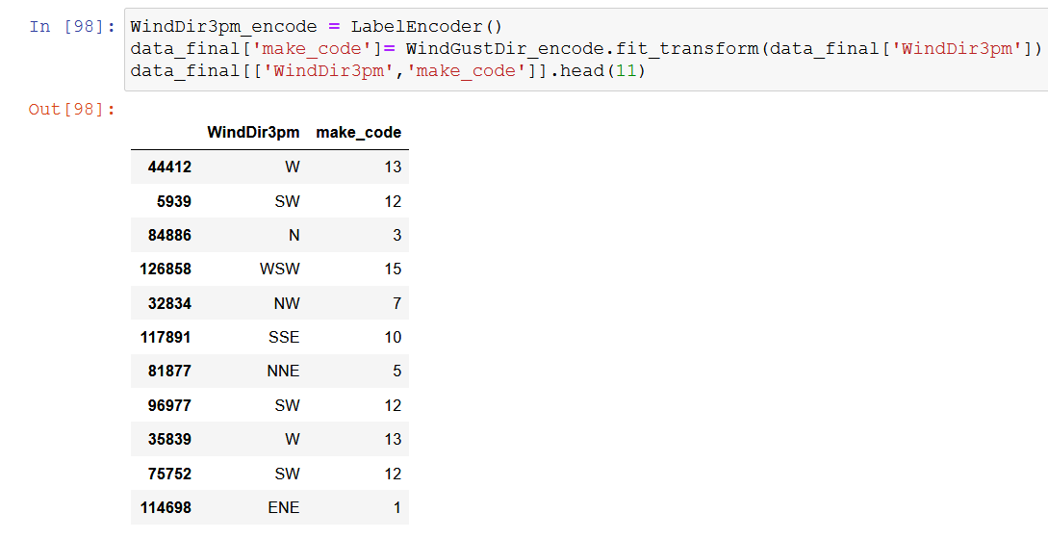
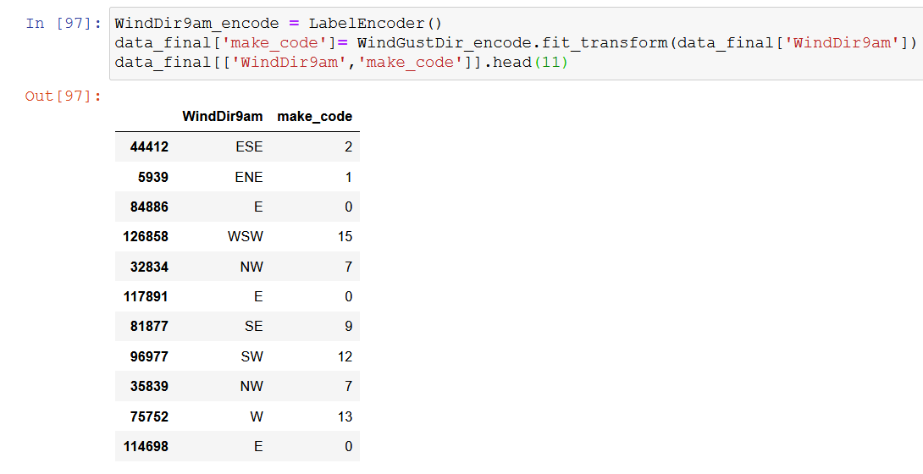
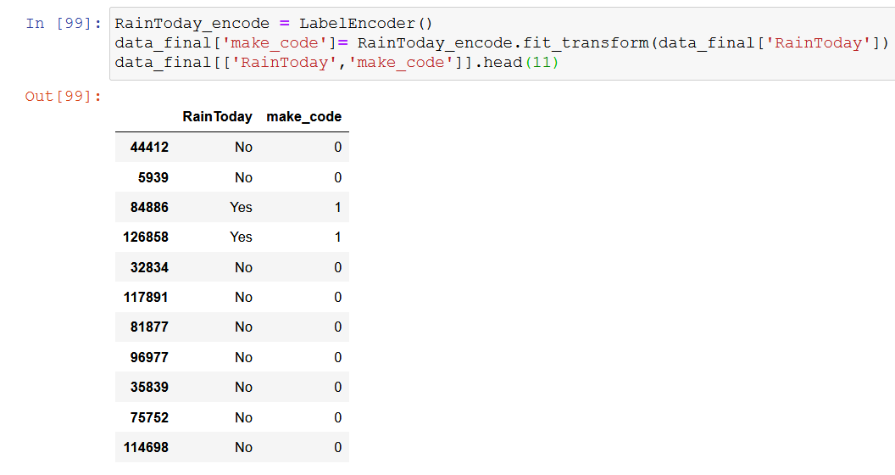
Using barchart for categorical variables :WindGustDir,WindDir9am,WindDir3pm,RainToday.
For plotting purpose we are encoding all these features into values.

Slide 16
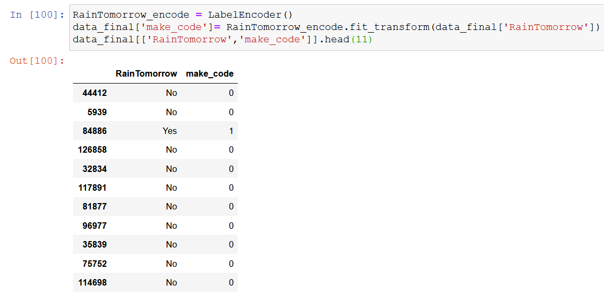
RainToday and RainTomorrow code values are same after encoding i.e “0 : No” and “1 : Yes”
Regarding all the dataset, probability of Rain tomorrow is 22 %.

Slide 17
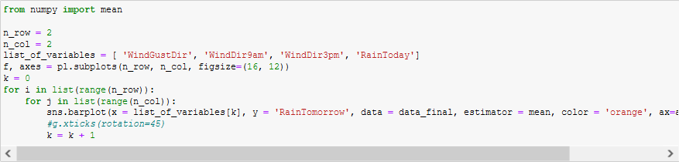
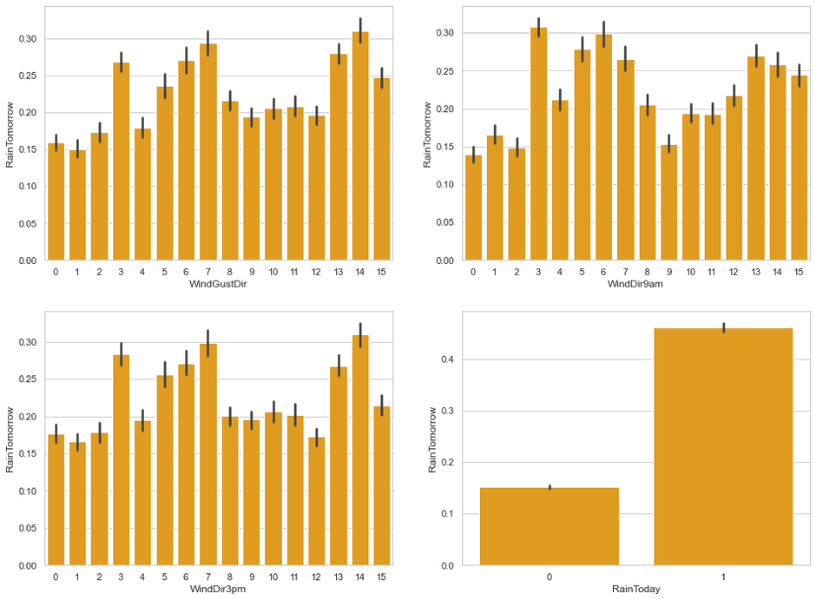
Below, the probabilities of rain tomorrow for the classes of each categorical variable are plotted with their mean values.

Slide 18
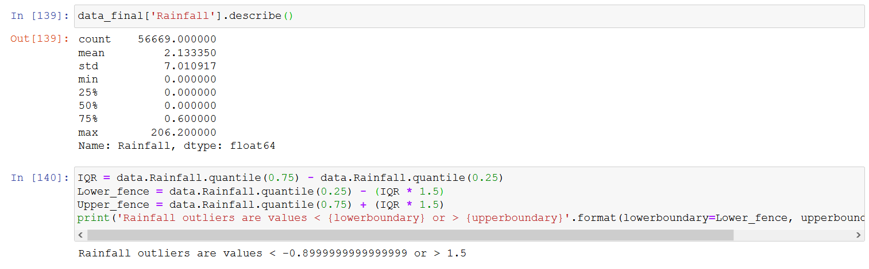
Outliers
Checking for outliers on all numerical values
From all the boxplots we observed that MaxTemp,Temp9am,Temp3pm,Evaporation,Humidity9am,Pressure9am,Pressure3pm,WindGustSpeed,WindSpeed9am,windSpeed3pm,Rainfall these columns have outliers.
Calculating 5 tuple summary for all.
Rainfall :
All values Above 1.5 mm are to be considered as outliers.

Slide 19
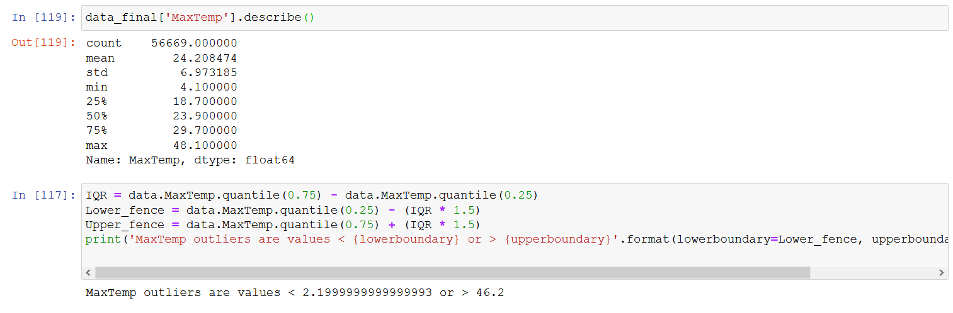
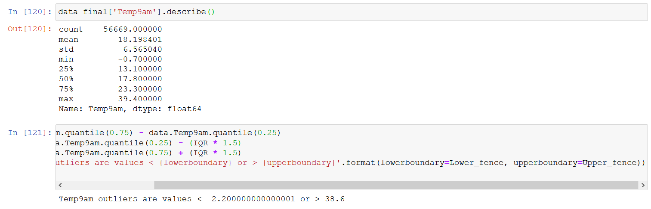
MaxTemp :
All values Above 46.2 C and below 2.2 C are to be considered as outliers.
Temp9am :
All values Above 38.6 C and below -2.2 C are to be considered as outliers.

Slide 20
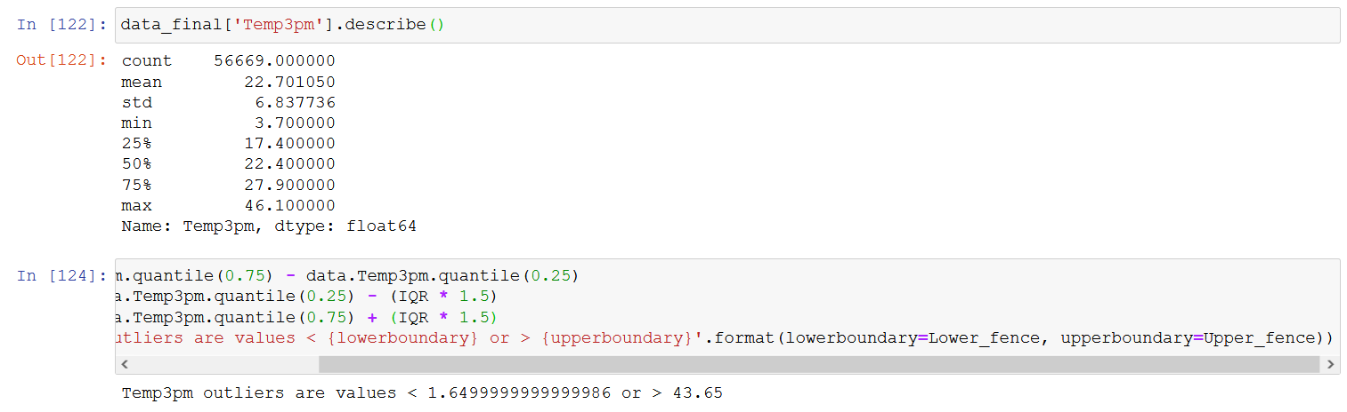
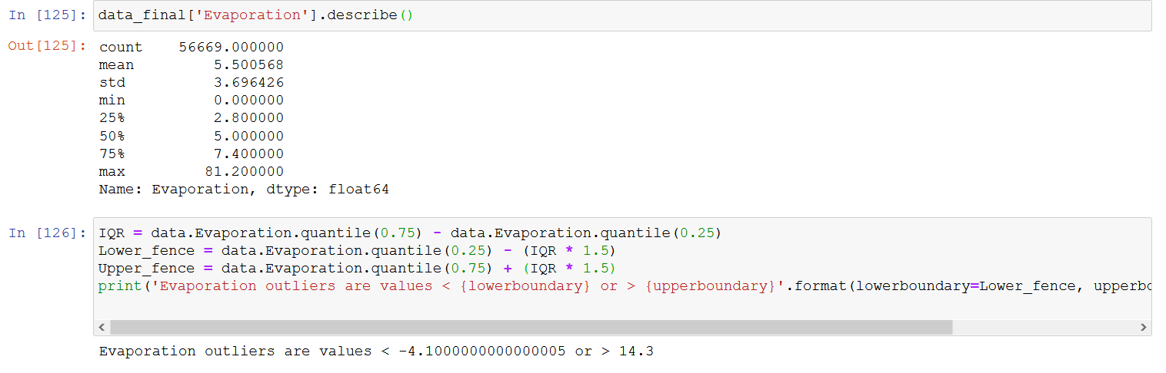
Temp3pm :
All values Above 43.65 C and below 1.65 C are to be considered as outliers.
Evaporation :
All values Above 14.3mm and below -4.1 are to be considered as outliers.

Slide 21
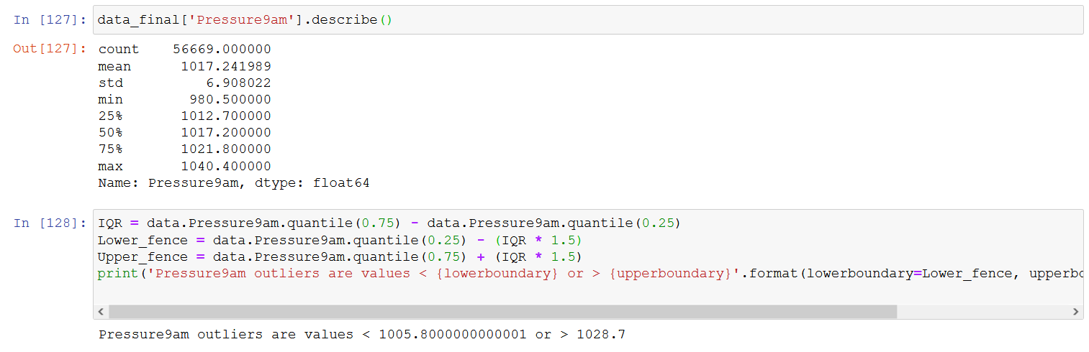
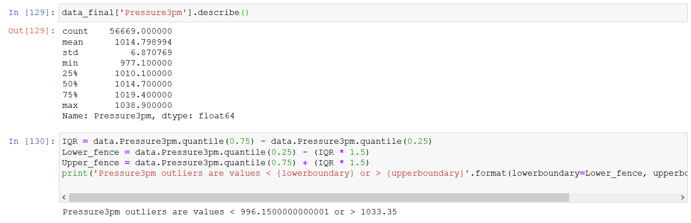
Pressure9am
All values Above 1028.7 hpa and below 1005.8 hpa are to be considered as outliers.
Pressure3pm
All values Above 1033.35 hpa and below 996.15 are to be considered as outliers.

Slide 22
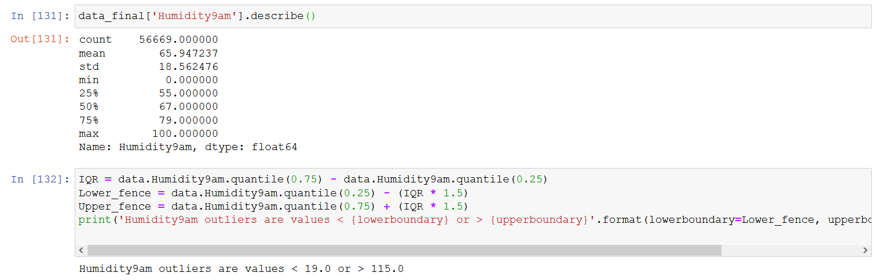
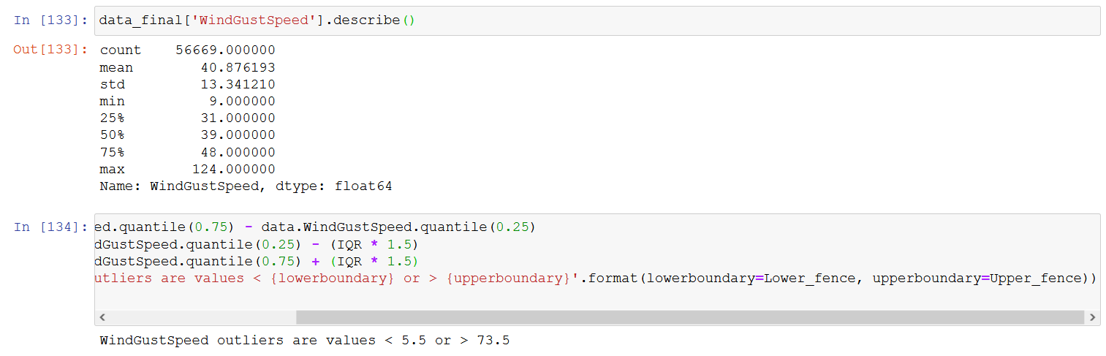
Humidity9am :
All values Above 115 % and below 19% are to be considered as outliers.
WindGustSpeed :
All values Above 73.5 km/h and below 5.5 km/h are to be considered as outliers.

Slide 23
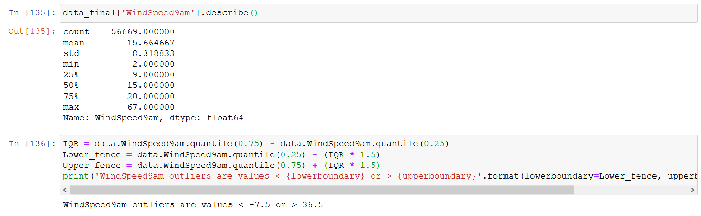
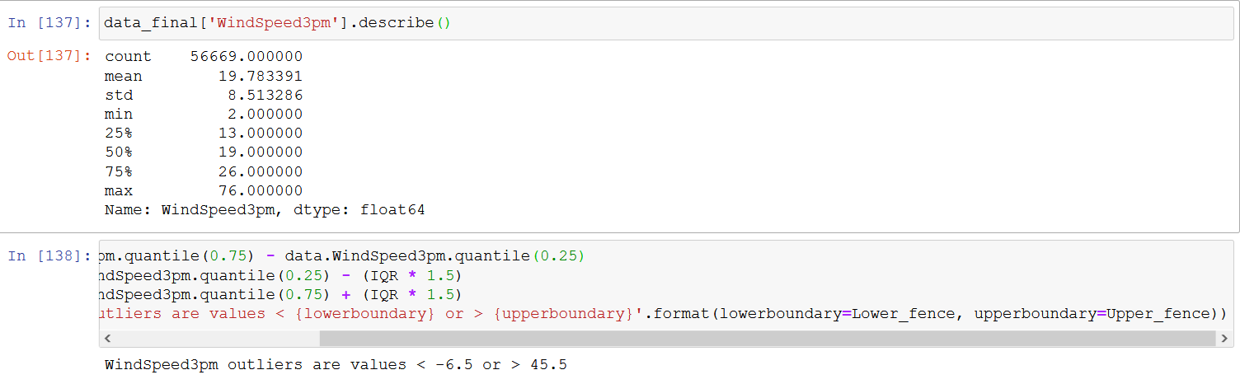
WindSpeed9am :
All values Above 36.5 km/h and below -7.5 km/h are to be considered as outliers.
WindSpeed3pm :
All values Above 45.5 km/h and below -6.5 km/h are to be considered as outliers.

Slide 24
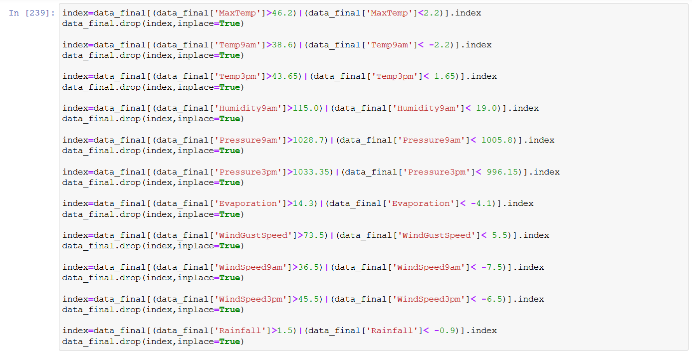
Filtering all the outliers.
Dropping all those rows containing outliers.
Exporting filtered data to “Filtered data.csv” file.

Slide 25
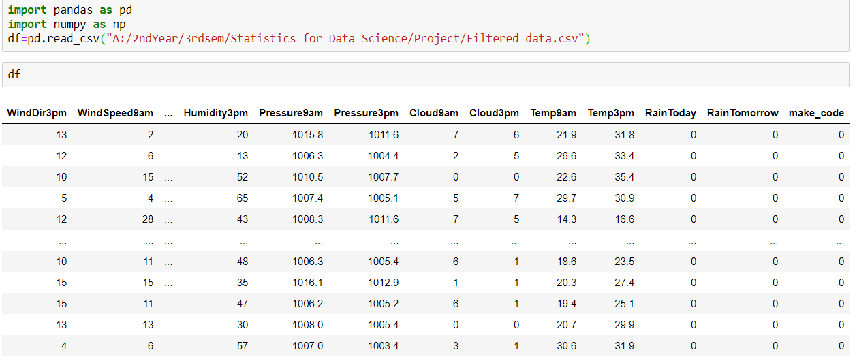
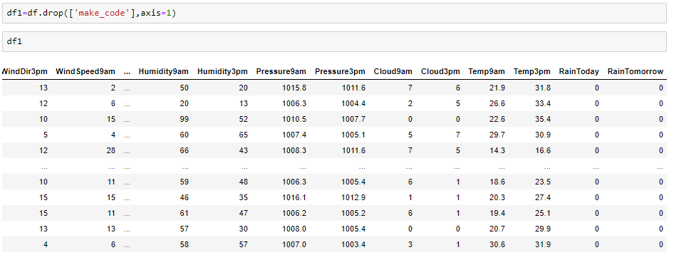
4. NORMALIZATION AND STANDARDIZATION
Data frame(df) is the cleaned dataset with all the columns intact.
Dataframe1(df1) is the dataset obtained after dropping the non-useful columns
I) COMPUTING MEAN AND VARIANCE :
We calculated the mean and variance for the columns with the help of pandas.
We first read the csv file and then drop the non-numeric columns from our dataset for calculation of mean and variance.

Slide 26
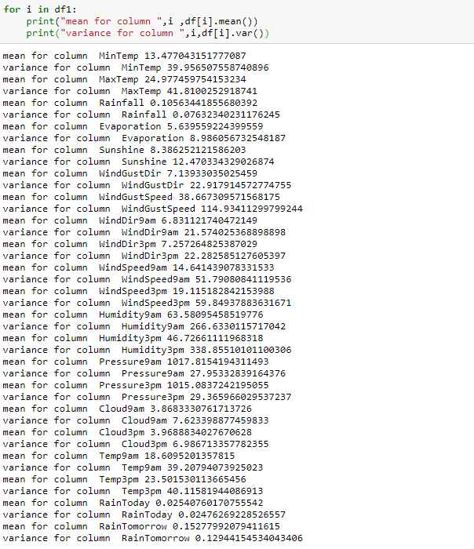
I)Mean and variance values:

Slide 27
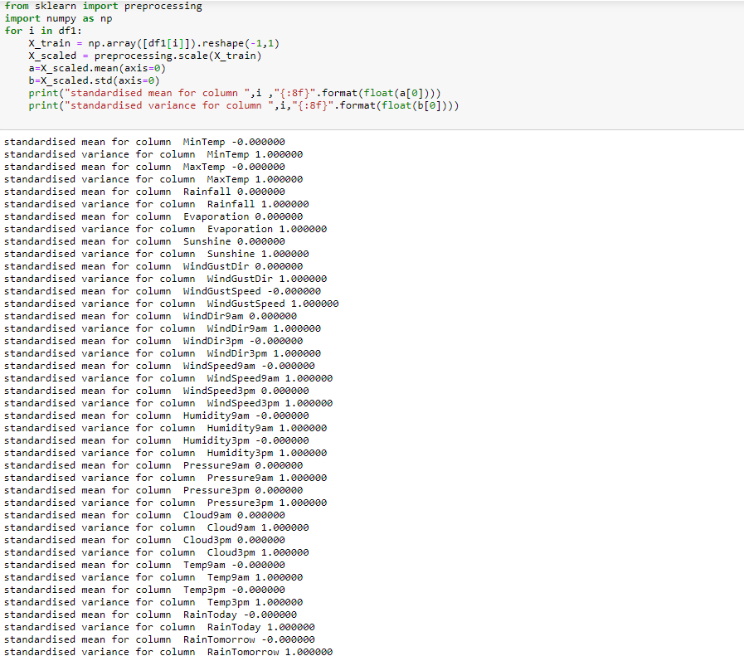
II)Standardization

Slide 28
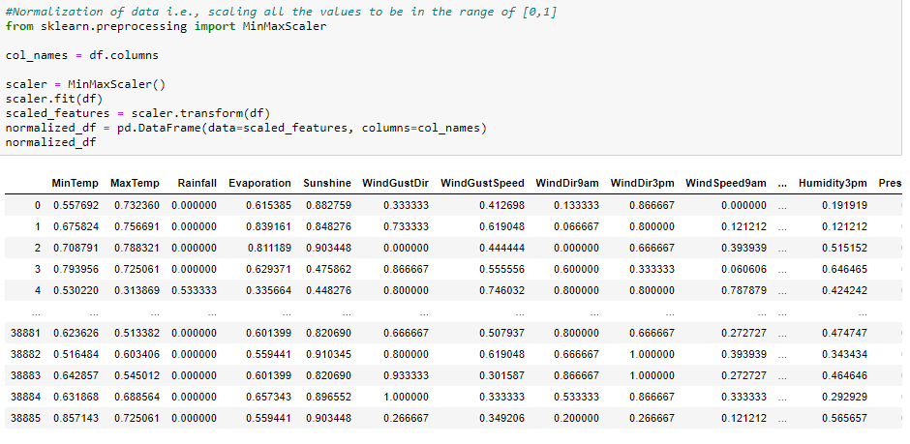
III )Normalised value of all variables columns value range from 0 to 1

Slide 29
We have used preprocessing from the sklearn module to standardize the dataset, we then reshaped each column as numpy.arr() accepts a 2D array. Finally while printing we converted the scientific notation form to decimal and the NumPy array returned to whole numbers(0 and 1).
III) WHY NORMALIZATION IS NEEDED?
Standardization:
Standardizing the features around the centre and 0 with a standard deviation of 1 is important when we compare measurements that have different units. Variables that are measured at different scales do not contribute equally to the analysis and might end up creating a bias.
For example, a variable that ranges between 0 and 1000 will outweigh a variable that ranges between 0 and 1. Using these variables without standardization will give the variable with the larger range weight of 1000 in the analysis. Transforming the data to comparable scales can prevent this problem. Typical data standardization procedures equalize the range and/or data variability.

Slide 30
Normalization:
Similarly, the goal of normalization is to change the values of numeric columns in the dataset to a common scale, without distorting differences in the ranges of values. For machine learning, every dataset does not require normalization. It is required only when features have different ranges.
For example, consider a data set containing two features, age, and income(x2). Where age ranges from 0–100, while income ranges from 0–100,000 and higher. Income is about 1,000 times larger than age. So, these two features are in very different ranges. When we do further analysis, like multivariate linear regression, for example, the attributed income will intrinsically influence the result more due to its larger value. But this doesn’t necessarily mean it is more important as a predictor. So we normalize the data to bring all the variables to the same range.
When Should You Use Normalize and Standardize?
Normalization is a good technique to use when you do not know the distribution of your data or when you know the distribution is not Gaussian (a bell curve). Normalization is useful when your data has varying scales and the algorithm you are using does not make assumptions about the distribution of your data, such as k-nearest neighbours and artificial neural networks.
Standardization assumes that your data has a Gaussian (bell curve) distribution. This does not strictly have to be true, but the technique is more effective if your attribute distribution is Gaussian. Standardization is useful when your data has varying scales and the algorithm you are using does make assumptions about your data having a Gaussian distribution, such as linear regression, logistic regression, and linear discriminant analysis.

Slide 31
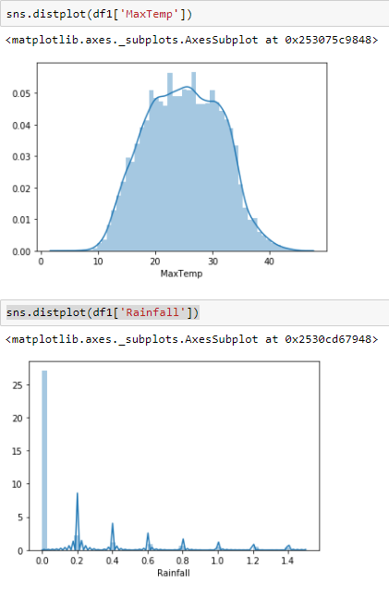
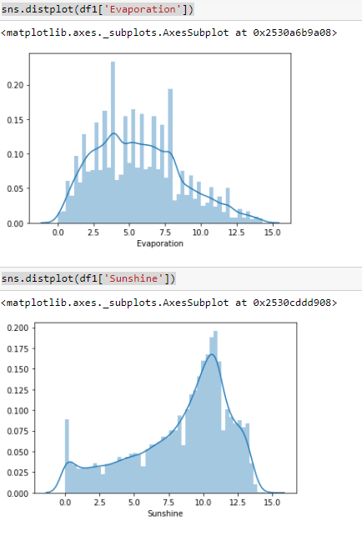
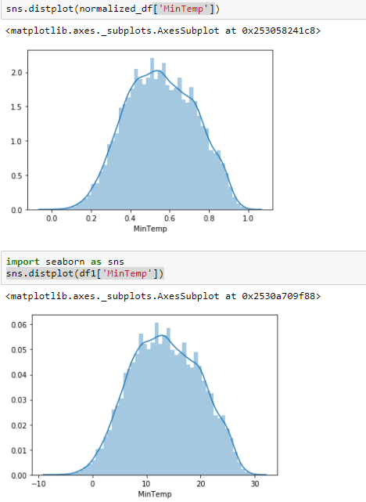
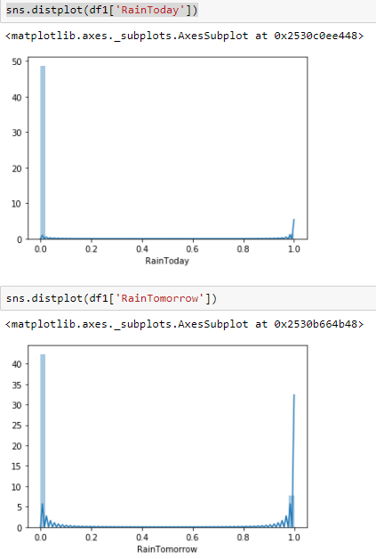
4.4 Using Graphs obtained previously to check whether the data is normal.
. . .
From all the graphs above we observe that we cannot outline a symmetrical bell curve/Gaussian curve from them and hence they are not normally distributed.

Slide 32
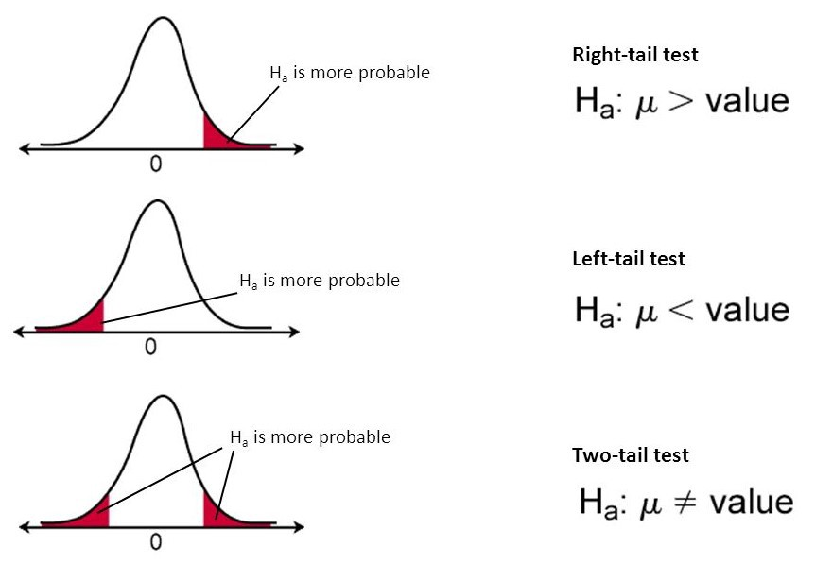
5. Hypothesis Testing.
What is Hypothesis Testing?
Hypothesis testing is an act in statistics whereby an analyst tests an assumption regarding a population parameter.
Research Hypotheses: Research Hypotheses is nothing but alternative hypotheses give a testable and potentially prediction about the relationship between two variables.
Hypothesis testing is used to assess the plausibility of a hypothesis by using sample data. Such data may come from a larger population, or from a data-generating process.
In our dataset, we have made 5 different research hypothesis statements
Each Hypothesis test is done by taking a random sample consisting of 100 values from the population data set

Slide 33
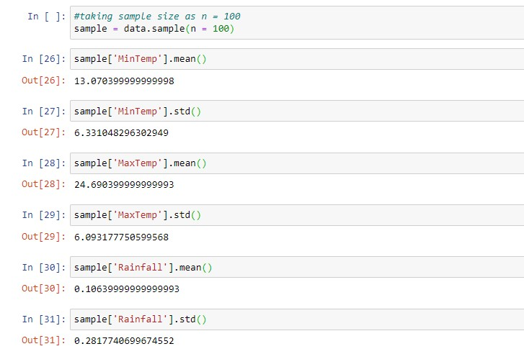
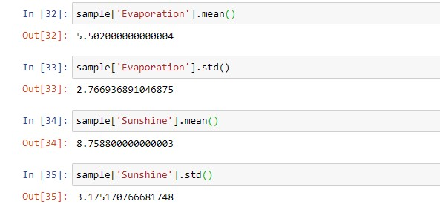
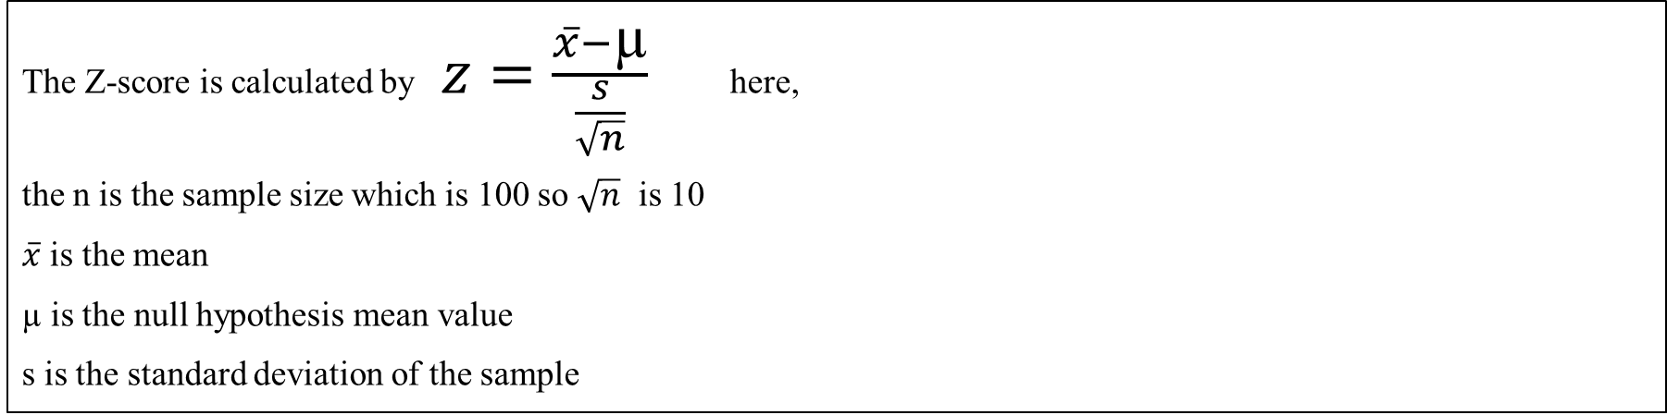
The Z-score is calculated by $z=\frac{\overline{x}−\text{µ}}{\frac{s}{\sqrt{n}}}$ here,
the n is the sample size which is 100 so $\sqrt{n}$ is 10
$\overline{x}$ is the mean
µ is the null hypothesis mean value
s is the standard deviation of the sample
The Figs shown below takes 100 random samples from the dataset and calculates the SD and mean of the required columns

Slide 34
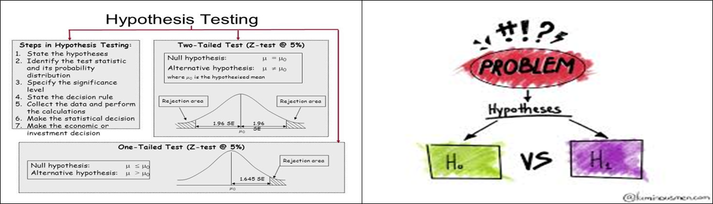

Statement 1: The mean Minimum Temperature at least 12.
Therefore H₀: µ >= 12
H₁: µ > 12 s = 6.33 α = 0.05 x-bar = 13.07 (Right tailed test)
z = $\frac{13.07−12}{6.33/10}$ = 1.69
Hence the p-value is 1 – 0.9554 = 0.0445, p<0.05
Hence the hypothesis statement & null hypothesis rejected.
We conclude that H₁ true.

Slide 35


Statement 2: The mean Maximum Temperature at most 25.
Therefore H₀: µ >= 25
H₁: µ < 25 s = 6.09 α = 0.05 x-bar = 24.69 (Left tailed test)
z = $\frac{24.69−25}{6.09/10}$ = -0.509
Hence the p-value is 0.0655 , p>0.05
Hence the hypothesis statement & null hypothesis fail to reject.
We conclude that both H₁ & H₀ plausible.
Statement 3: The mean Rainfall is 0.2.
Therefore H₀: µ = 0.2
H₁: µ ≠ 0.2 s = 0..28 α = 0.05 x-bar = 0.1063 (Two tailed test)
z = $\frac{0.1063−0.2}{0.28/10}$ = -3.3428
Hence the p-value is 2(0.0004) = 0.0008 , p<0.05
Hence the hypothesis statement & null hypothesis rejected.
We conclude that H₁ true.

Slide 36


Statement 4: The mean Evaporation is less than 6.
Therefore H₀: µ >= 6
H₁: µ < 6 s = 2.7669 α = 0.05 x-bar = 5.502 (Left tailed test)
z = $\frac{5.502−6}{2.7669/10}$ = -1.799
Hence the p-value is 0.0351 , p<0.05
Hence the hypothesis statement & null hypothesis rejected.
We conclude that H₁ true.
Statement 5: The mean Sunshine is greater than 8.
Therefore H₀: µ <= 8
H₁: µ > 8 s = 3.175 α = 0.05 x-bar = 8.75 (Right tailed test)
z = $\frac{8.75−8}{3.175/10}$ = 2.36
Hence the p-value is 1 - 9909= 0.009 , p<0.05
Hence the hypothesis statement & null hypothesis rejected.
We conclude that H₁ true.

Slide 37

6.Correlation
I).To find the correlation between variables that are positively and negatively related
Loading the dataset and importing the required modules

Slide 38






Finding correlations using the corr function between all possible variables.

Slide 39







Slide 40
II)State inferences about the correlation data obtained
Correlation (to be exact Correlation in Statistic) is a measure of a mutual relationship between two variables whether they are causal or not. This degree of measurement could be measured on any kind of data type (Continuous and Continuous, Categorical and Categorical, continuous and Categorical).
Pearson Correlation is one of the most used correlations during the data analysis process. Pearson correlation measures the linear relationship between variable continuous X and variable continuous Y and has a value between 1 and -1.In other words, the Pearson Correlation Coefficient measures the relationship between 2 variables via a line.
When the correlation coefficient is closer to value 1, it means there is a positive relationship between variable X and Y. A positive relationship indicates an increase in one variable associated with an increase in the other. On the other hand, the closer correlation coefficient is to -1 would mean there is a negative relationship which is the increase in one variable would result in a decrease in the other. If X and Y are independent, then the correlation coefficient is close to 0 although the Pearson correlation can be small even if there is a strong relationship between two variables.

