Slide 1
PROFIT ANALYSIS REPORT
Project ID : PRDA - 01 - Profit Analysis
Team ID : PTID-CDA-MAR-26-1366
Presented By:
Kiran Hipparkar

Slide 2
Project Overview
Objective: Analyze how R&D, Administration, and Marketing
expenditures affect company profit
Dataset: Sales data from companies across 3 U.S. states – New York ,
Florida, and California.
Tools Used: SQL (Data extraction)
Power BI (Dashboard creation)
Excel (Data cleaning &Regression)

Slide 3

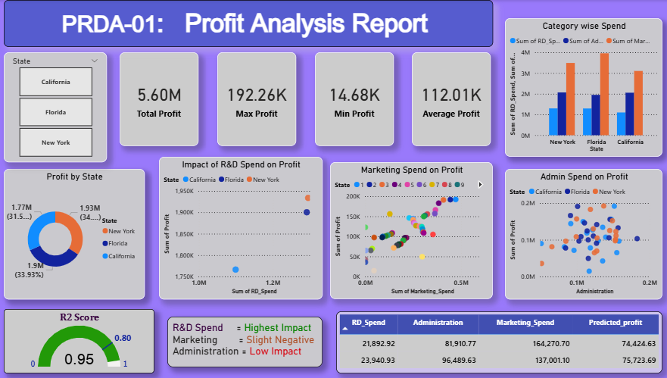
Power BI Dashboard

Slide 4

Summary Metrics
The total profit 5.60M represents the cumulative profit generated across all states.
Average Profit 112.01K indicates the mean profit per state, reflecting overall profitability.
The amount 192.26K is the highest recorded profit among all individual states.
The amount 14.68K is the lowest profit observed, highlighting variability in project outcomes.

Slide 5

Profit by State
New York: 34% (Highest contributor)
Florida: 33.93%
California: 32.54%
Insight: Profit distribution is relatively balanced among states.

Slide 6
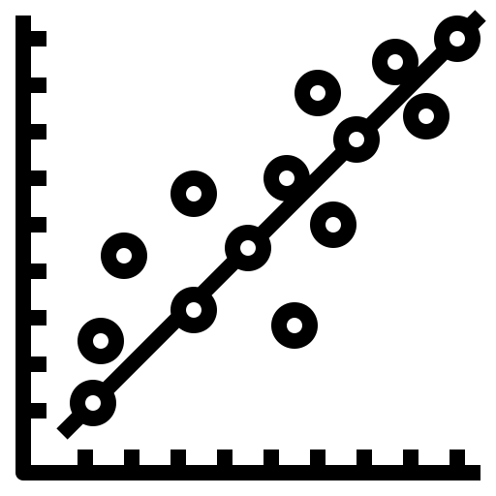
Regression Insights
R² Score: 0.94 → Strong predictive power
Multiple regression model gives R² = 0.95
R&D Spend: Strong positive influence on profit
Administration Spend: Slight negative influence
Marketing Spend: Low influence

Slide 7
Spend Category Insights
R&D Spend: 51.96%
Administration Spend: 29.88%
Marketing Spend: 18.15%
Insight: “ Majority of the budget is allocated to R&D, showing focus on innovation.”
(Calculated by Percentage Formula )

Slide 8

Prediction (By Excel)
Case 1 – Predicted Profit: 70066.94
Case 2 – Predicted Profit: 70584.94
Insight: Model generates reliable profit estimates for new inputs.
R&D spend | Admin spend | Marketing spend | Predicted Profit
21892.92 | 81910.77 | 164270.7 | 70066.94
23940.93 | 96489.63 | 137001.1 | 70584.94

Slide 9
Recommendation
R&D spending has the strongest positive correlation with profit. Strategic increases here can drive innovation and sustainable growth.
Administrative expenses show minimal or negative impact on profit. Cost control and process streamlining are key for higher efficiency.
Marketing investments exhibit low correlation with profit. Focus on data-driven campaigns with measurable outcomes to avoid waste.

Slide 10
Conclusion
R&D is the key driver of profit.
Administration needs cost control.
Marketing has limited influence on profits.
Balanced state-wise profit distribution.
Model is effective for profit prediction and planning.

Slide 11
Thank you
For Your Attention

